Slide 1

00 / Infrastructure team · Architecture review 2026-10
Cloud outage review:
priorities for our HA
What 13 official outage records mean for our multi-region plan
13 outages · 2025-06 → 2026-09 · official postmortems and status pages only
Notes:
This review uses the vendors' own postmortems and status pages from Google Cloud, AWS, Microsoft Azure, Cloudflare and GitHub, covering 13 cloud outages between June 2025 and September 2026. The question for the board: do we invest in multi-region and failover, how far do we take it, and what do we do first. Data as of October 4, 2026.

Slide 2
00 P02
Warm standby, but fix retries and paths first
01
02
Big outages: one change pushed everywhere
Regional failures are real, regions hold
5 of 8 major outages pushed a global config or policy to every
Storms, voltage dips and fiber work each hit one region. The
node fast. Another region on the same cloud would not stop it.
others kept running.
03
04
Retries and backlogs drag out recovery
SLAs refund fees, not revenue
AWS: DynamoDB was back in 2h 52m. The outage ran 14h 32m.
99.99% allows 4.38 min a month. Credits cap at one month's
fee, revenue is not covered.
Notes:
The answer first. We went through 13 cloud outages from June 2025 to September 2026, eight of them major, using what the vendors themselves published. Four findings. One: the outages with the widest blast radius were almost never hardware. A config or policy got pushed everywhere within seconds or minutes, and a second region in the same cloud does nothing against that. Two: single-region physical and network failures are real, from storms and power dips to fiber work and, in the Middle East, facilities destroyed outright. Multi-region does contain those. Three: recovery takes far longer than the fault itself, and what stretches it is retries, backlogs and everything restarting at once. Four: SLAs refund future fees. So our recommendation: take the second region to warm standby, not active-active. Give entry, identity and config rollout each a backup path that does not share a control plane. And ship throttling and backoff in Q4 without waiting for the new region.

Slide 3

01 / Chapter DIR
01
Review: what 13 outages tell us
5 of 8 major outages: one change pushed to all
├─ 04
Bad config reached everything in seconds
├─ 05
DynamoDB took 2h 52m, the outage 14h 32m
├─ 06
Retries, backlogs and restarts drag out recovery
├─ 07
Storm, power, fiber work: one region at a time
├─ 08
Regions stop regional faults, not global pushes
├─ 09

Slide 4
01 / Review P04
5 of 8 major outages: one change pushed to all
Pushed everywhere
Single region
Incident window · min
One change pushed everywhere
5/8
Azure West US 2
1,326
2026-05
AWS us-east-1
872
2025-10
Global config, policy or data reached every
Azure Front Door
node fast
504
2025-10
Azure multi-region
387
2026-02
AWS Middle East, two regions
Cloudflare network
190
7+ months
2025-11
Google Cloud APIs
180
2025-06
Since March 1, drone strikes on facilities,
Cloudflare WAF
some data confirmed lost
25
2025-12
src:
vendor postmortems, team math. Google: mini report, Cloudflare Nov: core recovery, Azure Feb: main phase
Notes:
These are the incident windows for the eight major outages, split by root cause. Teal is one change pushed everywhere, five of the eight: Azure Front Door in October 2025 (customer config metadata), Azure in February 2026 (a storage policy job), Cloudflare in November 2025 (the Bot Management feature file), Google Cloud in June 2025 (a quota policy) and Cloudflare in December 2025 (a global WAF config). Their windows are not the longest, but the blast radius was global or multi-region. Grey is single-region: the Azure West US 2 storm at 22h 6m and the AWS us-east-1 DNS race at 14h 32m. Longer, but contained to one region. The eighth is AWS in the Middle East. As of the September 15 status update the two regions had not recovered, so it does not fit on the same chart. On definitions: these are vendor-wide incident windows, not any one customer's downtime. Google's mini report says 3 hours, while the last product recovered after 7h 27m. We use 3 hours. Cloudflare's core traffic recovered in 3h 10m and everything in 5h 46m. We use the former. Azure's main phase in February was 6h 27m, or 12h 2m including managed identity. AWS uses the post-event summary's 14h 32m. The other five incidents are smaller: the AWS use1-az4 thermal event, the Google europe-west4-a voltage dip with cooling unavailable, Google us-west1 fiber maintenance, Azure West US egress network repair in July 2026, and Cloudflare withdrawing about 1,100 BYOIP prefixes in February 2026. The first three come up later. The impact also ran downstream: in Azure's February outage, GitHub Actions hosted runners were unavailable, and the PIR says all regions and runner types were impacted.

Slide 5
01 / Review P05
Bad config reached everything in seconds
postmortems / quotes.txt
1
# Google Cloud · 2025-06-12 · Service Control quota policy
2
"this metadata was replicated globally within seconds."
3
4
# Cloudflare · 2025-12-05 · global configuration system
5
"propagates changes within seconds to the entire fleet of servers in our network"
6
7
# Cloudflare · 2025-12-19 · Code Orange, on Nov 18 and Dec 5
8
"In both events, a wrong configuration took down our network in seconds."
9
10
# Azure · 2026-02-02 · a policy job that reached many regions
11
"There was nothing that customers could have done to avoid or minimize
12
impact from this specific service incident."
src:
Google Cloud (2025-06-13), Cloudflare (2025-12-05, Code Orange 2025-12-19), Azure PIR FNJ8-VQZ. Quoted verbatim
Notes:
Four quotes from three vendors. Google, June: quota management is global, so a policy with blank fields was replicated worldwide within seconds and Service Control crashed in every region at once. Cloudflare, December: the global configuration system used to switch off an internal test tool does no gradual rollout, so the change hit the whole network in seconds. In its Code Orange post on December 19, Cloudflare put November and December down to the same cause: a wrong configuration took the network down in seconds. Azure, February: a security policy job was rolled out region by region, but a defect in the health assessment let the bad targeting state spread across public cloud regions in a short window. Azure's PIR says it plainly: there was nothing customers could have done. Two takeaways. A second region in the same cloud does not help here. And our own config rollout must not have a push-to-everything path either.

Slide 6
01 / Review P06
DynamoDB took 2h 52m, the outage 14h 32m
us-east-1 · 2025-10-20 · UTC
Fault vs incident window
DynamoDB unreachable
DNS record emptied
06:48
2h52m
Endpoint IPs gone
DynamoDB recovers
09:40
Whole event
+2h 52m
14h32m
Leases throttled
11:14
Backlog had collapsed
5×: backlogs and cascades stretched it, not the fault
NLB errors begin
12:30
Health checks flapping
Verbatim
NLB failover off
16:36
"DWFM had entered a state of
Stops node removals
congestive collapse", with no runbook
Event ends
21:20
to follow.
14h 32m total
src:
AWS DynamoDB post-event summary (Oct 2025). Times in UTC. End per the summary, status page says 22:01
Notes:
This is the cascade in us-east-1 on October 20, 2025. The root cause was a latent race condition in DynamoDB's DNS management. A badly delayed Enactor applied an old plan over a new one, another Enactor's cleanup then deleted that old plan, and every IP for the regional endpoint vanished. The automation could not repair it, so engineers had to. DNS was restored at 09:25 and DynamoDB recovered at 09:40 once client caches expired: 2h 52m. Then came another 11 hours or so. EC2's lease manager for physical hosts, DWFM, depends on DynamoDB. Leases timed out, and when DNS came back it had to rebuild a huge number of them at once. Timeouts re-queued work and it fell into congestive collapse. AWS writes that there was no established recovery procedure, and it took throttling and staged restarts. Network configuration then backed up, NLB health checks flapped for new instances and nodes kept getting pulled from DNS, so at 16:36 AWS turned off NLB's automatic failover. EC2 was fully back at 20:50, the summary puts the end at 21:20, the status page declared full recovery at 22:01, and the last affected Redshift clusters came back at 11:05 the next day. Two points worth keeping: EC2 instances already running before the event stayed healthy throughout, and DynamoDB global table replicas in other regions kept serving reads and writes.

Slide 7
01 / Review P07
Retries, backlogs and restarts drag out recovery
Azure 2026-02
AWS 2025-10
Google 2025-06
Retry storms cross regions
Backlog into collapse
Everything restarts at once
Retries swamped East US, then West US.
The lease backlog stalled until throttled.
Tasks restarted into one table, no backoff.
Cloudflare 2025-11
Azure 2026-05
Login backlog
Sequential checks
We can do this now
the first four run in our services too.
Login retries degraded the
Cooling back in 1h 31m, storage
Capped, jittered retries and queue
dashboard again.
checks 14h.
throttling need no new region.
src:
Azure, AWS, Google Cloud and Cloudflare postmortems (June 2025 to May 2026)
Notes:
Why does recovery take so long? The same causes show up across vendors, and none of them is the original fault. Azure in February: automatic retries, meant for resilience, overloaded the managed identity backend, and resilient routing then sent the retry traffic to West US and overloaded that too. Two rounds of scaling out did not help, and in the end they drained all traffic and brought it back slowly. AWS in October: the lease system fell into congestive collapse and needed throttling and staged restarts. Google in June: tasks in us-central1 restarted together and all hit the same Spanner table, and the report admits Service Control lacked randomized exponential backoff. Google calls it a herd effect. Cloudflare in November: after the core recovered, a backlog of logins plus retries made the dashboard unavailable again from 14:40 to 15:30. Azure West US 2 in May: cooling came back in 1h 31m, but storage validation has to run sequentially and took about 14 hours. The first four exist in our own services: client retries, batch restarts and queue backlogs. None of them needs a second region. We can fix them in Q4.

Slide 8
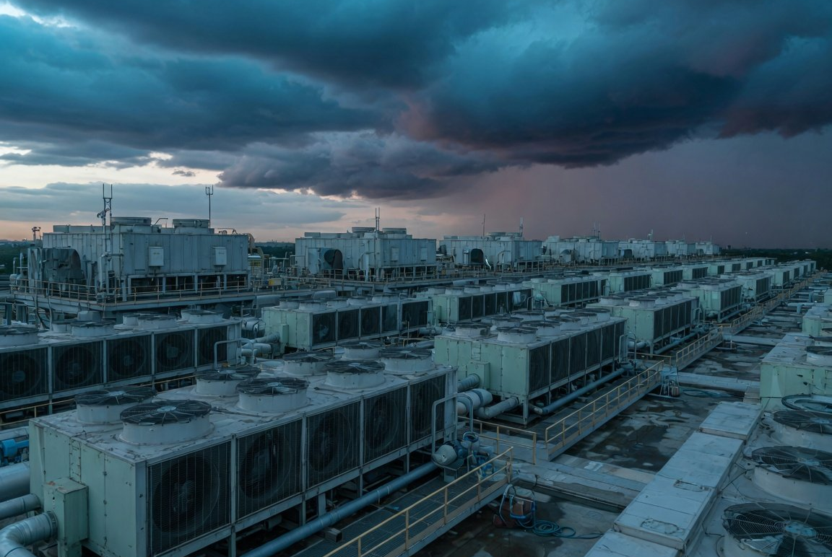
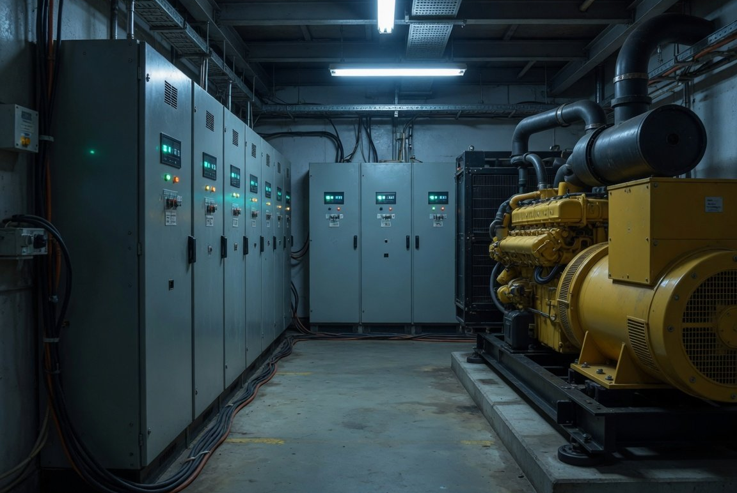

01 / Review P08
Storm, power, fiber work: one region at a time
Azure West US 2 · 2026-05
Google europe-west4-a · 2026-07
Google us-west1 · 2026-08
22h 06m
44°C
One region
A storm hit two zones
Backup cooling under construction
Bandwidth squeezed, others fine
Each hit one region. Multi-region in the same cloud holds.
src:
Azure PIR GHRP-84G, Google Cloud incident reports (2026-07-25, 2026-08-27). Images are AI-generated illustrations
Notes:
Single-region physical and network failures do happen, and all three of these have official reports. Azure West US 2, May 29, 2026: a storm caused voltage sags and swells across several data centers, cooling went into protective lockout and equipment shut down on heat. It hit two physical availability zones in the same region, a 22h 6m window. Google europe-west4-a, July 2026: a 3 ms utility voltage dip while backup cooling was unavailable because of construction work, and the room reached 44°C. Google's official duration is 14h 55m. Google us-west1, August 20, 2026: planned fiber maintenance squeezed bandwidth between data centers, automatic rerouting failed, and Spanner and metadata latency cascaded downstream. The report says other regions remained fully operational and unaffected. What they share: each hit one region. Microsoft's West US 2 report recommends multi-region for mission-critical workloads. AWS also had a thermal event in use1-az4 in May 2026, which AWS describes as a single availability zone. The three images are AI-generated illustrations, not photos of the incidents.

Slide 9
01 / Review P09
Regions stop regional faults, not global pushes
Incident
Scope
AZs
Regions, same cloud
AWS use1-az4 · 2026-05
One AZ
Yes
Yes
Azure West US 2 · 2026-05
Two AZs in one region
No
Yes
Google us-west1 · 2026-08
One region's network
No
Yes
AWS us-east-1 · 2025-10
One region, some global features
No
Yes
mostly, IAM tied to us-east-1
AWS Middle East · 2026-03
Two regions, several AZs
No
Yes
with off-region backups
Google 2025-06, Azure 2026-02
Global or multi-region control plane
No
No
Cloudflare, Azure Front Door
Global edge network
n/a
n/a
needs a backup entry
src:
official postmortems and AWS status pages (Oct 2025 to Sep 2026), team summary. use1-az4 scope as stated by AWS
Notes:
One question: which kind of redundancy stops which kind of failure. Every cell rests on the vendors' own words. A single-AZ failure is stopped by multi-AZ: AWS's thermal event in use1-az4 in May was one zone by AWS's account, though Coinbase said it saw failures across several zones. Next, single-region failures. The Azure West US 2 storm hit two physical zones in one region, so multi-AZ did not help, and Microsoft's report recommends multi-region. For Google us-west1, the report says other regions remained fully operational. AWS us-east-1 is mostly yes: DynamoDB global table replicas elsewhere kept working, but IAM, Redshift and console sign-in had us-east-1 dependencies, which we come back to later. In the Middle East, two regions were damaged across several zones, and only customers with backups outside the region could recover elsewhere. The highlighted row matters most. Against a global or multi-region control plane failure like Google in June or Azure in February, a second region in the same cloud does nothing, and Azure says customers could not have avoided it. For global edge networks like Cloudflare and Azure Front Door, regions do not apply at all. What helps is a backup entry point: after the Front Door outage, Microsoft moved the Azure Portal and other key entry points to active-active with the ability to fail away from Front Door.

Slide 10

02 / Chapter DIR
02
Decision: which tier, what first
SLAs refund fees: 99.99% allows 4.38 min a month
├─ 11
Warm standby, not active-active: RTO in minutes
├─ 12
Every key dependency needs an independent path
├─ 13
Keep status and alerts off the cloud they watch
├─ 14
Roadmap: retries in Q4, warm standby in Q2 2027
├─ 15

Slide 11
02 / Decision P11
SLAs refund fees: 99.99% allows 4.38 min a month
Per month
Per year
Downtime an SLA allows
Credit cap
1 month's fee
99.9%
43.8 min
8.77 h
AWS, Google and Azure alike. Azure excludes lost revenue
in writing
99.95%
21.9 min
Top VM SLA tier at all three
4.38 h
99.99%
Multi-AZ in one region, no multi-region tier
99.99%
4.38 min
52.6 min
AWS 2025-10 window vs the monthly budget
99.999%
26.3 s
199×
5.26 min
872 min vs 4.38 min, if fully down
src:
AWS EC2, Google Compute Engine and Microsoft Online Services SLAs (Oct 2026), team math. Month of 30.4375 days
Notes:
Can the SLA cover us? No. First the budget: 99.99% allows 4.38 minutes a month. Every incident window we looked at is far beyond that. The AWS window in October was 872 minutes, 199 times the monthly budget. That assumes the whole window was a full outage and is only illustrative, since real credits depend on each product's definition of downtime and on our own resources. Then what they pay: AWS, Google and Azure cap credits at that service's monthly fee, paid as credit against future bills, and Microsoft's contract states that credits do not compensate for lost revenue. Cloudflare Business caps credits at one month's fee in any 12 months. One more point: the top tier in the EC2, Compute Engine and Azure VM terms is multi-AZ within one region at 99.99%. None has a multi-region tier. DynamoDB global tables are the only cross-region 99.999% tier we found. Bottom line: an SLA is a billing clause, not an availability guarantee, and the business cost of downtime is ours. Method: we use an average month of 30.4375 days. Google's and Microsoft's docs use a 30-day month and print 4.32 minutes.

Slide 12
02 / Decision P12
Warm standby, not active-active: RTO in minutes
SELECT
T1
T2
T3
T4
Backup & restore
Pilot light
Warm standby
Active-active
Cost $
Cost $$
Cost $$$
Cost $$$$
RPO
RPO
RPO
RPO
Hours
Minutes
Seconds
Near zero
RTO
RTO
RTO
RTO
Within 24h
Tens of minutes
Minutes
Potentially zero
Always running
Always running
Always running
Always running
Backups only
Databases and storage
Scaled-down full stack
Full stack in several regions
Built at failover
Built at failover
Built at failover
Built at failover
All infrastructure
App servers
Nothing, scale up only
Nothing
src:
AWS Well-Architected REL13-BP02, AWS DR whitepaper. Cost is the whitepaper's relative scale, no vendor publishes a dollar gap
Notes:
To pick a tier we use AWS's four, the only vendor guidance with minute-level targets. They rise in cost and complexity and fall in RTO and RPO. Backup and restore: only backups, infrastructure is built after the event, RPO in hours, RTO within 24 hours. Pilot light: databases and object storage always on, app servers built after the event, RPO in minutes, RTO in tens of minutes. Warm standby: a scaled-down but fully functional copy always running, RPO in seconds, RTO in minutes. Active-active: several regions taking traffic at once, RPO near zero, RTO potentially zero. We recommend warm standby. The single-region windows we saw ran from about 2 to 22 hours, and an RTO in minutes keeps us clear of all of them. The fourth row is why not pilot light: backup and pilot light both need to create resources during the failover, and in October new EC2 launches in us-east-1 failed for hours, while in February Azure VMs could not be deployed or scaled in several regions. AWS's own guidance lists dependency on control plane operations during recovery as an anti-pattern. Warm standby already runs the whole stack and only needs to scale up. AWS calls active-active the most complex and costly approach, and it still does not protect against data corruption or a global config push. Cost is only relative: the whitepaper goes from one dollar sign to four, Google only says smaller RTO and RPO cost more, and nobody publishes a dollar figure.

Slide 13
02 / Decision P13
Every key dependency needs an independent path
Single points that sink every region
One independent path each
One way in
Backup entry around the CDN
Azure Front Door down 8h 24m
Identity in one region
Sign-in that survives a region
Redshift IAM queries failed everywhere
Config pushed to all
Staged, fall back to last good
5 of 8 major outages
Data in one region
Replicas plus off-region backup
Bahrain: region-only data unrecoverable
src:
Azure PIR YKYN-BWZ, AWS DynamoDB post-event summary (Oct 2025), AWS status page (2026-09-15), team summary
Notes:
Multi-region only works if the dependencies are multi-region too. This tree asks what can still take us down after we fail over. One, entry and DNS: Azure Front Door was down globally for 8h 24m in October 2025, and Microsoft then moved the Azure Portal and other key entry points to active-active with the ability to fail away from Front Door. Two, identity, the one teams miss most often: in AWS's October outage, running in another region was not enough. Redshift customers in every region could not run queries with IAM user credentials, because resolving user groups called the IAM API in us-east-1, and customers with IAM Identity Center in us-east-1 could not sign in. Three, config rollout: 5 of the 8 major outages were one push to everywhere. Cloudflare's Code Orange moved config changes to health-checked staged rollout, falls back to the last good config when a new one cannot be read, and built backup authorization paths for 18 critical services, declared complete in May 2026. Four, data: DynamoDB global tables kept serving in other regions that day, while data hosted only in AWS's Bahrain region was declared unrecoverable in September. Observability is the fifth, on the next page.

Slide 14
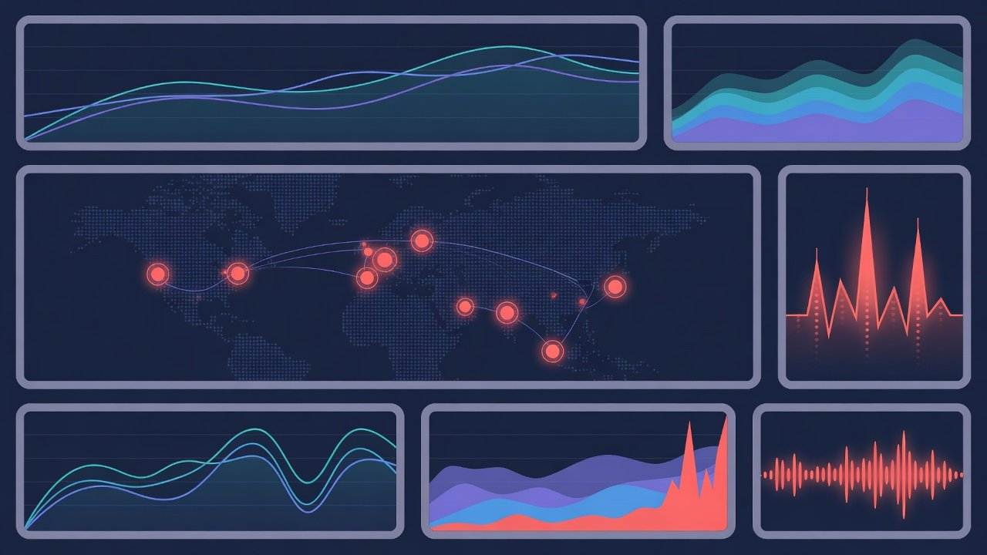
02 / Decision P14
Keep status and alerts off the cloud they watch
status.internal / overview
Google · 2025-06
Status page hit too, first post 55 min late
Cloudflare · 2025-11
Status page down too, first read as DDoS
Google's promise
Comms must work when monitoring is down
Us
Status, alerts and paging off the main cloud
src:
Google Cloud incident report (2025-06-13), Cloudflare postmortem (2025-11-18). Dashboard is an AI-generated illustration
Notes:
Observability and communication are a dependency too. In Google's June outage the status page itself was affected, in the report's words due to the Cloud Service Health infrastructure being down due to this outage, and the first public post came 55 minutes after the start. In Cloudflare's November outage, its status page, which is not hosted on Cloudflare, happened to go down at the same time, and the team suspected a DDoS attack for a while. Google committed afterwards that monitoring and communication must keep working even when Google Cloud and its primary monitoring products are down. Our plan: the status page, alerting and on-call paging live outside the main cloud, with at least one path to get a message out that does not depend on it.

Slide 15
02 / Decision P15
Roadmap: retries in Q4, warm standby in Q2 2027
Q4 2026
Q1 2027
Q2 2027
Q3 2027 on
Throttling and
Independent
Warm standby
Failover drills
backoff
paths
region
Quarterly
Cadence
Capped backoff
Backup DNS
Scaled down
Retries
Entry
Size
Revisit active-active
Then
Length throttling
Multi-region
Replicas, backups
Queues
Identity
Data
Staged pushes
Off main cloud
Seconds
Rollout
Status
RPO
Off by default
Minutes
Flags
RTO
Decide today: warm standby, not active-active. Throttling, backoff and staged rollout ship in Q4.
Notes:
The order is deliberate. Q4 goes first on work that needs no new region but shortens recovery directly: jittered exponential backoff with caps on retries and throttling on queue length, the two problems that keep coming up in the Google, AWS, Azure and Cloudflare reports. Config rollout moves to staged pushes, and risky changes ship behind flags that are off by default, which answers the push-to-everything class. Q1 2027 adds independent paths for entry and DNS, identity and observability. In Q2 the second region goes live as warm standby, scaled down but fully functional, with cross-region replicas and backups kept outside the region, targeting an RPO in seconds and an RTO in minutes. From Q3 we run a regional failover drill every quarter, and the results come back to this board before anyone proposes active-active. Each phase can be signed off on its own. What we are asking the board to decide today: warm standby, not active-active, and throttling, backoff and staged rollout in Q4 without waiting for the new region.

Slide 16
EOF / Decision 2026-10
Go warm standby. Fix retries and paths first
Throttling and backoff
[ ]
Retry backoff, queue throttling, staged config
Q4 2026
Independent paths
[ ]
Entry, identity and status each get a path
Q1 2027
Warm standby region
[ ]
RPO in seconds, RTO in minutes
Q2 2027
Notes:
To repeat the ask: take multi-region to warm standby, and fix retries, backoff and independent paths first. With approval, phase one starts in Q4.

