Slide 1
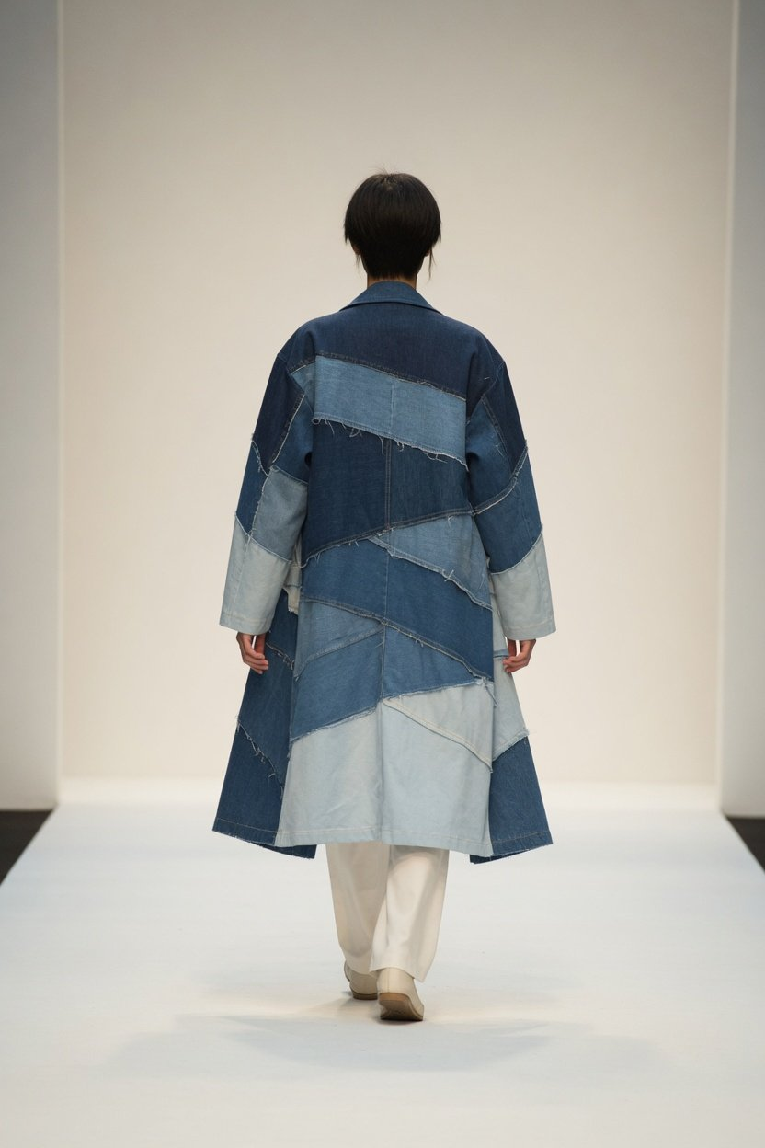
Final Project · BA Fashion
Wear It Again
Used jeans, taken apart and made into a collection
Seven looks
LOOK 01 (AI-generated)
Notes:
Good morning. My final project is called Wear It Again. I took used jeans apart, sorted the pieces by shade and pieced them back together into a collection of seven looks. The coat on the cover is LOOK 01. One note before I start: the cover and every picture of the work and the process in this deck are AI-generated illustrations.

Slide 2
2
Running order
Final Project · Wear It Again
Five parts: from old jeans to a collection
01
02
03
04
05
Why old denim
Inspiration
Fabric
Collection
Limits
How much textile waste, and
Fading, creases and pocket
Unpick, grade by shade,
Seven looks, walking from dark
What it does, and what it
the water in one pair
marks as pattern
piece together
to light
cannot do
Notes:
I'll go through this in five parts. The first two pages are background, and every figure on them is one I checked against the original document. The middle three parts are the design itself and take most of the time. The last page is about limits: I want to say plainly what this collection cannot prove.

Slide 3
3
Why old denim
Final Project · Wear It Again
Plenty of old clothes,
few ways to reuse them
About 22 million t
25% 30%
Easy to unpick
Textile waste in China in 2020, when about 20%
China's recycling-rate targets for 2025 and 2030
The same policy asks for textiles easier to take apart,
was recycled
sort and recycle
Source: National Development and Reform Commission et al., NDRC Huanzi [2022] No. 526, and expert commentary on the NDRC website, April 2022
Notes:
Why this topic. In 2022 three ministries, led by the National Development and Reform Commission, set targets for recycling waste textiles: a 25% recycling rate by 2025 and 30% by 2030. An expert commentary published on the NDRC website gives the starting point: about 22 million tonnes of textile waste in 2020, about 20% of it recycled. I could not find any official figure on whether the 2025 target was met, so I only show the target. The same document asks for textiles that are easier to take apart, sort and recycle, and mentions collection drives on campus in graduation season and design competitions. Taking jeans apart and remaking them sits right on that first point.

Slide 4
4
Why old denim
Final Project · Wear It Again
A new pair of jeans has already paid in water
3,781 L
10,850 L
One pair of Levi's 501, from cotton field to disposal
Virtual water in 1,000 g of jeans, global average
Levi's life cycle assessment, 2015, company figure
Chapagain et al., UNESCO-IHE, 2005
The two are counted differently, one over a pair's whole life, one as virtual water per kilogram. Read them side by side, never added or ranked
Source: Levi Strauss & Co., The Life Cycle of a Jean (2015), Chapagain et al., The water footprint of cotton consumption (2005)
Notes:
There are at least two ways to count the water in a pair of jeans, and I keep them side by side rather than merging them. On the left is Levi's own 2015 life cycle assessment of one stonewashed 501: 3,781 litres of net water use, 68% of it in growing the cotton. That is the company's figure. On the right is a 2005 virtual water study: for 1,000 grams of jeans, a global average of 10,850 litres, which also counts rainwater and the water needed to dilute pollution. A larger figure that circulates online comes with no method, so I left it out. And to be clear, both numbers describe the cost of a new pair of jeans. Neither is water this collection saved.

Slide 5
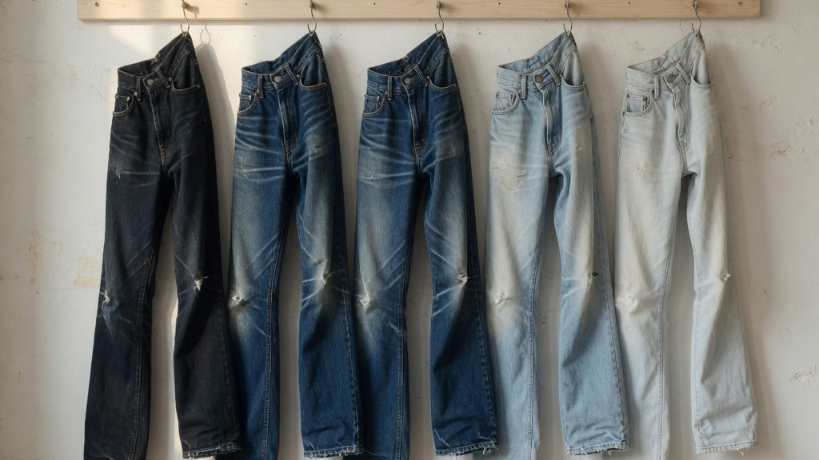
Part 1
Final Project · Wear It Again
01
Inspiration: the marks of wear
Fading, creases and pocket marks are proof of wear
AI-generated
Notes:
Part one, inspiration. The section image is an AI-generated illustration.

Slide 6
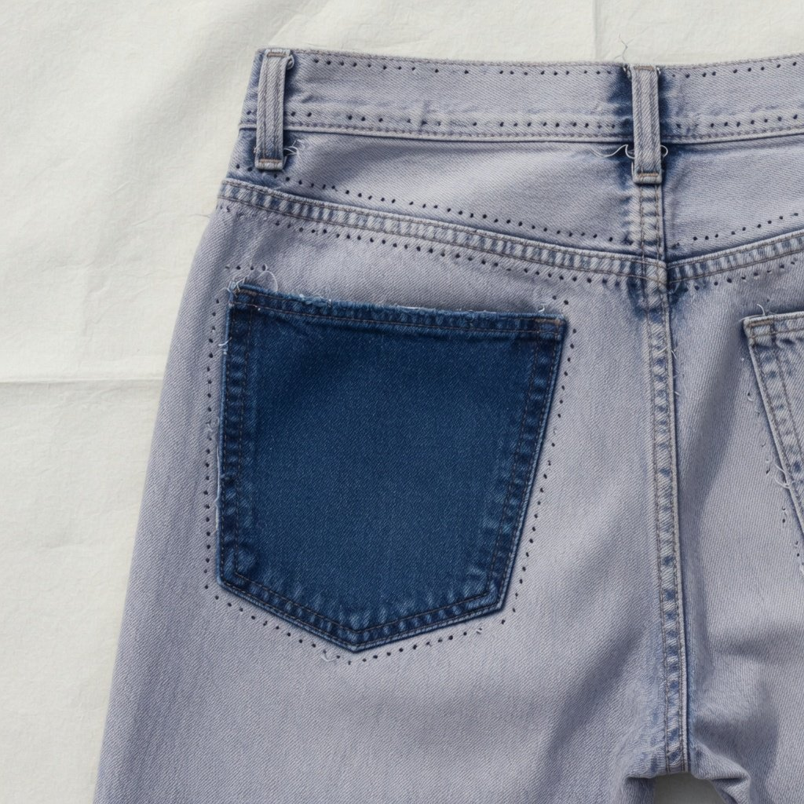
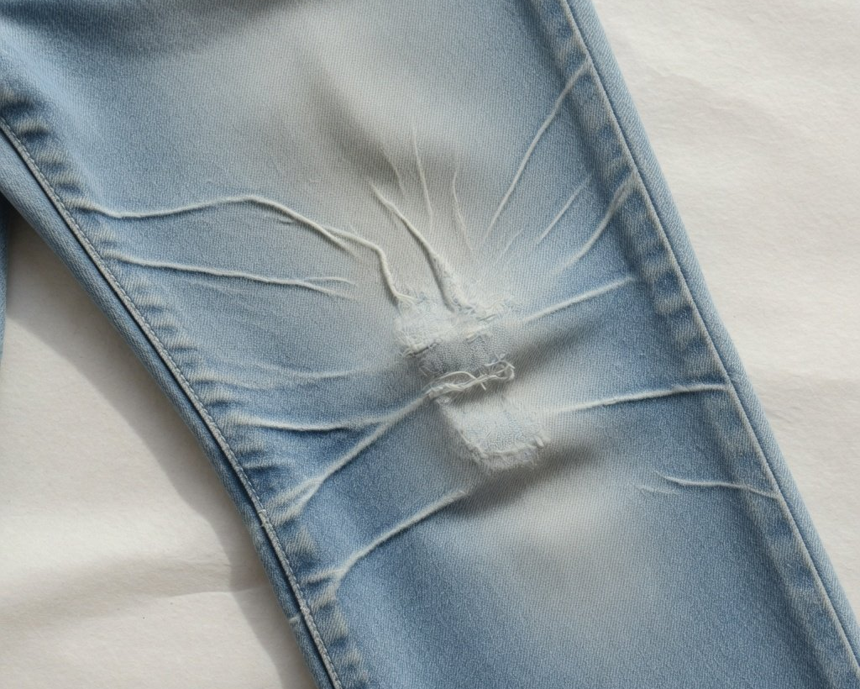
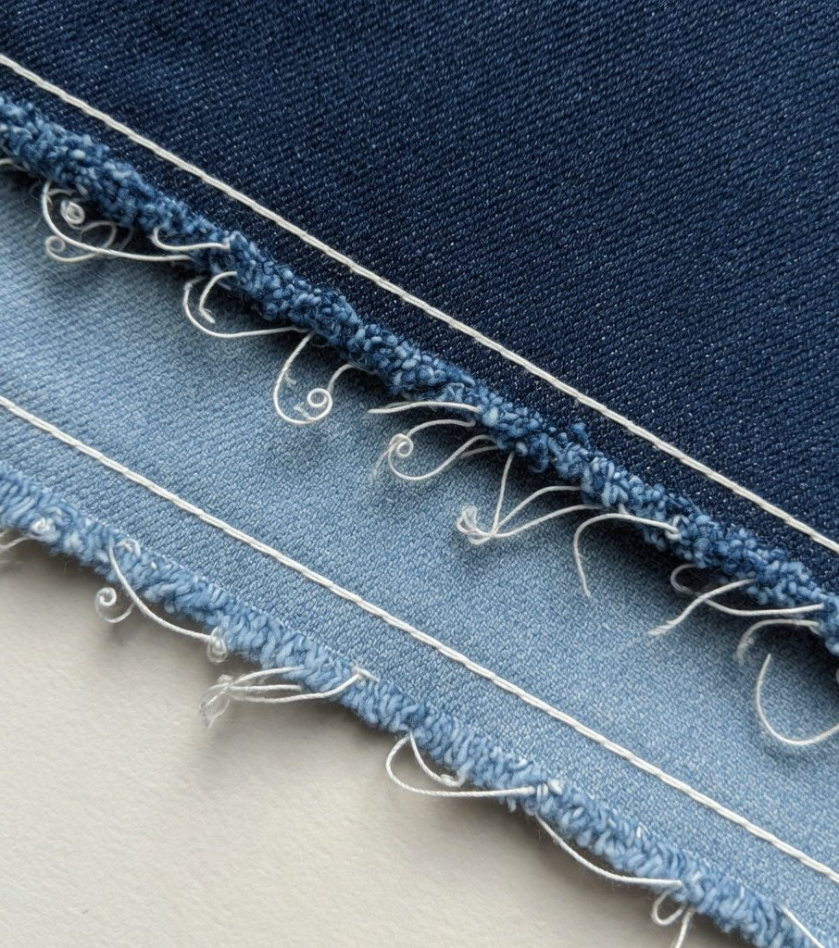
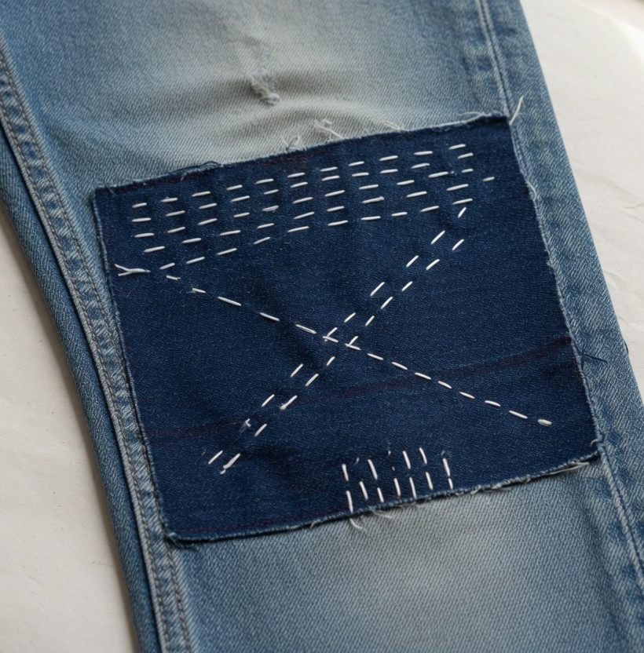
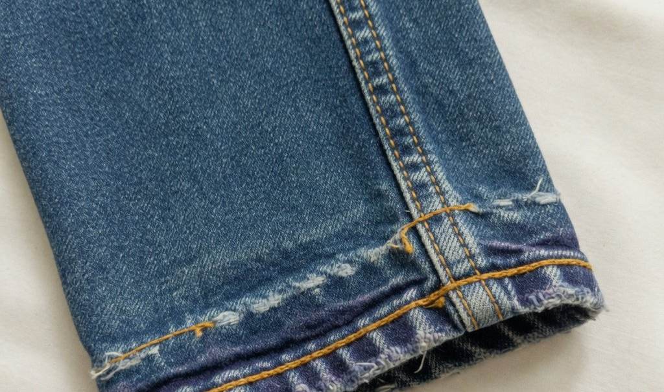
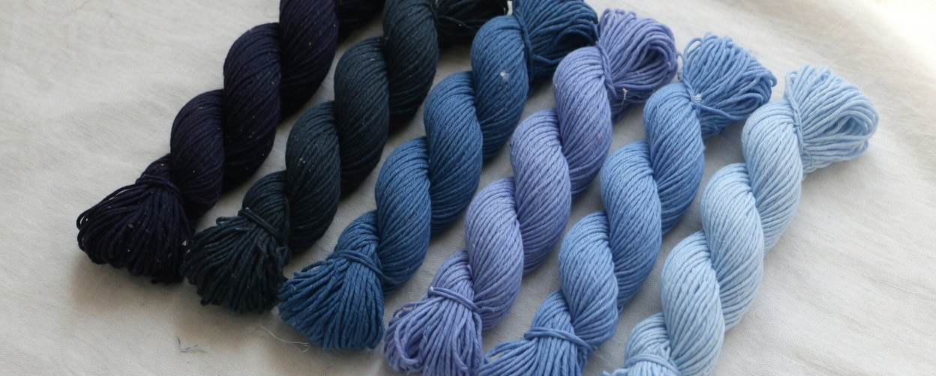
6
Inspiration
Final Project · Wear It Again
Moodboard: wear as pattern
2 Faded knee
4 Raw edge
5 Mend
1 Pocket mark
3 Stitched hem
Where the jeans were worn
is the pattern of the collection
6 Indigo shades
All images are AI-generated
Notes:
The inspiration is what wearing leaves on a pair of jeans. Unpick a back pocket and the cloth underneath, never sunned or rubbed, stays dark in the shape of the pocket. Knees bent thousands of times fade to white. Then there is the topstitching, the rolled hem, raw edges and old mends. I did not want to wash these away or hide them. I wanted them to be the pattern of the collection. The last image is a run of indigo shades, which is where the grading of the fabric later comes from.

Slide 7
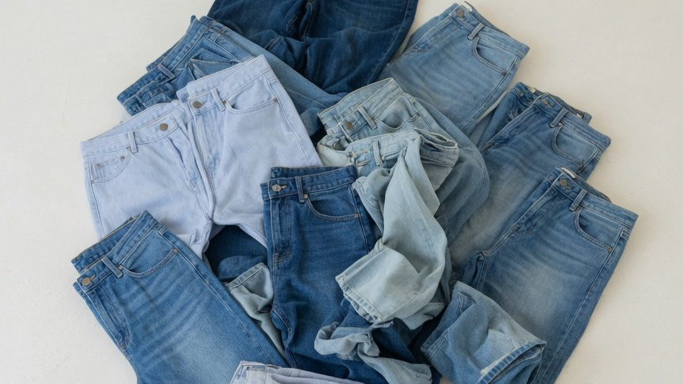
Part 2
Final Project · Wear It Again
02
Fabric: unpick, grade, piece
All the main fabric comes from used jeans
AI-generated
Notes:
Part two, fabric. All the main fabric in this collection comes from used jeans. Linings and trims are separate. The section image is an AI-generated illustration.

Slide 8
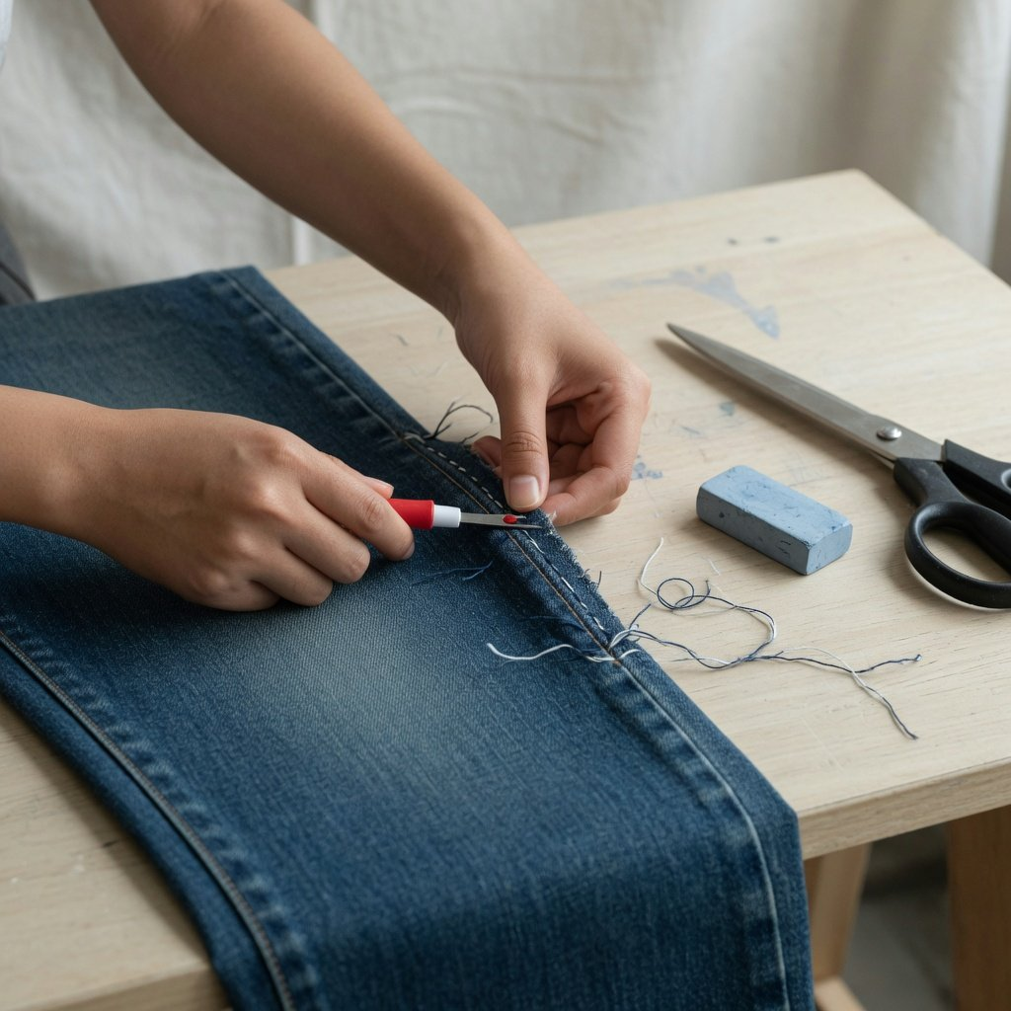
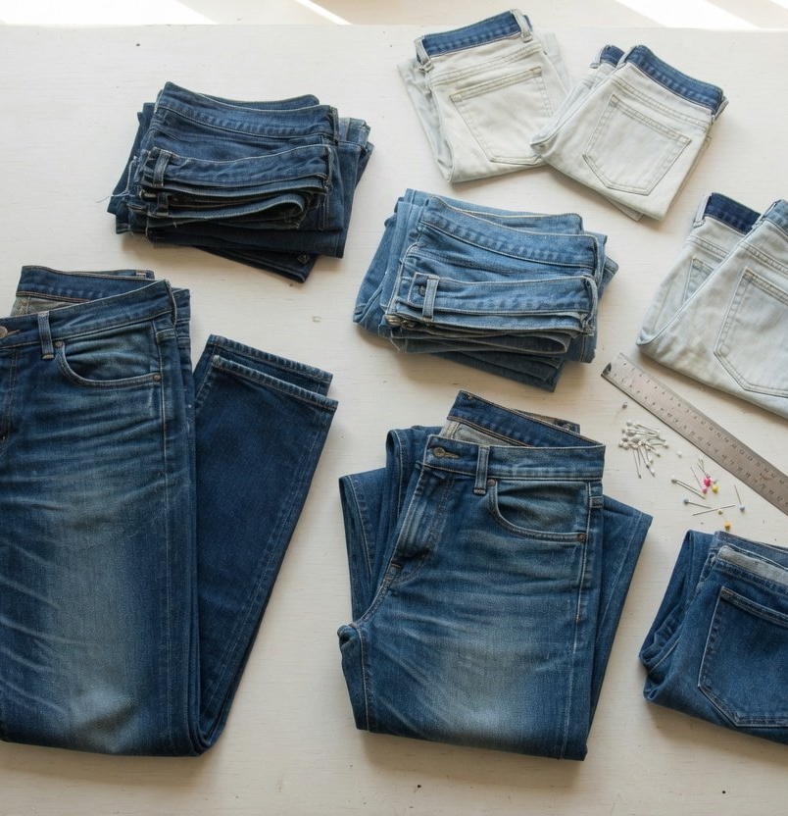
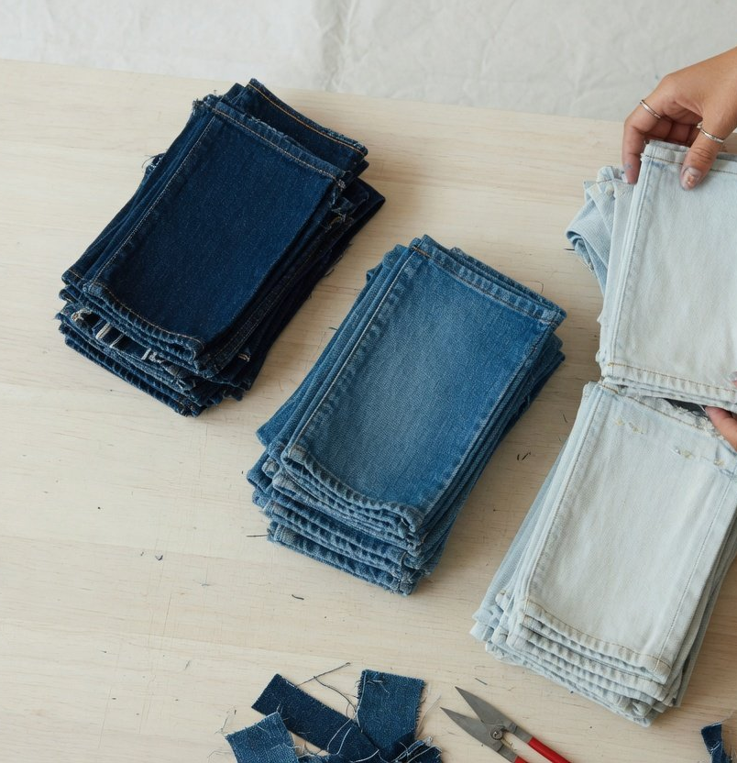
8
Fabric
Final Project · Wear It Again
Five steps turn an old pair of jeans into fabric
01
02
03
04
05
Wash and dry
Unpick
Press flat
Grade
Lay out and piece
Then see what is torn and what
Open the seams, never cut, to
Fronts, backs, waistbands and
Sort into three shades, each
Piece whole lengths, then cut
can be used
keep whole pieces
pockets apart
kept together
the pattern
02 Unpicking a seam
03 Pressed by part
04 Sorted by shade
Process images are AI-generated
Notes:
Turning an old pair of jeans into fabric I can cut takes five steps. The key one is the second: I open the original seams rather than cutting across them, so every piece keeps its full size and the old topstitching and seam marks survive. In the fifth step I join whole lengths of fabric first and only then cut the pattern, so I decide where the seams fall.

Slide 9
9
Fabric
Final Project · Wear It Again
Shredding shortens fibre by a third, so I unpick
28.3 mm
Virgin cotton fibre, upper quartile length
Arafat & Uddin, Heliyon, 2022
18.9 mm
Post-consumer recycled cotton, same measure
Same trial
In the same trial, a 30s ring-spun yarn took at most 25% recycled cotton. So this collection is remade as fabric, with the fibre left whole
Source: Arafat & Uddin, Heliyon (2022), industrial-scale spinning-mill trial. A third shorter is calculated: (28.3 − 18.9) ÷ 28.3. The lines are drawn to scale
Notes:
Why I only unpick and never shred. Mechanical recycling chops cotton fibres short. In an industrial-scale trial at a spinning mill, virgin cotton had an upper quartile length of 28.3 millimetres and post-consumer recycled cotton only 18.9, about a third shorter by my own calculation from those two figures. Short fibre has to be blended with new cotton, and in a 30s ring-spun yarn recycled cotton could make up at most 25%. Unpick a whole piece and sew it again, and its colour, its wear and its original fibre are all still there. That is why this project stays at the level of fabric.

Slide 10
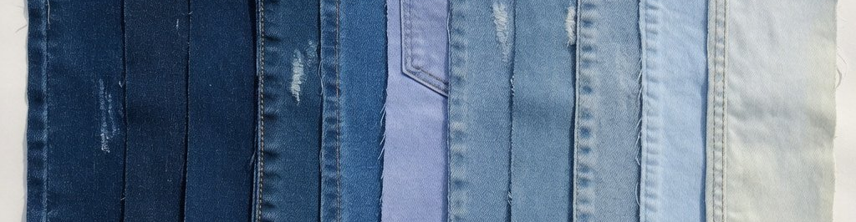
10
Fabric
Final Project · Wear It Again
Every piece is graded into three shades
Dark
Mid
Light
Waistband backs and under pockets, out of the light
Large pieces from the fronts of thighs and shins
Knees, seat and creases, worn pale
Pieces from one batch of jeans, laid out dark to light (AI-generated)
Notes:
Jeans from different sources differ a lot in colour, and pieced at random they look like a mess. So I grade every piece into three shades. Dark pieces mostly come from places that saw little light, like the back of the waistband and under the pockets. Light pieces come from the knees, the seat and the creases. Grading gave me one rule: dark goes at the shoulder, light falls to the hem, and the running order of the collection follows the same scale.

Slide 11
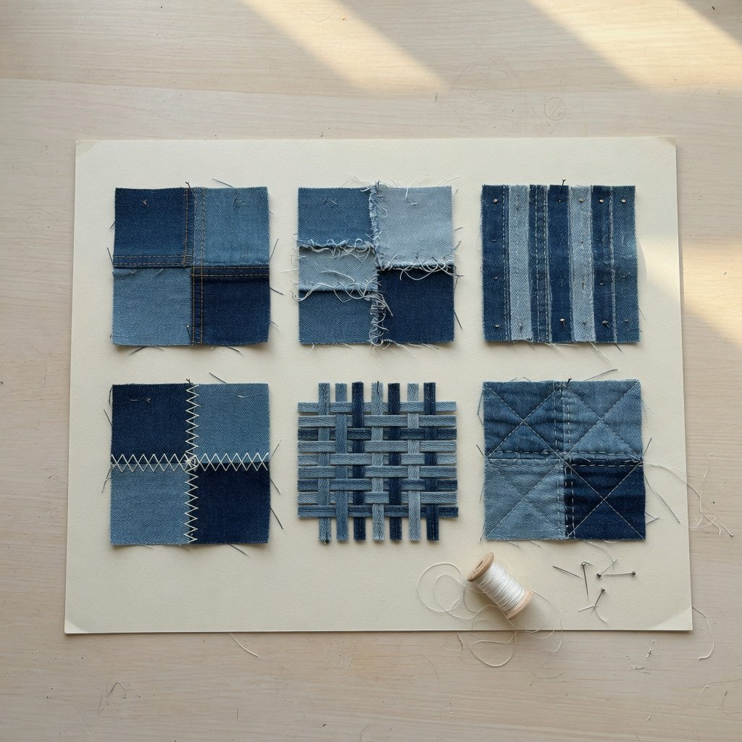
11
Fabric
Final Project · Wear It Again
Three joins, each for its own part of a garment
1
Flat seam
For shoulders, waist and crotch, where it pulls. Strong, but slow to stitch
2
Raw overlap
For body panels and hems. Both shades stay in view
3
Narrow strips
Uses even the smallest scraps. The most seams, the most hours
Joining samples (AI-generated)
Notes:
In the fabric experiments I made a set of joining samples and kept three methods, each for its own part of a garment. Where the garment takes strain I use a flat seam with topstitching, the strongest. On large body panels I overlap the pieces and leave the edges raw, so both shades show. Scraps too small for anything else are cut into narrow strips, which wastes nothing but means the most seams and the most hours.

Slide 12
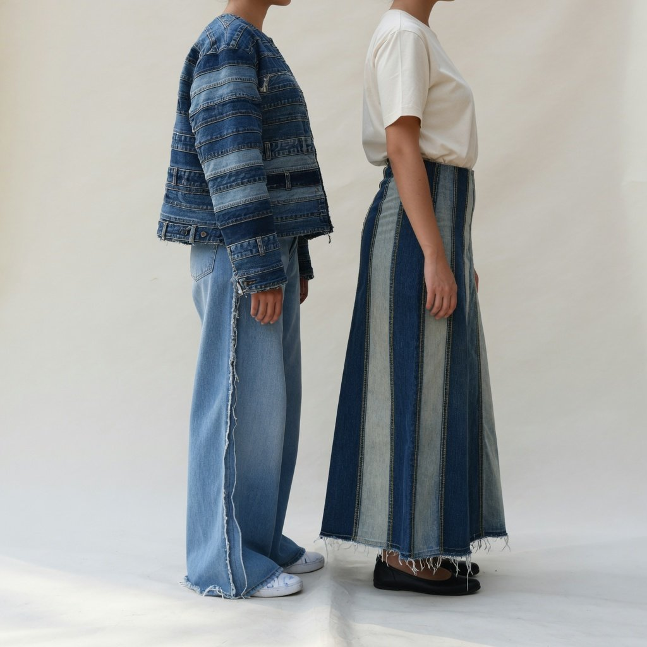
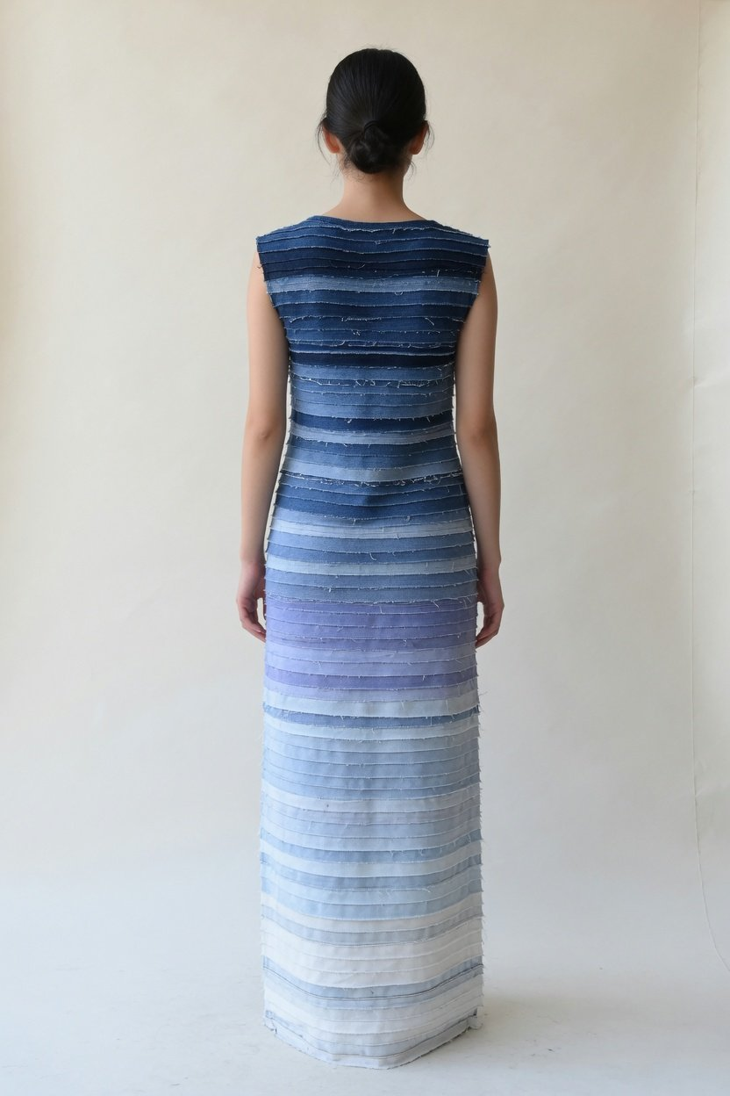
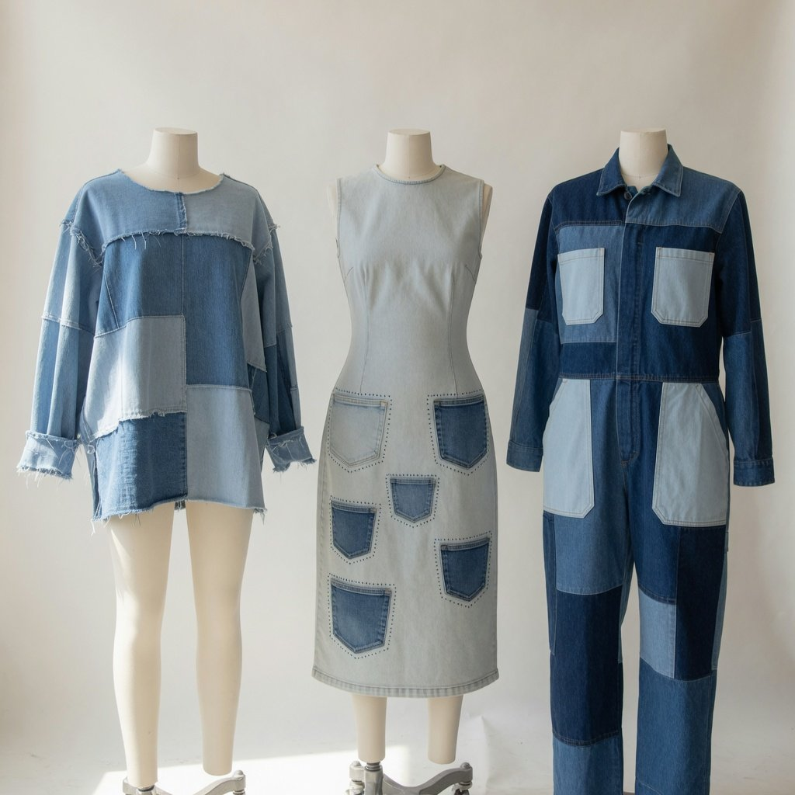
Part 3
Final Project · Wear It Again
03
Collection: seven looks
They walk in order of shade, dark to light
LOOK 01
LOOK 02
LOOK 03
LOOK 04
LOOK 05
LOOK 06
LOOK 07
AI-generated. Looks 2 and 3, and 5 to 7, are cut from one group photograph
Notes:
Part three, the collection. The seven looks come out in order of shade, from deep indigo to pale blue. The section image is an AI-generated illustration.

Slide 13
13
Final Project · Wear It Again
01
LOOK
Graded patchwork trench
Large pieces from several pairs, laid on the bias by shade
FABRIC
Flat seams where it pulls, raw overlaps on the body
MAKE
Dark at the shoulder, a shade lighter each step to the hem
SHADE
LOOK 01 (AI-generated)
Notes:
LOOK 01 is a long dropped-shoulder trench, and the whole collection in one garment: dark at the shoulders, a shade lighter at each step, pale at the hem. The pieces run on the diagonal, so the seams step down the coat like a line of slashes. Shoulder seams and armholes, which take strain, are flat seams with topstitching. The body panels overlap with raw edges.

Slide 14
14
Final Project · Wear It Again
02 03
LOOK
Waistbands and legs,
used again elsewhere
Cropped jacket of stacked waistbands, wide trousers with
LOOK 02
seams out
Legs cut into long panels, dark and light in turn, as a long skirt
LOOK 03
The old waistbands, side seams and yellow stitching kept
SHARED
LOOK 02 (left) and LOOK 03 (right), AI-generated
Notes:
LOOKs 02 and 03 share one idea: the parts that make jeans recognisable, moved somewhere new. The cropped jacket in LOOK 02 is built from the waistbands of many pairs stacked in rows, and the wide trousers turn the old side seams outwards as a detail. LOOK 03 cuts jeans legs into long tapering panels and alternates dark and light into a long skirt, keeping the original yellow topstitching on every panel.

Slide 15
15
Final Project · Wear It Again
04
LOOK
Gradient maxi dress
Horizontal strips by shade, dark at the top, pale at the hem
FABRIC
Strips overlapped, their edges left unfinished
MAKE
Sleeveless, falling to the floor
SHAPE
LOOK 04, back (AI-generated)
Notes:
LOOK 04 is a sleeveless maxi dress that turns the shade scale into horizontal strips, darkest at the top and nearly white where the hem meets the floor. The strip edges are deliberately left unfinished, so with wear and washing the fraying keeps changing. That is what I wanted to keep: the garment is still being worn, and its marks are still growing.

Slide 16
16
Final Project · Wear It Again
05–07
LOOK
Raw edges, pocket marks, workwear
Pieced shirt, raw edges left out at the yoke and cuffs
LOOK 05
Dress patterned with the dark marks of removed pockets
LOOK 06
Workwear jumpsuit, a mid to dark body and pale pockets
LOOK 07
Left to right: LOOK 05, 06, 07 (AI-generated)
Notes:
The last three looks. LOOK 05 is a pieced shirt with raw edges left showing at the yoke and cuffs. LOOK 06 uses the dark marks left by unpicked pockets as a pattern across the front of a dress, the same trace as the first image on the moodboard. LOOK 07 is a workwear jumpsuit with a dark and mid body and pale pockets, and it closes the collection.

Slide 17
17
Limits
Final Project · Wear It Again
A method, not an environmental fix
What it does
What it cannot do
Keeps the colour, wear and seams of old denim
Labour-heavy, uneven supply, hard to scale
Remade as fabric, the fibre left whole
The Ellen MacArthur Foundation's view of such methods
Turns mismatched jeans into one collection
No environmental accounting, no claim of water saved
Graded into dark, mid and light
Washing, trims and offcuts all have costs
Sets out a way to unpick, grade and piece
About 5.55 million t recycled a year, this counts pairs
Three joins, each for its own part
2025 figure, China National Resources Recycling Association
It can claim a method, not an environmental gain
Source: Ellen MacArthur Foundation, A New Textiles Economy (2017), China National Resources Recycling Association (2025 recovery)
Notes:
Finally, I want to be clear about the limits. What the collection achieves is a method: the colour and wear of old denim survive, and mismatched jeans become one collection through grading. What it cannot do comes in three parts. First, the Ellen MacArthur Foundation says plainly that this kind of remaking, taking cloth apart and sewing it again, is labour-intensive, has an unreliable supply, cannot be mass-produced and often leaves pieces too small or too worn. Second, I have not done the environmental accounting. Washing, trims and offcuts all have costs, and a 2018 peer-reviewed review found that reuse only pays off if the garment is actually worn and replaces a new purchase. Third, scale: the China National Resources Recycling Association puts the country's 2025 recovery of waste textiles at about 5.55 million tonnes, while a graduate collection uses jeans by the pair. So I do not claim this collection solves an environmental problem. It shows a design method.

Slide 18
Final Project · Wear It Again
Thank you
Wear It Again · Questions welcome
Notes:
That is the end of my presentation. Thank you, and I am happy to take your questions.

