Slide 1
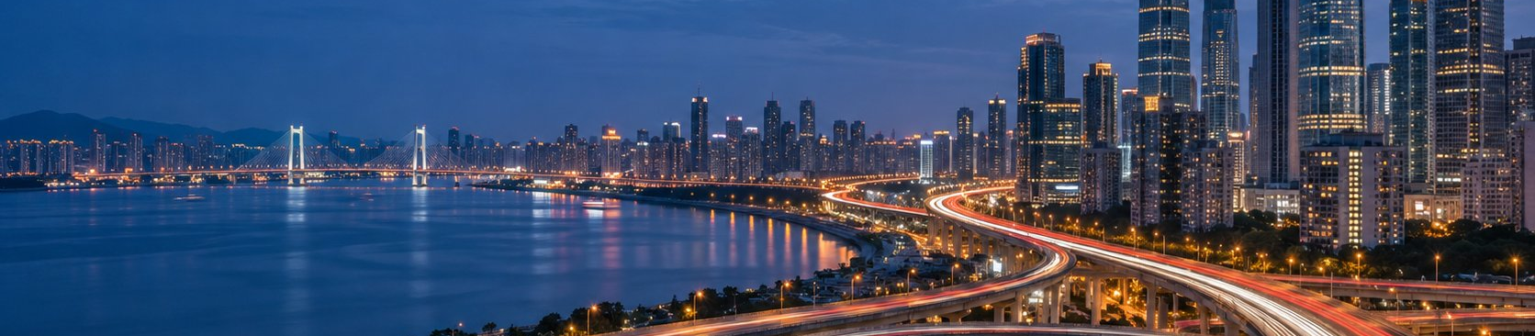
2026 review
January 2027
105% of target, on two new channels
441m
105.0%
49.5m
Zhou Qihang
Presenter
Channel Sales Manager, East China
Role
RMB shipped this year
Of target
RMB from two
East China channel sales
Team
new channels
My lead
The regional director and HR
For
Fictional example: the person and figures are invented
Notes:
Good morning. I'm Zhou Qihang, channel sales manager for East China. In fifteen minutes I'll cover three things: this year's result and which parts of it were mine, one thing I got wrong, and next year's target with the support I need to hit it.

Slide 2
01
This year's numbers
New channels carried us.
I got the north wrong
Shipments reached RMB 441m, 105% of target. About two thirds of the RMB 73m growth came from
the electronics chain and carrier channels I opened this year. The RMB 4m we lost in northern Jiangsu
came from my decision to switch distributors.
105.0%
49.5m
−4m
Of the year's target
RMB from the two new channels
RMB, the north on last year
Met
My lead
My mistake
2
Zhou Qihang · 2026 review
Fictional example: the person and figures are invented
Notes:
If you remember one sentence, make it this one. Next come three pages on results, three on what I got done, then the team, northern Jiangsu, and next year.

Slide 3
01
This year's numbers
RMB 441m, 105% of target: Q1's gap closed by Q3
Target
Target
Actual
Actual
Gap
Quarter
Verdict
96
87
−9
Q1
Missed
133
Cumulative +8 by Q3
112
105
109
+4
109
Q2
Met
87
99
112
+13
Q3
Beat
120
133
+13
Q4
Beat
105.0%
420
441
+21
Year
+19.8%
Up
on last year, which was RMB 368m
Q1
Q2
Q3
Q4
Basis: East China channel shipments including VAT, RMB millions
3
Zhou Qihang · 2026 review
Fictional example: the person and figures are invented
Notes:
Q1 came in at 90.6%, RMB 9m short, mostly in northern Jiangsu. From Q2 the chain stores and carrier stores started to ramp, Q3 alone beat target by RMB 13m, and by the end of Q3 we were RMB 8m ahead year to date. Q4 beat target by another RMB 13m. For the year we finished RMB 21m over.

Slide 4
01
This year's numbers
Up RMB 73m, two thirds from two new channels
Unit: RMB m, axis from 300
Who the growth came from
31
+27.5
−4
Chain stores
441
18.5
Carriers
+18.5
49.5
+31
The two channels I opened
68% of the net change
27.5
368
Existing
−4
North
73
Net change
2025
Chain stores
Carriers
Existing
North
2026
My lead
My lead
Team
My mistake
Basis: East China channel shipments including VAT, RMB millions
4
Zhou Qihang · 2026 review
Fictional example: the person and figures are invented
Notes:
I'd like you to read this page in two parts. The electronics chain and the carrier channel are new this year, and I led both from negotiation to pricing: RMB 49.5m between them. The RMB 27.5m from existing channels is the team's work, not mine. Northern Jiangsu lost RMB 4m, and I'll come back to that.

Slide 5

02
What I got done
Three things I got done
What I did, and what the team did
120 stores in a new chain
RMB 31m
1
My lead
210 carrier stores from zero
RMB 18.5m
2
My lead
Weekly restock board cut stock
52 → 34
3
days
My lead
5
Fictional example: the person and figures are invented
Notes:
For each of the next three, I'll split out which step was mine and which was the team's.

Slide 6
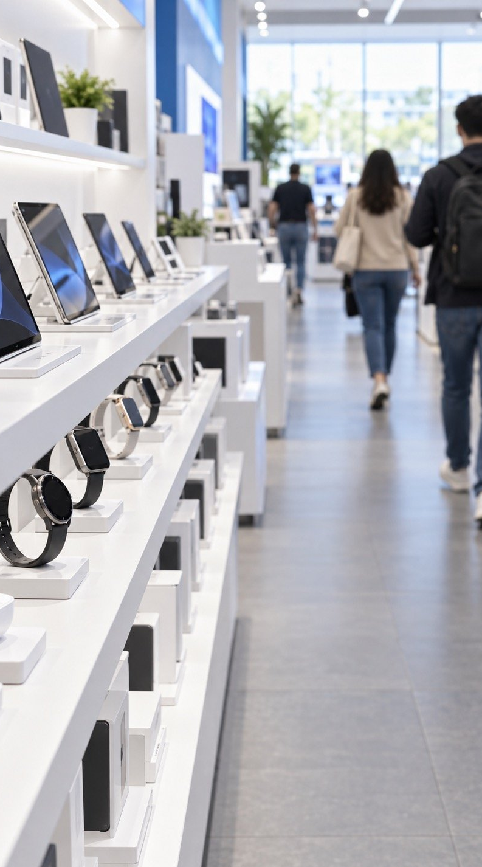
02
What I got done
120 stores in a new chain, adding RMB 31m
Not one store in this chain
Before
Four months of talks, tiered rebates
Me
Two account reps ran setup
Team
31
120
258
Result
Added, RMB m
Stores
Per store a year, RMB k
6
Zhou Qihang · 2026 review
Fictional example: the person and figures are invented
Illustrative image
Notes:
Last year we were in none of this East China electronics chain's stores. I started talks in January and they took four months. The key was a tiered rebate: once annual shipments pass RMB 20m, the rebate goes from 2% to 3%, which got us counter space. After signing, the work was the team's. Two account reps opened the first 40 stores in May and all 120 by September.

Slide 7
02
What I got done
0 to 210 carrier stores: my deal, team's rollout
Feb
Dec
RMB 18.5m
Wrote the proposal
RMB 88k per store
Contract phones and trade-ins
Me
Mar
Won carrier pricing
A separate price list from HQ
Jan
Feb
Mar
Apr
May
Jun
Jul
Aug
Sep
Oct
Nov
Dec
Apr
Jul
Sep
First 60 stores
Up to 150
All 210
Team
He Jiawen led setup and training
Weekly staff incentives
Three cities covered
My part was the proposal and the pricing. Setup, training and upkeep were the team's.
7
Zhou Qihang · 2026 review
Fictional example: the person and figures are invented
Notes:
We started the year with no carrier business at all. I did two things: wrote the proposal, and got HQ to give the carrier channel its own price list, which took more than a month. Once we had it, He Jiawen and the team did the setup, the store staff training and the weekly incentive payouts.

Slide 8
02
What I got done
My restock board cut channel stock to 34 days
34
My lead
27
→ 6
Cross-region selling complaints
days
380
Channel stock cover in 2026
Stores on the weekly board
52 days
2025
34 days
−18 days
2026
Basis: channel stock divided by average daily shipments at stores on the board, monthly average
8
Zhou Qihang · 2026 review
Fictional example: the person and figures are invented
Notes:
This one was mostly mine. Restocking used to run on monthly reports, dealers sat on more than 50 days of stock, and the surplus leaked out cheap into other regions. I built a weekly restock board covering the chain stores, carrier stores and 50 key stores, with suggestions based on actual sell-through. Stock cover fell from 52 days to 34, and complaints about cross-region selling from 27 to 6. The channel reps keep the board's data up to date each week.

Slide 9

02
What I got done
Two left, two joined, one became a team lead
In January
Left
Joined
At year end
8
−2
+2
8
Same as January
One resigned
One in April
One moved south
One in June
Gu Xiaofeng
He Jiawen
Own 40 stores after 3 months
Rep
carrier team lead
Leads two people
9
Zhou Qihang · 2026 review
Fictional example: the person and figures are invented
Illustrative image
Notes:
We started and ended the year with eight people. Two left and two joined. I spoke with the one who resigned twice and couldn't keep her, which is something I need to look at. The person I most want to mention is He Jiawen: she built the carrier channel on the ground, was promoted to team lead mid-year, and now has two reports. Gu Xiaofeng joined in April, shadowed the chain stores for three months, and has run 40 stores on his own since July.

Slide 10
02
What I got done
Changing distributor up north was my wrong call
Before: stores covered
Jan to Apr, year on year
H2, year on year
The north, of target
150
−38%
+6%
81.3%
→ 64
Old dealer against new
Taken back only in May
Two city distributors and key stores
RMB 9m short
1
2
What happened
Where I went wrong
My mistake
I moved three cities in northern Jiangsu to a new distributor. Jan to Apr
I checked their money, not their reach: 64 stores against the old
shipments fell 38%, and the area hit 81.3% of target.
dealer's 150.
4
What I changed
3
Why it took till May
Done
Took it back in May: two city distributors plus direct supply to key stores.
I waited two months to see if they would catch up, instead of
H2 was up 6%.
cutting losses.
10
Zhou Qihang · 2026 review
Fictional example: the person and figures are invented
Notes:
This was my misjudgment, not the market. I switched because the old dealer paid slowly and the new distributor had more capital, but I never checked their store coverage one by one: 64 stores against 150. Shipments fell 38% from January to April, and I waited two more months before acting. Since taking it back in May with two city distributors and direct supply to key stores, the second half was up 6% on last year. From now on I check store coverage before anything else when changing a distributor.

Slide 11
02
What I got done
Fewer shoppers, but sales per store up a quarter
2025
2026
Change
Average store on the board
−7.5%
186
172
Shoppers a day
+2.4 pts
11.2%
13.6%
Conversion rate
+10.9%
RMB 1,280
RMB 1,420
Average ticket
+24.6%
RMB 26,700
RMB 33,200
Sales a day
+13 pts
18%
31%
Trade-in share of orders
Fewer people come in, but they buy more and spend more. Next year's money goes into converting shoppers in store, not
into traffic.
Basis: average across the 380 stores on the weekly restock board, full year
11
Zhou Qihang · 2026 review
Fictional example: the person and figures are invented
Notes:
The clearest change on the customer side: footfall fell 7.5%, but conversion rose from 11.2% to 13.6% and the average ticket from RMB 1,280 to 1,420, so daily sales per store rose by about a quarter. Trade-ins went from 18% to 31% of orders and drove most of the higher ticket. That's why I want next year's spend on in-store promoters and trade-ins rather than on traffic.

Slide 12
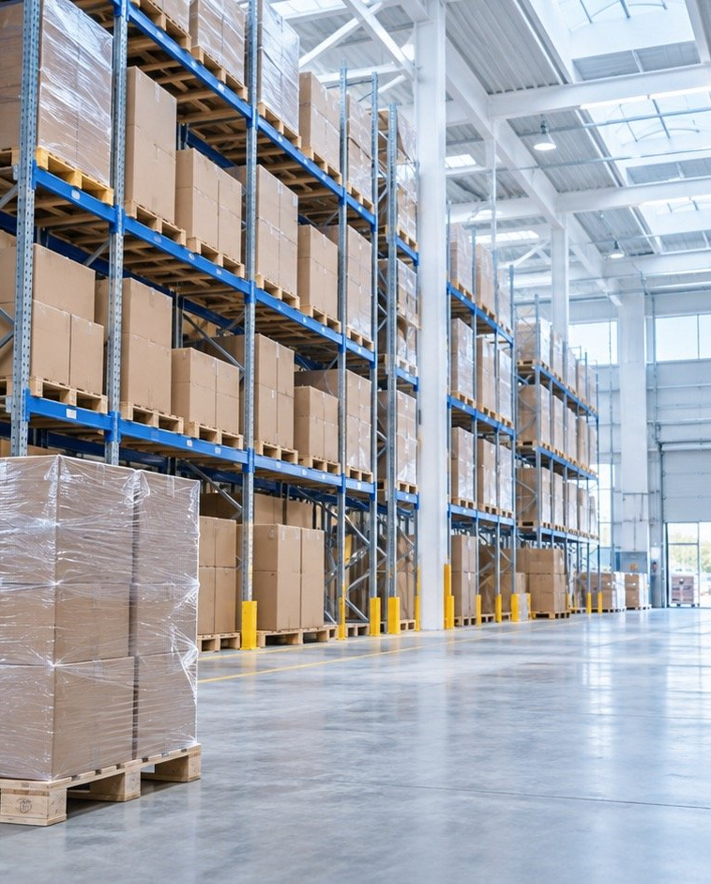
03
Next year
2027: how we get to
RMB 500m
The target, the plan, and the support I need
1
Target
RMB 500m, up RMB 59m
2
Plan
Steady the north, then grow both channels
3
Support
People, budget and terms
To approve
12
Fictional example: the person and figures are invented
Notes:
Now for next year.

Slide 13
03
Next year
RMB 500m next year, 83% of growth on three lines
Unit: RMB m
2026 actual
2027 target
RMB 500m
+26
57
+6
45
2027 full-year target
39
+17
+13.4%, RMB 59m of growth
35.5
31
RMB 49m
18.5
Growth from these three
Existing channels add RMB 10m
Chain stores
Carriers
North Jiangsu
Basis: East China channel shipments including VAT, RMB millions
13
Zhou Qihang · 2026 review
Fictional example: the person and figures are invented
Notes:
Next year's target is RMB 500m, RMB 59m more than this year. The chain goes from 120 stores to 200, adding RMB 26m. Carrier stores go from 210 to 350, adding RMB 17m. Northern Jiangsu returns to RMB 45m, a little above the RMB 43m before the switch, adding RMB 6m. Those three come to RMB 49m, and existing channels cover the other RMB 10m.

Slide 14
03
Next year
Steady the north first, then grow both channels
Q1
Q2
Q3
Q4
A full quarter on the
Steady the north
new setup
160 chain stores
40 more stores
Grow both
200 stores, 350 carriers
Push
Peak season and trade-ins
Quarter target
RMB m, 500 for the year
110
120
122
148
14
Zhou Qihang · 2026 review
Fictional example: the person and figures are invented
Notes:
Steady first, then grow. In Q1 the two city distributors in northern Jiangsu run a full quarter to prove the new setup holds. In Q2 we add 40 chain stores, in Q3 another 40 to reach 200, and carrier stores go to 350. Q4 is peak season, with a trade-in push. The four quarters add up to RMB 500m.

Slide 15
03
Next year
Three asks, each tied to a slice of growth
Cost
Ask
What exactly
What it buys
Decision
360
People
2 hires: carriers, the north
Carriers +17m, north +6m
Yes
No
RMB
k a year
2.6
Budget
Chain spend 6.2m → 8.8m
Chain +26m, 10% cost ratio
Yes
No
+RMB
m
1.85
Terms
North payment terms 30 → 45 days
Dealers stock up, north +6m
Yes
No
≈ RMB
m tied up
2.96
49
People and budget come to RMB
m a year, against RMB
m of next year's growth
Figures in the last column are RMB millions of shipments
15
Zhou Qihang · 2026 review
Fictional example: the person and figures are invented
Notes:
Three asks, each with what it buys. The biggest is chain store spend: RMB 2.6m more to ship RMB 26m more, a 10% cost ratio, the same as this year. Two hires cost RMB 360k a year, one for carriers and one based in northern Jiangsu. Moving the two northern distributors from 30 to 45 days ties up about RMB 1.85m on RMB 45m of shipments, and in return they'll hold stock. Without these three, I can't commit to that RMB 49m.

Slide 16
I'll take RMB
1
Two hires: carriers and the north
500m. Please
2
Chain store spend up to RMB 8.8m
approve these
3
45-day terms for northern dealers
three
For the review panel to approve
Zhou Qihang
Channel Sales Manager, East China · Consumer electronics brand
16
Fictional example: the person and figures are invented
Notes:
I'll take on the RMB 500m target. These three are what I'm asking the panel to approve today. Thank you.

