Slide 1
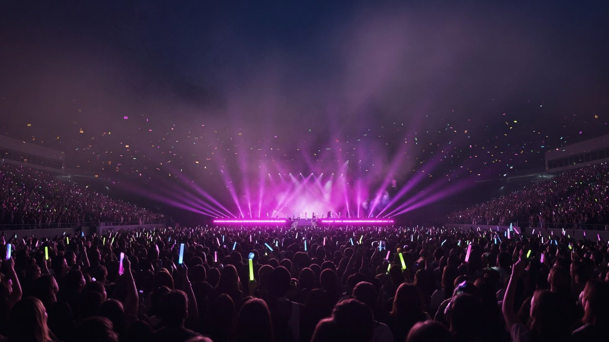
Proposal
Marketing · October 2026
Summer Concerts 2027
Before the show, after the encore: meet fans on their concert weekend
June to September
Outside · After · City
A code at every touchpoint
Notes:
This is the marketing team's proposal to management on whether to put the summer 2027 budget behind large concerts, and how. We start with the one-line plan, then why live shows, why concerts rather than festivals, the summer calendar and who the audience is. Then the touchpoint map, what peers have done, how we will attribute sales, the city ticket-stub schemes, risks and Plan B, the timeline, the KPI board and the budget split, and we close on four decisions for management. Market figures come from the China Association of Performing Arts (CAPA), its joint reports with Dengta Pro, and press reports, with a source on every data page. The plan contains none of our own sales, user or budget figures: everything about us is written as a plan or as something to test. The cover image is an AI-generated illustration.

Slide 2
01
The idea
Skip naming rights,
meet fans
before and after
Drink stations
Co-branded packs
Stub swaps
Fresh cups, a code on each
Pack codes track sell-through
Store vouchers track visits
2
/ 18
Notes:
The plan in one line. The campaign is called Before the Show, After the Encore. We do not chase naming rights inside the stadium. We meet fans in the hours before they go in and after they come out: drink stations outside the venue, co-branded packs, and a drink in exchange for a ticket stub. The following pages show why. Nearly two in three big-concert fans travel from another city, most stay two days or more, and nearly all of them eat locally, so their time and money are spent outside the venue. Inside belongs to the promoter and the venue, and Beijing police have banned bottled drinks at large events. Every touchpoint carries a code (cup codes, pack codes, store vouchers), so after the first stop we can count what worked before we spend more.

Slide 3
02
Market
43.39m at big shows, over half the box office
43.39
Big-show box office (RMB bn)
32.45
29.64
million · 2025 · up 18.81%
17.8
Admissions to shows for 5,000 or more. Up another 20.37% in H1 2026.
3.96
Over half of all box office
35.4% in 2023, 51.1% in 2024, about 52.6% in 2025 (324.48 ÷ 616.55)
2019
2023
2024
2025
Sources: CAPA 2025 annual brief (Jan 2026), H1 2026 figures (Jul 2026), CAPA and Dengta Pro report (Apr 2025)
3
/ 18
Notes:
Why live shows. Shows with 5,000 or more seats, which means stadium and arena concerts and festivals, drew 43.39 million admissions in 2025, up 18.81%, and took RMB 32.45 billion at the box office, up 9.49%. Dividing by China's total live-show box office of RMB 61.66 billion gives about 52.6%, so big live shows are now the core of the market. The first half of 2026 is growing faster still: 23.28 million admissions, up 20.37%, and RMB 17.11 billion, up 17.70%. We sell drinks, so we count people rather than tickets, and that is the number on this page. Note that CAPA restated its 2025 national figures on a comparable basis, so admissions from different years should not be joined into one trend line.

Slide 4
03
The split
Concert crowds grew 30.8%, festivals fell 6.1%
Concerts · our 2027 bet
+30.8%
Nearly 38m admissions · 2,496 shows · RMB 29.56bn box
office (+13.7%)
2025
Festivals
2024
Press
−6.1%
5.46m admissions · 547 shows · about 40 shows Mar to May
2026, 90+ a year before
Sources: CAPA and Dengta Pro (Apr 2026), Jiemian (Apr 2026). Spring 2026 show counts come from industry sources
4
/ 18
Notes:
Why concerts rather than festivals. Both are big live shows of 5,000 or more, but they are moving apart. In 2025 large concerts numbered 2,496, took RMB 29.56 billion, up 13.7%, and drew nearly 38 million admissions, up 30.8%. Large festivals numbered 547, flat on the year, and took RMB 2.89 billion, up 22%, but admissions fell 6.1% to 5.46 million: prices up, people down. Dengta Pro's platform figures for the first half of 2026 show a wider gap, RMB 14.54 billion for concerts against RMB 0.98 billion for festivals. These are company figures and do not add up with CAPA's. On supply, tickets on sale per concert rose 11% in the first half. For festivals, an industry source told Jiemian there were about 40 shows from March to May this year against more than 90 a year earlier, with Foshan Strawberry and Changsha Malanshan among those cancelled or postponed, and sponsors vetting deals harder. So the summer 2027 budget goes to concerts.

Slide 5
04
Calendar
Concerts peak Aug to Sep, festivals May and Oct
Jan
Feb
Mar
Apr
May
Jun
Jul
Aug
Sep
Oct
Nov
Dec
Concerts
Festivals
2027 concert season · Jun to Sep
Concerts: most shows in Aug and Sep, box office highs in May and Nov
Festivals: 60+ shows at May Day, 40+ at National Day, Jul to Sep next
Shading marks peaks only. The 2024 monthly chart carries no values
Source: CAPA and Dengta Pro, 2024 large-show market report (Apr 2025)
5
/ 18
Notes:
The summer calendar. In the CAPA and Dengta Pro report on 2024, large concerts had box office highs in May, August, September and November, and the number of shows peaked in August and September. Festivals peak twice, over the May Day and National Day holidays, with more than 60 shows at May Day and more than 40 at National Day. July to September is only their second tier. The report's monthly chart carries no values, so we mark peaks rather than drawing a curve. Dengta Pro's first-half 2026 figures agree: May was the biggest concert month at RMB 4.73 billion. We set the 2027 season for June to September, covering the summer break and the August and September concert peak.

Slide 6
05
Audience
Over 70% are aged 18 to 34, about 2 in 3 women
Concerts
25.8
31.1
18.0
10.3
5.4
5.9
66.1%
3.6
Aged 18 to 34: 74.9%
of concert-goers
are women
Festivals
5.0
36.2
33.3
15.4
6.0
67.1% at festivals (2024)
2.2
Aged 18 to 34: 84.9%
1.9
Born 2000 or later: 32.5% of
the live music crowd (2025)
Teens
18-24
25-29
30-34
35-39
40-44
45+
The market is not the show: 44.5% of Dao Lang's tour crowd was over 50. Pick shows by each artist's own audience.
Sources: CAPA and Dengta Pro (Apr 2025, Dengta platform data), CAPA live music report (DoNews, Apr 2026)
6
/ 18
Notes:
Who comes. In 2024, 66.1% of large-concert audiences were women and 74.9% were aged 18 to 34, adding 25.8% aged 18 to 24, 31.1% aged 25 to 29 and 18.0% aged 30 to 34. Festival crowds are younger still: 84.9% aged 18 to 34, 67.1% women. In 2025, people born in 2000 or later made up 32.5% of the live music audience. That is exactly who a young drinks brand wants. But the market is not the show. Household-name singers pull the age up: 44.5% of Dao Lang's 2024 tour audience was 50 or older, against 20.3% for Wakin Chau and 10.7% for Andy Lau. So we choose shows by the artist's own audience profile, not by the market average. That is our first test for any artist: their audience overlaps with 18 to 34. Then many tour dates, no public controversy, and acceptance of a morals clause. The profile data come from the Dengta platform, so they are effectively company figures.

Slide 7
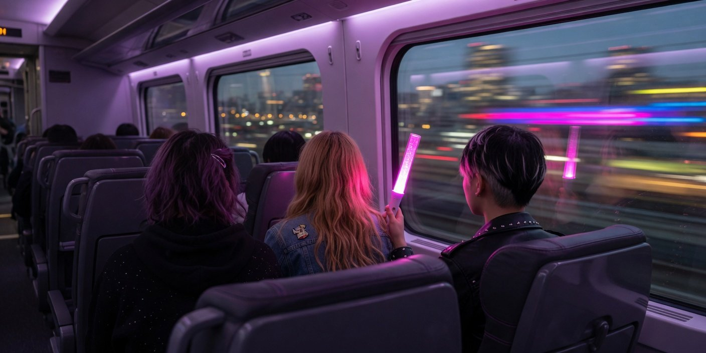
06
Travel
64.2% of fans travel in, more in smaller cities
Tier 1
46.5
10.2
43.3
Tier 2
35.1
20.7
44.2
Tier 3
28.3
37.0
34.7
Tier 4
18.6
Illustration (AI-generated)
48.5
33.0
64.2%
Local
Same province
Other province
By host city tier, 2024
of 2024 big-concert crowds came from another city
(festivals 62.2%)
Source: CAPA and Dengta Pro (Apr 2025, Dengta platform data)
7
/ 18
Notes:
Where they come from. In 2024, 64.2% of large-concert audiences travelled from another city, and 62.2% of festival audiences. By the tier of the host city, shows in Tier 1 cities still draw 46.5% local fans, while in Tier 4 cities locals are only 18.6% and 48.5% come from elsewhere in the province. The smaller the city, the more outsiders. The cities with the highest share of travelling concert fans were Xianyang at 93.4%, Yantai at 88.7% and Changzhou at 87.9%. Reports of the 2025 figures, 64.6% for concerts and 68.4% for festivals, disagree on whether they count other cities or other provinces, so we use the checked 2024 numbers. For us it means fans take the train, check into a hotel and eat out, so stations, hotels, late-night food and the city itself are all touchpoints. The image is an AI-generated illustration.

Slide 8
07
Weekend
78.5% stay 2+ days, 98.4% eat locally
We sell nothing inside
Travel
Before
During
After
Next day
Rail to the show
Queue outside
Inside is the promoter's
Find a meal
Shops and sights
Stay two days or more
Share who spent on each at the destination (not how the money splits)
78.5%
Food
98.4%
Tickets
96.4%
City transport
68.1%
Two days 41.5%, three 24.2%, four to
Shopping, merch
five 11.7%
64.7%
Sights
30.2%
Source: CAPA-commissioned survey (last out-of-town show in 2024, N=830, Apr 2025)
8
/ 18
Notes:
The on-site journey: one travelling fan's concert weekend. A survey commissioned by CAPA asked 830 people about their last out-of-town concert in 2024. 78.5% stayed two days or more: 41.5% two days, 24.2% three. 98.4% ate locally, 68.1% paid for city transport, 64.7% went shopping, merchandise included, and 30.2% bought tickets for local sights. Total spending at the destination on that trip was RMB 500 to 2,000 for 52%. These are shares of people with each kind of spending, not a split of the money, so we do not draw a spending pie. Rail operators ran more than 100 fan trains in 2025. The show itself belongs to the promoter and venue, so our touchpoints sit before the show, after it, and the next day.

Slide 9
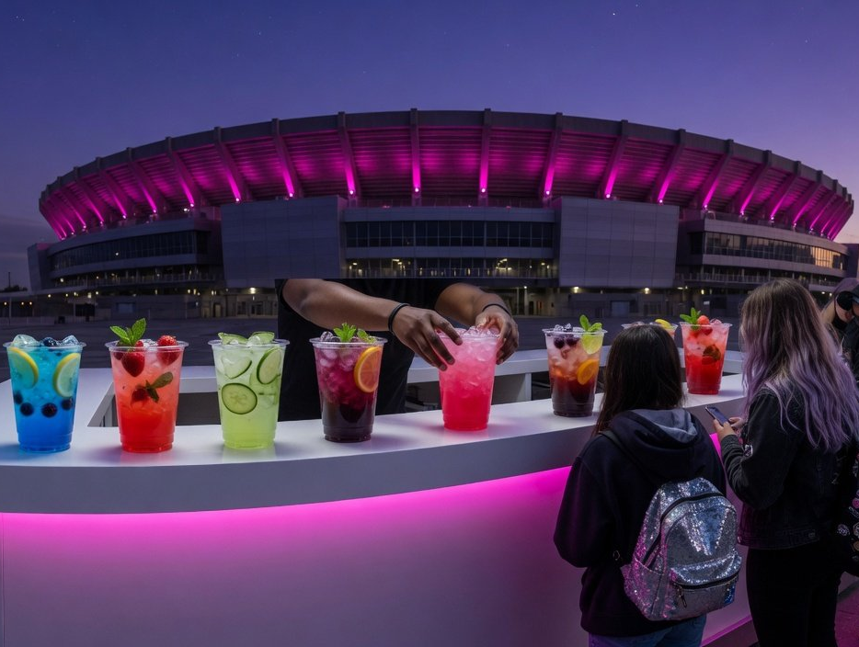
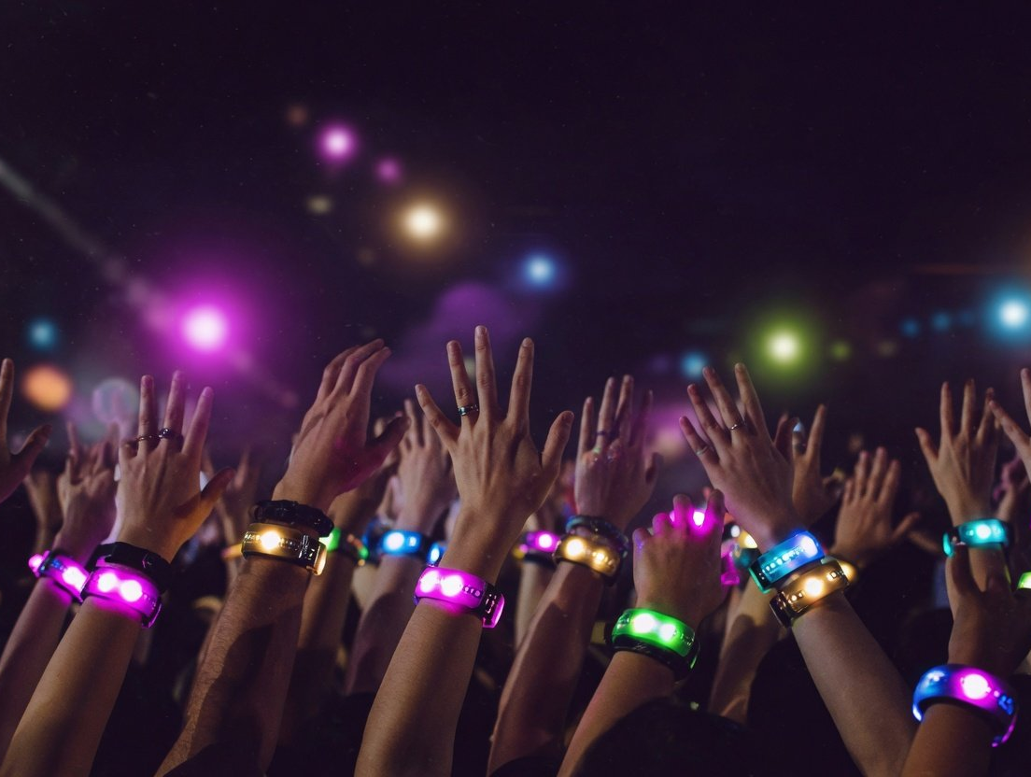
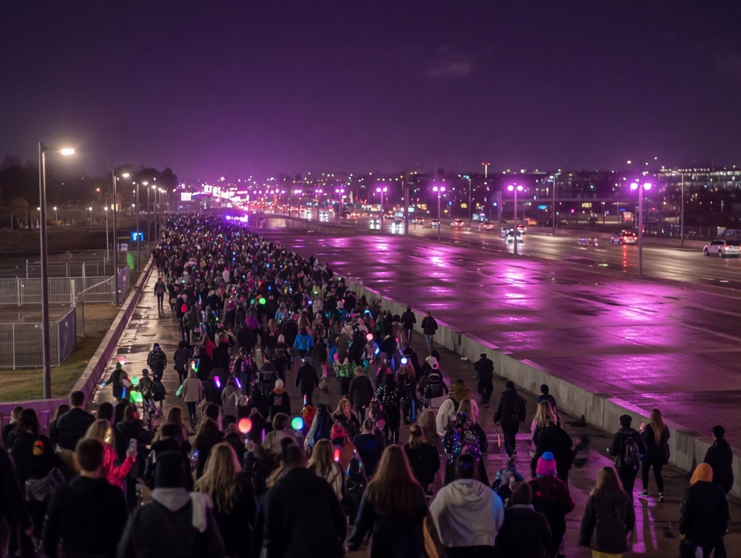
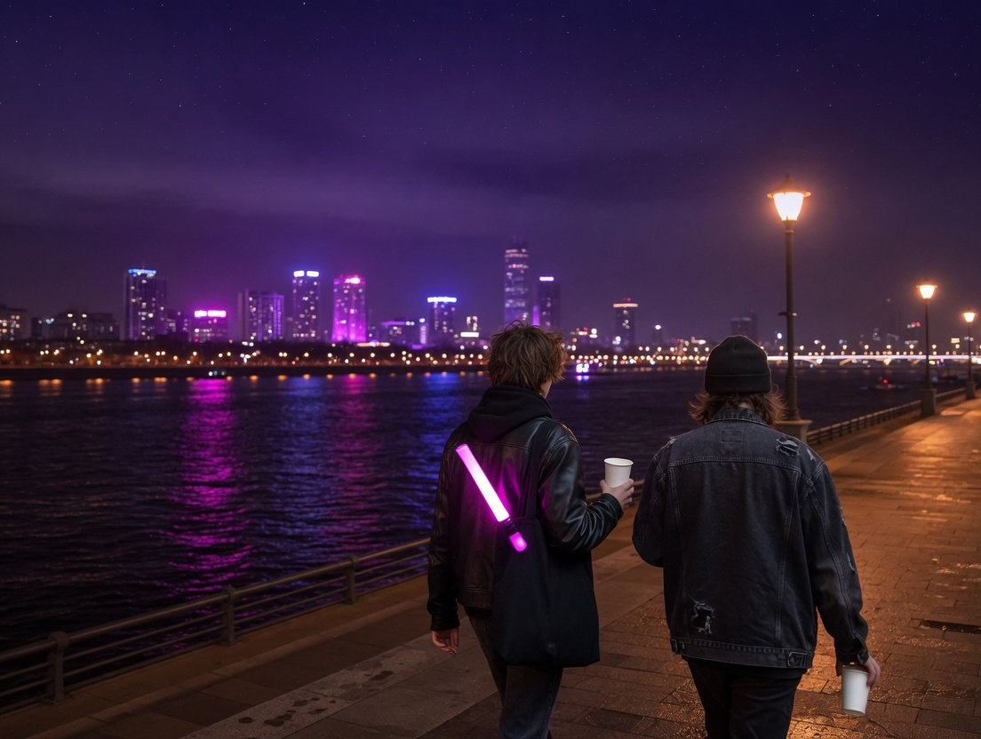
08
Touchpoints
Touchpoint map: four places, one job in each
Outside
Inside
A drink station, fresh cups, a code
Only what the promoter allows
on each
Illustration (AI-generated)
Illustration (AI-generated)
After
City
Drinks at shuttle stops,
A drink for a ticket stub, with
store vouchers
local merchants
Illustration (AI-generated)
Illustration (AI-generated)
Beijing police have banned bottled drinks at big events (Beijing, one holiday, not a national rule): we never hand out bottles to carry in
9
/ 18
Notes:
The touchpoint map: four places, one job in each. Outside: drink stations in the queues and at shuttle points, freshly made cups drunk on the spot, a code printed on every cup. Inside: the promoter and venue decide, and we only discuss official drinks and fan activities they allow. After: refreshments at the shuttle stops and late-night store vouchers. City: we sign up as a ticket-stub merchant, so a stub buys a drink in our stores, and we sell a city-edition co-branded pack. Beijing police listed bottled drinks among banned items in their notice for large events over the 2026 Dragon Boat holiday. That applies to Beijing at that time, not nationally, but it shows that getting bottles into venues is unreliable, so we never hand out bottles for fans to carry in. All four images are AI-generated illustrations.

Slide 10
09
Peers
Plenty of activations, zero attributable sales
Hushang Ayi
Zhanma
Changqing
Published sales anyone
Tea · 2024
Energy drink · 2025
Dairy · 2025
can attribute
0
Tour combo for two, 700+ stores in
Named every drink station at
Co-branded pack, buy yogurt to
12 cities
Strawberry Xinjiang
win tickets
10,000 sold in 10 minutes
Nearly 80,000 fans (whole festival)
Not disclosed
Company figure
Advertorial
Trade media
cases
Yili Xujinhuan
Yanghe M6+
Pepsi
Dairy · 2024
Baijiu · 2024
Soft drinks · 2023
Every result is reach,
trends or sell-outs. Not
Named 3 concerts, stalls on site
8-city tour sponsor, scan a cap to
Title sponsor, TFBOYS 10th
win tickets
anniversary in Xi'an
one figure traces back
to sales
1.1bn+ Weibo impressions
5bn+ video views
No brand results disclosed
Company figure
Company figure
Press
Sources: Digitaling (Mar 2024, Jun 2024, Jun 2025), 21st Century Business Herald, China.com, Jiemian, Xin Caijing. All results self-reported
10
/ 18
Notes:
What peers have done. Drinks, tea and dairy brands already have a full playbook at live shows: naming rights, drink stations, tie-in combos, co-branded packs, buy-a-product-win-a-ticket and scan-to-win. Hushang Ayi ran a two-cup combo with Jason Zhang's 2024 tour in more than 700 stores across 12 cities and, by company and platform figures, sold 10,000 in ten minutes, while its ordering system also crashed. Zhanma named every drink station at Strawberry Festival Xinjiang. The nearly 80,000 fans were the whole festival, not people reached by the brand. Changqing's co-branded pack let shoppers win tickets by buying yogurt, with no results disclosed. Yili Xujinhuan and Yanghe reported impressions and video views. The key point is that published results are almost all self-reported impressions, trending topics and sell-outs. We could not find a single published, attributable figure for sales or repeat purchase. That is the gap this plan closes: every contact has to count back to sales.

Slide 11
10
Attribution
A code at every touchpoint, traced to the show
01
02
03
04
05
Issue codes
Scan
Redeem
Repeat
Compare
Cup, pack and stub
A mini program issues a
Each redemption traces
Did they buy again within
Against similar cities with
codes, by city and show
store voucher
to its touchpoint
30 days?
no show
Each review feeds the codes for the next stop
Touchpoint
Code
Tells us
To test at the first stop
Drink station
Cup code
Pickups by city and show
Does a sample turn into a store sale?
Co-branded pack
Pack code
Scan rate and sell-through
Are the buyers new customers?
Stub swap
Voucher
Out-of-town fans in our stores
Do they keep buying back home?
11
/ 18
Notes:
How we attribute. Every touchpoint issues a code: the cup code at drink stations, the pack code on co-branded packs and the store voucher for stub swaps, each carrying the city and the show. Fans scan to get a store voucher in our mini program, redeem it in our stores or convenience stores, and each redemption traces back to a show and a touchpoint. Then we check whether people who scanned buy again within 30 days. The last step matters most: comparing show cities with similar cities that had no show, on co-branded and store sales, tells us whether the extra sales came from the concert. The table says what each code can tell us and what the first stop still has to test. The central question is whether a free sample at the venue turns into a store purchase. No peer has published a figure for that step.

Slide 12
11
Cities
Cities reward stubs, so we swap stubs for drinks
National
Nanjing
Show your
1:6.85
Show your
Travel for a Show
Enjoy 1+3
stub
stub
A national measure since January 2025
453 merchants, deals a week either side
CAPA estimate: other spending
per RMB 1 of tickets
Method unpublished. It shows
Pudong, Shanghai
Qingdao
why cities welcome shows, not
Show your
what we earn.
Show your
Stub rewards
Stub Economy 3.0
stub
stub
District pays 30%, merchants 20%,
800+ merchants, shuttles at start
real-name checks
and end
Sources: State Council (Jan 2025), Yangtse Evening Post (Oct 2025), Pudong government (Jun 2025), China News Service (Jun 2026), CAPA (Jan 2026)
12
/ 18
Notes:
Working with cities. Cities are already reaching out to travelling fans. A State Council General Office document in January 2025 made travelling for a show a national measure. Nanjing's 1+3 scheme, running since May 2025, gives discounts at sights, hotels and restaurants, and malls to anyone holding a ticket on the day of a show or within a week either side. 453 merchants had joined by October. Shanghai's Pudong district ran stub rewards from May to September 2025: e-tickets bought hotel and sight discounts, with the district paying 30% and merchants 20%, and booking names had to match ticket names. Qingdao's stub economy 3.0 this year has more than 800 merchants, longer metro hours and post-show shuttle lines. CAPA estimates that each RMB 1 of large-show tickets brought RMB 6.85 of other spending in 2025, more than RMB 220 billion in all, but the method is unpublished. It explains why cities court shows. It cannot measure our return. Our move is to join these schemes as a stub merchant: show a stub in our stores and get a drink, with the voucher coded like everything else.

Slide 13
12
Plan B
All six risks have happened. Each has a Plan B
Risk · public case
Plan B
Typhoon Bavi cancelled 3 G.E.M. shows in Hangzhou, Jul 2026
Kit moves cities, vouchers follow the new dates
Weather
Genki Forest's Beijing festival cut sets short and fans demanded
No festival of our own. The stage is the promoter's, we run
Execution
refunds, May 2025
stations outside
After Zhang Zhehan, Aug 2021, 26 brands quit within 4 hours
Show deals only, never endorsement, a morals clause, assets
Artist
21 minutes
down within 4 hours
A Zhenjiang ring took 60,000+ tickets in two years, RMB 16m+ profit
Prize tickets are real-name, the winner attends
Scalpers
Concert complaints doubled in H1 2025, over 90% about refunds
Refund rules for prize tickets stated up front, platform rules apply
Refunds
Beijing police notice for the 2026 Dragon Boat holiday
Fresh cups finished on the spot, no bottles to carry in
Bottle ban
Sources: Guancha, China Music Business News, Jiemian, CCTV News, Legal Daily (citing the China Consumers' Association), Beijing police
13
/ 18
Notes:
Risks and Plan B. All six risks have happened in the past two years. Weather: in July 2026 Typhoon Bavi cancelled three G.E.M. shows in Hangzhou, and the promoter refunded tickets and covered travel and hotels. In May a gale damaged the stage at the Bubble Island festival in Tianjin. Our station kit can move to another city, and vouchers follow the new date. Execution: at Genki Forest's own Beijing festival on 1 May 2025 a band arrived late, the headline set shrank from the advertised 30 minutes to about seven, the crowd chanted for refunds and the brand's social account was swamped. When a brand runs the festival, the brand takes the blame, so we will not run one. Promoters run the stage and we run the stations outside. Artists: after the Zhang Zhehan affair in August 2021, Wahaha cut ties first and 26 brands followed within 4 hours 21 minutes. We sign show-level deals only, no endorsements, with a morals clause, and take every asset down within four hours if needed. Scalpers: a ring in Zhenjiang grabbed more than 60,000 tickets in two years and made over RMB 16 million. Prize tickets are real-name, so the winner is the person who attends. Refunds: the China Consumers' Association says concert complaints doubled in the first half of 2025 and more than 90% concerned refunds, so prize-ticket refund rules are set out in advance. The last one is ours alone: Beijing police listed bottled drinks as banned at large events over the 2026 Dragon Boat holiday. That is a Beijing notice, not a national rule, but our default is freshly made cups finished on the spot.

Slide 14
13
Schedule
Sign off now, first stop in June
2026.10
11
12
2027.1
2
3
4
5
6
7
8
9
10
Sign-off
Cities and shows
With promoters, venues
Packs, boards, stubs
Ready by May
First stop
Pass review, then tranche 2
Season
Covers the Aug and Sep peak
Wrap-up review
Concert season Jun to Sep
14
/ 18
Notes:
The timeline. Sign-off this October. From November to January we choose cities and negotiate with promoters and venues, favouring cities with many concerts, a high share of travelling fans and an existing ticket-stub scheme. Co-branded pack design starts in December and production finishes before May, with the pack codes printed in production. The attribution board, stub merchants and store vouchers are also ready by May. The first stop opens in June 2027, the most important bar on the chart: the second budget tranche is released only if the first stop passes review. July to September is the full concert season, covering the August and September peak, and the final review is due at the end of September.

Slide 15
14
Scoreboard
KPIs count only redemptions, targets come later
Cup codes
Voucher redemption
Co-brand uplift
Target: set after the first stop
Target: set after the first stop
Target: set after the first stop
Cups picked up and scanned, by city and show
Redeemed within 7 days ÷ issued
Weekly co-brand sales, show city minus control
30-day repeat
Stub swaps
Sentiment
Target: set after the first stop
Target: set after the first stop
Target: set after the first stop
Scanned members who buy again within 30 days
Stub redemptions, by city and merchant
Negative share. A trigger starts the 4-hour drill
The board goes to management weekly. No code, no project.
15
/ 18
Notes:
The KPI board. Only numbers we can redeem go on the board. Impressions and trending topics stay off. Six measures. Cup codes: cups picked up and scanned at stations, by city and show. Voucher redemption: vouchers redeemed within seven days of the show divided by vouchers issued. Co-brand uplift: weekly co-branded sales in show cities minus similar control cities, the closest we get to true incremental sales. Thirty-day repeat: the share of scanned members who buy again within 30 days. Stub swaps: stub redemptions by city and merchant. Sentiment: the share of negative mentions, where a trigger starts the four-hour response. We set no targets yet, because no published case gives a credible baseline. The first stop sets the baseline, and targets for the second tranche follow. The board goes to management every week.

Slide 16
15
Budget
Six budget lines, with 15% ring-fenced
30%
25%
15%
15%
8%
7%
15% ring-fenced
Proposed share
Stations and kit · 30%
Co-brands and stores · 25%
Stubs and prize tickets · 15%
Content and online · 15%
Attribution and data · 8%
Contingency · 7%
Two tranches
Amounts to follow
The second only after the first stop passes
Shares proposed by Marketing, not modelled
16
/ 18
Notes:
The budget split. We show categories and proposed shares only. Amounts will be submitted separately. Drink stations and kit take 30%, the largest share. Co-branded packs and store activity take 25%. Stub deals and ticket prizes 15%. Content and online 15%. Attribution and data 8% and contingency 7%: together 15%, ring-fenced and not to be moved. Without attribution we cannot say what the money did. Without contingency, a typhoon or a postponement means asking for more mid-season. The money is released in two tranches, the second only after the first stop passes review.

Slide 17
16
Decisions
Four decisions: direction, budget, codes, risk
Direction
Budget
Approve
Approve
Concerts, outside and in the city
Six shares, two tranches
Revisit
Revisit
No naming rights, no festival of our own, June to
Second tranche after the first stop passes, amounts
September 2027
to follow
See pp. 3 to 9
See p. 16
Attribution
Authority
Approve
Approve
No code, no project
Marketing head acts on artist risk
Revisit
Revisit
Weekly board to management, targets after the first stop
Show deals with morals clauses, assets down within 4 hours
See pp. 10, 11, 15
See p. 13
17
/ 18
Notes:
Four decisions for today. First, direction: in summer 2027 we back the outside of the venue and the city at large concerts, with no naming rights and no festival of our own, from June to September. Second, budget: six categories, released in two tranches, the second only after the first stop passes review, with amounts submitted separately. Third, the attribution rule: no code, no project. The board goes to management weekly and targets are set after the first stop. Fourth, risk authority: artist deals are show-level with a morals clause, and if something happens the head of marketing can take down every asset within four hours without waiting for sign-off. In 2021, 26 brands walked away in just over four hours. Slow is costly.

Slide 18

Next
Before the Show, After the Encore · Summer 2027
Sign off in October,
first talks in November
November
December
June 2027
First list of cities and shows
Co-branded packs approved
First stop opens
Sign off, curtain up
Notes:
If we decide today, we bring the first list of cities and shows in November and start talks with promoters for the first stop, kick off the co-branded packs in December, and open the first stop in June 2027. The background image is an AI-generated illustration.

