Slide 1
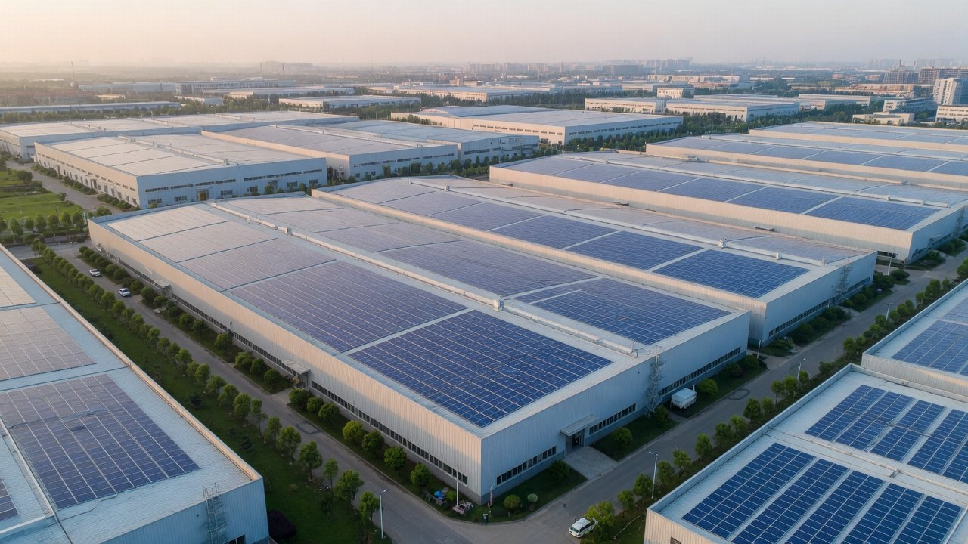
October 2026
For your management team
Let your roof pay part of
your power bill
Commercial rooftop solar and storage
1.08 m kWh
6.1 to 7.7 yrs
RMB 0
A year from 1 MW of solar
Payback, self-funded
Your outlay
Jiangsu official figure
Per MW, Jiangsu
Under an energy contract
Image is AI-generated and illustrative
Notes:
This proposal answers what your management team asks first: how much a year, how long to pay back, whether you have to put money in, whether the roof and production are affected, whether storage is safe, and who answers if something goes wrong. Every figure is worked per MW of solar or per MWh of storage, with its inputs and sources on the page. Your own numbers come from your last twelve months of power bills and your electricity supply contract. The cover image is AI-generated and illustrative.

Slide 2
Rooftop solar and storage proposal
· For your management team
Solar still pays back. Storage has to prove it
Summary
You get three things
Numbers
Daytime power
A payback worked from
A contract naming who pays,
from your own roof
your bills and contract
who runs it, who is liable
Plan
1.08 m kWh
6.1 to 7.7 yrs
RMB 0
A year from 1 MW of solar
Simple payback, self-funded, per MW
Your outlay under an energy contract
Delivery
Jiangsu official figure, 1,080 h
Before degradation, tax and finance
Savings shared through a discount
Decide
Storage is not in by default: it goes in only if your load curve clears the bar after O&M, fade and sharing.
Source: Jiangsu DRC bidding notice (2025-11-11), CPIA PV roadmap (2024-2025 edition), The Paper (2026-08-18)
2
Notes:
The short answer first. Jiangsu and Zhejiang have moved midday into the off-peak band, and many plant owners now assume rooftop solar no longer pays. On Jiangsu's official parameters and industry cost data, 1 MW of solar makes about 1.08 million kWh a year, and a self-funded system pays back in 6.1 to 7.7 years, depending on how much of that power you use yourself and what the surplus sells for. If you would rather not invest, an energy management contract lets an investor fund the system while you pay a discounted tariff for the power. Storage is different: spreads are narrowing and costs are rising, so we only propose it once your own load curve shows it pays.

Slide 3
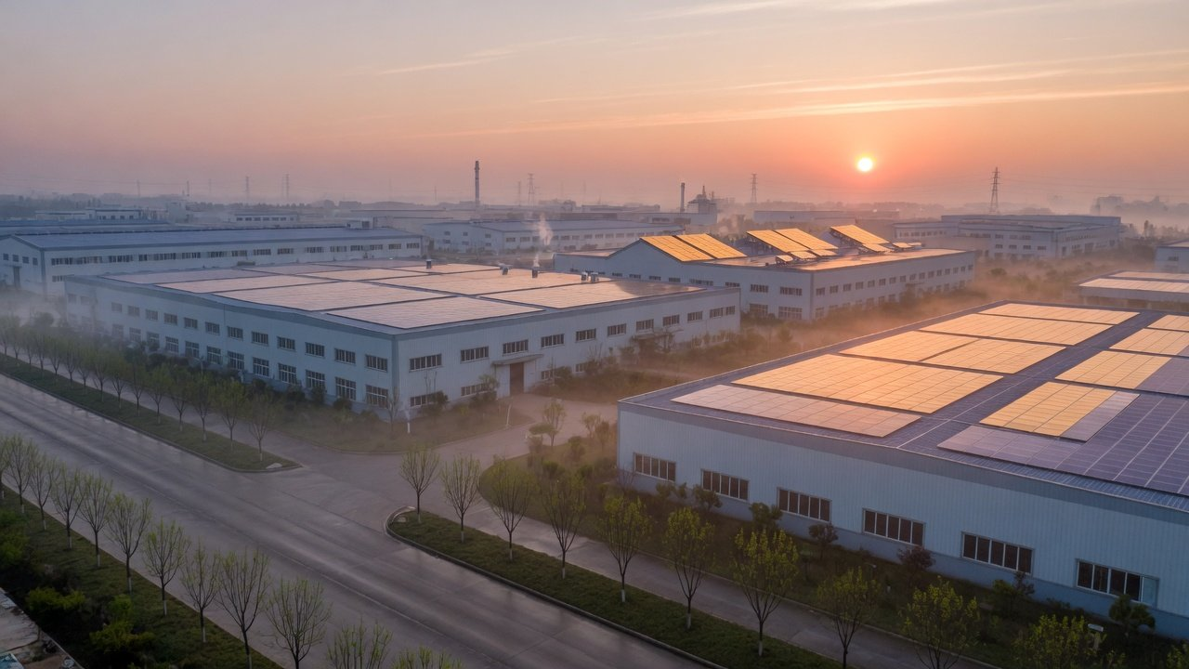
01
Summary
Numbers
Part 1 · The numbers
First, the numbers under the new tariffs
Plan
This part answers
What 1 MW of rooftop solar still saves now the tariff hours have moved
Delivery
How much you use by day, at what price, and how payback moves with it
The most storage can gross, and why that figure needs discounting
Decide
Notes:
Part one is the numbers: how the time-of-use bands have changed, what 1 MW of solar and 1 MWh of storage can each save, and which figures need discounting. The background image is AI-generated and illustrative.

Slide 4
Rooftop solar and storage proposal
· For your management team
Midday is now off-peak in Jiangsu and Zhejiang
Summary
Midday, 10:00-14:00
Spread 0.5738
Jiangsu, Oct
Std
Off
Std
Off
Peak
Std
Numbers
Off 0.3828 · Std 0.6400 ·
Jiangsu DRC No. 426 (2025)
Peak 0.9566
Spread 0.76 (est.)
Zhejiang, spring
Off
Std
Off
Std
Peak
Plan
Off 0.3653 · Std 0.6803 ·
Zhejiang DRC No. 112 (2026)
Peak 1.1267
Spread 0.8192
Shantou, Sep
Off
Delivery
Std
Std
Top
Peak
Std
Off 0.2635 · Std 0.6483 · Peak
Guangdong DRC No. 331 (2021)
1.0827 · Top 1.3465
0:00
6:00
12:00
18:00
Decide
Grid agency price, two-part, 1-10 kV, RMB/kWh
Off-peak
Standard
Peak
Top peak
Source: provincial time-of-use rules, State Grid Jiangsu (Oct 2026) and Guangdong Grid Shantou zone (Sep 2026) price lists. Zhejiang prices worked from No. 112 and Nov 2025 components,
indicative only
4
Notes:
The bands cover all 24 hours of the day, and the dashed frame marks midday, 10:00 to 14:00, when a rooftop array makes most of its power. October counts as autumn in Jiangsu: 10:00 to 14:00 is off-peak at RMB 0.3828 per kWh, and the peak starts only at 15:00. Zhejiang's Document No. 112 has made 11:00 to 14:00 off-peak all year since 1 July 2026. That row is our own illustration, worked from the November 2025 price components under the new rules, not an official price list. Guangdong still applies its 2021 Document No. 331: 10:00 to 12:00 and 14:00 to 19:00 are peak, and July to September add a critical peak at 11:00 to 12:00 and 15:00 to 17:00. So a kWh of rooftop power mostly replaces peak power in Guangdong, while in Jiangsu and Zhejiang the midday hours only replace off-peak power. These are grid agency prices for customers who buy through the grid. They change monthly, and customers on the market should use their own contract. The Guangdong figures are for the Shantou price zone and exclude the five Pearl River Delta cities, whose list we could not obtain.

Slide 5
Rooftop solar and storage proposal
· For your management team
Above 10 kV, your own contract sets the price
Summary
Jiangsu
Zhejiang
Guangdong
Jiangsu DRC No. 426 (2025)
Zhejiang DRC No. 112 (2026)
Guangdong DRC No. 331 (2021)
Numbers
At midday
At midday
At midday
Off-peak, 10:00-14:00
Off-peak, 11:00-14:00
Peak 10-12, standard 12-14
Spread (RMB/kWh)
Spread (RMB/kWh)
Spread (RMB/kWh)
Plan
0.5738
0.76
0.8192
est.
Shantou
Midday solar mostly offsets off-peak
Midday solar mostly offsets off-peak
Daytime solar mostly offsets peak
Delivery
Above 10 kV, your supply contract sets the price
NDRC No. 1656, Article 35: from 1 March 2026, customers trading in the market leave the administered bands. Jiangsu retail packages still set
Decide
peak and valley at least 60% from standard.
Source: provincial time-of-use rules and grid agency price lists, NDRC Document No. 1656 (2025), Jiangsu DRC Document No. 1141 (2025)
5
Notes:
On the 1 to 10 kV two-part tariff, the peak-valley spread is RMB 0.5738 in Jiangsu and RMB 0.8192 in Guangdong's Shantou zone. For Zhejiang we work out about RMB 0.76 under Document No. 112, as an illustration. The bigger difference is midday: Jiangsu and Zhejiang now price it off-peak, Guangdong still prices it peak and standard. For solar, that decides how much each self-used kWh is worth. For storage, all three provinces allow two charge and discharge cycles a day, but Guangdong's spread is wider. One more point matters a great deal: most plants connected at 10 kV and above already buy on the market. Article 35 of NDRC Document No. 1656 says administered time-of-use prices no longer apply to them, from 1 March 2026. In Jiangsu, retail packages that set time-of-use prices must still put peak and valley at least 60% above and below standard. If you buy on the market, the grid agency prices in these pages are only a guide, and the final numbers come from your own supply contract.

Slide 6
Rooftop solar and storage proposal
· For your management team
1 MW in Jiangsu saves about RMB 440,000 a year
Summary
Value
Input
Source
Net saving a year
Annual output
1.08 m kWh
E × p − O
E
Policy text
1 MW × 1,080 h, Jiangsu bidding notice
1.08 m × 0.45 − 46,000
Numbers
RMB 440,000
Price replaced
RMB 0.45/kWh
p
Press
Jiangsu 9:00-15:00 average, May 2026
Plan
O&M
RMB 46,000/yr
Simple payback
O
Industry body
RMB 0.046/W a year, CPIA 2024
I ÷ net saving
2.70 m ÷ 440,000
Investment
Delivery
RMB 2.70 m
6.1 years
I
Industry body
RMB 2.70/W, CPIA 2024
Decide
All used on site, before degradation, tax, finance and roof rent. Your case is reworked from your bills and contract.
Source: Jiangsu DRC bidding notice (2025-11-11), CPIA PV roadmap (2024-2025 edition), The Paper (2026-08-18)
6
Notes:
This is the account for one megawatt, with a source for each input. Output uses the parameter in Jiangsu's official bidding notice: an average of 1,080 hours a year for this kind of plant over the last three years, on the AC side, so 1 MW makes 1.08 million kWh. The price replaced is RMB 0.45, a press-reported statistic: the average Jiangsu price between 9:00 and 15:00 was RMB 0.78 in May 2025 and RMB 0.45 in May 2026. Cost and O&M are CPIA's 2024 figures for commercial and industrial rooftop systems: RMB 2.70 per watt to build and RMB 0.046 per watt a year for basic maintenance. With all the power used on site, the bill falls by RMB 486,000 a year. Less RMB 46,000 of O&M, that is about RMB 440,000 net, and the RMB 2.7 million pays back in about 6.1 years. That is a simple payback, before panel degradation, tax, finance and roof rent. One caveat on units: if the RMB 2.70 per watt is priced on the DC side while the 1,080 hours are AC, CPIA's 1:1.25 DC-to-AC ratio would stretch the payback by about a quarter.

Slide 7
Rooftop solar and storage proposal
· For your management team
Payback: how much you use by day, at what price
Summary
Jiangsu per MW, simple payback
How much you use by day
All on site, standard 0.64
4.2 yrs
RMB 645,000 a year
Jiangsu's three-year average is 58.46%
Numbers
used on site, the rest exported. The more
All on site, RMB 0.45
6.1 yrs
RMB 440,000 a year
you use, the faster it pays.
58.46% on site, surplus 0.391
6.5 yrs
RMB 414,000 a year
Plan
All on site, off-peak 0.3828
7.3 yrs
RMB 367,000 a year
At what price
Power used on site replaces RMB 0.3828
58.46% on site, surplus 0.25
7.7 yrs
RMB 350,000 a year
to 0.64. Surplus bids RMB 0.25 to 0.391,
with no win guaranteed.
Delivery
Guangdong reference, company figures
1,163 h at RMB 0.803
3.0 yrs
RMB 888,000 a year
0 yrs
None of these paybacks deduct: degradation,
5 yrs
10 yrs
Decide
tax, finance, roof rent or inverter replacement.
With cost on the DC side and output on the
AC side, add about a quarter.
Source: inputs as on the previous page, Jiangsu bidding range and three-year average, Laibao Hi-Tech filing for Guangdong. Payback = RMB 2.7 m ÷ net saving
7
Notes:
Two things drive the payback. The first is how much of the daytime output you use yourself. In Jiangsu's official parameters, distributed systems that export their surplus sent 41.54% to the grid on average over three years, which means 58.46% was used on site. The second is the price each kWh is worth: what you would otherwise pay for the power you use, and what the surplus sells for. New projects in Jiangsu bid for a guaranteed price between RMB 0.25 and RMB 0.391, and a bid is not guaranteed to win. Across these combinations, simple payback per MW in Jiangsu runs from 4.2 to 7.7 years, and 6.1 years with all power used on site at RMB 0.45. The Guangdong bar is a reference, worked from a listed Shenzhen company's EMC filing: a weighted price of about RMB 0.803 for the solar hours and a forecast 1,163 hours, giving about 3.0 years. Those are company figures. Your own share of self-use and your own prices come from twelve months of time-of-use readings and your supply contract. Guangdong's edge is not guaranteed either: if Guangdong also moves midday to off-peak, it narrows, so a Guangdong plant should also be worked on current hours and its own contract.

Slide 8
Rooftop solar and storage proposal
· For your management team
Storage tops out at RMB 712/MWh a day in Jiangsu
Summary
Gross per cycle = 1,000 kWh × (discharge price − charge price ÷ 86.5%)
86.5% efficiency, CPIA
Numbers
Jiangsu, Oct
Two-part, 1-10 kV, RMB/kWh
Shantou, Guangdong, Sep
Two-part, 1-10 kV, RMB/kWh
RMB 514.1
RMB 778.1
Off 0.3828
Peak 0.9566
Off 0.2635
Cycle 1
Peak 1.0827
Cycle 1
RMB 197.5
Plan
RMB 333.2
Off 0.3828
Std 0.6400
Std 0.6483
Cycle 2
Peak 1.0827
Cycle 2
300 to 330 days a year
300 to 330 days a year
A day, two cycles
A day, two cycles · excl. top peak
RMB 711.5
RMB 1,111.3
RMB 213k-235k
Delivery
RMB 333k-367k
Decide
A ceiling, not a return
Nothing deducted for O&M, fade, depth of discharge, sharing or finance, and the days are assumed. Payback comes from your load curve.
Source: State Grid Jiangsu (Oct 2026) and Guangdong Grid Shantou zone (Sep 2026) price lists, two-part 1-10 kV. CPIA system efficiency 86.5%. k = thousand
8
Notes:
Storage uses one formula: each discharge earns the discharge price minus the charge price divided by efficiency, taken as CPIA's 86.5%. In Jiangsu in October the battery can cycle twice a day: charge off-peak and discharge at peak for RMB 514.1 per MWh, then charge off-peak and discharge at standard for RMB 197.5, RMB 711.5 a day in all. In Guangdong's Shantou zone in September, off-peak to peak earns RMB 778.1 and standard to peak RMB 333.2, RMB 1,111.3 a day, without counting the critical peak. At 300 to 330 operating days, a MWh in Jiangsu grosses RMB 213,000 to 235,000 a year. These are ceilings: nothing is taken off for O&M, capacity fade, depth of discharge, revenue sharing with the site owner or finance, and the operating days are an assumption with no authoritative source. That is why this page gives no payback. We work out a storage payback only once we have your 15-minute load curve and your price contract.

Slide 9
Rooftop solar and storage proposal
· For your management team
Discount storage: narrower spreads, higher costs
Summary
Before
Now
0.85
0.65
Jiangsu peak-valley spread
Down about 25%
Numbers
RMB/kWh
RMB/kWh
CNESA estimate, before and after No.
426, approximate
553
599.3
2-hour system bid price
Plan
Up 8.3%
RMB/kWh
RMB/kWh
CNESA, H1 averages, mostly large systems,
2025 derived
5.4
9.1
Zhejiang storage payback
Delivery
Research estimate
yrs
yrs
NRDC and CNESA estimate, before and after
the change
Decide
Customer-side storage added in Q1 2026 fell about 50% year on year. No subsidy counted: the only ones found have expired.
Source: CNESA (Yicai 2025-05-27, Xinhua 2026-06-01, 08-28), NRDC and CNESA (Jiemian 2025-12-17). Bid prices are H1 averages, mostly large-scale storage
9
Notes:
The previous page was a ceiling. This one shows why it needs discounting. First, spreads are narrowing: CNESA estimates that Jiangsu's Document No. 426 cut the peak-valley spread from about RMB 0.85 to about RMB 0.65, roughly a quarter. Second, costs are rising: CNESA reports that the average winning bid for a 2-hour system was RMB 599.3 per kWh in the first half of 2026, up 8.3% on a year earlier. That price is mostly for large grid-scale projects, not commercial cabinets, and the 2025 figure is worked back from the growth rate. Third, the research groups NRDC and CNESA estimate that Zhejiang's new rules stretch the payback of commercial storage from 5.4 to 9.1 years. The market has noticed: customer-side storage added in the first quarter of 2026 fell by about half on a year earlier, with the end of fixed time-of-use bands, narrower spreads and fading subsidies among the reasons. On subsidies, we only found local, temporary payments for peak discharge in summer and winter, such as RMB 1 per kWh in central Wenzhou, which ended on 31 January 2026, so none is counted. Our advice: model storage first, and install it only if it clears the bar.

Slide 10
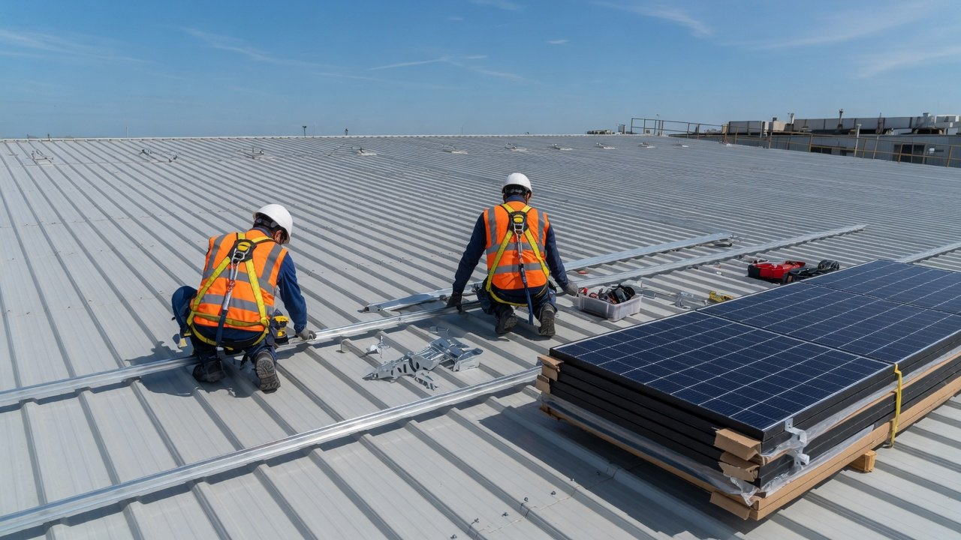
02
Summary
Numbers
Part 2 · Plan and delivery
Then the plan: what, who pays,
Plan
how it gets built
Delivery
This part answers
What the system is made of, and when storage goes in
Self-funded, energy contract or finance lease: how to choose
Decide
Safety, risks, the steps, the quote and the documents we need
Notes:
Part two is how it gets done: what to install, how to choose among three ways to fund it, how safety and risk are handled, the steps from survey to operation, how the quote is laid out, and what we need from you. The background image is AI-generated and illustrative.

Slide 11
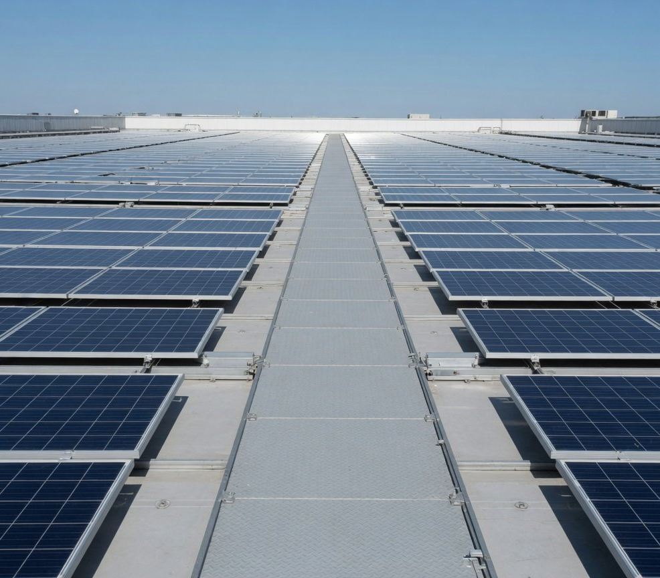
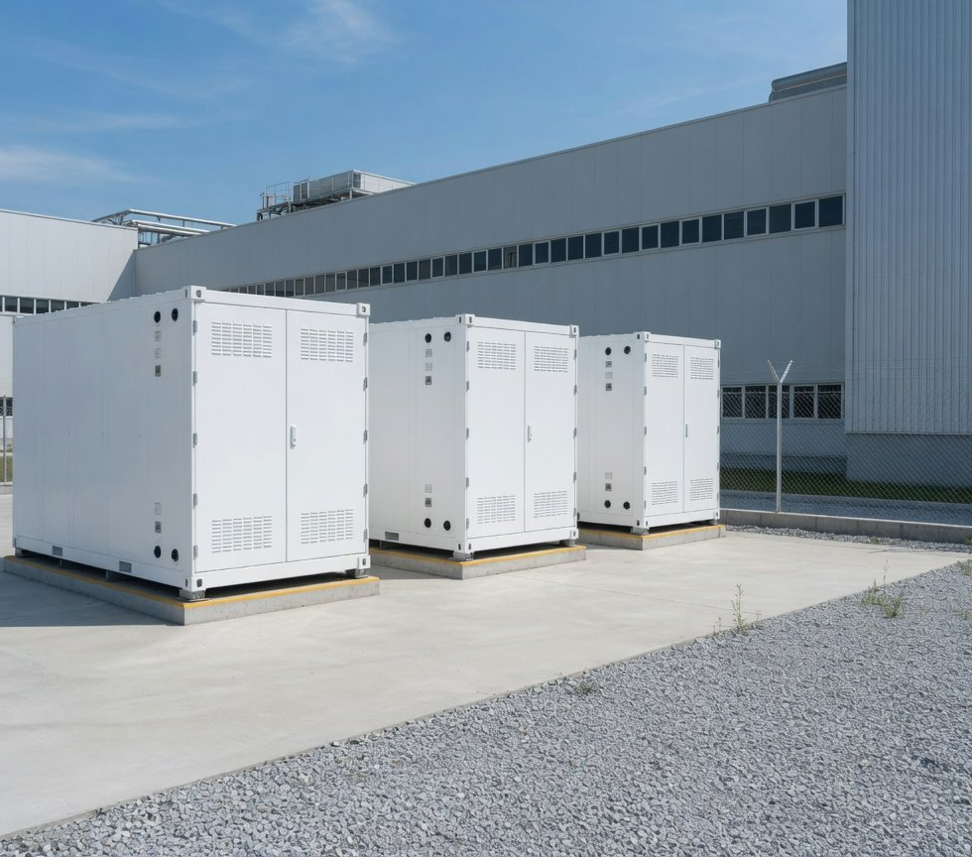
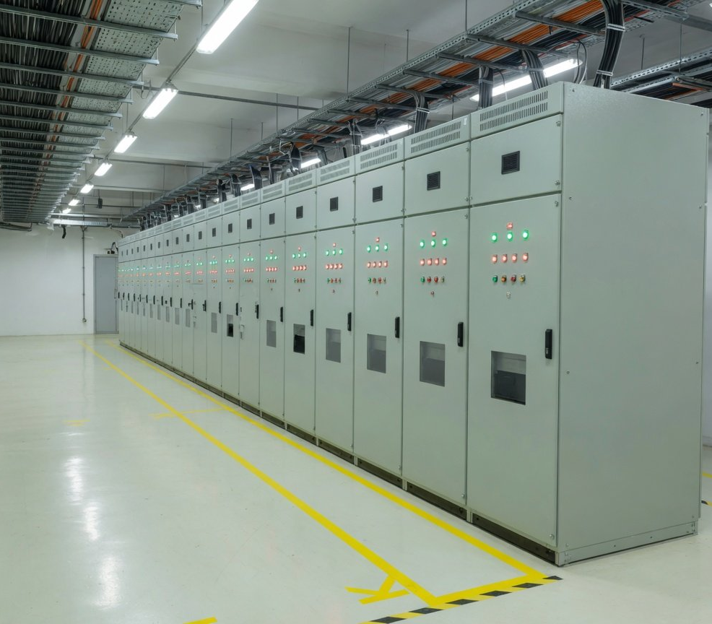
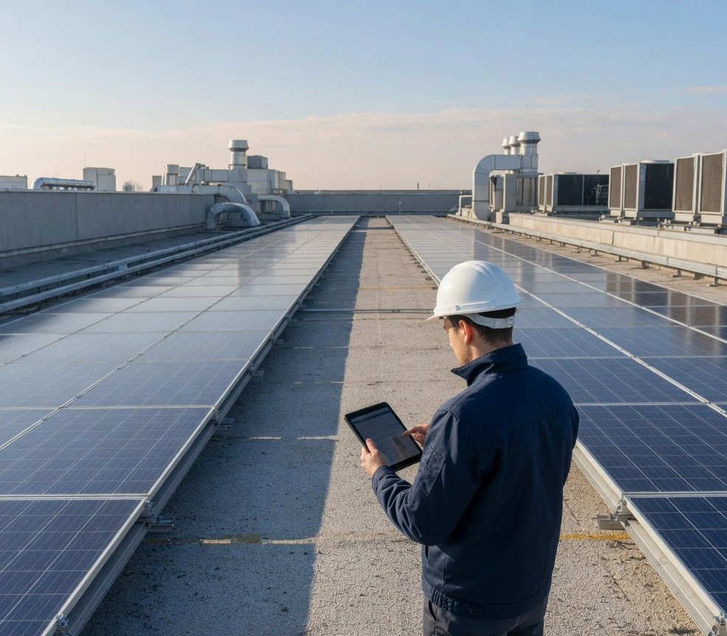
Rooftop solar and storage proposal
· For your management team
Four parts: solar first, storage only if it pays
Summary
1
2
3
4
Optional
Numbers
Plan
Rooftop solar
Storage
Grid connection
Operation
Delivery
Sized to roof loading and daytime
Modelled on your load curve, in
Built to the grid's connection
Output, self-use, export and
load, used on site first
only if it clears the bar after O&M,
opinion, no work before it
savings reconciled monthly and
fade and sharing
is issued
reported to you
Decide
Images are AI-generated and illustrative
11
Notes:
The proposal has four parts. The first is the rooftop array, sized to what the roof can carry and to your daytime load, so that most of the power is used on site and little depends on export. The second is storage, which is not included by default: we model it on your 15-minute load curve and your price contract, and propose it only if it still pays after O&M, degradation and revenue sharing. The third is the grid connection and switchgear work, built to the connection opinion the grid issues. The fourth is operation and energy reporting: output, self-use, export and savings are reconciled and reported to you every month.

Slide 12
Rooftop solar and storage proposal
· For your management team
Fund it and save RMB 440,000/MW, or pay nothing
Summary
Self-funded
Energy contract (EMC)
Finance lease
Suits: cash to spare, all the savings
Suits: keeping your cash free
Suits: owning it, paying over time
You pay RMB 0
Numbers
Jiangsu, per MW a year
Jiangsu, per MW a year
Jiangsu, per MW a year
About RMB 440,000
About RMB 129,000
RMB 440,000 less rent
Plan
All savings are yours
Billed at 73.5% of tariff, surplus to investor
Savings yours after rent
Who pays
Who pays
Who pays
You, about RMB 2.7 m per MW
The investor, not you
The lessor first, then your rent
Output and equipment risk
Output and equipment risk
Output and equipment risk
Delivery
Yours
The investor's
Yours
At the end of the term
At the end of the term
At the end of the term
Yours throughout
Handed over after 20 years (sample)
Yours under the lease
Decide
73.5% for 20 years comes from one listed company's filing, not an industry norm. The press reports Jiangsu EMC discounts narrowing from 60% to 80% of
tariff. Yours is negotiated on your own tariff and roof.
Source: Laibao Hi-Tech EMC filing (2024-10-30, company figures), Jiemian (2026-06-23). EMC: 1.08 m kWh × RMB 0.45 × 26.5% ≈ RMB 129,000
12
Notes:
Whether to put money in is a trade-off. Self-funded, you invest about RMB 2.7 million per MW, keep all the savings, about RMB 440,000 per MW a year in Jiangsu, and carry the output and equipment risk, with maintenance done by you or contracted to us. Under an energy management contract, an investor pays for the system, carries the risk and maintains it, and you pay a discount on the grid's time-of-use tariff for the power you use. The public sample is a filing by a listed Shenzhen company: a 20-year term, power billed at 73.5% of the matching grid time-of-use price, surplus to the investor and the system handed over at the end. At that discount you would save about RMB 129,000 per MW a year in Jiangsu without investing anything. It is one company's sample, not an industry standard, and the press reports that Jiangsu discounts have narrowed from 60% to 80% of tariff. A finance lease sits between the two: the lessor pays up front, you pay rent, and the savings after rent are yours. Note that lending has tightened since Document No. 136: the press reports low-voltage projects are now financed at RMB 1.6 to 1.8 per watt and high-voltage projects at no more than RMB 2.2, so part of the cost may need your own funds.

Slide 13
Rooftop solar and storage proposal
· For your management team
Plants like yours already do it: five references
Summary
None of these are our projects
Laibao Hi-Tech, Guangming, Shenzhen
About RMB 629,000 a year, forecast
Company figure
2.541 MWp solar, energy contract
Numbers
Jinruida park, Zhonglou, Changzhou
1.467 m kWh, about RMB 360,000 a year
District government
About 1.6 MW solar
Plan
Zhigu Works, Zhonglou, Changzhou
Over RMB 200,000 a year
District government
0.9 MWp solar + 1.33 MW storage
Taijing plants, Gaoyou, Yangzhou
About RMB 20 m a year
Power supplier
Delivery
40 MW solar + 80.25 MWh storage
EGing PV, four Jiangsu sites
991 to 1,098 h, 77.7% to 91.0% used on site
Audited
0.81 to 3.49 MW
Decide
References show plants like yours make it work. What you save is worked from your own bills, load curve and roof.
Source: Laibao Hi-Tech (2024-10-30), Zhonglou District, Changzhou (2025-04-11), Yangtse Evening Post (2026-07-01), EGing PV (2025-04-29)
13
Notes:
All five references come from public records. None is our project. They show what plants like yours have done and what figures they have published. Laibao Hi-Tech's plant in Guangming, Shenzhen, runs a 2.541 MWp array under a 20-year EMC, with forecast savings of about RMB 629,000 a year and forecast output of 2.956 million kWh. Changzhou's Zhonglou district reported two parks: Jinruida's first phase, about 1.6 MW, makes 1.467 million kWh a year and saves about RMB 360,000. That is about 917 hours per MW, below Jiangsu's official parameter, which is a reminder that each roof's real output has to be measured. Zhigu Works pairs solar with storage. The Taijing plants in Gaoyou, Yangzhou, are a large solar and storage microgrid with an expected 50 million kWh of green power a year, in figures given by the power supply company. The most useful line is EGing PV's four Jiangsu sites, whose data an accounting firm audited: 991 to 1,098 hours a year, with 77.7% to 91.0% of the power used on site. References only show that it can be done. What you would save still depends on your own documents.

Slide 14
Rooftop solar and storage proposal
· For your management team
Storage meets GB 44240, No. 65 and past lessons
Summary
What we build to
Lessons from public incidents
Who answers if it goes wrong
GB 44240-2024
Huangpu, Guangzhou, 14 June
Numbers
Mandatory national standard
A pack ran away under test and exploded,
Self-funded
one death.
Safety owner: you
In force since 1 August 2025. Only batteries
What we do: cabinets away from workshops
tested to it, with the test reports filed
and walkways, with gas detection
with you.
and venting.
Plan
Energy contract
Safety owner: the investor
NEA Document No. 65 (2025)
Cabinet fire, Longhua, Shenzhen
Delivery
Design, build and O&M
Preliminary cause: overcharging heated
A safety study at feasibility, safety
the battery.
Ours, by contract
responsibility named in the filing, a
completion check and a review after start.
What we do: charge limits, with trips and
alarms on heat or current.
The filing names the safety owner
Decide
Source: GB 44240-2024, NEA Document No. 65 (2025), Huangpu District incident report (published 2026-03-23), Southern Metropolis Daily (2026-06-15)
14
Notes:
Storage safety is now a hard requirement. GB 44240-2024 is a mandatory national standard for lithium cells and battery packs used in energy storage, in force since 1 August 2025. NEA Document No. 65, issued with four other agencies, requires every electrochemical storage project to study its safety conditions at the feasibility stage, name the party responsible for safety when it is filed, inspect its safety systems on completion and run a safety review after a period of operation. It makes no exception for customer-side storage. Two public incidents shape our design. The first is in an official report published by Huangpu District, Guangzhou: in June 2024, at a storage company's workshop, a lithium iron phosphate pack in a test cabinet went into thermal runaway, the gas it released built up and exploded, and one person died. That happened in testing, not in a plant's operating system, but the lesson is the same: flammable gas has to be detected and vented, and cabinets kept apart from where people work. The second, reported by Southern Metropolis Daily, is a storage cabinet fire in Longhua, Shenzhen, with overcharging named as the preliminary cause and no one hurt. Hence the charge limits and automatic trips with alarms.

Slide 15
Rooftop solar and storage proposal
· For your management team
Five risks, each with a source and a response
Summary
Risk
Public basis
Our response
Jiangsu and Zhejiang made midday off-peak, and No. 1656
Size to self-use, and rework the numbers yearly on
Tariff hours shift
leaves market customers to their contracts
current prices
Numbers
No. 136 sends exports to market, and Jiangsu's bids run RMB
Rely little on export, and model it at RMB 0.25/kWh
Export price
0.25-0.391/kWh with no win guaranteed
Plan
NEA No. 7, Articles 17-19, and a ruling that a new owner is not
A structural check, and a contract covering sale,
Roof loading, title
bound by an old EMC
demolition and compensation
Delivery
Output falls a little every year, and the figures so far do not
A degradation limit and warranty in the contract,
Degradation
deduct it
checks on delivery
NEA No. 7: when capacity runs short, applications queue
Check the county's open capacity before the survey
Decide
Grid capacity
in order
Source: NDRC Document No. 136 (2025), NEA Document No. 7 (2025), Jiangsu bidding notice, case (2022) Zhe 06 Min Zhong 4075 (Zhong Lun review)
15
Notes:
Five risks, each with its public basis and what we do about it. Storage safety has the previous page to itself. The biggest is that time-of-use hours change again: Jiangsu and Zhejiang have already moved midday to off-peak, and Document No. 1656 leaves market customers to set prices by contract. So we size the system to what you use yourself and rework the numbers every year on current prices and your contract. Second, the price for surplus power: since Document No. 136 all exported power goes to market, Jiangsu's guaranteed price for new projects is bid between RMB 0.25 and RMB 0.391 with no guarantee of winning, and the press reports five provinces have already excluded new commercial rooftop projects from it. So we rely little on export and model it at RMB 0.25. Third, the roof: Document No. 7 requires clear title and sound structure, fire safety and waterproofing, and a Zhejiang court held that a new owner of a sold plant was not bound by the previous owner's EMC, so the contract must deal with sale, demolition and compensation. Panel degradation is not deducted in the figures so far, so the contract sets a degradation limit and warranty. Last, grid capacity: when it runs short, applications queue, so we check before the survey.

Slide 16
Rooftop solar and storage proposal
· For your management team
Six steps, each closed by a document you sign
Summary
Step 1
Step 2
Step 3
Step 4
Step 5
Step 6
Numbers
Survey
Design, model
Grid opinion,
Build
Grid acceptance
Operation
Roof structure, switch
Worked from your
Structure, fire and
Runs once it
Output and savings
filing
room, connection
bills and contract
waterproofing to
passes inspection
reconciled monthly
Plan
No work starts before
point
standard
the grid opinion
You sign off
You sign off
You sign off
You sign off
You sign off
You sign off
Survey report
The model
Opinion and filing
As-built records
Inspection report
Monthly report
Delivery
No. 7, Articles 12, 17, 26
No. 7, Article 19
No. 7, Article 31
Decide
Storage adds three safety gates:
safety study · completion safety check · review after start (No. 65)
Source: NEA Document No. 7 (2025), Articles 12 to 35, NEA Document No. 65 (2025). Timing for each step is set after the survey
16
Notes:
Six steps, in the order NEA Document No. 7 sets. First the survey: roof structure, switch room and connection point, with a structural opinion. Second, the design and the numbers, worked from your bills and contract. Third, the step that matters most: apply to the grid, and start no work until its connection opinion is in hand, while the investor files the project on its AC capacity, which is you if self-funded and the investor under an EMC. Fourth, construction by a qualified contractor to the structural, fire, waterproofing, wind and lightning requirements. Fifth, grid acceptance: the grid reviews the equipment test reports and the system runs once it passes inspection. Sixth, operation, reconciled monthly. Each step ends with a document for you to sign off. If storage is included, Document No. 65 adds three safety gates. Once running, Document No. 7 allows the export mode to be changed once.

Slide 17
Rooftop solar and storage proposal
· For your management team
Itemised quote: roof and grid work priced apart
Summary
Line
Covers
Priced as
Amount (after the survey)
Solar · Priced per watt
Numbers
Solar panels
RMB/W
— — —
Modules
String inverters
RMB/W
— — —
Inverters
Racking, DC and AC cable, site work
RMB/W
— — —
Mounting, cabling, installation
Plan
Itemised · Set by site conditions
Transformer, switchgear, monitoring, metering
Per item
— — —
Primary and secondary kit
Works the grid's opinion requires
Separate line
— — —
Grid connection
Delivery
As the structural check finds
Separate line
— — —
Roof strengthening
Zero if not needed
Rent for a roof not owned, design, permits
Per year, per item
— — —
Roof rent and management
Optional
Decide
Cabinets, converters, fire systems, safety study
RMB/kWh, if it pays
— — —
Storage
Lines follow CPIA's cost breakdown for commercial rooftop solar (PV roadmap 2024-2025 edition). O&M is quoted per watt a year
17
Notes:
The quote follows CPIA's cost breakdown for commercial and industrial rooftop systems line by line: modules, string inverters, racking, cabling, installation, grid connection, roof rent, roof strengthening, primary equipment, secondary equipment and management. The array itself is priced per watt. Lines that depend on the site, such as grid connection and roof strengthening, are priced on their own so you can see where every yuan goes. Roof strengthening in particular: the survey includes a structural check, and strengthening is quoted only if it is needed, otherwise it is zero, never folded into the per-watt price. Storage is optional, priced per kWh, and quoted only if the model shows it pays. O&M is quoted separately per watt a year. Amounts are set in the quotation after the survey.

Slide 18
Rooftop solar and storage proposal
· For your management team
Six documents turn these numbers into your own
Summary
12 months of power bills
Supply contract
Finance
Your retailer
For: time-of-use energy, demand charges, real prices
For: real peak and valley prices above 10 kV, or the agency note
Numbers
15-minute load curve
Roof drawings, title
Meters
Facilities, legal
Plan
For: daytime self-use and storage cycle times
For: loading check, title, the roof agreement
Delivery
Single-line diagram
Shifts and shutdowns
Engineering
Production
For: transformer size, connection point, demand
For: weekend self-use, installation windows
Decide
With these, we work out your own numbers and survey report.
Each one you tick removes an assumption.
18
Notes:
Everything so far is worked per MW and per MWh on industry and policy parameters. These six documents turn it into your own numbers. The most important is the first: twelve months of power bills, which show your time-of-use consumption, demand charges and real prices. If you connect at 10 kV or above and buy on the market, your supply contract matters just as much, because it sets your peak and valley prices. The 15-minute load curve shows how much daytime power you can use yourself and whether storage is worth it. Roof drawings and proof of title support the structural check and the roof agreement, and the single-line diagram the choice of connection point. The shift pattern and shutdown plan tell us how much you use at weekends and on holidays, and let us schedule installation around production.

Slide 19
Rooftop solar and storage proposal
· For your management team
Three decisions, and we start the survey
Summary
01
02
03
Numbers
Approve a survey of the roof
Send bills and the supply
Pick a way to fund it
and switch room
contract first
A structural check and a look at the
So the model runs on your own prices
Self-funded, energy contract (EMC) or
connection point, then a survey report
and contract
finance lease
Plan
Agree
Discuss
Agree
Discuss
Self-fund
EMC
Lease
Delivery
Book the survey
Once your documents arrive, we work out your numbers and the survey report
Decide
Notes:
Three decisions to close. First, approve a survey of the roof, switch room and connection point, which is where everything else starts. Second, send the documents, with the power bills and supply contract first. Third, say which way you lean on funding: self-funded, an energy management contract or a finance lease. It does not need settling today, but once we know, we model it that way. When the documents arrive, we work out your own numbers and survey report on your own prices.

