Slide 1
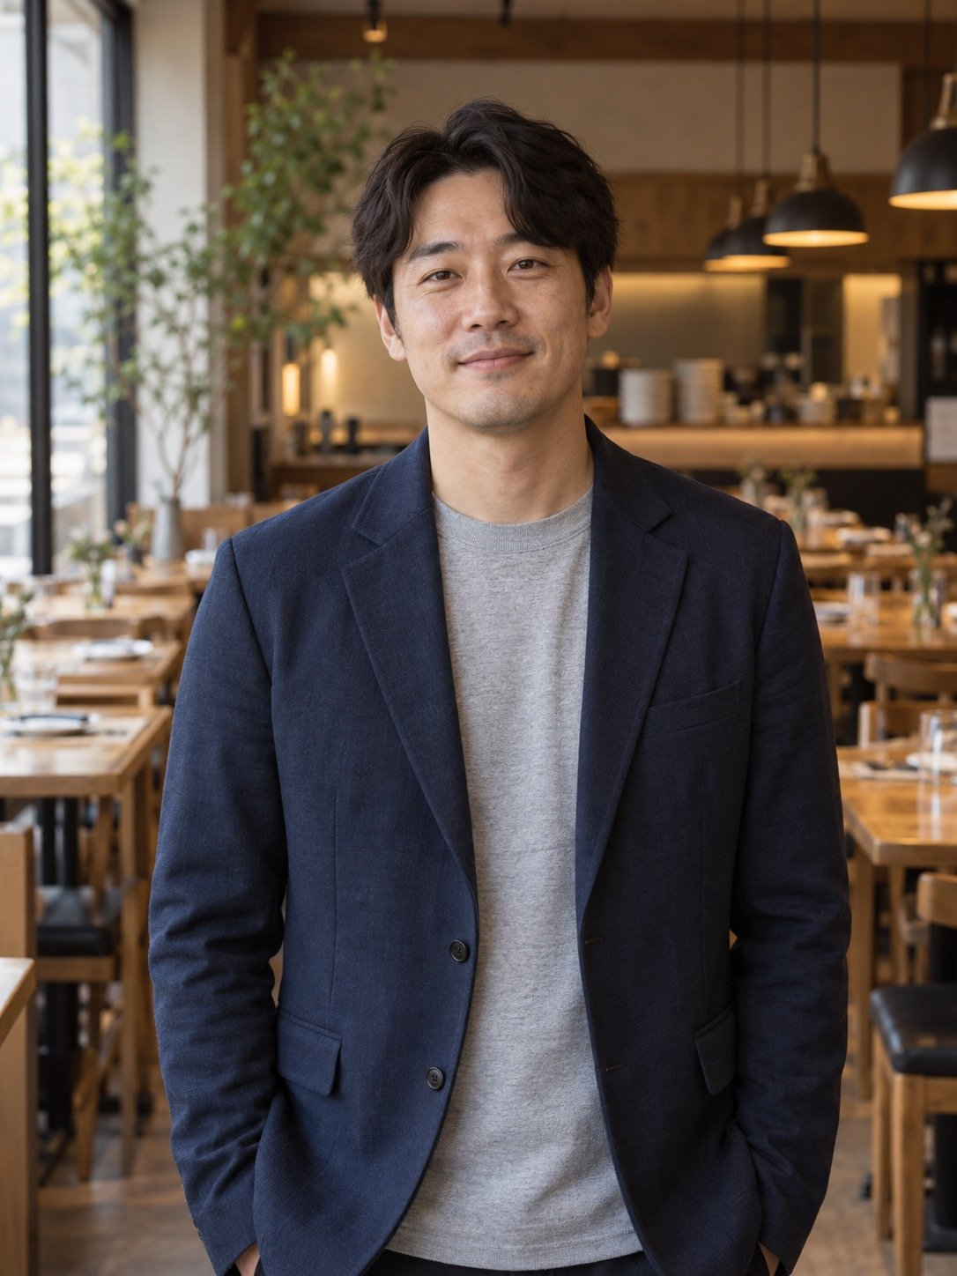
Internal application
October 2026
Chen Lixing
Making member loyalty part of
the product
Membership Ops Lead
Membership Product Manager
9
3
134k
yrs
with members
rule redesigns led
members won back
Support to
Birthdays, top-ups
Full rollout, 2025
membership ops
and win-back
Fictional example: the person and figures are invented
Notes:
Good morning. I'm Chen Lixing, I lead membership operations, and I'm applying for Membership Product Manager. In eight minutes I'll cover four things: who I am, what I've delivered, where I still fall short of this role, and exactly what I'll do in my first 90 days.

Slide 2
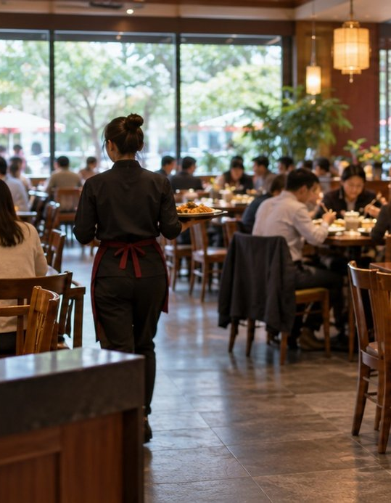
1 Who
Nine years with members,
from calls to rules
Started in support
Thousands of calls taught me which rule sits behind a complaint
Led by data
I read the member dashboard weekly and A/B test rule changes
Gets things done
Led stores, finance, IT and marketing on the top-up redesign
AI-generated illustration
2
Chen Lixing
Fictional example: the person and figures are invented
Notes:
In one line: I've spent nine years beside our members, from taking their complaints to rewriting the rules that caused them. Three things describe me. I started in customer support, and thousands of calls taught me that members rarely complain about a server. They complain about a rule nobody explained. I lead with data: I read the member dashboard every week and test a change on a small group first. And I get things done across teams. The top-up card redesign needed four departments, and I led it.

Slide 3
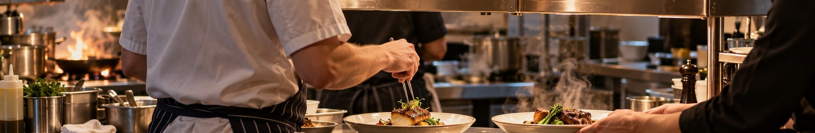
1 Who
Four roles, each with a result you can check
Jul 2017
Mar 2019
Apr 2021
Jun 2023
Now
Support agent
Support team lead
Membership specialist
Membership lead
5
380
27%
6
types
Sorted points complaints into
Points complaints 1,240 to 380
Birthday redemption 12% to 27%
Team of 6: top-ups and win-back
5 types
a month
3
Chen Lixing
Fictional example: the person and figures are invented
AI-generated illustration
Notes:
Four roles in nine years. I joined the support center in 2017 and sorted points complaints into five types for the knowledge base. As team lead in 2019 I pushed for a change to how points are credited, and points complaints fell from 1,240 to 380 a month. That taught me one fixed rule beats ten more agents. In 2021 I moved to membership operations and redesigned birthday coupons. Since 2023 I've led a team of six, and we rebuilt top-up cards and lapsed-member win-back.

Slide 4
1 Who
Five asks: I've shown three, two still to build
Skill
What the role asks
What I have done
Status
Membership
Tiers, perks and rule design
Led the birthday and top-up redesigns
Have
Data and tests
Set metrics, run experiments
A/B tested win-back before rollout
Have
Cross-team work
Align stores, IT, finance, marketing
Led 4 teams on the top-up redesign
Have
Specs with dev
Write specs, see a sprint through
Wrote 3 specs, never ran a full sprint
Build
Roadmapping
Own a six-month roadmap
Never owned a roadmap past six months
Build
4
Chen Lixing
Fictional example: the person and figures are invented
Notes:
I went through the job description line by line. The role asks for five things: membership know-how, data and experiments, cross-team delivery, writing specs and shipping with engineering, and roadmapping. For the first three I have results you can check. For the last two I'll be straight with you. I've written three specs but never followed a full development sprint. And roadmapping is my biggest gap: I've never owned a roadmap longer than six months. I'll show you how I plan to close both.

Slide 5
2 Proof
Earlier birthday coupons: redemption 12% to 27%
01
02
03
Problem
What changed
Result
27%
Sent
7 days early
On the day
Valid only on the day, when
most members were nowhere
Valid for
Redemption, before 12%, up 15 points
near a store
14 days
1 day
Redeemed a year
288k → 648k
2.4 million sent a year, 360k more tables
At RMB 186 per birthday table, 360,000 extra tables is about RMB 67 million in sales
5
Chen Lixing
Fictional example: the person and figures are invented
Notes:
My first proof point is birthday coupons. The problem was simple: the coupon only worked on the birthday itself, and on that day most people are at work or travelling, nowhere near a store. I changed two things. We now send it seven days early and it stays valid for fourteen days. Redemption went from 12% to 27%. We send about 2.4 million a year, so that's 360,000 more birthday tables a year, roughly RMB 67 million in sales at RMB 186 a table.

Slide 6

2 Proof
Three top-up tiers lifted repeat visits
to 38%
7 → 3
Top-up tiers
tiers
Led 4 teams, live in six weeks
38%
90-day repeat visits
Card members, up from 31%
186
New top-ups in 2024
RMB million
RMB 152m in 2023, up 22%
AI-generated illustration
6
Chen Lixing
Fictional example: the person and figures are invented
Notes:
Second, top-up cards. We had seven top-up tiers. Staff couldn't explain them and members couldn't do the maths, so more people held cards but they didn't come back more often. I cut seven tiers to three and added a balance reminder. That touched store scripts, finance, the till system and marketing material, so I asked each of the four teams for one person, we met weekly, and it went live in six weeks. Among our 480,000 card members, 90-day repeat visits rose from 31% to 38%, and new top-ups reached RMB 186 million in 2024, up 22% on the year before.

Slide 7
2 Proof
Dish coupons won back over twice as many members
Win-back rate by dish group
Unit: %
9.8%
11.2
Signature
10.4
Set meals
Win-back rate, full rollout
1.36m lapsed members, generic 4.1%
9.1
Breakfast
134k
8.9
Snacks
Members back in 2025
8.3
Mostly delivery
No visit in 180 days, 5 dish groups
Generic coupon 4.1%
A/B tested on 20,000 members, 10,000 per arm, before rolling out to all 1.36 million
7
Chen Lixing
Fictional example: the person and figures are invented
Notes:
Third, lapsed members. We had 1.36 million members who hadn't visited in 180 days. We used to send them all the same generic coupon, and 4.1% came back. My bet was that people don't return because nothing gives them a specific reason. So I grouped them by the dish they last ordered and sent a coupon for that dish. We tested it on 20,000 members first, then rolled it out. Across everyone, 9.8% came back, more than twice the generic rate, which is 134,000 members in 2025. Today that still takes three person-days a week of manual sends, and that's exactly why I want to turn it into a product.

Slide 8
3 Gaps
Strongest in membership, weakest in roadmapping
Membership
Skill
Me today
vs Role needs
Membership
1 above
Data
Meets
Roadmap
Data
Cross-team
Meets
Specs
1 short
Roadmap
2 short
Specs
I meet the bar on 3 today. In a year: all 5, and cross-team work a
Cross-team
notch higher.
Role needs
Me today
Me in a year
8
Chen Lixing
Fictional example: the person and figures are invented
Notes:
This is how I score myself against the role. Membership is my strongest skill, a notch above what the role needs. Data and cross-team work are right at the bar. Specs and engineering work are one notch short, and roadmapping is two notches short, my widest gap. My one-year goal is to meet the bar on all five, and push cross-team work a notch higher.

Slide 9
3 Gaps
Both gaps start now, with proof by day 90
Gap
How I close it
When, and what I hand in
Day 90
Roadmapping
The product director mentors me and reviews my
priorities every two weeks
never owned six months
draft roadmap for next half
Day 60
Specs with dev
Before I start, I shadow IT's product team from review
to release
no full sprint yet
my first complete spec
How you check: rescore me on day 90
Use today's skills table. Both gaps must reach the role's bar. The rescore goes into my probation review.
9
Chen Lixing
Fictional example: the person and figures are invented
Notes:
I'm not waiting until I start to work on these. For roadmapping, the product director has agreed to mentor me and review my priorities every two weeks, and on day 90 I'll hand in a draft roadmap for the next half-year. For specs, before I start I'll shadow IT's product team through one full sprint, from review to release, and by day 60 I'll deliver my first complete spec. How will you know it worked? On day 90, score me again on today's table, and put the result in my probation review.

Slide 10
4 Plan
First 90 days: listen, decide, ship a release
Day 90
Day 1
Day 31
Day 61
Listen
Decide
Ship
Days 1 to 30
Days 31 to 60
Days 61 to 90
Visit 20 stores, interview 50 members
Turn two problems into specs
Auto win-back live, rate 9% or more
One dashboard with agreed definitions
Auto win-back, balance reminders
Manual sends 3 to 0.5 days a week
Draft roadmap for next half
Delivers
Delivers
Delivers
Top 10 member problems
Two specs approved
Live, roadmap in
A written check-in every 30 days
What I did, where the numbers are, and what changes next
10
Chen Lixing
Fictional example: the person and figures are invented
Notes:
My first 90 days come in three parts. Days 1 to 30, I listen: I visit 20 stores, interview 50 members, and get every team onto one member dashboard with the same definitions. The output is a top-ten list of member problems. Days 31 to 60, I decide: I pick two problems and turn them into specs. Right now I'd pick automatic win-back coupons and balance reminders. Both specs have to pass review. Days 61 to 90, I ship: automatic win-back goes live, with the win-back rate holding at 9% or better and manual sends cut from three person-days a week to half a day, and I hand in a draft roadmap for the next half. At the end of each 30 days, my manager gets a written check-in.

Slide 11
4 Plan
I know why members leave and what wins
them back
“
Nine years taught me why members stop
coming. Now I want to build that into
the product.
134k
lapsed members won back last year
I know what each of them last ordered
11
Chen Lixing
Fictional example: the person and figures are invented
AI-generated illustration
Notes:
Why me? A membership product manager has to answer two questions: why do members stop coming, and what brings them back. I've been answering both on the front line for nine years, and last year a single dish coupon brought back 134,000 people. Now I want to build those answers into the product, so stores stop sending coupons by hand and every member gets their own reason to come back.

Slide 12
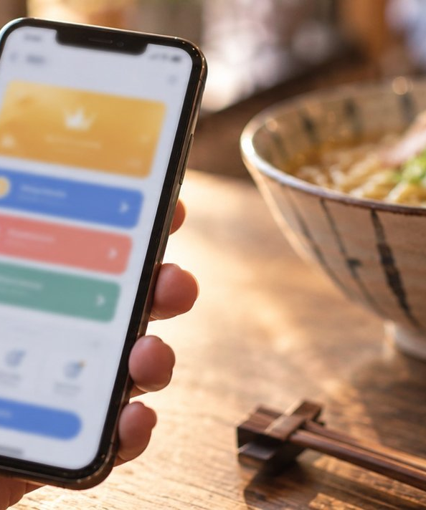
Thank you. On day 90,
I'll report the numbers
Questions welcome
Chen Lixing
Membership Ops Lead, for Membership Product Manager
12
Fictional example: the person and figures are invented AI-generated illustration
Notes:
Here's my commitment: in 90 days I'll report back to you with the win-back rate and my first roadmap. Thank you. I'm happy to take your questions.

