Slide 1
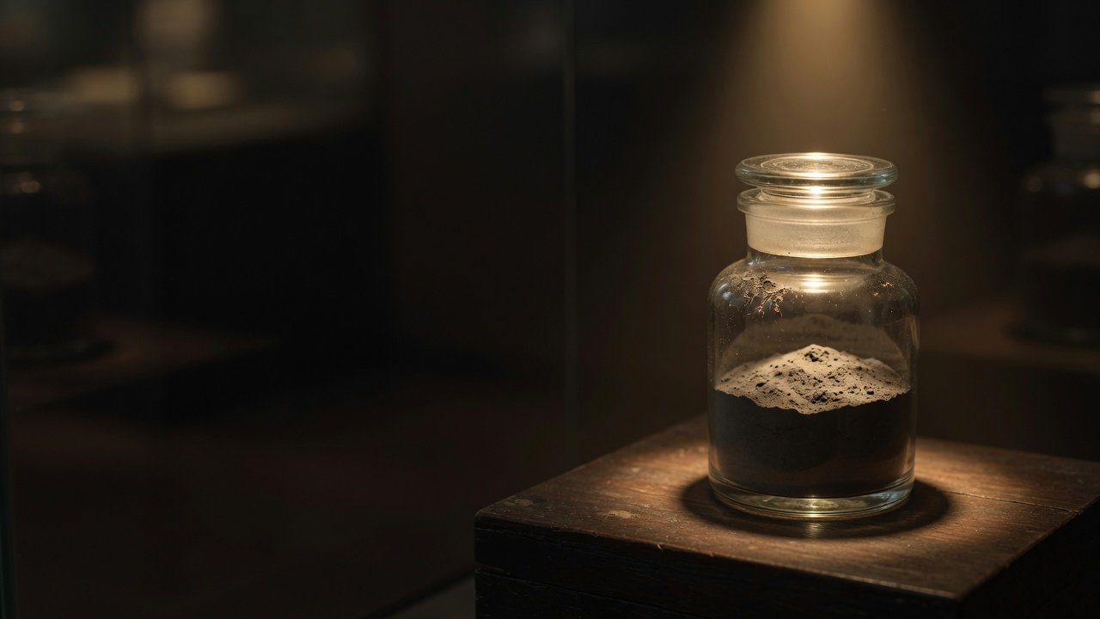
Weekend Science Talk
Soil from the Far Side
of the Moon
Chang'e-5 and Chang'e-6 lunar samples, one exhibit at a time
October 2026
Sample jar, AI-generated, not a real sample
Notes:
Welcome. Today's talk is called Soil from the Far Side of the Moon. We will treat the samples brought back by China's Chang'e-5 and Chang'e-6 missions as exhibits and look at them one at a time, asking the same question of each: what did it teach us? Every figure comes from the China National Space Administration's announcements or from peer-reviewed papers, and each page names its source. Where a press release and the paper say different things, we follow the paper. The jar on the cover is an AI-generated illustration, not a photograph of a real sample.

Slide 2
Guide
Four halls, seven exhibits
Foyer
Hall 1
Hall 2
Hall 3
Two missions,
Near-side soil
Far-side soil
Where it went, what is open
beside Apollo and Luna
1
4
7
Basalt
2.8-billion-year basalt
Moon soil in a case
2
5
Water in glass beads
The oldest fragment
3
6
Beads and new minerals
The mantle
The dotted line is the route
2
Weekend Science Talk · Soil from the Far Side of the Moon
Notes:
Here is today's route: four halls and seven exhibits. In the foyer we look at the two missions: where they collected soil, how much they brought home, and how that compares with the American Apollo and Soviet Luna samples. Hall 1 is near-side soil from Chang'e-5, with three exhibits: a basalt about 2 billion years old, the water in impact glass beads, and the beads and new minerals under the microscope. Hall 2 is far-side soil from Chang'e-6, with three more: a basalt about 2.8 billion years old, the oldest fragment, and what the basalts tell us about the mantle. Hall 3 covers where the samples went and the questions scientists still can't answer, and its one exhibit is Moon soil in a display case: what to look for the next time you see some. The dotted line is our route.

Slide 3
Foyer
Two missions, two jars: near side and far side
Chang'e-5
Chang'e-6
Northern Oceanus Procellarum, about 43°N
Apollo basin, inside the South Pole–Aitken basin
1,731 g
1,935.3 g
Near side
Far side
Launched 2020-11-24, home 12-17, 23 days
Launched 2024-05-03, home 06-25, about 53 days
Trip
Trip
Scooped about 1,480 g, drilled about 250 g (estimated)
Scooped about 1,610 g, drilled about 325 g (estimated)
Sampled
Sampled
Together, 3,666.3 g. Chang'e-6 brought back the first sample from the far side
The drilled amounts were never published: they are the total minus the scooped amount
Source: China National Space Administration sample handovers (2020-12, 2024-06), National Astronomical Observatories report (2022), National Science Review (2024)
3
Weekend Science Talk · Soil from the Far Side of the Moon
Notes:
Two missions, two jars of soil. Chang'e-5 launched on 24 November 2020 and landed on the near side, north of Mons Rümker in Oceanus Procellarum, at about 43 degrees north, farther north than any of the nine earlier Apollo and Luna landing sites. It came home to Inner Mongolia on 17 December, 23 days in all, and the first weighing at handover gave about 1,731 grams. Chang'e-6 launched on 3 May 2024 and landed on the far side, in the Apollo basin inside the South Pole–Aitken basin. It came home on 25 June, about 53 days in all, with 1,935.3 grams, the first sample ever taken from the far side. You may see 1,953.3 grams in some reports. That is a typo. Both missions scooped soil from the surface and drilled into it. Chang'e-5 scooped about 1,480 grams and Chang'e-6 about 1,610 grams, figures from a National Astronomical Observatories report and the first Chang'e-6 sample paper. The drilled amounts have never been published, so we estimate them as the total minus the scooped amount: roughly 250 and 325 grams. Chang'e-6 drilled a little over one metre before hitting what looked like a rock.

Slide 4
Foyer
Under 1% of Apollo's haul, but from the far side
Lunar samples returned
Apollo, 6 crewed landings
About 104 times
About 382 kg
Apollo's total over both Chang'e missions
First
Chang'e-5 + 6
3.67 kg
Luna, 3 missions
About 0.3 kg
Every earlier sample return was from the near side
Source: NASA lunar sample collection and NSSDC landing sites, CNSA. Square areas are drawn to scale by mass. Luna is rounded: its parts add up to 321 to 326 g, depending on whether Luna 20 counts as 50 or 55 g
4
Weekend Science Talk · Soil from the Far Side of the Moon
Notes:
Let's put this in history. The six Apollo landings brought back about 382 kilograms. The three robotic Soviet Luna missions brought back about 0.3 kilograms. Their individual figures add up to 321 or 326 grams, depending on whether Luna 20 is counted as 50 or 55 grams, because two NASA sources differ. Chang'e-5 and Chang'e-6 together brought 3,666.3 grams. So by weight, Apollo's haul is about 104 times larger, and the two Chang'e missions together are under one percent of it. Please don't say China has brought back the most Moon soil. It hasn't. The value is in where the soil came from. Chang'e-5 landed farther north than any earlier mission and brought back the youngest lunar basalt ever dated by radiometric methods. Before Chang'e-6, all ten sample-return missions had landed on the near side. Chang'e-6 was the first to bring soil home from the far side.

Slide 5
Hall 1
Hall 1
Near-side soil
Chang'e-5 · 2020 · northern Oceanus Procellarum
5
Notes:
Hall 1: near-side soil. This jar came back with Chang'e-5 in 2020 from northern Oceanus Procellarum, a young lava plain on the near side, which is why its rocks turned out to be so young. We will look at three exhibits.

Slide 6
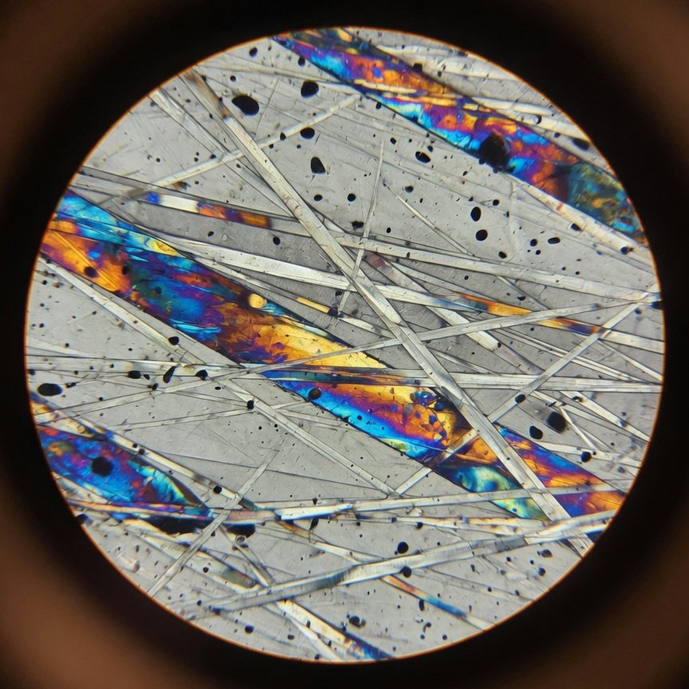
Hall 1 · Near-side soil
A 2-billion-year basalt: volcanoes ran late
Exhibit 1
Chang'e-5 basalt
About 2.0 billion years
Two papers: 2.030 and 1.963 billion years
Field then: 2 to 4 μT, weak but present
What it tells us
Lunar volcanism lasted 800 to 900 million years longer
than we knew
Source: Li et al. (Nature, 2021), Che et al. (Science, 2021), Cai et al. (Science Advances, 2025)
Basalt thin section, AI-generated, not a real sample
6
Weekend Science Talk · Soil from the Far Side of the Moon
Notes:
Our first exhibit is a fragment of basalt from Chang'e-5. Basalt is rock formed when lava cools. In 2021 two teams dated it by different methods: a Nature paper used lead-lead dating and got 2.030 billion years, give or take 4 million, and a Science paper got 1.963 billion. So, about 2 billion years. Before this, no returned sample had shown volcanic activity younger than about 2.9 billion years. In the paper's own words, this extends the duration of lunar volcanism by about 800 to 900 million years. Some press releases said it extended the Moon's geological life by a billion years. We follow the paper, and what it extends is known volcanic activity, not the Moon's life. Two more Nature papers found that the source of this magma was neither rich in heat-producing radioactive elements nor wet, so why the Moon was still erupting this late remains open. The rock also kept a magnetic record: when lava cools, its magnetic minerals lock in the field around them. Nine millimetre-sized fragments show the Moon still had a magnetic field 2 billion years ago, about 2 to 4 microtesla, weak but present. The image is an AI-generated illustration, not a photograph of this sample.

Slide 7
Hall 1 · Near-side soil
Water on the Moon? First ask which water
Outermost 100 nm of grains
1,116 to 2,516
PNAS, 2022
Hydrogen from the solar wind
Impact glass beads
0 to 1,909
Nature Geoscience, 2023
Solar wind, refilled in under 15 years
Bulk soil, several methods
28.5 to 170
Nature Communications, 2022
Upper end at least 170
Chang'e-5 mantle source
1 to 5
Nature, 2021
Carried up in magma
1
10
100
1,000
Amount, μg per g (log scale)
All of it is hydrogen and hydroxyl locked in minerals and glass, not water you could drink
Source: PNAS (2022), Nature Geoscience (2023), Nature Communications (2022), Nature (2021). The impact beads' lower end is 0, drawn at the start of the scale
7
Weekend Science Talk · Soil from the Far Side of the Moon
Notes:
Our second exhibit is the impact glass bead, and we will use it to talk about water. When a meteorite hits the Moon, molten rock splashes out and cools into tiny glass beads. A team picked 117 beads out of about one gram of Chang'e-5 soil and measured 32 of them. Their water content ranged from 0 to 1,909 micrograms per gram, up to about 2,000 at the rim and less toward the centre, which shows the water seeped in from outside. Where does it come from? Hydrogen in the solar wind is driven into the glass and combines with oxygen. The paper estimates the supply is refilled in under 15 years, so the lunar surface holds a store that the solar wind keeps topping up. But whenever someone says the Moon has water, ask which water. In the outermost 100 nanometres of soil grains, hydrogen reaches 1,116 to 2,516 micrograms per gram. Averaged over the bulk soil, different papers using different methods give 28.5 to at least 170. Deep down, the mantle source holds only 1 to 5. These differ by orders of magnitude and can't be merged into one number. And all of it is hydrogen and hydroxyl locked in minerals and glass. As CNSA itself pointed out, this is not water in the everyday sense. The headline figure of 270 billion tonnes for the glass beads is the top of an estimate that spans three orders of magnitude, so we leave it out.

Slide 8
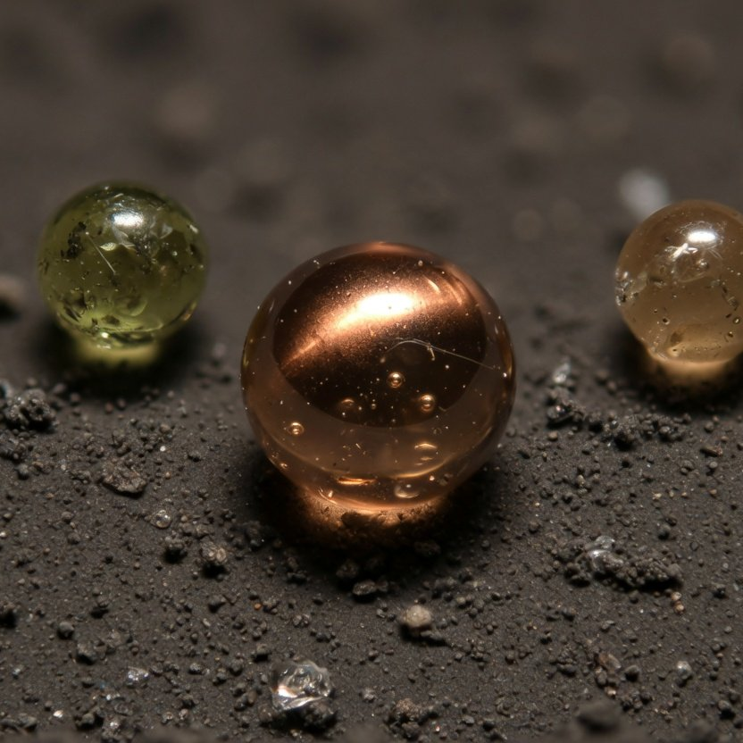
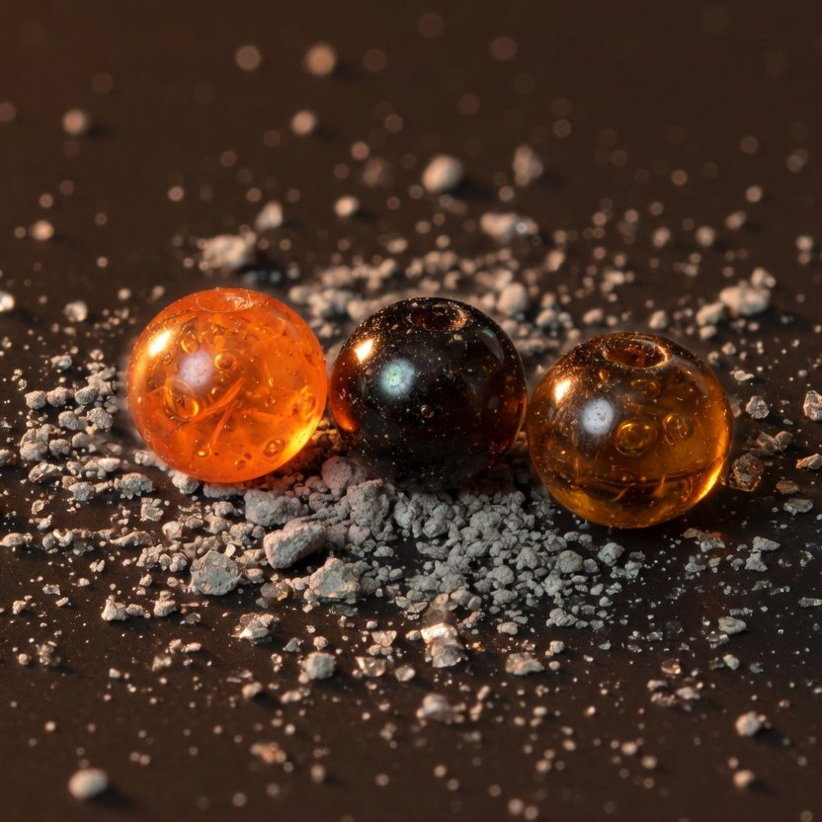
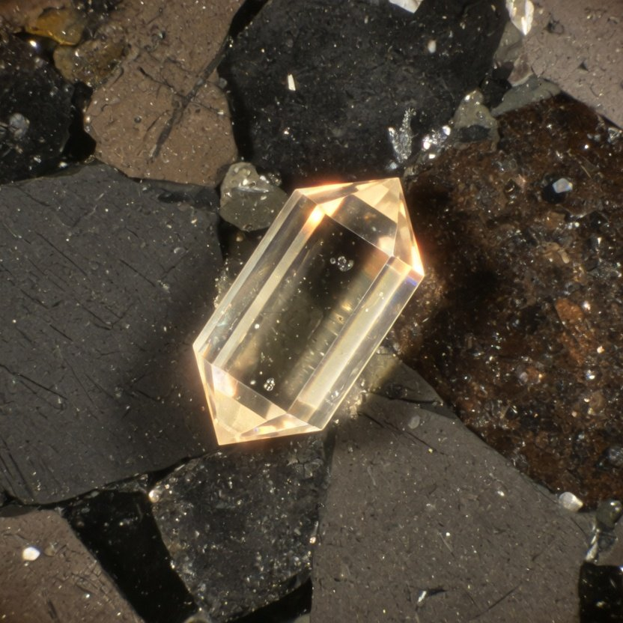
Hall 1 · Near-side soil
Under the microscope: beads and new minerals
Impact glass beads
Volcanic glass beads
Changesite-(Y)
117 from about 1 g of soil, 32 measured
3 of about 3,000 volcanic, 120 million years
One 10 μm crystal, a yttrium phosphate
Two more approved in 2026, magnesiochangesite-(Y) and changesite-(Ce): 3 new minerals from Chang'e-5
Source: Nature Geoscience (2023), Science (2024), CNSA (2022-09, 2026-09), IMA new mineral newsletters. All three micrographs are AI-generated illustrations, not real samples
8
Weekend Science Talk · Soil from the Far Side of the Moon
Notes:
Now a few small exhibits under the microscope. The first image shows impact glass beads, the kind we just talked about. The second shows volcanic glass beads. Among about 3,000 glass beads from Chang'e-5, a team used their structure, chemistry and sulfur isotopes to identify three that came from volcanic eruptions, not impacts, about 120 million years old. That suggests the Moon may have had small eruptions surprisingly late. But the evidence is three beads less than a millimetre across, not a 120-million-year-old lava plain, and it certainly doesn't mean the Moon is erupting today. The third image stands for changesite-(Y), announced in September 2022. The team separated a single crystal about 10 micrometres across, less than a tenth the width of a hair, from 140,000 grains. It is a phosphate mineral containing yttrium. The same press event also reported helium-3 measurements, but that was separate work: changesite is not a helium-3 ore. In 2026 the International Mineralogical Association approved two more, magnesiochangesite-(Y) and changesite-(Ce), so Chang'e-5 samples have yielded three new minerals. All three images are AI-generated illustrations, not sample photographs.

Slide 9
Hall 2
Hall 2
Far-side soil
Chang'e-6 · 2024 · South Pole–Aitken basin
9
Notes:
Hall 2: far-side soil. First, a common myth: the far side is not the dark side. It has day and night like the near side, and at new Moon it is fully lit. It simply always faces away from Earth, so we never see it from the ground. Chang'e-6 landed inside the South Pole–Aitken basin, the largest, deepest and oldest impact basin on the Moon, about 2,500 kilometres across. The first soft landing on the far side was Chang'e-4 in 2019. Chang'e-6 was the first mission to bring far-side soil home.

Slide 10
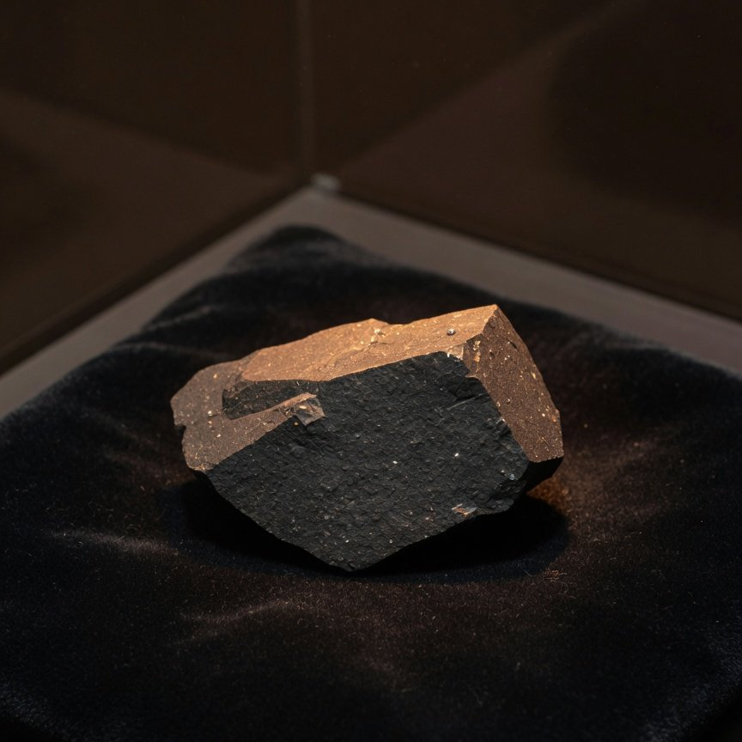
Hall 2 · Far-side soil
The far side erupted 2.8 billion years ago
Exhibit 4
Chang'e-6 main basalt
About 2.8 billion years
Papers: 2.807, 2.823 and 2.830 billion years
Field then: 5 to 21 μT, stronger than later
What it tells us
The far side erupted about 2.8 billion years ago, and the
Moon's field had weakened, then picked up again
Source: Zhang et al. (Nature, 2024), Cui et al. (Science, 2024), Che et al. (Science, 2025), Cai et al.
Basalt fragment, AI-generated, not a real sample
(Nature, 2024)
10
Weekend Science Talk · Soil from the Far Side of the Moon
Notes:
Exhibit four is a fragment of Chang'e-6 basalt. One team dated 108 basalt fragments and found a main age of 2.807 billion years. Two other teams, using different methods, got 2.830 and 2.823 billion. The methods differ and the error bars don't all overlap, so we say about 2.8 billion years and don't average the three. So the far side had volcanic eruptions around 2.8 billion years ago. There is a bonus: scientists estimate the age of lunar surfaces by counting craters, and that ruler was calibrated with near-side samples. The Chang'e-6 basalt age matches the crater-count age, which suggests the ruler works on the far side too. These basalts also kept a magnetic record. Four millimetre-sized fragments show a field of about 5 to 21 microtesla 2.8 billion years ago, with a median around 13. Earlier work showed the field dropped sharply around 3.1 billion years ago. These samples show it picked up again by 2.8 billion. Some reports said this overturned the idea of a steady decline. What the paper actually argues against is one specific scenario, in which the field stayed weak after 3 billion years until it died out. Put next to the 2 to 4 microtesla from Chang'e-5, we can only say the field was stronger at 2.8 billion years and weaker at 2 billion. Two points don't make a curve. The image is an AI-generated illustration.

Slide 11
Hall 2 · Far-side soil
Exhibit 5
4.203 billion years
One fragment: the oldest basalt brought back
This one fragment is the only evidence so far that the far side had volcanism 4.2 billion years ago
Source: Zhang et al. (Nature, 2024)
11
Weekend Science Talk · Soil from the Far Side of the Moon
Notes:
Exhibit five is a single fragment. In the same batch of Chang'e-6 samples, the team found one high-aluminium basalt fragment 4.203 billion years old, the oldest basalt among all returned samples. The paper argues it formed locally on the far side, most likely from an ancient buried mare near the landing site, rather than being thrown over from the near side. So this part of the far side had at least two episodes of volcanism, about 4.2 and about 2.8 billion years ago, some 1.4 billion years apart. Two cautions. First, the evidence for the older episode is this one fragment. Second, the samples can't tell us whether eruptions continued in between, so we can't say the far side erupted continuously for 1.4 billion years.

Slide 12
Hall 2 · Far-side soil
The far-side mantle: maybe drier, more reduced
1 to 200
Near side, overall
1 to 5
Chang'e-5
1 to 1.5
Chang'e-6 (far side)
1
10
100
Water in the mantle source, μg per g (log scale)
The copper band is Chang'e-6's range: at the bottom of the near-side range, overlapping the Chang'e-5 estimate. The paper says “potentially drier”
Oxygen fugacity ΔIW · near side
Oxygen fugacity ΔIW · far side
−0.80 ± 0.64
−1.93 ± 0.58
Apollo and Chang'e-5 basalts
Chang'e-6, 23 basalt fragments
“More reduced” means less oxygen was available when the magma formed
Source: He et al. (Nature, 2025), Zhang et al. (Nature Communications, 2025), Hu et al. (Nature, 2021)
12
Weekend Science Talk · Soil from the Far Side of the Moon
Notes:
Exhibit six: looking through the basalt at the mantle beneath it. A team sieved 578 grains from 5 grams of Chang'e-6 soil and worked out that the mantle source of this far-side basalt held 1 to 1.5 micrograms of water per gram, at the very bottom of the range estimated from near-side samples. The paper's own wording is that the far-side mantle is potentially drier. Some reports said it was markedly drier than the near side, which goes too far: Chang'e-5 put the near-side mantle source at 1 to 5 micrograms per gram, so the two overlap. Another paper studied 23 Chang'e-6 basalt fragments and measured oxygen fugacity, a gauge of how much oxygen was available when the magma formed. The far side came out at minus 1.93, lower than the minus 0.80 for Apollo and Chang'e-5 basalts, which means more reduced. Taken together, the far-side mantle may differ from the near side, but each result still rests on samples from one place.

Slide 13
Hall 3
Hall 3
Where the soil went, and what is left to ask
Where it went · What we don't know · What to look for
13
Notes:
Hall 3. The first two halls held six exhibits. Here we cover where the 3,666.3 grams went and which questions scientists still can't answer, and end with exhibit seven, Moon soil in a display case: what to look for the next time you see some in a museum.

Slide 14
Hall 3 · Where it went, what is open
2020 to 2026: two missions, a run of papers
2020-12
2022-09
2024-06
2025-04
Chang'e-5 returns
Chang'e-6 returns
Changesite
Far-side mantle
About 1,731 g
A new mineral
1,935.3 g
Nature
2021
2022
2023
2024
2025
2026
2021-10
2023-03
2024-11
2026-04
Basalt ages
Water in beads
Far-side basalts
Two more minerals
Science, Nature
Nature Geoscience
Nature, Science
3 new minerals in all
The first far-side ages came out less than five months after the samples landed
Papers by first online date, only those in this talk. Large copper dots mark the returns
14
Weekend Science Talk · Soil from the Far Side of the Moon
Notes:
Let's put the exhibits back in time. Chang'e-5 returned in December 2020. In October 2021 the 2-billion-year basalt papers appeared in Science and Nature. Changesite was announced in September 2022. The impact-bead water paper came out in March 2023. Chang'e-6 returned in June 2024, and less than five months later, in November, papers on the 2.8- and 4.2-billion-year far-side basalts appeared together. Then came the far-side magnetic field and far-side mantle water, and in July 2025 these far-side papers were presented together as cover articles in one issue of Nature. 2025 also brought the more reduced far-side mantle, an age of about 4.25 billion years for the South Pole–Aitken basin, and fragments of CI-like meteorites in far-side soil. CI chondrites are rich in water and organic matter and rare among meteorites found on Earth, and the Moon has kept pieces of them for us. In April 2026 two more minerals, magnesiochangesite-(Y) and changesite-(Ce), were announced. This chart only shows what we covered today. CCTV reported in August 2025 that the two missions had produced more than 150 results.

Slide 15
Hall 3 · Where it went, what is open
About 148 g went to research, 4% of the total
About 148 g · about 4%
The rest
Both missions, 3,666.3 g
Research loans
Gifts
Public display
Ten domestic rounds, mostly in milligrams. The
1.5 g each to Russia and France. Far-side soil
National Museum of China: 100 g since 2021.
first foreign round: 2.18 g to 7 institutions in
given to the United Nations in September 2026
Beijing Planetarium: 0.6 g on show since 2024
6 countries
Source: CNSA loan notices (2021–2026), CCTV (2025-08), National Museum of China, Beijing Planetarium. About 148 g is the official running total
15
Weekend Science Talk · Soil from the Far Side of the Moon
Notes:
Where did the 3,666.3 grams go? Think of three separate ledgers. The first is research loans. CNSA reviews applications twice a year, and by February 2026 it had made ten rounds, about 148 grams by the official running totals, roughly 4 percent of everything brought back. As one researcher put it, getting one or two grams is a lot. Most samples are handed out in milligrams. The first international round, announced in 2025, gave 2.18 grams of Chang'e-5 samples to seven institutions in six countries. The second ledger is gifts: 1.5 grams to Russia in 2022, which sent back 1.5 grams of Luna 16 soil in return, and 1.5 grams to France in 2023. In September 2026 China gave Chang'e-6 far-side soil to the United Nations, now on permanent display at its Vienna headquarters. The amount wasn't published. The third ledger is public display. The National Museum of China took in 100 grams of Chang'e-5 soil in February 2021, and the Beijing Planetarium has shown 0.6 grams since December 2024. Keep the three ledgers apart, and remember that the amount approved for a loan is not necessarily the amount already collected.

Slide 16
Hall 3 · Where it went, what is open
Five things we still don't know
Question 1
Question 2
Question 3
Why did the Moon still have magma 2
Two far-side episodes, or one long run?
How old is the South Pole–Aitken
billion years ago?
basin?
Its source was neither rich in heat-producing elements
Between 4.2 and 2.8 billion years, the samples can't say
Chang'e-6 gives about 4.25 billion years, another study
nor wet
about 4.33
Not settled
Not settled
Not settled
Question 4
Question 5
What kept the magnetic field going?
Why is the far-side mantle so depleted?
A magma ocean at the mantle's base, precession, or
Born that way, or stripped of melt by the giant impact
something else
Not settled
Not settled
Source: Nature (2021, 2024, 2025), National Science Review (2025), Nature Astronomy (2024)
16
Weekend Science Talk · Soil from the Far Side of the Moon
Notes:
What I most want to leave you with are the questions. One: the Moon is small and should have cooled early, so why was there still magma 2 billion years ago? The Chang'e-5 papers found its source was neither rich in heat-producing elements nor wet, so the question is open. Two: on the far side, were the 4.2- and 2.8-billion-year episodes two separate eruptions, or one long run? The samples can't say. Three: how old is the South Pole–Aitken basin? A Chang'e-6 norite fragment gives about 4.25 billion years. Another study using a lunar meteorite gives about 4.32 to 4.33 billion. The debate continues. Four: what kept the Moon's magnetic field going until 2 billion years ago? The papers suggest a magma ocean at the base of the mantle, precession, or other mechanisms. Five: the source of the far-side basalt is extremely depleted, meaning it lacks the elements that most readily enter a melt. Was the mantle born that way when the magma ocean crystallised, or did the giant impact strip the melt away? The paper sets out both explanations and does not choose.

Slide 17
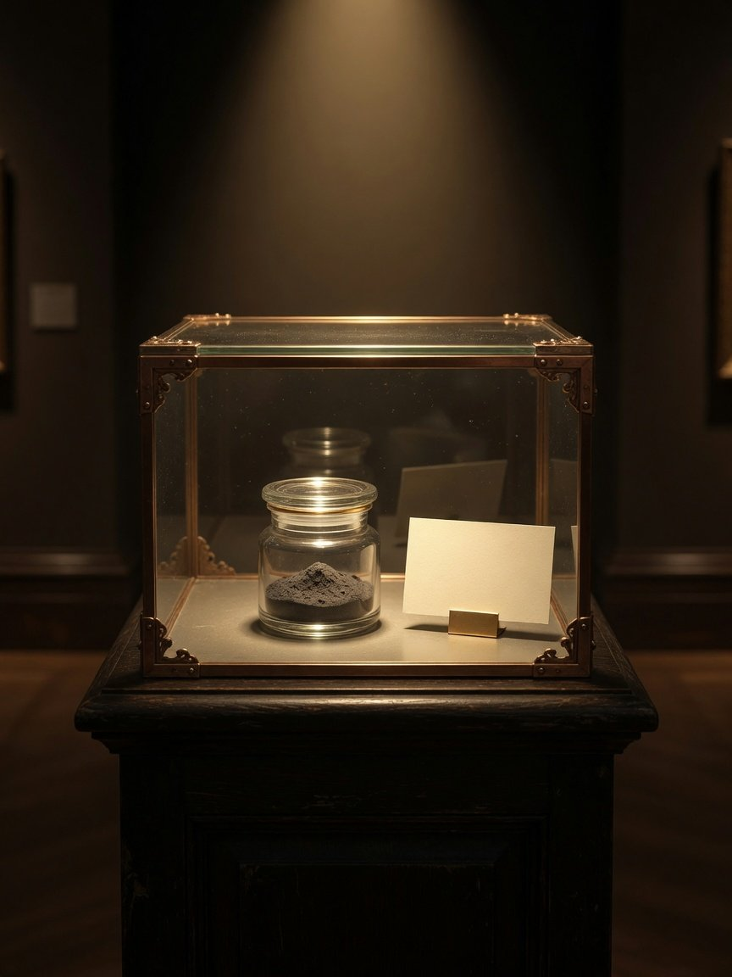
Hall 3 · Where it went, what is open
Next time, read the Moon-soil label for these
1
Origin
Which mission, near side or far side
2
Method
Scooped or drilled
3
Colour
Chang'e-6 soil is a little lighter
4
Weight
Most displays are counted in grams
5
Microscope
Most grains are under 10 μm
Based on: National Astronomical Observatories (2022), National Science Review (2022, 2024), National Museum of China and Beijing
Planetarium notices
Display case, AI-generated, label left blank
17
Weekend Science Talk · Soil from the Far Side of the Moon
Notes:
Our last exhibit, number seven, is Moon soil in a display case. Next time you see Moon soil here or in another museum, look for five things on the label. Origin: was it Chang'e-5 or Chang'e-6, near side or far side? Method: scooped soil comes from the surface. Drilled soil keeps the layers underground. Colour: Chang'e-5 soil is grey-black. Chang'e-6 soil is also mostly grey-black but a little lighter, with more feldspar and glass. Weight: displays are usually measured in grams. The Beijing Planetarium shows 0.6 grams, and the National Museum of China holds 100 grams. And if there is a microscope nearby, use it: counted grain by grain, 95 percent of Chang'e-5 grains are between 1.4 and 9.4 micrometres, far finer than a hair. Then ask yourself: what did this exhibit teach us? The image is an AI-generated illustration.

Slide 18
Weekend Science Talk
So little soil, so many questions
Thank you. Questions are welcome.
October 2026
Notes:
One last line: so little soil, so many questions. The two missions brought back 3,666.3 grams, less than one percent of Apollo's haul, but from places no one had sampled before. They answered some old questions and raised plenty of new ones. Thank you, and I'm happy to take questions.

