Slide 1

Annual Dealer Conference
After Gold's Record High,
What Do We Sell?
From head office to our dealer partners across China
October 2026
Illustration: a heritage gold bangle (AI-generated)
Notes:
Welcome, everyone, to this year's dealer conference. Today's question is a simple one: gold has hit a record, so what do we sell now? Over the past two years the gold price is what you have felt most in your stores. We will first look at what has happened outside, to the price, to customers and to the trade, then at what we do together next year, and finish with five things we would like to decide with you. Every figure today comes from official statistics, industry associations or listed companies' filings, and each page names its source. Our own operating figures stay off the screen. We will go through them region by region after the session.

Slide 2
Four things today, the last we settle together
I
Gold
03
How high it went, and how far it has fallen since
II
Customers
05
Less jewellery, more bars and coins, fixed prices and per-gram swinging
III
The trade
09
Who is closing stores, and what the tax change and purity standard bring
IV
Us
13
Product, pricing, store service and gold risk, and five things to settle together
2
Annual Dealer Conference · October 2026
Notes:
Four things today. The first three are changes outside our walls: where the gold price stands, how customers buy gold now, and who in the trade is closing stores along with the new tax and standards. The fourth is us: how we shape next year's range, how we price, how we run store services and how we manage gold-price risk. The last few items are not decisions head office has already made. We want to make them with you.

Slide 3
Gold rose 3.3× in 7 years, peak 1,256 yuan/g
Annual average, China Gold Association
1,500
Calculated from SGE Au99.99 daily quotes
Record 1,256.00 · intraday, 29 Jan 2026
3.3×
1,025.08
1,000
798.12
548.49
449.05
500
2019 average 308.70 yuan/g
390.58
388.13
373.66
308.70
Jan-Sep 2026 average 1,025.08 yuan/g
In yuan per gram. The multiple is calculated
0
2019
2020
2021
2022
2023
2024
2025
2026 Jan-Sep
Source: China Gold Association annual releases, Shanghai Gold Exchange Au99.99 daily quotes. From 2025 the average is calculated from daily quotes by the association's own method
3
Annual Dealer Conference · October 2026
Notes:
First, where the price stands. These are annual volume-weighted averages for the Shanghai Gold Exchange's Au99.99 contract, in yuan per gram. 308.70 in 2019 and 548.49 in 2024 are figures published by the China Gold Association. The association has not published a 2025 average, so the last two bars are ours, worked from the exchange's daily turnover and volume by the association's own method: 798.12 for 2025 and 1,025.08 for January to September this year. We checked that method against four averages the association did publish, including the whole of 2024 and the first half of 2025, and it matches. The average so far this year is 3.3 times 2019's. The record came on 29 January: 1,256 intraday, with a close of 1,243.02.

Slide 4
27% off the high, still 14% above 2025's average
Record close · 29 Jan 2026
1,243.02
−27%
907.32
30 Sep close 907.32 yuan/g, 27% below the record close
Close · 30 Sep 2026
Still 14% above the 2025 average of 798.12 yuan/g (calculated from
2025 full-year average 798.12
Au99.99 close
daily quotes)
Source: Shanghai Gold Exchange Au99.99 daily quotes. In yuan per gram. The fall and the 2025 average are calculated from daily quotes
4
Annual Dealer Conference · October 2026
Notes:
How far has it fallen? 30 September was the last trading day before the National Day holiday. Gold closed at 907.32 yuan a gram, 27% below the record close of 1,243.02 on 29 January. London tells the same story: the LBMA afternoon price peaked at 5,405 US dollars an ounce in January and stood at 4,156.40 on 6 October, 23.1% lower. But look at the other side too. 907 yuan is still 14% above the 2025 average of 798, a figure we calculated from the exchange's daily quotes. Gold is not going back to where it was, and it will not rise forever either. For us, volatility is the new normal, and stocking, pricing and inventory all have to start from that.

Slide 5
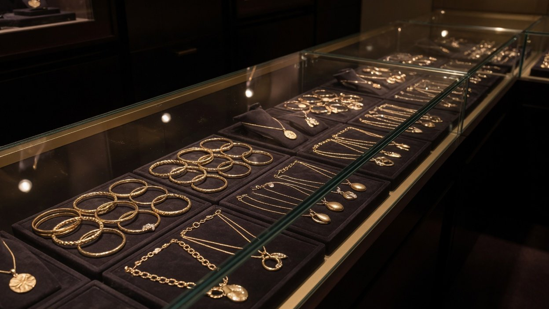
Annual Dealer Conference
I
Chapter One
Our customers have
changed
Less jewellery, more bars and coins, fixed prices swinging back
Illustration (AI-generated)
Notes:
Part one: our customers have changed. They still buy gold at these prices, but what they buy and how they buy it is different. The background photo is an AI-generated illustration.

Slide 6
Chapter One · Our customers have changed
Bars and coins overtook jewellery, now 2.6× it
2.6×
2025
504.2 t
Bars and coins
363.8 t
Gold jewellery
H1 2026
In H1 2026 bars and coins took 2.6 times the gold
339.3 t
jewellery did
Bars and coins
132.1 t
In 2025 bars and coins passed jewellery for the first time
Gold jewellery
Source: China Gold Association market data for 2025 and H1 2026. China Gold Association basis. The multiple is calculated
6
Annual Dealer Conference · October 2026
Notes:
This is the most important change of the day. In the China Gold Association's figures, bars and coins used 504.2 tonnes of gold in 2025, up 35%, while jewellery used 363.8 tonnes, down 31.6%. It was the first time bars and coins came out ahead. The gap widened in the first half of this year: jewellery fell by another third to 132.1 tonnes, while bars and coins reached 339.3 tonnes, 2.6 times as much. The World Gold Council counts differently and its numbers are not the same, but it reaches the same conclusion: 2025 was the first year bars and coins overtook jewellery. Customers have not left gold. They have moved money from jewellery into bars and coins. In the association's own words, demand for bars at gold shops is strong but the margin is thin. So we can sell bars, but bars will not carry a store's margin.

Slide 7
Chapter One · Our customers have changed
A quarter less gold in jewellery, 8% more spent
Gold used
Money spent
2025
2025
360.1 t
281.4 bn yuan
Down 25%
Up 8%
H1 2026
H1 2026
136 t
141.9 bn yuan
Down 30%
Up 2%
World Gold Council basis. Spending is tonnes times the average Au9999 price, an estimate without labour charges, brand premiums or tax, not what tills took in. Not
added to or set against the China Gold Association's tonnes
Source: World Gold Council, China gold market reviews for 2025 and H1 2026
7
Annual Dealer Conference · October 2026
Notes:
Jewellery used a quarter less gold, yet customers spent 8% more. In World Gold Council figures, mainland China's jewellery took 360.1 tonnes of gold in 2025, a quarter less, while spending reached 281.4 billion yuan, 8% more and close to the 2023 record of 281.8 billion. In the first half of this year jewellery took 136 tonnes, 30% less, and spending was 141.9 billion yuan, still up 2%. A word on the basis: the council estimates spending by multiplying tonnes by the gold price, so it leaves out labour charges, brand premiums and tax and is not the same as what our tills take in. The China Gold Association counts 363.8 tonnes of jewellery for 2025. That is a separate set of statistics, and we do not add the two together or divide one by the other. The point is simple. Customers still want to spend. Each piece is just lighter.

Slide 8
Chapter One · Our customers have changed
Fixed prices climbed, then per-gram came back
While gold rose
After gold fell
FY2025 ○ → ● FY2026
Apr-Jun 2025 ○ → ● Apr-Jun 2026
35.4%
29%
30.6%
34%
Chow Tai Fook
Per-gram retail value up 21.0%
Fixed-price share of mainland retail value
18%
24%
Luk Fook
Per-gram same-store volume up
13%, back from a fall
Fixed-price share of group retail value
Chow Sang Sang
Fixed price down 20%, per gram
up 34%
Mainland same-store, H1 2026
Each company reports its own period and base, so read each one's direction and do not rank them
Source: Chow Tai Fook FY2026 results and quarterly update, Luk Fook quarterly retail update, Chow Sang Sang 2026 interim results. Company figures
8
Annual Dealer Conference · October 2026
Notes:
Fixed pricing, where a piece carries one price rather than a price per gram, has been the talk of the trade. The leading brands did push it up. At Chow Tai Fook, whose FY2026 ran from April 2025 to March this year, fixed-price jewellery reached 35.4% of mainland retail value, up from 30.6%. Luk Fook's fixed-price sales rose by half in the same year. But once gold fell back in the second quarter, all three swung the same way. Chow Tai Fook's fixed-price share fell to 29.0% in April to June, while retail value of gold priced by weight rose 21%. Luk Fook's fixed-price share dropped from 24% a year earlier to 18%, and same-store volume of gold sold by weight turned from a fall to a rise. At Chow Sang Sang, mainland same-store sales of fixed-price products fell 20% in the first half while weight-priced products rose 34%. Each company uses a different base, so we read the direction and do not rank them. There is no official national figure for fixed-price share, and we will not give you one. The conclusion: fixed pricing is one leg to stand on, not a one-way street.

Slide 9

Annual Dealer Conference
II
Chapter Two
The trade has changed
Peers are closing stores, and tax and standards are changing
Illustration (AI-generated)
Notes:
Part two: the trade has changed. As customers changed, the trade has been adjusting: stores are shrinking, the tax has changed and the standards are being rewritten. The background photo is an AI-generated illustration.

Slide 10
Chapter Two · The trade has changed
Most peers close stores, Laopu and CHJ open more
← Net closures
Net openings →
Chow Tai Fook
7,170 → 5,047
−2,123
mainland POS · Mar 2024 to Jun 2026
China Gold
4,236 → 3,311
−925
stores · 2025
Lao Feng Xiang
5,838 → 4,916
−922
outlets · end 2024 to Jun 2026
Luk Fook
3,179 → 2,880
−299
mainland · Mar 2025 to Mar 2026
Chow Sang Sang
842 → 677
−165
mainland · end 2024 to Jun 2026
Laopu Gold
36 → 45
+9
own stores · end 2024 to Jun 2026
CHJ
1,511 → 1,682
+171
jewellery stores · end 2024 to Jun 2026
Source: company annual, interim and quarterly reports. Company figures with different periods and store definitions, so read direction, not size
10
Annual Dealer Conference · October 2026
Notes:
Who is closing stores and who is opening them. Every figure here is what the listed companies themselves report. Fiscal years and store definitions differ, so each row carries its own period, and we read the direction rather than rank them. Chow Tai Fook's mainland points of sale went from 7,170 at the end of March 2024 to 5,047 at the end of June this year, a net 2,123 fewer in just over two years. Lao Feng Xiang, China Gold, Luk Fook and Chow Sang Sang are all shrinking too. The two adding stores are CHJ and Laopu Gold, which runs 45 stores of its own. What kind of stores are closing? Of the 1,073 Chow Tai Fook closed in FY2026, 524 were in third-tier cities and below, and franchised stores fell by a net 949. Lao Feng Xiang closed 342 franchised stores in third and fourth-tier cities in the first half while opening 71 in first and second-tier cities. China Gold's annual report also cites industry association data: the 11 jewellery companies listed in Shanghai and Shenzhen had a net 1,704 fewer stores than at the end of 2024, down 7.19%. Lao Feng Xiang's and China Gold's starting counts are worked out from their year-end counts and net closures. The trade is shrinking, and what it is shedding is stores that did not pay their way.

Slide 11
Chapter Two · The trade has changed
VAT credit per 100 yuan: about 11.50 to 6.00
Gold drawn for jewellery, not investment
Until 31 Oct 2025
From 1 Nov 2025
Caishui [2002] No. 142
MOF and STA Announcement 2025 No. 11
Special VAT invoice
Ordinary invoice
Invoice received
13% backed out of price
Invoice amount × 6%
Input VAT counted as
About 11.50 yuan
6.00 yuan
Credit per 100
yuan of gold
About 5.50 yuan less
Source: Ministry of Finance and State Taxation Administration, both documents in full. Credit calculated by the announcement's formulas: 100 × 13 ÷ 113, 100 × 6%
11
Annual Dealer Conference · October 2026
Notes:
The third change is tax. Announcement No. 11 of 2025 from the Ministry of Finance and the State Taxation Administration took effect on 1 November last year and runs to the end of 2027. What matters most to us is gold drawn from the exchange to make jewellery. Before, that gold came with a special VAT invoice and the 13% rate was backed out of the price, so every 100 yuan of gold carried about 11.50 yuan of input VAT credit. Now jewellery counts as non-investment use, the exchange issues only an ordinary invoice, and the credit is the invoice amount times a 6% deduction rate: 6 yuan per 100. The 5.50 or so that is lost is an extra cost in what we pay for gold. We worked that figure out from the formulas in the two texts. Whether and how much of it reaches retail prices, the announcement does not say, so please do not describe it as a uniform 5.5% rise in jewellery prices. The World Gold Council saw in Shenzhen's Shuibei market that store jewellery prices rose from 3 November, and that gold bars from non-member channels, such as independent gold shops and brand franchise stores, went up by about 13%. Most of us in this room are in that channel, so the cost of buying in bars needs working out again.

Slide 12
Chapter Two · The trade has changed
Purity rules date from 2012, new ones pending
2013-05
2024-01
2025-05
GB 11887-2012 in force
Review: revise it
Hard-gold standard
Mandatory, still current
QB/T 5793-2024
2022-07
2024-10
2026-10
Price-marking rules
Revision planned
Still in approval
No charges beyond the tag
Name adds labelling
Not yet published
What to do now
Tags and receipts follow the current rules and show purity, weight, pricing method and labour charge. Once the new
version is out, head office issues one set of changes to tags and hallmarks
Source: National Public Service Platform for Standards Information (checked 7 Oct 2026), SAMR Order No. 56, industry standards information platform
12
Annual Dealer Conference · October 2026
Notes:
Purity standards. Stores still work to GB 11887-2012, the mandatory national standard on precious metal purity and naming for jewellery, in force since May 2013. A review in January 2024 concluded it should be revised, and a revision plan followed that October. The new title adds labelling to purity and naming, and several leading brands are among the drafters. As of 7 October the national standards platform lists it as awaiting approval. It has not been published, so neither its final text nor its start date is known. Two current rules also bear on tags. The price-marking rules in force since July 2022 forbid charging anything beyond the marked price or any fee that is not shown. And at last year's consumer rights day, the market regulator reminded shoppers to ask whether a piece is priced by weight or at a fixed price. Hard gold has its own industry standard, in force since May last year. Our approach: write tags in full under today's rules now, and when the new standard is out, head office issues one set of changes for tags and hallmarks, so stores do not each go their own way.

Slide 13

Annual Dealer Conference
III
Chapter Three
What we do together
Product, pricing, store service and gold risk
Illustration (AI-generated)
Notes:
Part three, and the one we most want to discuss with you: what we do together next year. The background photo is an AI-generated illustration.

Slide 14
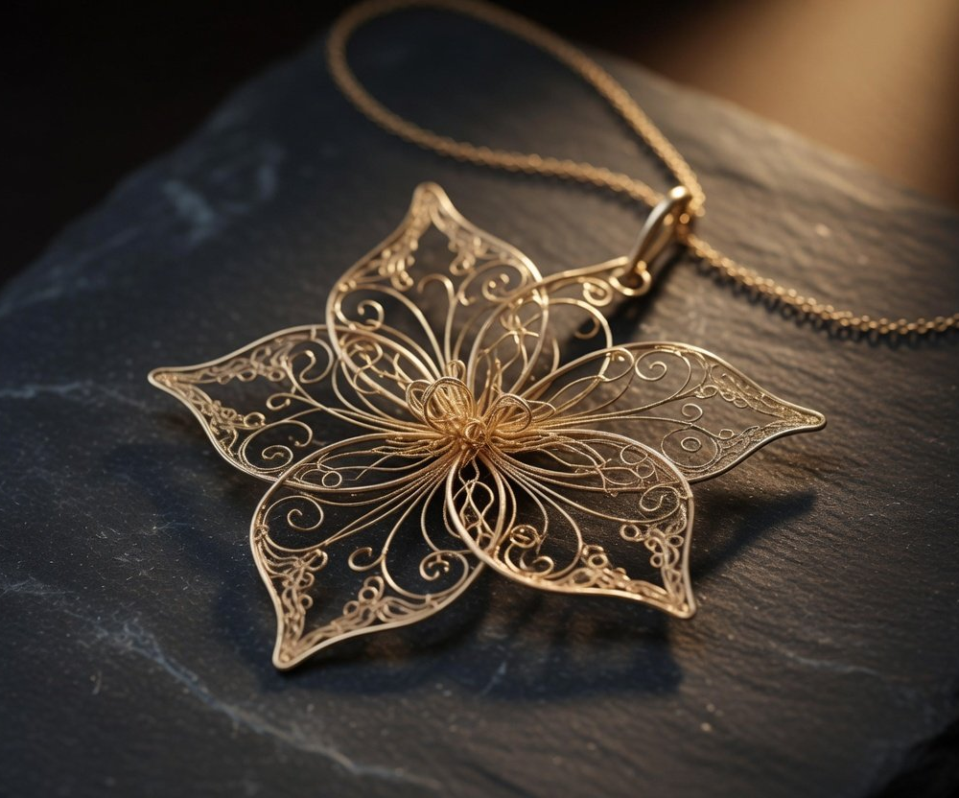
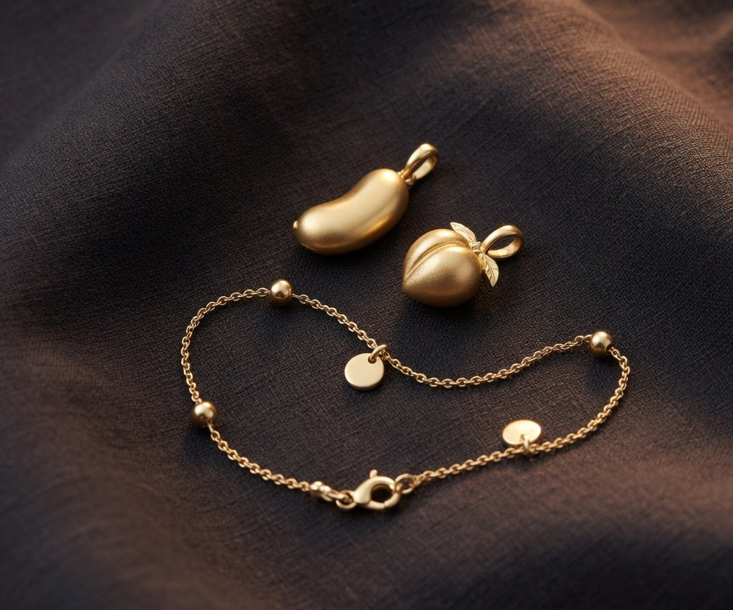
Chapter Three · What we do together
New lines go three ways: heritage, design, light
Heritage
Design
Light
Heavy, hand-made, a core profit
Under 10 g, 45% of units sold
Light, distinctive, higher value
Source: World Gold Council China gold jewellery retail insights 2025 (576 store managers), China Gold Association H1 2025 release. AI-generated illustrations
14
Annual Dealer Conference · October 2026
Notes:
Product. Next year we want new lines to go three ways. First, heritage gold, the hand-hammered gufa style. In a World Gold Council survey of 576 store managers, heritage and hard gold are still retailers' core source of profit, and heavy hand-made heritage pieces sell steadily in boutiques. Second, design pieces. In the China Gold Association's words from the first half of last year, light, design-led, higher value-added jewellery is still in favour. Third, light pieces. In the same survey, pieces under 10 grams made up 45% of units sold in stores, against 37% in 2023. One more figure worth keeping in mind: jewellery bought to wear oneself was 37% of store sales, up from 27% in 2024, while wedding jewellery fell from 24% to 19%. How much of each goes into the range is not for head office to impose. We will decide it with you, region by region. The pictures on this page are illustrations.

Slide 15
Chapter Three · What we do together
Fixed price for craft, by weight for plain gold
Fixed price · per piece
By weight
Which pieces
Design, small heritage, complex work
Plain gold, heavy pieces, bars, coins
When gold rises
Price holds, its share rises
Price follows, buyers go lighter
When gold falls
Looks dear, review and reprice
Price follows, recovers first
Margin from
Design and craft in the price
Labour charge, gold at cost
Rules for both: tags show pricing method, weight, purity and labour charge, and nothing is charged beyond the tag
Basis: disclosures on page 8, Laopu Gold prospectus (priced at launch, not moved by small swings in gold), SAMR Order No. 56
15
Annual Dealer Conference · October 2026
Notes:
On pricing, we propose standing on two legs. Fixed prices go on design pieces, small heritage pieces and complex work. Customers are buying design and craft, and the price does not move with the daily gold price. When gold rises those pieces look like good value and their share goes up. When gold falls they look dear and their share drops back, which is what our three listed peers saw this spring. So a fixed price cannot be set and forgotten. It needs reviewing on a schedule and changing when it should. Laopu Gold prices every piece at launch, and even it repriced three times in 2025. Pricing by weight goes on plain gold, heavy pure gold and bars and coins, where customers look at weight and today's price and can check the sum. When gold falls, that leg recovers first. Whichever leg, tags must be complete under the price-marking rules, with nothing added beyond the tag. Which pieces go on which leg is one of the things we will decide together.

Slide 16
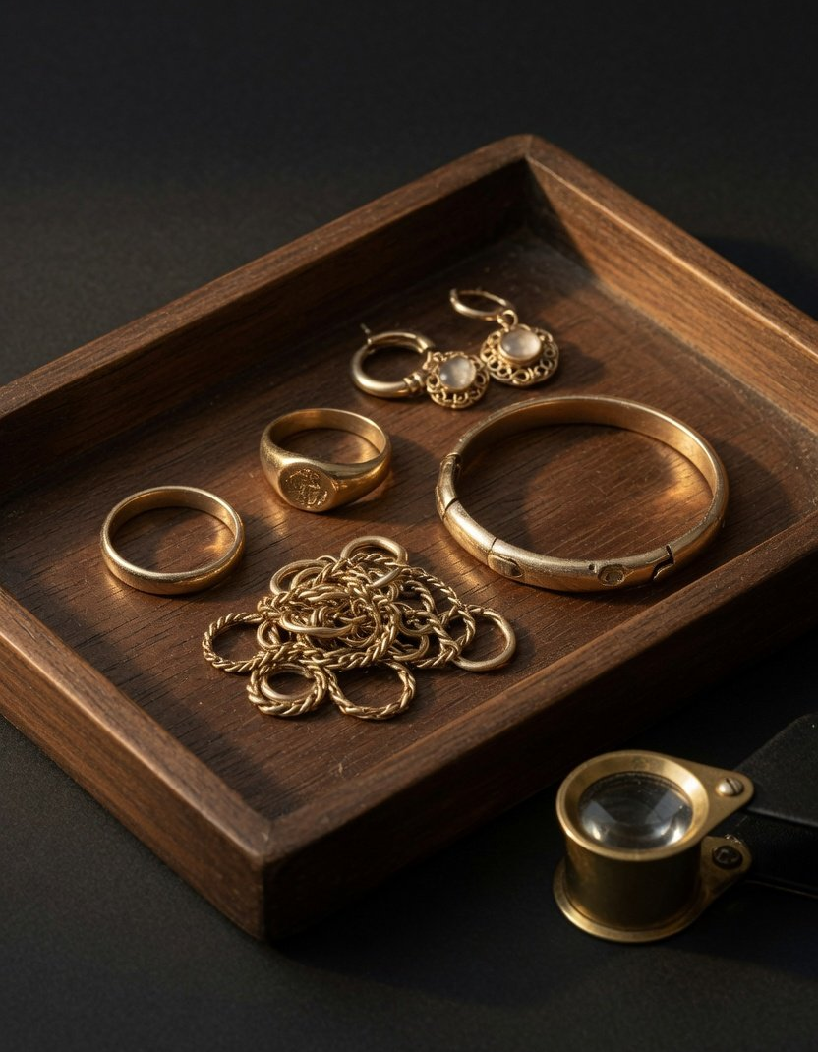
Chapter Three · What we do together
Trade-ins to standard,
gold risk logged first
Trade-ins
About a fifth of jewellery demand. Follow the industry standard, and receipts
state loss and discount
Buybacks
Since the tax change, prices include VAT and buybacks do not. Work the
quote out in front of the customer
Gold risk
Log each store's gold by weight and its price exposure first, then talk
about hedging
Source: China Gold Association (13 Dec 2025, a fifth is an incomplete count), World Gold Council VAT explainer (7
Nov 2025). AI-generated illustration
16
Annual Dealer Conference · October 2026
Notes:
Store services. Trade-ins first. By the China Gold Association's incomplete count, trade-ins are about a fifth of national jewellery demand. Last December the association led an industry standard for gold trade-in services: testing on camera with the customer present, consent before any destructive test, and a receipt that states gold content, weight, loss and discount. We propose every store works to it. Then buybacks. Since the tax change, jewellery sale prices include VAT and buyback prices do not, so the gap has widened and customers can feel short-changed. Work out every buyback quote in front of the customer. Last, gold-price risk. Our listed peers all hedge: Chow Tai Fook's hedge ratio by weight was 39.0% at the end of FY2026, and Chow Sang Sang hedges about 40% of its gold inventory, while Laopu Gold's prospectus says it uses no hedging instruments. When gold rises, a hedge shows a book loss first: Chow Tai Fook booked fair-value losses on gold loans of over 12 billion Hong Kong dollars across two years, so hedging is not as simple as buying insurance. We propose a first step: record each store's gold weight and price exposure, then talk about how to hedge. These are company figures. The picture is an illustration.

Slide 17
Chapter Three · What we do together
Five things we would like to settle with you
New-line mix
How much heritage, design and light pieces in next year's lines, by region
Pricing rules
Which pieces are fixed-price, how often to review, and what move in gold triggers a change
Reply · RSVP
Trade-ins
One standard in every store, and who supplies the testing kit and receipt forms
Gold risk
An exposure ledger in every store, and leasing and hedging for dealers who opt in
Tax and sourcing
Check each withdrawal's use and invoice, and which channel bars come through
17
Annual Dealer Conference · October 2026
Notes:
Finally, five things we would like to decide with you. We will discuss them in groups after this session and settle them next month. One, the new-line mix: how much heritage gold, design pieces and light pieces, set region by region because customers differ. Two, pricing rules: which pieces carry a fixed price and which are sold by weight, how often fixed prices are reviewed, and how big a gold move triggers a change. Three, trade-ins: whether every store works to the industry standard, and who provides testing equipment and receipt templates. Four, gold-price risk: every store keeps a ledger of its gold exposure, and we ask whether head office should arrange bank gold leasing and hedging for dealers who choose to join. Five, tax and sourcing: check what each withdrawal of gold is for and the invoice that goes with it. The World Gold Council found that after the tax change gold bars from non-member channels, such as independent gold shops and brand franchise stores, rose by about 13%, while member channels such as banks and brands' own stores were not affected. So which channel our bars come through is worth working out together. None of these has a ready answer. They all need your experience.

Slide 18
Annual Dealer Conference
Gold sets the price.
The rest we set together.
With thanks, head office
October 2026
Notes:
We cannot set the price of gold. It will rise and it will fall. But what we sell, how we sell it, and how we make every store a good one, those we can decide together. Thank you for all these years together. Let's move to the group discussions.

