Slide 1
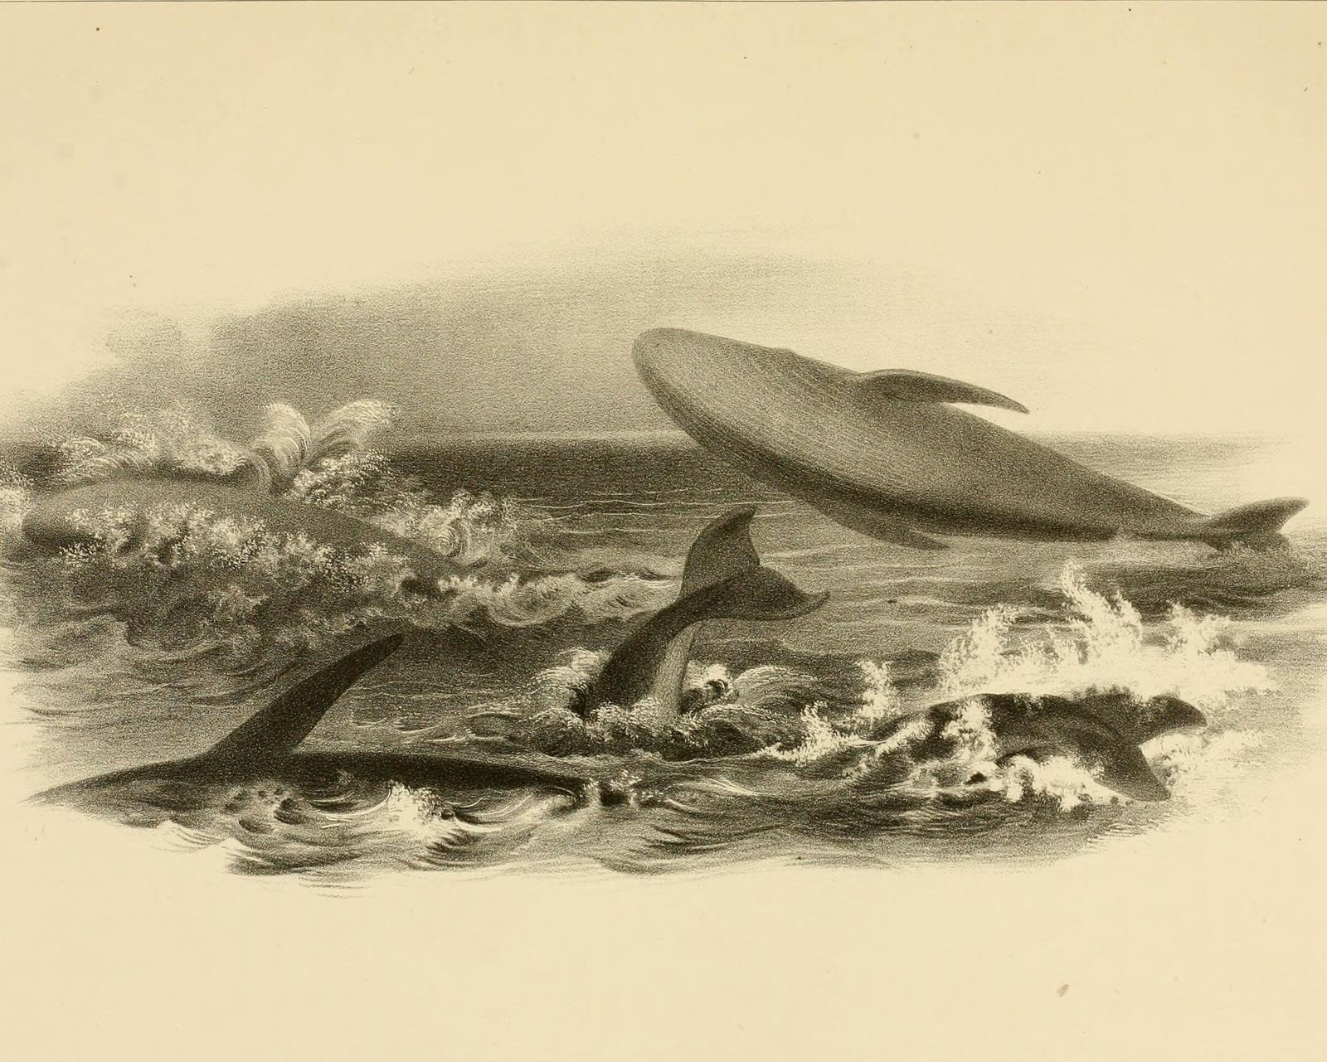
Whales: the mammals that
went back to sea
Notes:
Cover plate: C. M. Scammon, The Marine Mammals of the North-western Coast of North America (1874), Plate VIII, humpbacks lobtailing, breaching and finning. Public domain.

Slide 2
Whales look like fish, but they are mammals
Look at
Whale
Fish
Breathing
Lungs: surfaces to breathe through a blowhole
Gills: takes oxygen straight from the water
Birth
Live young, raised on milk
Most lay eggs
Tail
Flukes lie flat and beat up and down
Tail fin stands upright and sweeps side to side
Big from day one
A humpback carries her calf for about 11 months. It is born 4 to 5
metres long and stays close to her for up to a year before weaning.
Sources: NOAA Fisheries, Humpback Whale; Whale and Dolphin Conservation
Notes:
Whales and dolphins are cetaceans, mammals that breathe with lungs, give birth to live young and nurse them. Their flukes are horizontal and move up and down, while a fish's tail fin is vertical and moves side to side. Humpback gestation about 11 months; calves 13 to 16 ft (about 4 to 4.9 m) at birth; stay near their mothers for up to 1 year before weaning. Sources: NOAA Fisheries, Humpback Whale (fisheries.noaa.gov/species/humpback-whale); Whale and Dolphin Conservation, Why do whale and dolphin tails go up and down (whales.org).

Slide 3
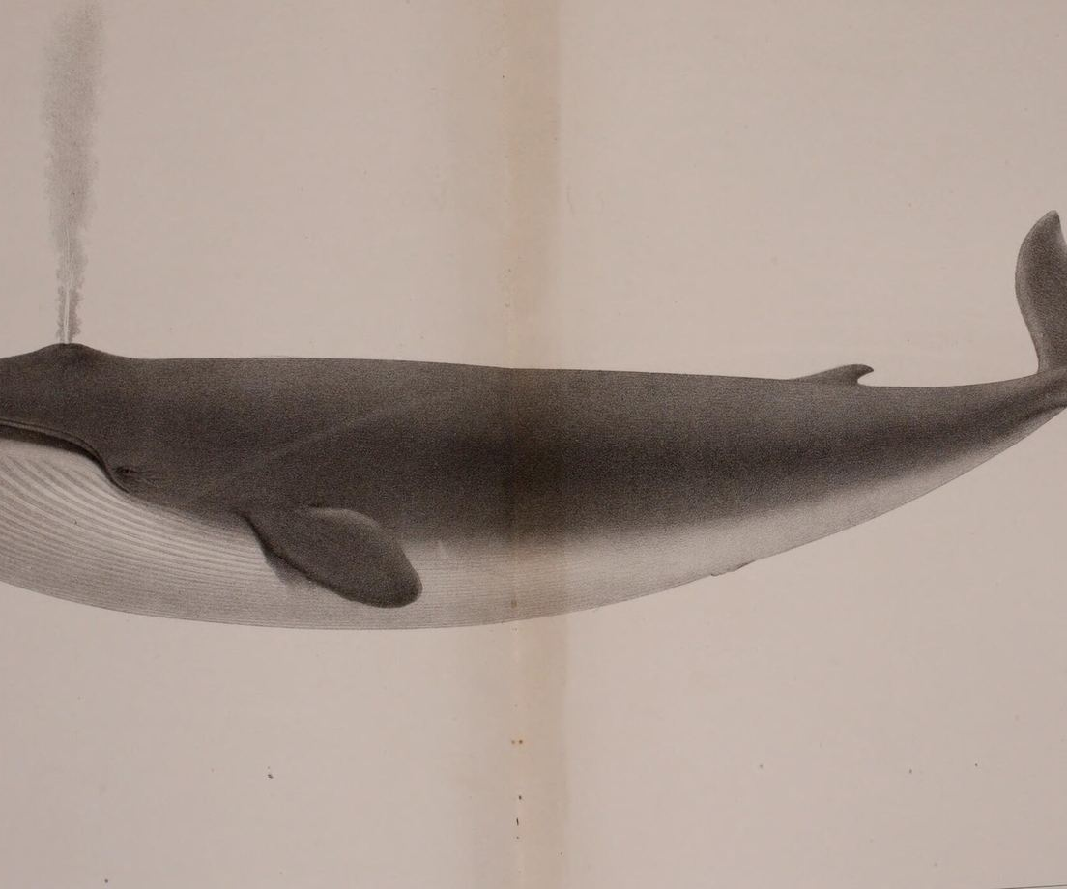
The blue whale is the largest animal on Earth
33.5 m
Blue whale
25.9 m
Fin whale
18.3 m
Humpback
15.8 m
Sperm (male)
9.8 m
Orca
Blue whale, Scammon Plate XIII, 1874
Figure 1
Maximum length of five whales
Large Antarctic blue whales can top 150 tonnes. The runner-up, the fin whale, reaches only three quarters of its length.
Source: NOAA Fisheries species pages, feet converted to metres
Notes:
Maximum lengths from NOAA Fisheries species pages (Quick Facts), converted from feet and rounded to 0.1 m: blue whale up to 110 ft (33.5 m), fin whale 75 to 85 ft (85 ft, 25.9 m), humpback up to about 60 ft (18.3 m), sperm whale males 52 ft (15.8 m), killer whale up to 32 ft (9.8 m). Blue whale weight: in the Antarctic, they can reach up to about 110 feet and weigh more than 330,000 pounds (about 150 tonnes). NOAA: The blue whale is the largest animal on Earth.

Slide 4
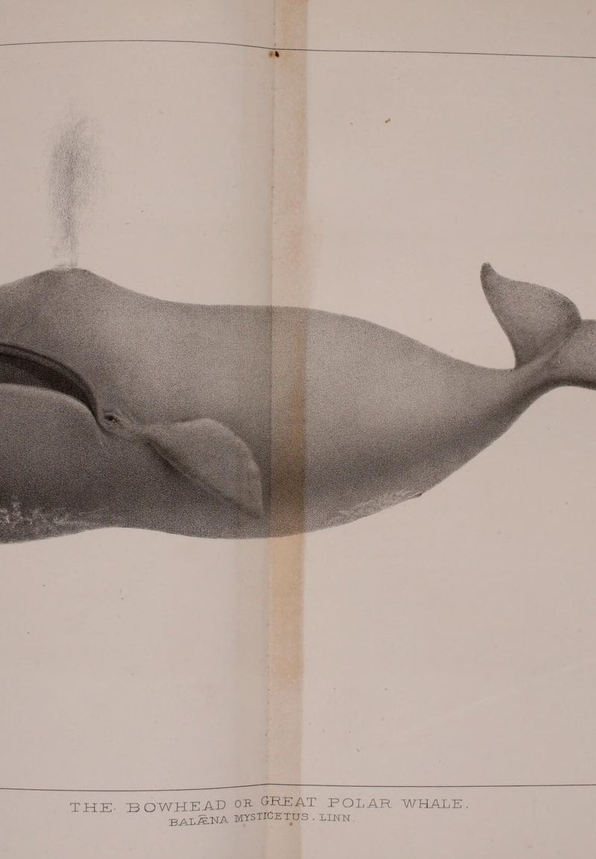
A bowhead may live past 200
43–48 cm
20 cm
5 m+
Blubber, thickest of any whale
Sea ice it can break
Skull, a third of its length
“
Evidence suggests they can live over 200 years.
Bowhead, Scammon Plate XI, 1874
Source: NOAA Fisheries, Bowhead Whale (quote from the same page)
Notes:
NOAA Fisheries, Bowhead Whale: 17- to 19-inch thick blubber layer, thicker than that of any other whale (43 to 48 cm); can break through 8-inch-thick sea ice (about 20 cm); bow-shaped skull can be over 16.5 feet long, about a third of a bowhead's body length (about 5 m); evidence suggests they can live over 200 years. Also: George et al. 1999, Canadian Journal of Zoology 77:571-580, estimated one individual at about 211 years by aspartic acid racemization of the eye lens, with a method error of about 16 percent.

Slide 5
One breath, nearly three kilometres down
137.5 min
2992
Longest breath-hold
Cuvier's beaked whale, 2014 tags
1401
45 min
610
Typical sperm whale dive
Beaked, max
Beaked, avg
Sperm whale
Often to about 600 metres
Figure 2
How deep whales dive (metres)
Both records come from tags on Cuvier's beaked whales off California, published in 2014, and both were new records for any mammal.
Sources: Schorr et al., PLOS ONE 9(3): e92633 (2014); NOAA Fisheries, Sperm Whale
Notes:
Schorr, Falcone, Moretti and Andrews 2014, First Long-Term Behavioral Records from Cuvier's Beaked Whales Reveal Record-Breaking Dives, PLOS ONE 9(3): e92633: group mean deep dive 1401 m and 67.4 min; dives to 2992 m depth and lasting 137.5 min, both new mammalian dive records. NOAA Fisheries, Sperm Whale: deep dives that routinely reach depths of 2,000 feet (about 610 m) and can last for 45 minutes.

Slide 6
The biggest whales eat some of the smallest prey
Two ways to eat
Baleen whales
Toothed whales
In the mouth
Rows of comb-like baleen
Teeth
Main food
Krill and schooling fish
Squid, fish, even sharks
How
Gulp seawater, strain out the food
Dive deep and hunt one by one
Examples
Blue, humpback, bowhead
Sperm whale, orca
Five tonnes of krill a day
The biggest blue whales can eat more than five tonnes of krill a day,
and each krill is only a few centimetres long.
Sources: NOAA Fisheries, Blue Whale, Humpback Whale, Sperm Whale
Notes:
NOAA Fisheries, Blue Whale: Some of the biggest individuals may eat up to 6 tons of krill a day (6 short tons is about 5.4 tonnes). Humpback Whale: filter-feed on small crustaceans (mostly krill) and small fish. Sperm Whale: diet consists of species such as squid, sharks, skates, and fish. Krill are small crustaceans measured in centimetres.

Slide 7
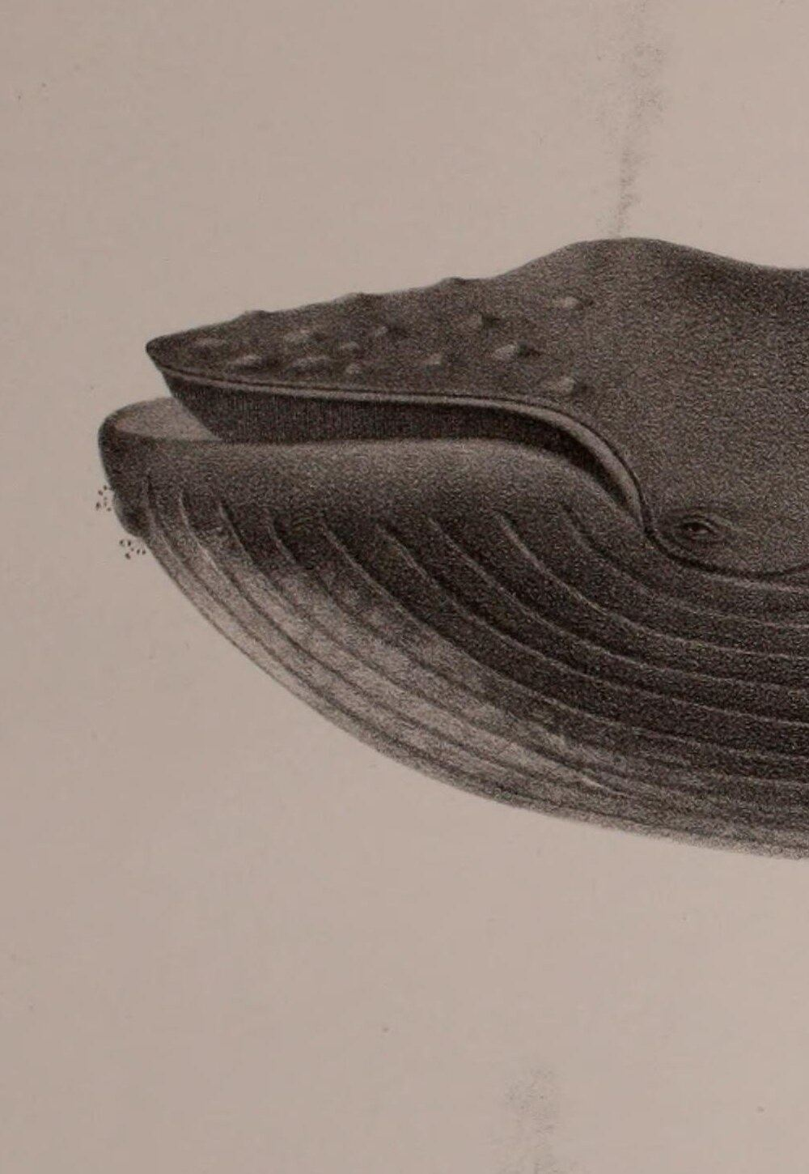
Humpbacks sing, sometimes for hours on end
7–30 min
24 h+
Length of one song
Longest singing session by a male
“
Humpback whales produce a series of beautiful and varied
sounds for a period of 7 to 30 minutes and then repeat the same
series with considerable precision.
Humpback, Scammon Plate VII, 1874
Quote: Payne & McVay, Science 173:585 (1971). Source: NOAA National Marine Sanctuaries
Notes:
Payne & McVay 1971, Songs of Humpback Whales, Science 173(3997):585-597, abstract: produce a series of beautiful and varied sounds for a period of 7 to 30 minutes and then repeat the same series with considerable precision; Songs are repeated without any obvious pause between them; thus song sessions may continue for several hours. NOAA Sanctuaries: It's believed that song is produced only by male humpback whales; Adult male humpbacks will sing in sessions ranging from five minutes to over 24 hours (sanctuaries.noaa.gov/news/jul21/humpbacks-olympic-coast.html); Humpback males all sing the same current rendition of a song while in a particular breeding area (sanctuaries.noaa.gov/news/sep22/mysteries-of-humpback-whale-song.html).

Slide 8
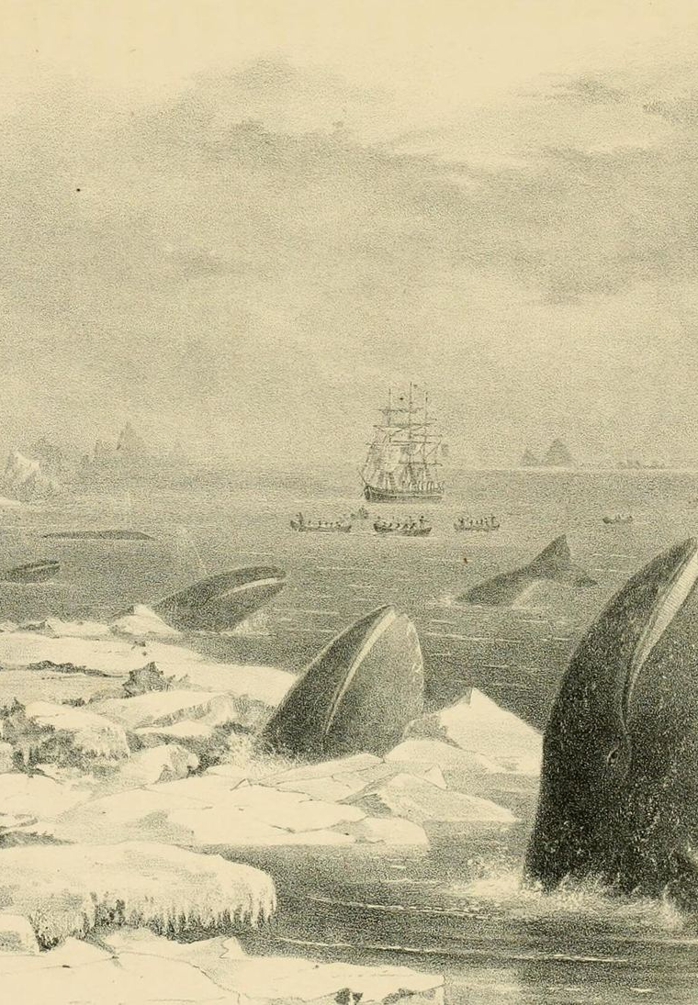
Gray whales swim about 16,000 km a year
16,000 km
22,500 km
28 days
Usual round trip, gray whale
Farthest gray whale trips
Humpback, Alaska to Hawaii
“
They feed through the summer in cold high-latitude seas, then
return to warm bays in winter to give birth.
Gray whales among the ice, Scammon Plate V, 1874
Sources: NOAA Fisheries, Gray Whale, Humpback Whale
Notes:
NOAA Fisheries, Gray Whale: traveling about 10,000 miles round-trip and in some cases upwards of 14,000 miles (about 16,000 km and 22,500 km). Humpback Whale: the roughly 3,000-mile trip from Alaska to Hawaii can take as few as 28 days; some animals migrating 5,000 miles between high-latitude summer feeding grounds and winter breeding areas in tropical waters.

Slide 9
One century of whaling killed nearly 3 million
2.9 million
2054
Large whales killed, 1900s
2,894,094 across the three oceans
564
1982
276
IWC votes to pause whaling
South
N. Pacific
N. Atlantic
Catch limits set to zero from 1985/86
Figure 3
Whales killed by industrial whaling, 1900–1999 (thousands)
Since the pause, humpbacks and some other populations have slowly recovered.
Sources: Rocha, Clapham & Ivashchenko, Marine Fisheries Review 76(4) (2014); International Whaling Commission
Notes:
Rocha, Clapham & Ivashchenko 2014, Emptying the Oceans: A Summary of Industrial Whaling Catches in the 20th Century, Marine Fisheries Review 76(4): North Atlantic 276,442, North Pacific 563,696, Southern Hemisphere 2,053,956, about 2.9 million in total. The IWC adopted the commercial whaling moratorium in 1982, with zero catch limits from the 1986 coastal and 1985/86 pelagic seasons. Recovery: NOAA Fisheries, Humpback Whale page, 2016 revision removed 9 of 14 distinct population segments from ESA listing as recovered.

Slide 10
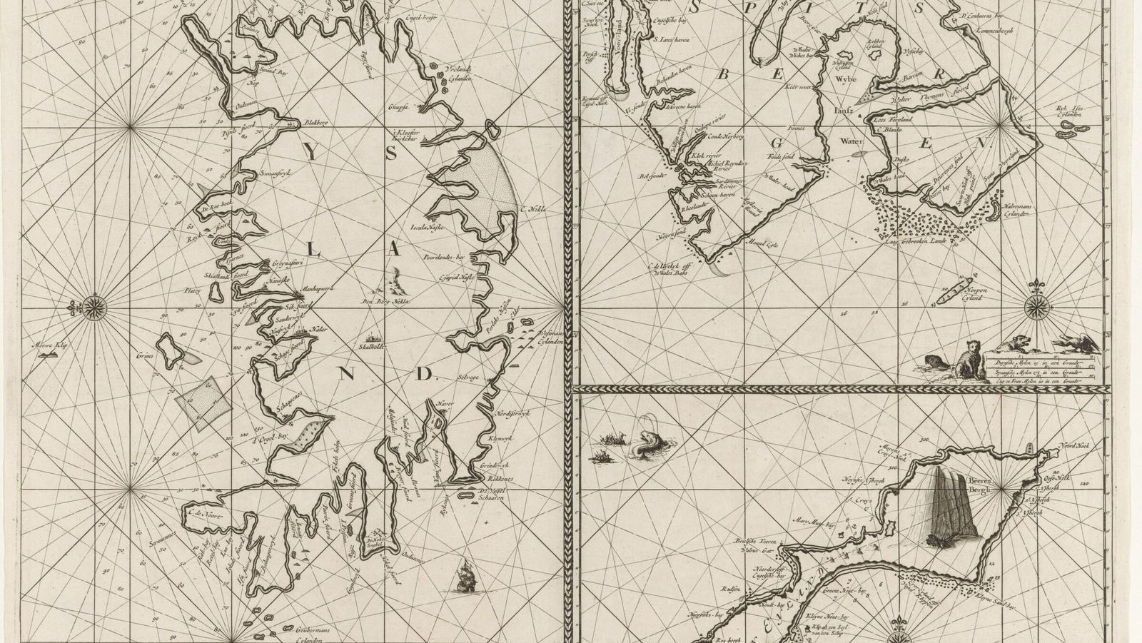
A spout at the surface is a whale breathing out
Notes:
A whale's spout is warm exhaled air that condenses as it meets cooler air. Background: Dutch sea chart of Iceland, Jan Mayen and Spitsbergen, Rijksmuseum, CC0.

