Slide 1

To Our Readers
Autumn 2026 · An annual letter to our subscribers
Are we still reading?
Ten years of reading surveys, and what the editor wants to tell you
03
Ten years on, the same readers, the same books
06
Periodicals fell hardest, and we are among them
11
Books sell less, cheaper, and somewhere else
17
Four things the editors plan for the year ahead
Cover image is AI-generated and illustrative
Notes:
Every autumn the editors write a long letter to our subscribers. This year it asks one question: are we still reading? Most figures come from China's National Reading Survey, run by the Chinese Academy of Press and Publication (CAPP). It is released each April for the year before, so "2025" in this letter always means the survey year. Book market figures come from OpenBook, library figures from the Ministry of Culture and Tourism, and figures from abroad from Pew Research Center, the US National Endowment for the Arts, Japan's Agency for Cultural Affairs and the UK's National Literacy Trust. Every data page names its source and how the figure is defined. The letter gives none of our own subscription or sales numbers, and our plans are written as plans. The photographs are AI-generated illustrations.

Slide 2
To Our Readers
Editor's note
Autumn 2026 · Annual letter
People still read books, just differently
T
60.0%
his year we read ten years of China's National Reading Survey from start to
finish, to answer a question we are often asked: are people still reading? The
Adults who read books
answer is better than we feared and more complicated than we thought. The
58.4% in 2015
share of readers and the books they read barely moved. What moved was how people
80.8%
read and where their time goes, and the line that fell furthest is our own.
Adults who read digitally
64.0% in 2015
16.6%
Adults who read periodicals
34.6% in 2015
Source: 13th and 23rd National Reading Surveys (Chinese Academy of Press and Publication, survey years 2015 and 2025), adults, as the survey defines its rates
·
2
·
Notes:
The short version: people are not reading fewer books, they are reading in different ways, and when reading changes shape, periodicals lose first. That includes us. One number for each part. By the survey's own measure, the share of adults who read books went from 58.4% to 60.0% in ten years, barely a change. The share who read digitally in some form went from 64.0% to 80.8%. The share who read periodicals fell from 34.6% to 16.6%, more than halved. The book reading rate is the survey's own indicator, and its releases do not say whether it counts print only, so we do not turn it into "four in ten adults never read a print book".

Slide 3
To Our Readers
Ten years
Autumn 2026 · Annual letter
Ten years on, readers went from 58.4% to 60.0%
6
4.58
Print 4.81
4
E-books 3.58
3.26
E-books dip to 2.84 in 2019
2
0
2015
2016
2017
2018
2019
2020
2021
2022
2023
2024
2025
Figure 1
Books read per adult a year, counting all adults, survey years 2015 to 2025
4.81 is an average, lifted by a few heavy readers. No median is published.
Source: 13th to 23rd National Reading Surveys (Chinese Academy of Press and Publication)
·
3
·
Notes:
The first chart is how many books the average adult read each year. Print went from 4.58 to 4.81, up just 0.23. E-books went from 3.26 to 3.58, with a dip to 2.84 in 2019. Over the same decade, by the survey's own measure, the share of adults who read books moved from 58.4% to 60.0%. So the number of readers and the number of books barely moved. Two cautions. The survey's sample and method changed several times, to online and phone interviews from 2020 and mainly face to face again in 2025, so a change of a tenth of a point a year means little. And 4.81 is a mean, with no median published, so most people read fewer.

Slide 4
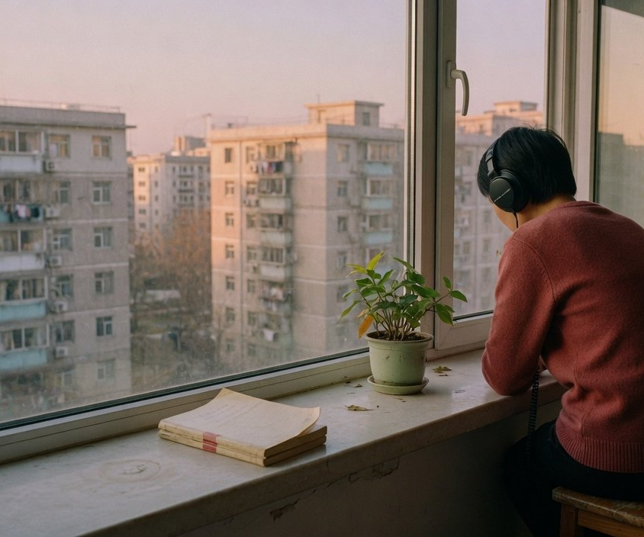
To Our Readers
How we read
Autumn 2026 · Annual letter
79.0% read on phones, 38.7% listen to books
79.0%
Phone
66.4%
Computer
38.7%
Listening
21.3%
E-reader
6.3%
Book videos
Listening by the window (AI-generated)
Figure 2
Adults using each way of reading in 2025 (%), one person may use several
Digital reading rose from 64.0% to 80.8% of adults in ten years, and has barely moved since 2019.
Source: 13th, 17th and 23rd National Reading Surveys
·
4
·
Notes:
What changed is how people read. In 2025, 79.0% of adults read on a phone, 66.4% read online on a computer, 38.7% listened to books, 21.3% used an e-reader and 6.3% watched videos about books. These overlap, since one person can read on a phone and listen too, so they do not add up. Listening has grown most steadily: it was 17.0% in 2016. The overall share who read digitally in some way went from 64.0% in 2015 to 79.3% in 2019, then rose only 1.5 points in six years. Its scope also shifted: it still counted CD-ROMs in 2016, and from the 22nd round it explicitly includes listening and book videos.

Slide 5
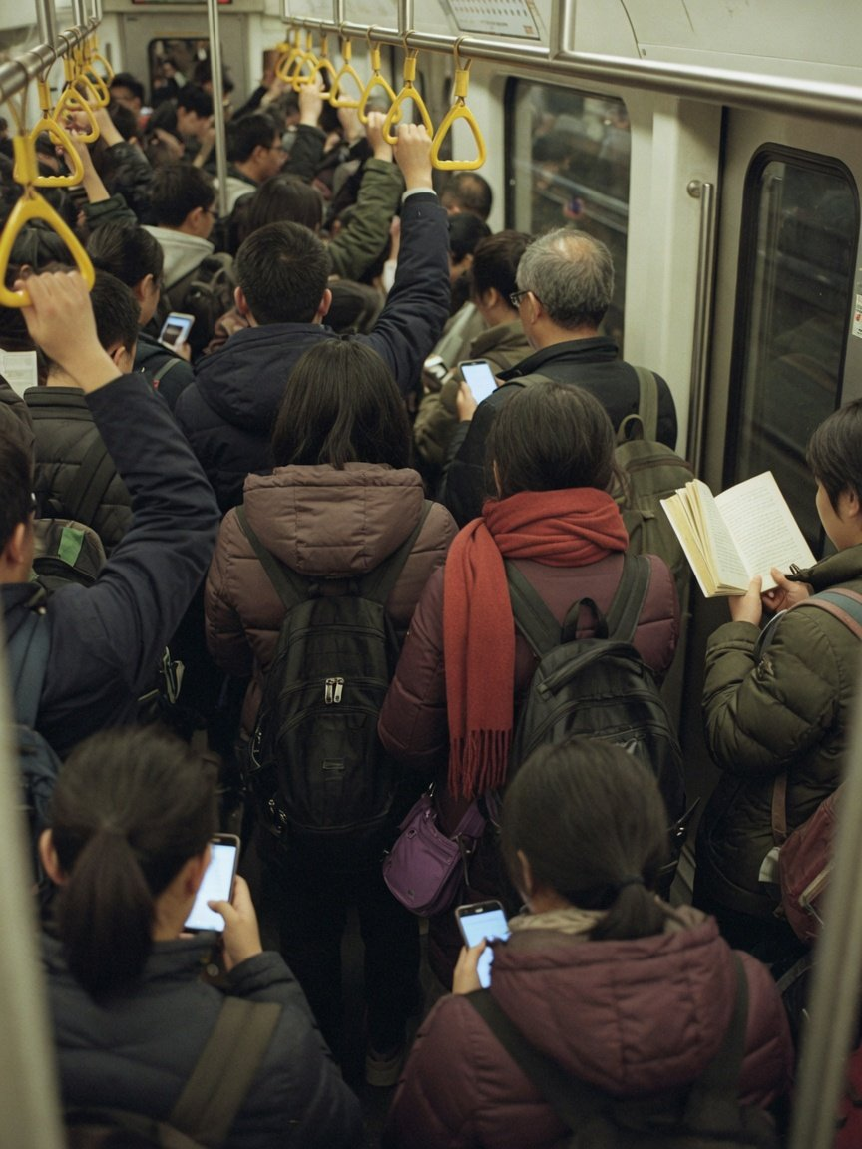
To Our Readers
Time
Autumn 2026 · Annual letter
Print time held, phone time grew far more
Phone use a day
2025
2017
109.54 min
Dashed line: 80.43 min in 2017
Print reading a day
24.68 min
Dashed line: 20.38 min in 2017
Short video reaches 1.074 billion people, 95.4% of internet users. No data shows how much reading time it
takes. We can only say both are happening at once.
A metro car at rush hour (AI-generated)
Sources: 15th and 23rd National Reading Surveys, CNNIC 57th report. Phone time for 2015 and 2016 was measured under another name and is left out
·
5
·
Notes:
Where did the time go? In 2025 the average adult spent 109.54 minutes a day on a phone and 24.68 minutes reading print books, about 4.4 times as much on the phone. But print time did not shrink. It was 19.69 minutes in 2015, so it grew by about five minutes. The survey renamed the phone measure in 2017, from phone reading time to phone use time, so we start the phone figure at 80.43 minutes in 2017. The phone figure jumped by more than 15 minutes in 2019, exactly when the survey's sample and method changed, so read that year with care. These daily times overlap and cannot be added into one day. By the end of 2025, 1.074 billion people used short-video apps, almost every internet user. Did short video take reading time away? We found no study that can answer that, so we only say the two are happening at the same time, not that one caused the other.

Slide 6
To Our Readers
Periodicals
Autumn 2026 · Annual letter
Periodicals fell hardest, by more than half
16.6%
50%
45.7
34.6
25%
Newspapers 21.2
Periodicals 16.6
Adults who read periodicals in 2025
blank
0%
34.6% in 2015
2015
2016
2017
2018
2019
2020
2021
2022
2023
2024
2025
Figure 3
Adults who read newspapers and periodicals (%)
Neither 2016 figure could be verified, so both lines break there.
Source: 13th to 23rd National Reading Surveys
·
6
·
Notes:
One number on this page: 16.6%. In 2025, only 16.6% of adults read a periodical, against 34.6% ten years earlier. That is more than half gone. Of every way of reading the survey tracks, newspapers and magazines fell furthest, and the newspaper reading rate also fell from 45.7% to 21.2%. We are a periodical. This line is about us.

Slide 7

To Our Readers
Periodicals
Autumn 2026 · Annual letter
Every periodical line points down, ours too
1.57 issues
2.77 min
21.2 %
Periodicals read a year
Periodical reading a day
Adults who read newspapers
4.91 in 2015, 68% fewer
8.83 min in 2015
45.7% in 2015
“
These are not someone else's numbers. A magazine kept alive by
its subscribers stands on these lines.
Spines of old magazines (AI-generated)
Source: 13th and 23rd National Reading Surveys, adults. The 68% fall is computed from the two years: 1.57 ÷ 4.91 − 1
·
7
·
Notes:
A closer look. The average adult read 4.91 print periodical issues a year in 2015 and 1.57 in 2025, about 68% fewer. Daily time with periodicals fell from 8.83 to 2.77 minutes. Newspapers fell further: the reading rate went from 45.7% to 21.2%, and issues per adult from 54.76 to 11.59 a year. These lines describe the whole periodical press, and they describe us. We do not list our own subscription figures here. This letter is about readers and how they read, not about our accounts.

Slide 8
To Our Readers
Non-readers
Autumn 2026 · Annual letter
In the words of people who do not read
“
No reading habit, or no liking for books.
Too busy at work.
No time, because of the internet, games, TV
and phones.
The three main reasons for not reading listed by the 23rd National Reading Survey. The share giving each reason was not published.
·
8
·
Notes:
These are the reasons non-readers gave in the survey, the top three: no reading habit or no liking for reading, being too busy at work, and no time because of the internet, games, television and phones. After those come not finding interesting books, no reading atmosphere, not knowing what to read and having nowhere to read. The release does not give each reason's share, so we quote the words and do not rank them by size.

Slide 9
To Our Readers
Heavy readers
Autumn 2026 · Annual letter
Heavy readers rose from 10.2% to 13.5%
45.9%
13.5
13.2
12.3
11.9
Not published
Not published
11.6
11.1
Would most like a print book
10.2
Several answers may count since 2024
30.3%
Satisfied with their reading
2017
2018
2019
2020
2021
2022
2023
2024
2025
Dissatisfied 13.8%, neutral 46.2%
Figure 4
Adults reading 10 or more print books a year (%)
No figures could be verified for 2018 and 2022, so they are left blank.
Source: 15th to 23rd National Reading Surveys
·
9
·
Notes:
Heavy readers are a minority, but a slowly growing one. Adults who read ten or more print books a year were 10.2% in 2017 and 13.5% in 2025, up 3.3 points in eight years. We could not verify 2018 or 2022, so those years are blank, not filled in. Another pair of numbers says more: 45.9% say their preferred way to read is to pick up a print book, yet only 30.3% are satisfied with their own reading. There is a gap between wanting to read and getting to read, and that gap is where a reading magazine belongs. Since 2024 the answers to the preference question add up to more than 100%, so several answers may be allowed, and we do not draw it as a pie.

Slide 10
To Our Readers
Who reads less
Autumn 2026 · Annual letter
Rural adults lag by 18.4 points, kids read more
Urban
Rural
Children aged 0 to 17
68.6
68.5
68.3
67.9
67.5
86.7%
2023 on
50.2
50.0
49.9
49.8
49.3
Not published
Read books, against 60.0% of adults
11.72 books
Books read per child a year
Children's and adults' books are counted differently, so
2017
2019
2020
2021
2022
compare only the rates
Figure 5
Adults who read books, urban and rural (%)
Print books per adult in 2022: urban 5.61, rural 3.77.
Source: 15th, 17th to 20th and 23rd National Reading Surveys
·
10
·
Notes:
Who reads less? The urban-rural gap is steady. In 2022 the book reading rate was 68.6% for urban adults and 50.2% for rural adults, a gap of 18.4 points that barely narrowed in five years. Urban adults read 5.61 print books a year, rural adults 3.77. These are the latest urban-rural figures in any public release. Releases since 2023 say only that cities read more, with no numbers. At the other end are children: 86.7% of those aged 0 to 17 read books, 11.72 a year on average, with 36.82 minutes of print reading a day, all well above adults. The ones reading less are adults, rural adults most of all. Recent releases give no adult reading rates by age or education.

Slide 11
To Our Readers
The book trade
Autumn 2026 · Annual letter
Sales are 86% of 2019, at 58% of list price
Company figures · restated basis from 2025
−14%
Price paid, share of list price
128.6
124.1
122.1
66%
114.6
112.9
2022
110.4
109.5
61%
2023
58%
2025
56%
Q1 2026
2019
2020
2021
2022
2023
2024
2025
2025: list-price sales −2.24%, net sales −3.80%
Figure 6
Retail book sales at list price (bn yuan)
Figures published on the old basis ran about 25.7% lower and cannot join this line.
Sources: OpenBook (company figures), via the German Book Information Centre's Buchmarkt China 2024 and 2025, and Huxiu citing OpenBook (Q1 2026)
·
11
·
Notes:
Books are selling less, and more cheaply. By OpenBook's count, retail book sales at list price were 110.4 billion yuan in 2025, down 2.24% on the year and only 86% of 2019. List-price sales count books at their cover price. Net sales count what buyers actually paid, and those fell 3.80% in 2025, faster than list-price sales, because discounts keep deepening: books sold at 58% of list price on average in 2025 and at 56% in the first quarter of 2026. One caution on definitions. In early 2025 OpenBook changed its estimation method and restated 2019 to 2023 upward by about 25.7%. The 2023 figure first published as 91.2 billion yuan became 114.6 billion. The chart shows the restated series. The old figures cannot be joined to it, and growth should never be computed between an old and a new figure. Another tracker, Zhongjin Yiyun, puts the 2025 fall at 11.2%, far from OpenBook. We use OpenBook only.

Slide 12
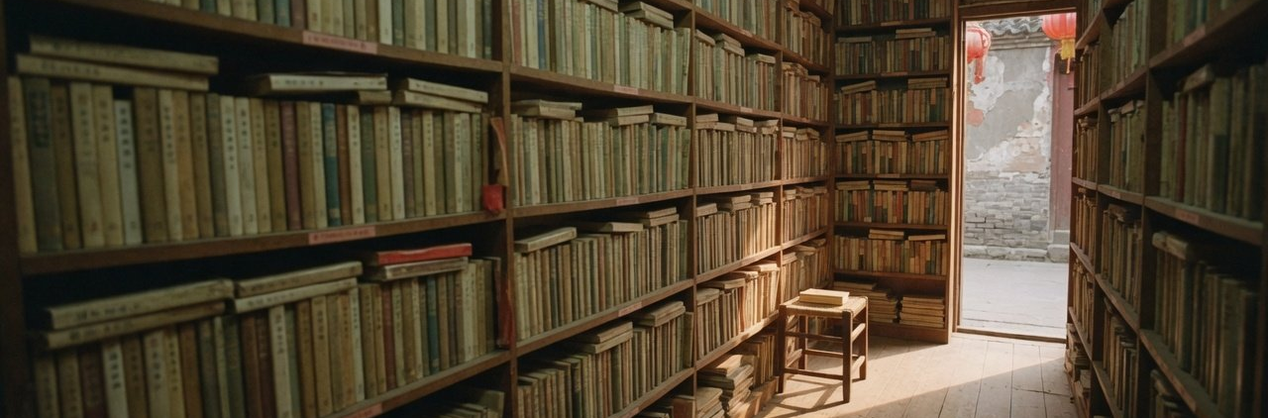
To Our Readers
The book trade
Autumn 2026 · Annual letter
Content commerce now sells four in ten books
Marketplaces
Content commerce
Other online
Bookstores
11.9
13.7
14.0
15.3
13.4
14.7
19.9
23.2
30.4
26.7
40.5
16.4
A small corner bookshop (AI-generated)
45.1
2025 sales by category (%)
41.5
40.9
32.4
Children's
Study aids
Lit.
Other
28.79
26.47
8.84
35.90
2022
2023
2024
2025
Literature (Lit.) is only 8.84%. Other is 100 less the three named categories.
Figure 7
Retail sales by channel (%)
Content commerce means apps such as Douyin, Kuaishou and Xiaohongshu.
Source: OpenBook (company figures), via the German Book Information Centre
·
12
·
Notes:
Where books sell, and what sells. In 2025 content commerce, the apps that sell through recommended videos and posts, such as Douyin, Kuaishou and Xiaohongshu, sold 40.53% of books by list price and became the largest channel for the first time. Four years earlier it was 16.42%. Traditional online marketplaces fell from 45.06% to 32.37%. Bookstores held 13.65% in 2025. Their share rose from 11.93% to 13.99% between 2023 and 2024, but that crosses OpenBook's restatement, and bookstore sales themselves kept falling. As for what sells: children's books were 28.79% of list-price sales and study aids 26.47%, together more than half, while literature was 8.84%. In 2024 the average discount in content commerce was over 60%, so books there sold below 40% of list price, the same story as the deepening discounts on the previous page. Source details: OpenBook, as reported in the German Book Information Centre Beijing's Buchmarkt China 2025.

Slide 13
To Our Readers
Libraries
Autumn 2026 · Annual letter
Library visits up 63% on 2019, but loans fell
Visits (millions)
Loans (millions)
1470
1340
840
830
1161
783
614
607
901
587
790
746
421
541
2019
2020
2021
2022
2023
2024
2025
2019
2020
2021
2022
2023
2024
2025
Figures 8 and 9
Public library visits and loans, each on its own axis
Books lent per visit fell from 0.68 to 0.56. Only 16.2% of urban adults have used a library.
Sources: Ministry of Culture and Tourism statistical bulletins, 2019 to 2025, and the 23rd National Reading Survey
·
13
·
Notes:
The library page surprised us most. In 2025 China's public libraries counted 1.47 billion visits, 63% more than in 2019. People came back, and in greater numbers than before the pandemic. But loans were only 830 million, 35% above 2019, and 0.3% below 2024, the first fall since 2020. Loans per visit went from 0.68 in 2019 to 0.56 in 2025. More and more, people go to the library to sit, study and attend events: libraries held 354,000 events in 2025. Meanwhile only 16.2% of urban adults say they have used a library. The two charts use different units, each on its own axis, and should not be compared bar for bar.

Slide 14
To Our Readers
Elsewhere
Autumn 2026 · Annual letter
Others ask differently, so we do not rank them
Survey
What it asks
Result
Earlier
75%
US · Pew, 2025
Read at least one book in the past 12 months, even in part
78% in 2011
48.5%
US · NEA, 2022
Read a book for pleasure in the past year, not for work or school
54.6% in 2012
62.6%
Japan · Culture agency, 2024
Aged 16 and over, read no book in a month
Method changed
36.1%
UK · NLT, 2026
Aged 8 to 18, enjoy reading in their free time
32.7% in 2025
60.0%
China · Reading survey, 2025
Adults who read books, as the survey defines it
58.4% in 2015
Not the same question. Read them side by side, never as a ranking.
Sources: Pew Research Center (2026-04), NEA 2022 Survey of Public Participation in the Arts, Japan's Agency for Cultural Affairs (2024-09), UK National Literacy Trust (2025, 2026), 13th and 23rd National
Reading Surveys
·
14
·
Notes:
Other countries ask the same question, each in its own way, so this table can only be read side by side, never as a league table. Pew in the US asks whether you read at least one book in the past twelve months, in print, digital or audio, whole or in part. It was 75% in 2025, about where it has been for over a decade. The National Endowment for the Arts asks about reading not for work or school: 48.5% in 2022, down from 54.6% in 2012. Japan's Agency for Cultural Affairs asks people aged 16 and over how many books they read in a month, excluding magazines and manga, and 62.6% said none, but it switched from face-to-face to mail surveys in 2020, so older figures do not compare directly. The UK's National Literacy Trust asks children aged 8 to 18 whether they enjoy reading in their free time: 32.7% in 2025, the lowest in twenty years, and 36.1% in 2026. The China row is the book reading rate as the National Reading Survey defines it. Five questions, five ways of answering. Read each country's own direction.

Slide 15
To Our Readers
Print and screen
Autumn 2026 · Annual letter
Print beats screens, but only by a small effect
Delgado et al. 2018
Clinton 2019
−0.21
Overall
−0.25
−0.27
Informational
−0.32
+0.01
Narrative
−0.04
−0.26
Timed
−0.09
Self-paced
−0.4
−0.3
−0.2
−0.1
0
+0.1
Print did worse →
← Screens did worse
A Hedges' g of about 0.2 is a small effect, not “21% better understanding”. Print readers also judge their own understanding better.
Sources: Delgado et al. (2018), Educational Research Review 25, Clinton (2019), Journal of Research in Reading 42(2). Both are meta-analyses. Clinton does not report timed and self-paced reading apart
·
15
·
Notes:
How much does paper beat the screen? Two meta-analyses agree: comprehension on screens is slightly worse than on paper. Delgado and colleagues pooled 54 studies with over 171,000 participants in 2018 and found an overall effect size g of -0.21. Clinton pooled 33 randomized experiments in 2019 and found -0.25. In statistics that is a small effect, and it must not be read as "21% better comprehension on paper". The gap sits mainly in informational texts and timed reading. With stories there is almost no difference, and when readers set their own pace the gap shrinks. Clinton also found print readers judge how much they understood more accurately, while screen readers tend to overrate themselves. One more caveat: none of these experiments covered short video or reading through conversations with AI.

Slide 16
To Our Readers
Long read
Autumn 2026 · Annual letter
Readers left the periodical habit, not books
Read together, these numbers left the editors with one plain
A magazine can make the pieces worth finishing easier to finish:
impression: the readers are still here. In ten years the share of
on paper, in your headphones, at a library's long tables. The next
readers and the books they read barely moved, and print reading
page lists our plans for the year, each with its reason. How far we
grew by about five minutes a day. What shrank was the time once
get, we will tell you in next year's letter.
kept for papers and magazines.
“
We will not cut our pieces short to fight screens for a few seconds.
·
16
·
Notes:
Here is where we land. Readers have not left books. What they left is the fixed time once given to newspapers and magazines, the morning paper and the few pages before bed, which now goes to the phone. That is not bad news, and not entirely good news either. We will not shorten our pieces to chase screens, which already have plenty. We want to do something else: make the pieces worth finishing easier to finish. The next page says how.

Slide 17
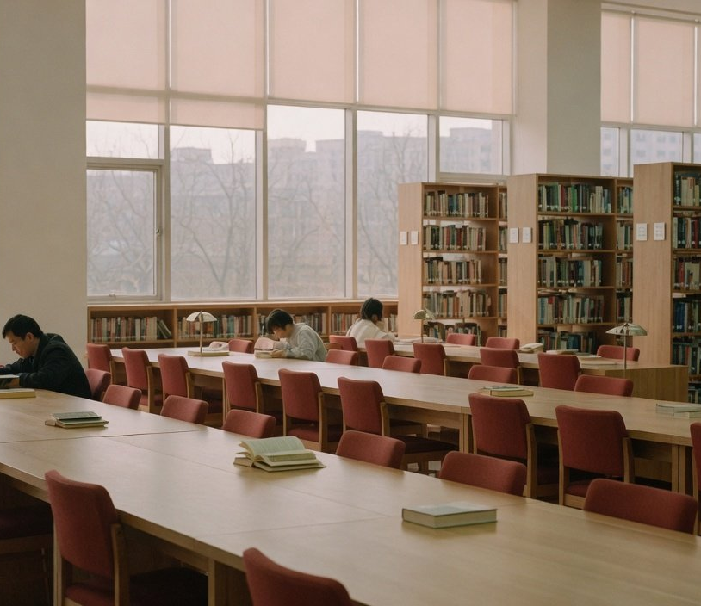
To Our Readers
Our plans
Autumn 2026 · Annual letter
Our four plans, each drawn from these numbers
1
A long read you can finish, every issue
Why: print time held for ten years, and 45.9% would most like a print book
2
Audio editions of our main pieces
Why: 38.7% of adults listen to books, so a piece should be heard to the end
3
Reader evenings in public libraries
Why: visits are 63% above 2019, while loans have stalled
4
Every figure with its definition
Why: almost every number in this letter has to be read with its definition
Reading room of a public library (AI-generated)
These are the editors' plans, not things already done. Sources are on the earlier pages.
·
17
·
Notes:
For the coming year the editors plan four things, each drawn from the numbers before. First, one long read in every issue, short enough to finish in one sitting, because print reading time held for ten years and 45.9% say they would most like to read a print book. Second, audio editions of our main pieces, because 38.7% of adults already listen to books and a good piece should be listenable to the end. Third, moving our reader evenings into public libraries, where visits are 63% above 2019 while loans have stalled. We would like to meet you at those long tables. Fourth, every figure we print will carry its source and definition, and this letter is our first practice. These are plans, not results. How far we get, we will report next year.

Slide 18
To Our Readers
Afterword
Autumn 2026 · Annual letter
Still reading, differently.
So are we, with you.
The Editors
October 2026
Notes:
People are still reading, only differently. We will change how we work too, and keep reading with you. Thank you for this year's subscription. See you in this letter next autumn.

