Slide 1
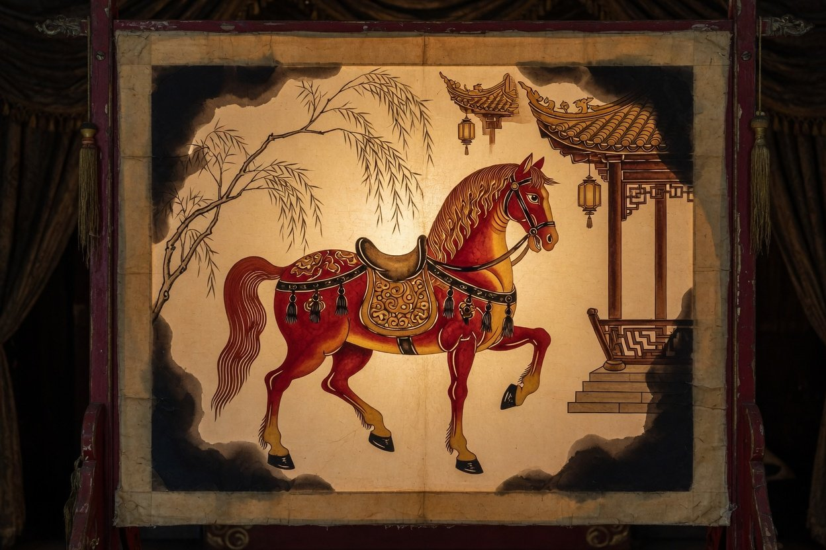
How Intangible
October 2026
Heritage Lives
On Today
Culture Lecture Hall · Public Lecture
From the lists, to the people, back to
everyday life
文
Illustration (AI-generated)
Notes:
Tonight's question is how intangible cultural heritage lives on today. We will go in three steps: first the lists, then the people behind them, then how heritage finds its way back into everyday life. Every figure comes from a public official document or a major news agency, and each slide names its source. Where two counts are easy to mix up, I will stop and say so.

Slide 2
Prologue
The lists are long. Heritage lives in people
Culture Lecture Hall · October 2026
45
1,557
3,994
On UNESCO's lists and register
National representative items
National representative bearers
As of December 2025
Five State Council batches, 2006 to 2021
End of 2025, statistical bulletin
A list records an item. A skill or a custom lives in the people who know it and still do it. Today: first the lists, then the
people, then how it returns to daily life.
Source: China ICH website (Dec 2025), State Council list notices, 2025 statistical bulletin of the Ministry of Culture and Tourism
2
Notes:
Three numbers to start. 45 is the number of Chinese elements on UNESCO's intangible heritage lists and register as of December 2025: 40 on the Representative List, 3 on the Urgent Safeguarding List and 2 in the Register of Good Safeguarding Practices. 1,557 is the number of national representative items the State Council published in five batches between 2006 and 2021. 3,994 is the number of national representative bearers in the 2025 statistical bulletin of the Ministry of Culture and Tourism. That last figure has several different counts, which we will come back to. The first two numbers say how long the lists are. The third is about people. My argument tonight: the lists are long now, and whether heritage lives on depends on who still practises it and who is learning it.

Slide 3
Prologue
Heritage includes its
Intangible cultural heritage means the traditional cultural
objects and places
expressions that people of all ethnic groups have passed down
Culture Lecture Hall · October 2026
through generations and regard as part of their cultural heritage,
together with the objects and places associated with them.
ICH Law of the PRC, Article 2 (translated)
Adopted 25 February 2011, in force 1 June 2011
3
Notes:
What counts as intangible cultural heritage? Start with the law. Article 2 of China's Intangible Cultural Heritage Law, in force since June 2011, defines it as the traditional cultural expressions that people of all ethnic groups have passed down through generations and regard as part of their cultural heritage, together with the objects and places associated with them. Three things follow. It is handed down, not newly invented. The community itself sees it as its own. And it is not only the performance or the skill, but also the objects and places that go with it: the leather figures of a shadow play, an opera stage, the carved blocks for New Year prints. The same article lists the fields: oral literature and the languages that carry it, fine arts, calligraphy, music, dance, drama, storytelling and acrobatics, craftsmanship, medicine and calendars, rituals, festivals and other customs, and traditional sports and games. The quotation is my translation.

Slide 4
Prologue
Over 100,000 items on four tiers of lists
Culture Lecture Hall · October 2026
Representative bearers
National · 1,557 items
Six national batches, more than 90,000 across all
four tiers
Provincial
Cultural ecology zones
21 national zones, plus 2 experimental ones
City
The ICH Law
In force since 2011, 6 chapters and 45 articles
County
Over 100,000 items across the four tiers
Source: ICH Law (2011), State Council General Office circular (2005), NPC Standing Committee inspection report (Nov 2024), China ICH website
4
Notes:
The system rests on four tiers of lists. The national list is published by the State Council: 1,557 items in five batches, or 3,610 entries when each applying region or organisation is counted separately. Provincial governments keep the second tier. Both of these are written into Article 18 of the law. The city and county tiers come from a 2005 circular of the State Council General Office. The law itself only goes as far as the provincial level, a gap that members of the National People's Congress Standing Committee have pointed out. All four tiers together hold more than 100,000 items. Around the lists sit three more pieces. First, representative bearers: 3,994 at national level at the end of 2025, and more than 90,000 across all four tiers. Second, cultural ecology protection zones: 21 at national level plus 2 experimental zones, which is why the press often says 23. Third, the law itself, in force since 1 June 2011.

Slide 5

Culture Lecture Hall · October 2026
Volume One
First, the lists
UNESCO's lists, and China's own
The painting is an AI-generated illustration
Notes:
Volume one: the lists. There are two kinds. UNESCO's international lists and register, and China's own four-tier lists.

Slide 6
Kunqu to Spring Festival: 45 on UNESCO's lists
Volume One · The Lists
Culture Lecture Hall · October 2026
Muqam, Long Song
25 in a year: paper-cut, calligraphy
Tea craft
Guqin
Acupuncture, Peking Opera
Taijiquan
Kunqu
Spring Festival
24 Solar Terms
Shadow play, Yimakan
Masterpieces, before the lists
Today's lists and register
2001
2003
2005
2009
2010
2011
2016
2020
2022
2024
Total 45
Total 29
Counted by first inscription, moves between lists not counted twice. Source: UNESCO China page, NPC Standing Committee inspection report, Annex Table 4 (Nov 2024)
6
Notes:
Think of this as a long scroll. In 2001 UNESCO proclaimed Kunqu Opera one of the first Masterpieces of the Oral and Intangible Heritage of Humanity, before today's lists existed. The Guqin followed in 2003, and in 2005 the Uyghur Muqam of Xinjiang and the Mongolian Long Song, shared with Mongolia. The convention was adopted in 2003 and China joined in 2004. In 2008 these four were folded into the Representative List. 2009 brought 25 elements in a single year, among them paper-cutting, calligraphy, Xuan paper and the Dragon Boat Festival. Peking Opera and acupuncture came in 2010, shadow puppetry and Hezhen Yimakan storytelling in 2011. Then one or two every few years: the Twenty-Four Solar Terms in 2016, Taijiquan and the Wangchuan ceremony in 2020, traditional tea processing in 2022, and the Spring Festival in December 2024. In 2025 the safeguarding plan for Yimakan entered the Register of Good Safeguarding Practices, bringing the total to 45. One counting detail: in 2024 three elements, and in 2025 Yimakan itself, moved from the Urgent Safeguarding List to the Representative List. A move does not add to the total, so this scroll counts each element once, in the year it first entered a list.

Slide 7
Volume One · The Lists
Yimakan's 14 years: from 5 to 121
Culture Lecture Hall · October 2026
5
121
could perform it in full, 2011
bearers, December 2025
Sung storytelling of the Hezhen people. Urgent list in 2011,
Representative List in 2025, and its safeguarding plan entered the
register of good practices.
The two counts differ slightly: the first is people who could perform it in full, the second
is bearers
Illustration (AI-generated)
Source: Xinhua interview with a Ministry of Culture and Tourism official (11 Dec 2025), China
ICH website
7
Notes:
A story. Yimakan is the sung storytelling of the Hezhen people. When it entered the Urgent Safeguarding List in 2011, only five bearers could perform it in full. In December 2025 an official of the Ministry of Culture and Tourism told Xinhua it now has 121 bearers. That same month Yimakan moved to the Representative List, and its safeguarding plan entered the Register of Good Safeguarding Practices, meaning UNESCO treats it as a model others can learn from. From urgent case to model took 14 years. Note that the two figures count slightly different things: five people who could perform it in full, and 121 bearers. Both come from the same interview. The picture is an AI-generated illustration, not a photograph of Yimakan.

Slide 8
45 is the most on UNESCO's country pages
Volume One · The Lists
Culture Lecture Hall · October 2026
China
45
How these are counted
Türkiye
32
Each country's own UNESCO page, all three
France
lists together. A shared element counts once
30
for every country in it, so the figures cannot
Iran
be added up. “Most in the world” is how
27
China's ICH website and Xinhua put it. The
Spain
26
bulletin only says “45 in total”, and
Azerbaijan
UNESCO publishes no ranking.
24
Japan
23
Rep. of Korea
23
Croatia
23
Source: UNESCO country pages (accessed 6 Oct 2026), China ICH website, Xinhua (5 Dec 2024)
8
Notes:
How does that compare? Each country's page on UNESCO's intangible heritage site states how many elements it has inscribed. Checking 27 countries on 6 October 2026, China's 45 is the highest, followed by Türkiye with 32, France 30, Iran 27, Spain 26, Azerbaijan 24, and Japan, the Republic of Korea and Croatia with 23 each. Two caveats. These totals combine all three lists, and an element shared by several countries counts once for each of them. The Mongolian Long Song, for example, counts for both China and Mongolia. So the figures cannot be added together. And the phrase most in the world comes from China's ICH website and Xinhua, not from UNESCO, which does not publish rankings. The 2025 statistical bulletin itself simply says 45. Worldwide, 849 elements from 157 countries were inscribed as of December 2025.

Slide 9
Craftsmanship leads with 287, medicine has 23
Volume One · The Lists
Culture Lecture Hall · October 2026
Items
Entries, by region or organisation
Craftsmanship
287
629
Music
189
431
Folk customs
183
492
Drama
171
473
Folk literature
167
251
Quyi storytelling
145
213
Dance
144
356
Fine arts
139
417
Sports, games, acrobatics
109
166
Medicine
23
182
Medicine's 23 items split into 182 entries, 7.9 per item
Source: NPC Standing Committee inspection report, Annex Table 1 (Nov 2024), data from the Ministry of Culture and Tourism
9
Notes:
The 1,557 national items fall into ten categories. Traditional craftsmanship is the largest with 287 items, 18.4 percent: think of Xuan paper, Longquan celadon or tea processing. Then come traditional music with 189, folk customs 183, traditional drama 171 and folk literature 167. Traditional medicine is the smallest with only 23 items, but they split into 182 entries, because the same practice was nominated by many regions and organisations: 7.9 per item, the most of any category. Entries are counted by applying region or organisation, 3,610 across all five batches. A small detail for the curious: the first batch in 2006 used older category names, and today's names date from 2008. Quyi is the Chinese umbrella term for storytelling, ballad singing and comic dialogue.

Slide 10
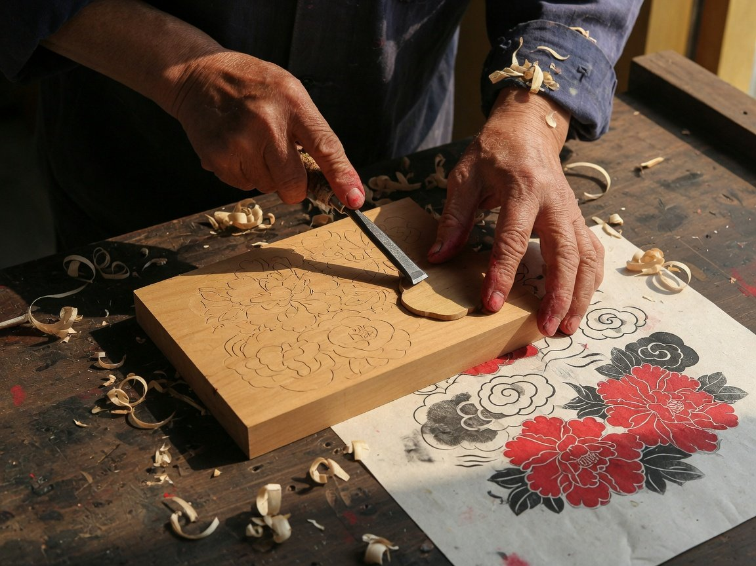
Culture Lecture Hall · October 2026
Volume Two
Behind the lists,
people
An item stays on the list. A skill lives only in
someone's hands
The painting is an AI-generated illustration
Notes:
Volume two. Behind the lists, people. An item stays on the list, but a skill lives only in someone's hands. Next we look at the bearers: how many there are, how old they are, and the race against time to record them. Then how heritage returns to daily life, the problems it runs into, and what each of us can do.

Slide 11
Six batches, 4,010 bearers, and no single total
Volume Two · The People
Culture Lecture Hall · October 2026
Named in each of six batches
As of
Bearers
What it counts
Source
1,082
2,241
End of 2023
942
Living
Bulletin
711
3,068
2024
First five batches
NPC report
551
3,107
498
May 2025
Living, of 3,997
National Library
3,994
End of 2025
Living not stated
226
Bulletin
These counts measure different things and cannot be joined into a growth line.
2007
Far fewer bearers are living than were ever named.
2008
2009
2012
2018
2025
Source: Ministry of Culture and Tourism batch notices, 2023 and 2025 statistical bulletins, NPC report (2024), National Library of China
11
Notes:
China began naming national representative bearers in 2007. There have been six batches: 226, 551, 711, 498, then 1,082 in 2018 and 942 in 2025, which add up to 4,010. But ask how many national bearers there are now and you get several answers, each counting something different. Please do not join them into a growth line. The 2023 statistical bulletin counted 2,241 living national bearers, while the first five batches added up to 3,068. The National Library's recording exhibition gave 3,997 as of May 2025, of whom 3,107 were living. The 2025 bulletin says 3,994 and does not say whether they are living. Over three years of reviews, the ministry also withdrew the title from 12 people and found 22 no longer able to pass on their skill. The official sources do not explain how these counts fit together. From the numbers alone, 3,994 looks closer to a register count that may still include people who have died. The two figures labelled as living are 2,241 and 3,107.

Slide 12
58.3% of the 2018 batch were 60 or older
Volume Two · The People
Culture Lecture Hall · October 2026
Fifth batch, named in 2018: 1,082 national bearers by age (this batch only)
40 to 59
60 to 69
70 to 79
80 and over
444
287
237
107
Under 40: 7
60 or older: 631 people, 58.3%
63.29 years
65 or older
0.6 %
Average age of the fifth batch
Average age of national bearers in the provinces
Under 40 in the fifth batch, 7 people
inspected, over 70 in half of them (NPC, 2024)
Source: Guangming Daily and Beijing News (May 2018), NPC Standing Committee inspection report (Nov 2024)
12
Notes:
The bearers are getting older. There is no national age table for all national bearers. The fullest data are from the fifth batch, named in 2018, as reported in the press at the time. Of 1,082 people, 107 were 80 or older, 237 were in their seventies, 287 in their sixties, 444 between 40 and 59, and only 7 were under 40. That makes 631 people aged 60 or older, 58.3 percent, with an average age of 63.29. This describes the 2018 batch only, not all bearers. The 2024 inspection report of the National People's Congress Standing Committee adds that in the provinces it inspected, the average age of national bearers was above 65 everywhere, and above 70 in half of them. I could not find a published age breakdown for the sixth batch of 2025.

Slide 13
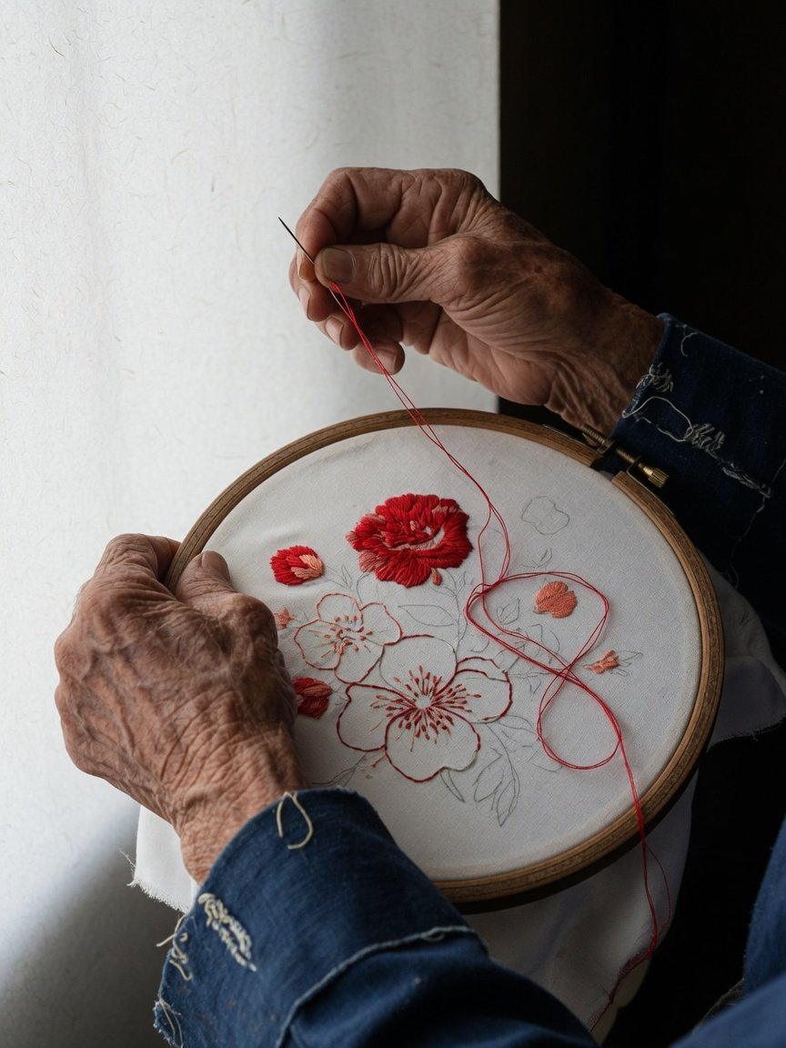
71 bearers died before their record
Volume Two · The People
was done
Culture Lecture Hall · October 2026
71
397
died while being recorded
died after their record was done
Rescue recording started for 2,290 bearers
Finished: 1,279, 56%
In progress: 1,011
Over 75,000 hours of raw footage and 148 million characters of oral history.
For some, this is all that remains.
Illustration (AI-generated)
As of May 2025. Source: National Library of China, ICH recording project exhibition
13
Notes:
The rescue recording project sets out to capture what each national bearer knows, in film, oral history and documents, while they are still with us. By May 2025 it had started on 2,290 bearers and finished 1,279. The other 1,011 are still in progress. Seventy-one bearers died before their own record was finished. Another 397 died after it was completed, and that record is now what remains. Together that is 468 people, 20.4 percent of everyone the project has started on. By the same date the project had gathered more than 75,000 hours of raw footage. The picture is an AI-generated illustration.

Slide 14
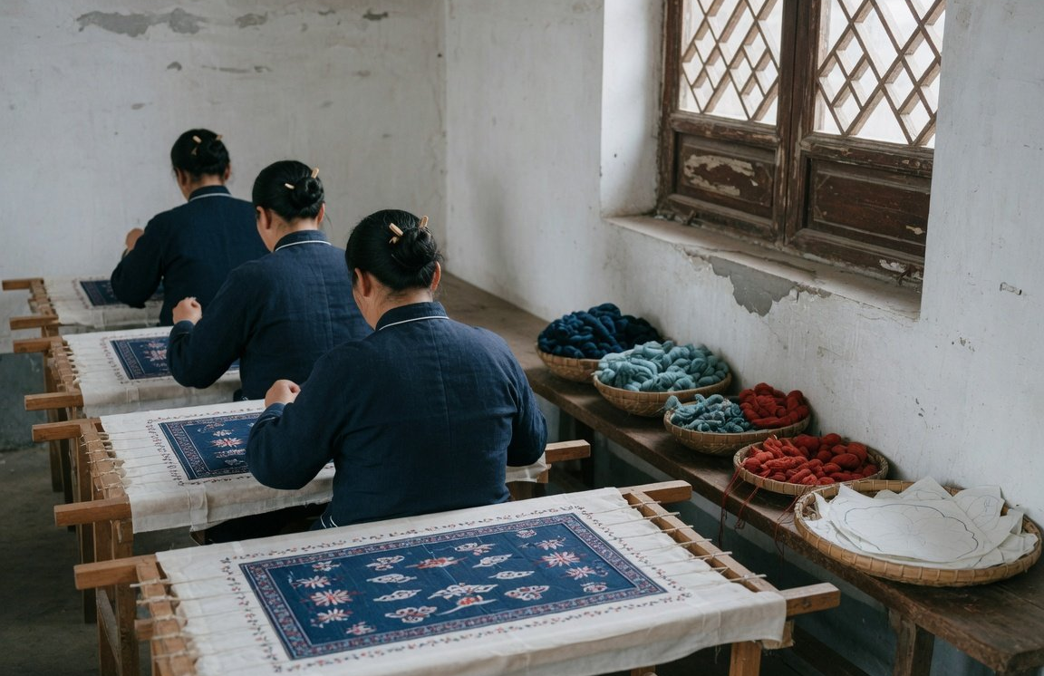
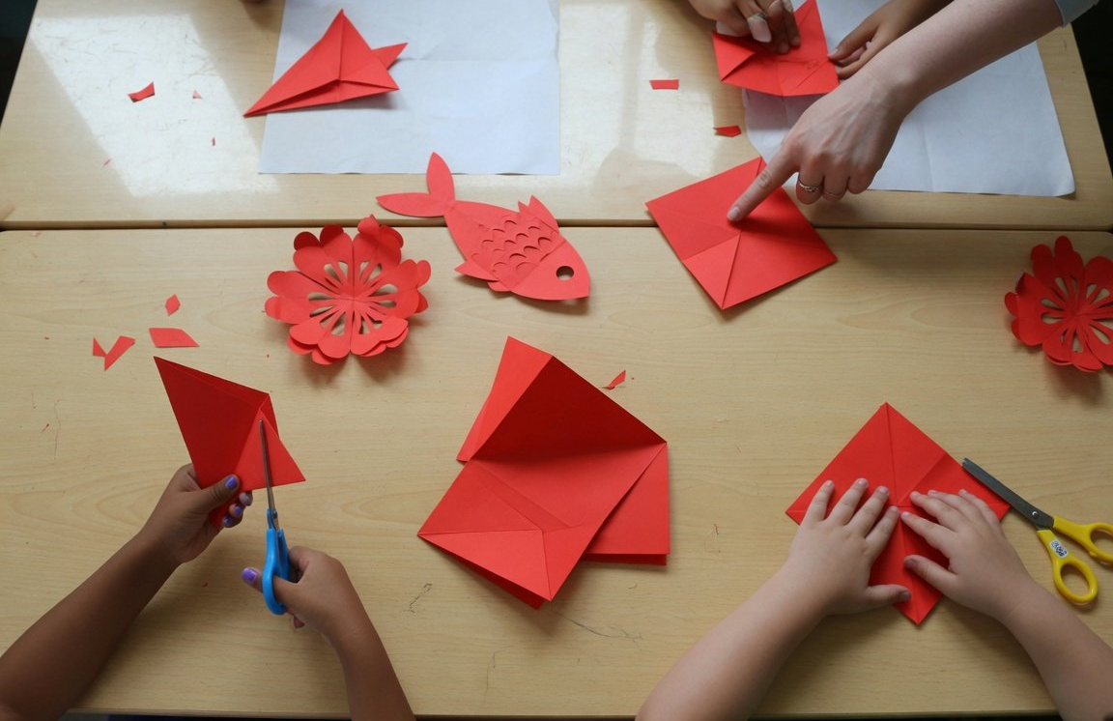
Crafts return to workshops, classes, schools
Volume Two · The People
Culture Lecture Hall · October 2026
Workshops
Training
Schools
14,900
About 1.3 million
51,000+
3,369
Heritage workshops, end of 2025
People with work or income from them
Training places, 149 colleges
Heritage schools
Statistical bulletin
SCIO press conference, Sep 2026
Ministry reply, Dec 2025
NPC report, 2024
Pictures are AI-generated illustrations. Platform figures for heritage videos and sales are company counts, not evidence that transmission is improving, so they are not on this page
14
Notes:
People, objects, daily life: the Ministry of Culture and Tourism's 2023 guidance on heritage and tourism asks that heritage be seen in its people, its objects and its everyday setting. Three directions. First, heritage workshops, which organise craftspeople to produce in villages and neighbourhoods. The 2025 statistical bulletin counts 14,900 of them at the end of 2025, and a State Council Information Office press conference in September 2026 said they bring jobs or extra income to about 1.3 million people. Reports during 2025 gave several other workshop counts that do not match, so I use only these two. Second, the training programme that sends bearers to universities: by the end of 2024, 149 colleges had run more than 1,430 courses with over 51,000 places. Third, schools: 3,369 primary and secondary schools are designated heritage schools, and 25 universities offer an undergraduate degree in heritage conservation. A word on short-video and e-commerce platforms, which also publish heritage views and sales: those are the companies' own figures, defined differently by each platform. They cannot be added up, and they are not evidence that transmission is getting healthier. All three pictures are AI-generated illustrations.

Slide 15
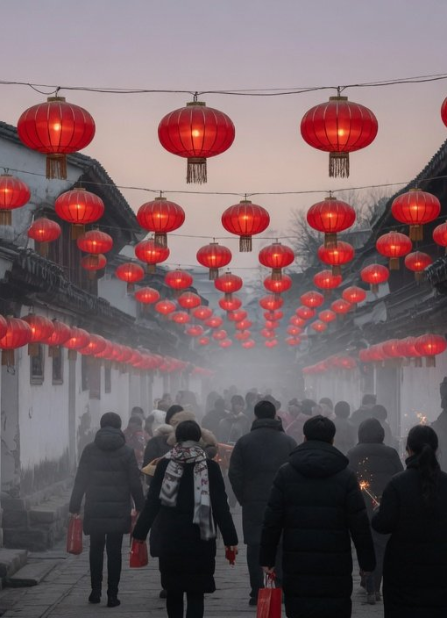
Volume Two · The People
After listing, trips rose 5.7% a day
Culture Lecture Hall · October 2026
Holiday
Days
Trips (million)
Per day (million)
501
62.6
Spring Festival 2025
8 days
596
66.2
Spring Festival 2026
9 days
Trips per day rose from 62.6 million to 66.2 million, up 5.7%
The travel rush is another count: 9.41 billion cross-region trips over 40 days in
2026, going home and to work included, not tourism. Nor can the rise be credited
to the listing.
Illustration (AI-generated)
Source: Ministry of Culture and Tourism (Feb 2025, Feb 2026), Ministry of Transport (Apr 2026)
15
Notes:
In December 2024 the Spring Festival was inscribed on UNESCO's Representative List. The ministry called the 2025 holiday the first Spring Festival after inscription. Over that 8-day holiday, people made 501 million domestic trips and spent 677.0 billion yuan. The 2026 holiday lasted 9 days, one day longer, with 596 million trips and 803.5 billion yuan spent. Because the holidays differ in length, a per-day comparison is fairer: 62.6 million trips a day, then 66.2 million, up 5.7 percent. That rise cannot be credited to the inscription, since many things drive holiday travel. And the travel-rush figure you often hear is another count altogether: 9.41 billion cross-region trips over the 40 days of the 2026 travel season, which includes people going home and going to work, not just tourism. The picture is an AI-generated illustration.

Slide 16
On record: listing over care, copycats, fakes
Volume Two · The People
Culture Lecture Hall · October 2026
Listing over care
“An emphasis on listing over protection, and on numbers over quality”
NPC Standing Committee inspection report, 2024
Copycat tourism
Heritage tourism shows “blind imitation and simple copying”
Same report
Thin local funding
Some local heritage budgets fall year after year, and a second national survey has not started
Same report
Fake “heritage”
Misused logos, invented bearers, health claims: 197 products pulled, 35 shops closed
Supreme People's Procuratorate cases, Mar 2026
16
Notes:
Now the problems, each one from a public document. First, the 2024 inspection report of the National People's Congress Standing Committee says plainly that there is an emphasis on listing rather than protection, and on numbers rather than quality. Getting on a list is a moment. Protecting is the work of years. Second, the same report finds that heritage and tourism are combined at a shallow level, with blind imitation and simple copying, and a 2023 ministry guideline asks places to avoid copy-paste, look-alike development. Third, local funding is thin: some local heritage budgets have fallen year after year, some counties rich in heritage have no protection office, and a second national heritage survey has not yet been organised. Fourth, fake heritage. In typical cases published by the Supreme People's Procuratorate in March 2026, sellers used China's official heritage logo without permission, livestreams invented items and bearers, health products claimed cures, and some people handed out knock-off heritage certificates. The result: 35 online shops closed, 13 livestream accounts suspended, 197 products taken down and fines of 400,000 yuan.

Slide 17
Five things: see, ask, check, record, learn
Volume Two · The People
Culture Lecture Hall · October 2026
See
Ask
Check
Record
Learn
Visit a cultural centre,
Ask who the bearer of an
Look up a claimed
With your elders'
If you want to learn a
library or heritage
item is, and whether they
bearer in the national list
consent, record family
craft, plan in years, not a
museum. Article 35 of
still practise it
on the China ICH
customs, dialect and
single taster class
the law asks them to
website, and report
skills, noting who, where
show heritage
fake livestreams
and when
These are suggestions, and none of them guarantees anything. Basis: ICH Law, Articles 14, 20 and 35
17
Notes:
Five things to take home. They are suggestions, and none of them guarantees an outcome, but all of them are within reach. See: go to your local cultural centre, library or heritage museum. Article 35 of the law asks public cultural institutions to show and explain heritage, and tonight's talk is part of that. Ask: when you watch a performance or a demonstration, ask who the bearer is and whether they still practise it. Check: if someone calls themselves a bearer or calls a product heritage, you can look up the item and region in the national list on the China ICH website. If they do not match, buy it as an ordinary product and do not pay extra for the label. If you see a livestream misusing the official heritage logo or claiming cures, you can complain to the market regulator. Record: with your elders' consent, record your family's festival customs, dialect and skills, and write down who, where and when. Article 14 of the law allows citizens to carry out heritage surveys. Learn: if you really want to learn a craft, plan in years, not a single taster class. Also, Cultural and Natural Heritage Day falls on the second Saturday of June. And if you think something near you deserves a place on the list, Article 20 lets you propose it to the provincial culture department.

Slide 18

October 2026
Lists keep names.
People keep skills alive.
Culture Lecture Hall · Public Lecture
文
Cultural and Natural Heritage Day
The second Saturday of every June
Background is an AI-generated illustration
Notes:
One last line: lists keep the names, people keep the skills alive. Now, questions. And a reminder that Cultural and Natural Heritage Day is the second Saturday of June, when cultural centres, libraries and museums across the country hold events. The background is an AI-generated illustration.

