Slide 1
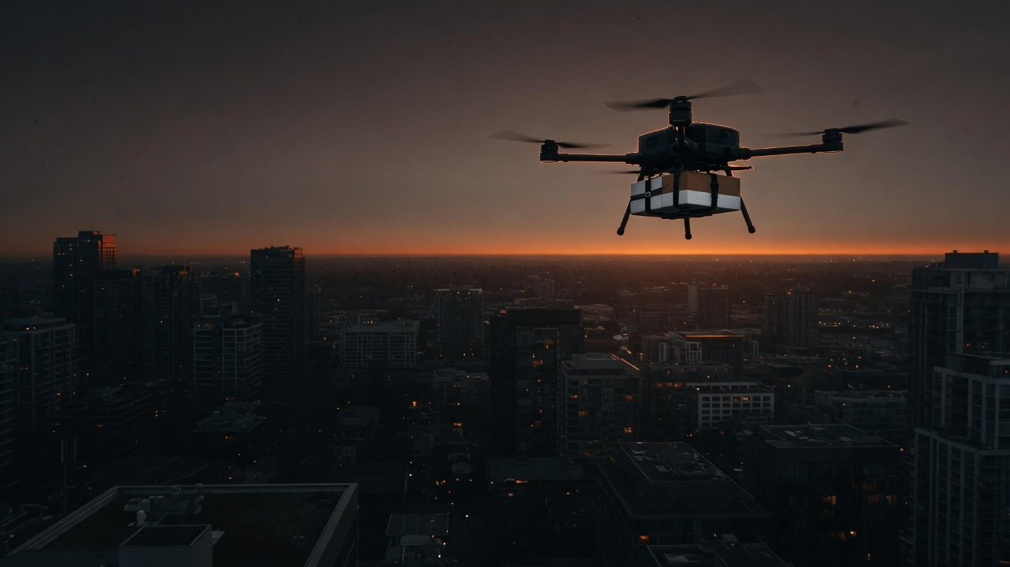
Seed round · October 2026
Drone delivery in cities:
medical first
We have not flown yet. In 18 months we prove three things.
Medical + community
Parks and suburbs first
Three tests in 18 months
Notes:
We are building drone delivery for cities, and we start with two kinds of orders only: medical and community. To be clear up front, we have not started commercial operations. Today is not about traction. It is about three things: why now, where we enter, and what we will prove with data in 18 months. Every outside figure in this deck comes from public regulations, official statistics or company announcements, and each page names its source. The cover photo is an AI-generated illustration.

Slide 2
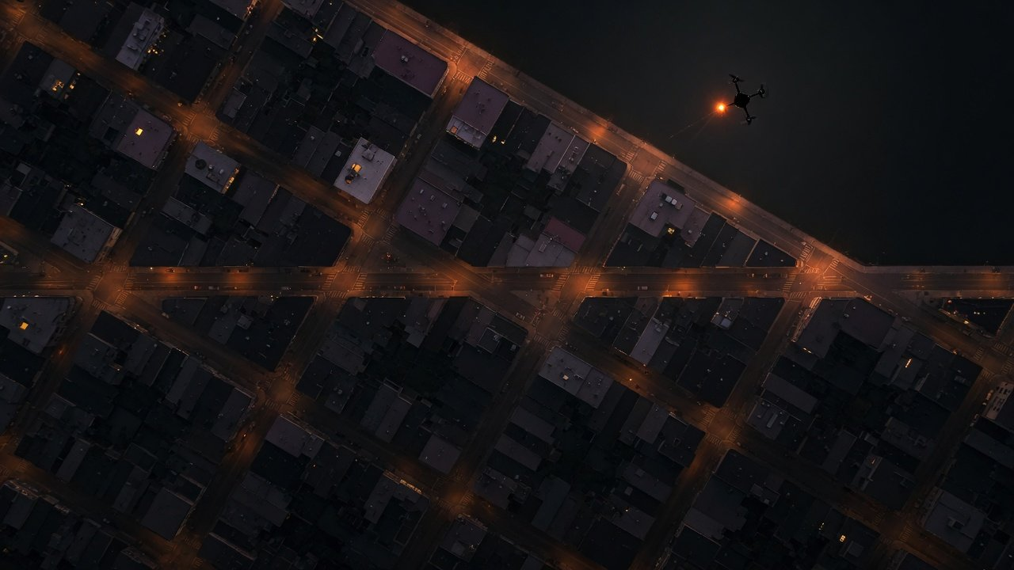
01
Huge demand,
a near-empty sky
60bn orders a year, drones 1m+ in all
Why now: three years, three policies
Medical landing points in Shenzhen's plan
What six pioneers have proven
Notes:
First, the opportunity. On the ground, instant delivery in China is one of the largest order pools in the world. In the air, the share is close to zero. The background photo is an AI-generated illustration.

Slide 3
Seed round
Opportunity
Timing
Rivals
Wedge
Proof
Risks
Plan
Ask
60bn orders a year. Drones: 1m+ in total
About 2
60bn
in 100,000
Instant delivery orders in China in 2025, one year
Several years of drone orders over one year of all orders,
scale only
1m+
The orders all move on the ground and the
Meituan's commercial drone orders, all years
sky's share is close to zero. That does not prove
demand. It proves the space is still open.
Source: CFLP 2026 instant logistics report (via Yicai, 2026-03-26), Meituan (2026-09-11, company figure), IT Home (2026-07-22). Illustration: the squares are not to scale
3
Notes:
One point on this page: the order pool is enormous and drones have almost none of it. China handled more than 60 billion instant delivery orders in 2025, according to the China Federation of Logistics and Purchasing. On the drone side, Meituan, the furthest along, passed 1 million commercial orders in total only by the end of June 2026, counting every year since it started. Set that multi-year total against one year of orders and you get about 2 in 100,000. The two numbers are not on the same basis, so we only use the ratio to show the order of magnitude: the sky is still empty.

Slide 4
Seed round
Opportunity
Timing
Rivals
Wedge
Proof
Risks
Plan
Ask
Why now: rules, then sequence, then status
2026
2025
Status raised
2024
Third year running in the Government
The order is set
Work Report
Named an emerging pillar industry
NDRC: cargo, segregated airspace and
Rules in force
outskirts first
Cargo delivery is first in line
Drone regulations and CCAR-92 took effect
on January 1
Certificates, licenses and cover got one bar
The base is growing too: 45.3m drone flight hours in 2025 (up 69.89%) and 38,872 licensed operators
Source: drone regulations, CCAR-92, NDRC briefing (2025-12-31), Government Work Reports 2024 to 2026, CAAC 2025 statistics
4
Notes:
Why now. Three reasons, one per year. On January 1, 2024, the State Council's interim drone regulations and CAAC's CCAR-92 took effect on the same day, and commercial drone flying got a clear licensing path for the first time. At the end of 2025, the NDRC set the order of entry at a press briefing: cargo before passengers, segregated airspace before shared airspace, outskirts before city centers. Instant delivery is cargo, so it comes first. City centers come last, which is both the opening and the constraint. In 2026 the low-altitude economy appeared in the Government Work Report for the third year running, moving from a new growth engine, to safe and healthy development, to an emerging pillar industry. The base is growing too: drones in China flew 45.3 million hours in 2025, up almost 70%, and the number of units holding an operating certificate doubled in a year to 38,872. Most of those hours are crop spraying and inspection, not delivery.

Slide 5
Seed round
Opportunity
Timing
Rivals
Wedge
Proof
Risks
Plan
Ask
Shenzhen plans 1,200 landing points, 148 medical
1,200 points
Already built
1,284
All landing points, 2026 target
Landing points in Shenzhen at end-2025,
past the 1,200 target
413 points
Community delivery
What it means for us
Medical and community pads are
148 points
written into the plan. We do not have to
talk a city into building them.
Medical
Source: Shenzhen DRC low-altitude infrastructure plan 2024 to 2026, Shenzhen government (2026-02-27). Plan targets, except the 1,284 built
5
Notes:
From the national order pool down to what our first city lets us serve. We start in Shenzhen because it is the only city that splits its landing points by use in a published plan. The plan calls for more than 1,200 landing points by 2026, of which 413 are for community delivery, and of those, 148 are for medical and 265 for shopping districts. These are targets, not built sites. The built count is keeping up: Shenzhen had 1,284 landing points by the end of 2025, already past the 1,200 target, and drones carried freight on more than 1 million flights that year across 310 cargo routes. Our serviceable market starts from those 148 medical points and 413 community points.

Slide 6
Seed round
Opportunity
Timing
Rivals
Wedge
Proof
Risks
Plan
Ask
Flying and licensing proven. Profit is not
Pioneer
Main use
Public scale
Network
Cost per order
Meituan
Food, medical
70 routes, 6 cities
1m+ orders
Not published
Phoenix Wings
Parcels, cross-sea
383 routes, Shenzhen
600-700 flights a day
Not published
JD Logistics
Rural last mile
78 routes, Zizhong
78 villages, Zizhong
Not published
Antwork
Mostly medical
55 cities
2.6m km flown
Not published
Zipline
Medical, retail
About 70% in the US
2.5m+ deliveries
Not published
Wing
Retail
270+ Walmart sites, 2027
1m+ deliveries
Not published
None of the six publishes an absolute cost per order, and Meituan only says it falls 40% to 50% a year. Whoever does this sum first has the say.
Source: Meituan, SF, JD, Antwork, Zipline and Wing releases and press reports (2025-07 to 2026-07), company figures
6
Notes:
The competitive landscape. Four in China. Meituan runs urban food and medical deliveries, has passed 1 million orders in total, flies 70 routes across six cities including Shenzhen, Beijing, Shanghai, Guangzhou, Hong Kong and Dubai, and holds China's first operating certificate for low-altitude logistics with full-area coverage. SF Express's Phoenix Wings runs parcels, cross-sea and intercity routes, with 168 drones and 383 routes in Shenzhen and 600 to 700 flights a day. JD Logistics runs rural last-mile routes in Zizhong, Sichuan, where its first 78 routes reach 78 villages. Antwork is mostly medical, active in 55 cities, with 2.6 million kilometers flown. Abroad, Zipline has passed 2.5 million deliveries and was valued at 7.6 billion dollars in January. Wing has passed 1 million and plans more than 270 Walmart sites by 2027. The takeaway: the pioneers have shown that drones can fly, get licensed and build networks. None has published an actual cost per order. Meituan only says its cost per order falls 40 to 50 percent a year. Whether this makes money is still an open question, and that is the question our data will answer. All figures are company statements or press reports.

Slide 7
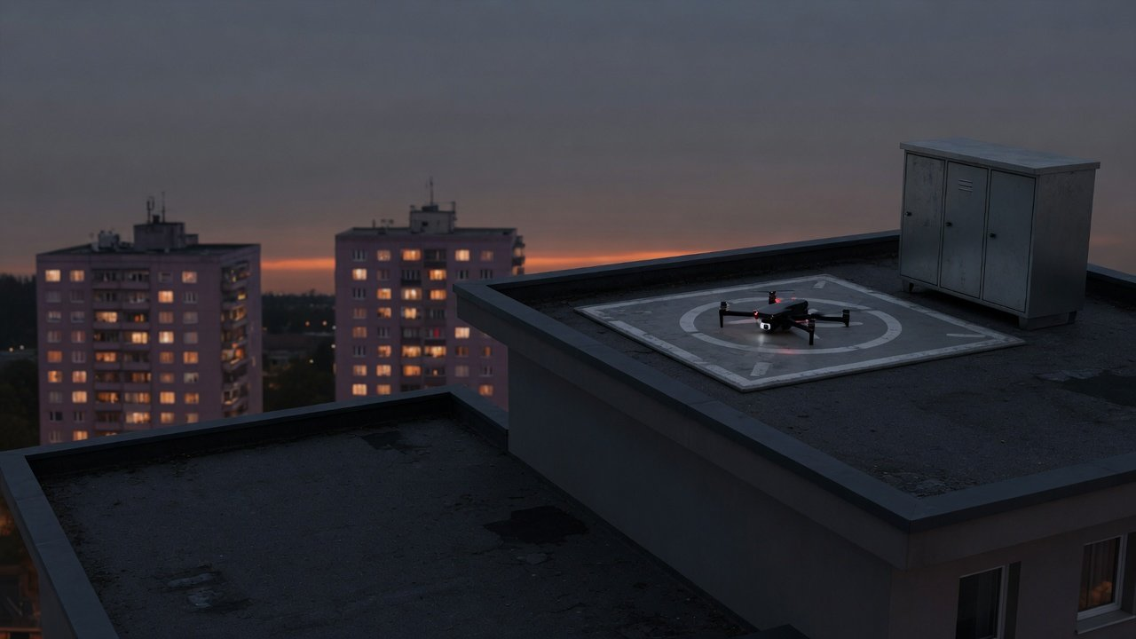
02
Where we start,
what we prove
The wedge: medical plus community, parks first
Three hypotheses to test
Five compliance gates and six risks
18-month milestones and this round's ask
Notes:
Part two: where we enter, why there, and what the next 18 months must prove. The background photo is an AI-generated illustration.

Slide 8
Seed round
Opportunity
Timing
Rivals
Wedge
Proof
Risks
Plan
Ask
Policy and pad plans point us to medical first
Order of entry
City plan
Proven demand
Our wedge
Medical +
Cargo
413
4.6m
+
+
=
community
Segregated airspace and
Shenzhen community points,
Medical sample tubes Antwork
Parks and suburbs with
outskirts first (NDRC)
148 of them medical
has flown (company figure)
pads first
Not yet
Last in the order of entry, and Meituan's home turf
Peak-hour food downtown
Source: NDRC briefing (2025-12-31), Shenzhen low-altitude infrastructure plan (Shenzhen DRC), China.com (2025-11-26, company figure)
8
Notes:
We did not pick this entry point by instinct. It falls out of public information. First, the order of entry: the NDRC was explicit, cargo before passengers, segregated airspace before shared airspace, outskirts before city centers. So we start with cargo, in parks and suburbs where segregated airspace is easiest to draw. Second, the landing-point plan: Shenzhen plans 413 community delivery points, 148 of them medical. The endpoints are already in the plan, so we do not have to persuade the city to build them. Put the two together and you get our wedge: medical first, then community, starting from business parks and suburbs that already have landing points. Just as important is what we will not do first: food orders at peak hours in city centers. That comes last in the order of entry, and it is Meituan's home ground. We will not take it head on.

Slide 9
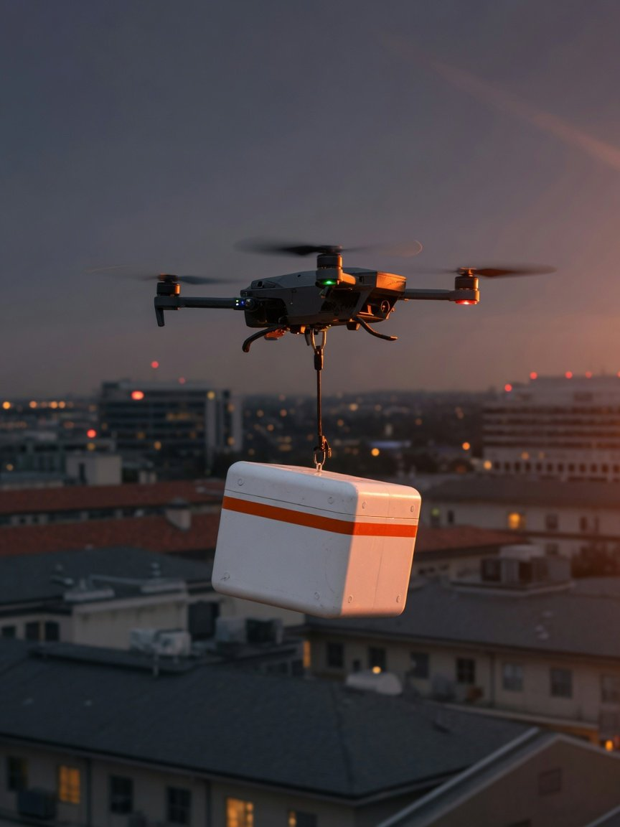
Opportunity
Timing
Rivals
Wedge
Proof
Risks
Plan
Ask
Light, urgent loads:
4.6m samples already flown
4.6m
Medical sample tubes Antwork had flown by Nov 2025, company figure
810k
2.5 kg
Lab samples and drugs Meituan had
Payload of Meituan's 4th-generation
flown by June 2026
drone, room for a sample box
Source: China.com (2025-11-26), IT Home (2026-07-22, 2023-07-05), company figures
9
Seed round
Illustration, AI-generated
Notes:
Why medical first. One, the loads are light: a sample or a pack of medicine weighs little, and Meituan's fourth-generation drone carries up to 2.5 kilograms, which covers almost every medical order. Two, they are urgent: lab samples and urgent medicine are time-sensitive, and the customer paying for speed is an institution, not a shopper comparing fees order by order. Three, other operators have already proven this use case: Antwork has flown 4.6 million medical samples, and Meituan has delivered more than 810,000 lab samples and drug packages. Both are company figures. We do not need to prove that medical demand exists. We need to prove we can serve it at a lower cost. The picture is an AI-generated illustration.

Slide 10
Seed round
Opportunity
Timing
Rivals
Wedge
Proof
Risks
Plan
Ask
Three hypotheses to prove: cost, density, safety
1
Cost per order below a courier's
Month 18
Month 1
Benchmark: Meituan's delivery cost, about RMB 4.54 an order in 2022 (our calculation)
Tested in months 16 to 18
2
Orders per landing point keep climbing
Month 18
Month 1
Benchmark: Meituan sites went from about 10 to as many as 400 orders a day
Tested in months 10 to 15
(company figure)
3
Safe, steady flying once licensed
Month 18
Month 1
Benchmark: drones in Shenzhen flew cargo on more than 1m flights in 2025
Tested in months 7 to 9
Source: Meituan 2022 annual results (our calculation), Yicai Global (2026-05-22, company figure), Shenzhen government (2026-02-27)
10
Notes:
Over 18 months we have three hypotheses to prove, and each one has a public number to check against. Hypothesis one, the one that matters most: our cost per order on medical and community routes is lower than a courier's. The latest public courier figure we can calculate is Meituan's 2022 delivery cost of 80.19 billion yuan over 17.67 billion orders, about 4.54 yuan per order. That is our calculation, not a figure Meituan publishes. Hypothesis two: orders per landing point keep climbing. Meituan has said a single site went from about 10 orders a day to as many as 400. That is a company figure, and we treat it as a ceiling, not a target. Hypothesis three: once licensed, we can fly safely and steadily. Shenzhen logged more than a million cargo drone flights in 2025, so this road has been traveled. We answer them in months 7 to 9, 10 to 15 and 16 to 18.

Slide 11
Seed round
Opportunity
Timing
Rivals
Wedge
Proof
Risks
Plan
Ask
Courier cost has a figure. Drones only a trend
Courier side · absolute figures
Drone side · only trends and estimates abroad
4.54
6.9
40-50%
5-7
RMB/order
RMB/order
/year
USD/order
Meituan's 2022 delivery cost
Essence estimate on food orders
Yearly fall in Meituan's drone
Barclays on automated delivery
over its instant orders
only, a smaller base
cost per order, no
in high-wage US and Europe
(our calculation)
absolute figure
To prove: on the same basis, a medical route under RMB 4.54 an order
Source: Meituan 2022 annual results (our calculation), Essence International (2023-10-13), Yicai Global (2026-05-22), Barclays (2026-04)
11
Notes:
What the unit economics have to prove. First, an admission: the figures on the two sides are on different bases and cannot share one axis. On the courier side, the most reliable figure is the one we calculated from Meituan's 2022 annual results: 80.19 billion yuan of delivery-related cost over 17.67 billion instant delivery orders, about 4.54 yuan per order. Essence International used a smaller base, first-party food orders only, and got 6.9 yuan. Meituan stopped disclosing both inputs after 2023. On the drone side, Meituan only says its cost per order falls 40 to 50 percent a year and has never published an absolute figure, and no other Chinese operator has either. Barclays estimates 5 to 7 dollars per autonomous delivery in high-wage markets, which is Western labor cost and cannot be carried over to China. So today the unit economics have no public answer. What we must prove is that on the same basis, total cost over total orders, our medical routes come in under 4.54 yuan per order.

Slide 12
Seed round
Opportunity
Timing
Rivals
Wedge
Proof
Risks
Plan
Ask
Compliance is the gate: five steps before flying
Gate 1
Gate 2
Gate 3
Gate 4
Gate 5
Registration
Pilot license
Liability cover
Risk
Operating
assessment
certificate
Two mandatory
Required to fly a
Required for
standards from
small drone
commercial flights
SORA 2.5 guide still out
CCAR-92, valid for
2026-05-01
for comment
24 months
Cost of skipping it
Below 120 m is not open sky
RMB 50k-500k
120 m
Fine for flying without a certificate (Regulations, Art. 49)
Airspace over airports and key sites is controlled (Art. 19)
Source: State Council drone regulations, CCAR-92, CAAC consultation notice (2026-04-15), Xinhua (2025-12-10)
12
Notes:
The regulatory path. To run commercial deliveries with small drones, there are five steps before the first flight. One, registration: two mandatory national standards on real-name registration and remote identification took effect on May 1, 2026. Two, anyone flying a small drone needs a pilot license. Three, commercial flights must carry liability insurance. Four, specific-category operations need a risk assessment. China uses the SORA method, and in April 2026 CAAC put out a draft guide based on SORA 2.5 for comment. It has not taken effect yet. Five, the operating certificate itself, valid for 24 months under CCAR-92 and then renewed. The gate is real: flying without an operating certificate carries a fine of 50,000 to 500,000 yuan. And staying below 120 meters does not mean free airspace: the areas around airports and key facilities are controlled. Because the assessment rules are changing, we prepare to the 2.5 draft and re-check when the final version is published. For us this is a barrier and a moat at once, and our first milestone is getting the certificate.

Slide 13
Seed round
Opportunity
Timing
Rivals
Wedge
Proof
Risks
Plan
Ask
Every risk has happened before. We plan for each
Risk
What has happened
Our response
When
Two Amazon MK30s hit a crane and caught fire
Survey every leg, log cranes daily
Obstacles
Months 1-6
(2025-10, NTSB)
Phoenix Wings' Ark 80 parachuted down in
Routes off crowds, a parachute on board
Forced landing
Months 1-6
Shenzhen (2026-02)
Wing landed on power lines, about 2,000 homes cut
Pads and routes clear of overhead lines
Power lines
Months 7-9
off (2022-09)
Wing's Canberra trial led to a noise review (2019)
Parks and suburbs first, notify residents before
Noise
Months 10-15
moving in
China's minimum cover due only around 2027
Full third-party cover before the first flight
Insurance
Months 1-6
Operators drew 2.2% of big low-altitude deals (H1
Spend by milestone, check each one
Funding
Throughout
2026, global)
Source: NTSB (2025-10), DoNews (2026-02-12), ABC (2022-09-30), Region (2019-06-19), NDRC (2026-02), ITjuzi (2026-07)
13
Notes:
Our risk register. Every risk here has a real precedent, and we state only the facts. In October 2025 in Arizona, two Amazon MK30 drones hit a moving crane one after the other and their batteries caught fire. No one was hurt, and the NTSB has issued a preliminary report. In February 2026 a Phoenix Wings Ark 80 came down under its parachute in Shenzhen. The company called it an operator error during a test. In September 2022 a Wing delivery drone landed on power lines in Australia and about 2,000 homes lost power. In 2019, Wing's trial in Canberra drew noise complaints and a federal review. On insurance, China plans to set up mandatory cover by around 2027, and the minimum amount is not set yet. And on money: in the first half of 2026, operating services drew only about 2.2 percent of large low-altitude funding deals, global figures from ITjuzi. Most of it went to passenger eVTOL aircraft. Our responses: survey every route leg by leg and update temporary obstacles such as cranes daily. Keep routes away from crowds and fly with parachutes. Site landing points and routes clear of overhead lines. Start in parks and suburbs and notify residents before entering a community. Buy full third-party cover before the first flight, without waiting for the mandatory standard. And spend by milestone, with each stage checked on its own. These responses are plans. They go into our operations manual for the licensing review.

Slide 14
Seed round
Opportunity
Timing
Rivals
Wedge
Proof
Risks
Plan
Ask
18 months: license, medical route, cost check
3 months
6 months
9 months
18 months
Start
12 months
15 months
Gate: month 6
Months 1 to 6
Months 7 to 9
Months 10 to 15
Months 16 to 18
Operating certificate
First medical route
Community points
Cost check
·
Certificate and pilot licenses
·
Point to point, in a park
·
From medical sites to
·
Same basis as RMB 4.54
or suburb
community pads
·
Full third-party cover
·
Raise the next round on three
·
Tests hypothesis 3: steady flying
·
Tests hypothesis 2: orders climb
data sets
·
Specific-category risk
assessment
Gate: no operating certificate by month 6, and route spending stops until we have one
This is a plan. Months count from the close of this round
14
Notes:
Eighteen months, four milestones, each one checked on its own. Months 1 to 6: get the operating certificate and pilot licenses, buy full insurance and complete the specific-category risk assessment. This is the gate, and nothing after it matters if we do not pass it. Months 7 to 9: open our first medical route, point to point in a business park or suburb, and answer hypothesis three, whether we fly safely and steadily. Months 10 to 15: extend from medical points to community delivery points and answer hypothesis two, whether orders per point keep climbing. Months 16 to 18: calculate our cost per order on the same basis and check it against the courier figure of 4.54 yuan, which answers hypothesis one. Then we raise the next round on those three data sets. We have set ourselves a gate: if we do not have the operating certificate by month 6, we stop spending on routes and landing points until we do, rather than gamble investors' money. All of this is a plan, and months count from the close of this round.

Slide 15
Seed round
Opportunity
Timing
Rivals
Wedge
Proof
Risks
Plan
Ask
The ask: 18 months, 60% to licensing and routes
This round
18 months,
30%
30%
25%
15%
three tests
30%
Licensing and safety
30%
Routes and pads
25%
Fleet and upkeep
From licensing to our first same-basis cost data. The amount
follows the milestones and due diligence.
15%
Team and operations
Planned share of this round
Benchmark: urban drone logistics rounds run to tens of millions of RMB (Antwork C+, 2025-11)
Source: China.com (2025-11-26). The shares are our plan, not an estimate
15
Notes:
Our ask: fund the four milestones over 18 months. We are not putting an invented amount on the slide. Here is how the money would be spent: 60 percent on licensing and routes, with licensing and the safety system at 30 percent, routes and landing points at 30 percent, the fleet and its upkeep at 25 percent, and the team and operations at 15 percent. These shares are our proposal and will be refined in due diligence. For scale, a public benchmark: urban drone logistics operators have raised single rounds in the tens of millions of yuan, for example Antwork's C+ round in November 2025.

Slide 16
Let's fly the first medical route
together
18 months, three tests: license first, then a medical route, then a cost check
Month 6
Month 9
Month 18
Operating certificate
First medical route
Same-basis cost data
Let's set a time
Notes:
To repeat the ask: this round funds 18 months of milestones, from the operating certificate, to our first medical route, to the first cost figures we can check against couriers. We would welcome a follow-up conversation.

