Slide 1
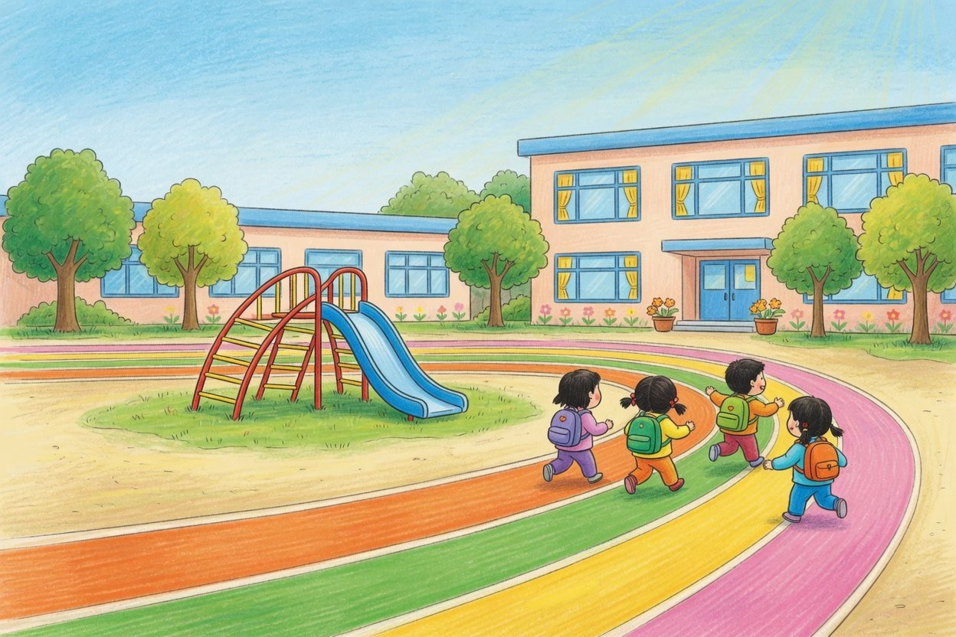
New term parents' meeting
Welcome back!
Let's grow together
New rules, how children grow, home habits and safety,
all in one go
Autumn term 2026
Illustration: outdoor play (AI-generated)
Notes:
Good evening, and welcome to the new term's parents' meeting. Tonight we cover four things you care about most: the new rules that involve parents, how children grow between three and six, what helps at home, and safety. For every point we will tell you where it comes from, so you can look it up yourself.

Slide 2
New rules
Five things to talk about today
01
02
03
04
05
New rules
How
Home and
Safety tips
A few
children
school
favours
grow
The preschool
Five areas, a day
Sleep, screens,
Pick-up, bus,
Five small things,
law, the free
at school
outdoors, meals,
water, getting
and next time
final year
eyes
lost
2
New term parents' meeting · Autumn term 2026
Notes:
We have five things to talk about. First the new rules, especially the free final year that started last autumn. Then how children grow between three and six, and what a day at kindergarten looks like. The third part is the heart of tonight: what helps at home with sleep, screens, outdoor time, food and eyesight, and how the youngest children settle in. Then safety. Last, a few small favours we would like to ask.

Slide 3
New rules
The new preschool law: six parts for you
No entrance tests
Tell us about health
Limit screen time
Apart from a health check, no test of any
Tell us of any special condition or illness
Home and school both teach sensible
kind to get in
your child has
use and limit it
Article 15
Article 15
Article 20
No school lessons
Fees in the open
Keep talking
Play comes first, and primary school
Meal money buys only meals, and fees
We tell you how your child is doing and
lessons are not taught
and refunds are posted
ask for your support
Articles 56 and 59
Article 69
Article 58
Source: Preschool Education Law of the PRC, passed November 8, 2024, in force since June 1, 2025
3
New term parents' meeting · Autumn term 2026
Notes:
China's first law just for preschool education took effect on June 1 last year. Six parts of it involve parents most closely. Apart from a necessary health check, no kindergarten may set any kind of test or exam to get in. If your child has an allergy, a special condition or an illness, the law asks parents to tell the kindergarten promptly, so please tell your child's teacher this week. Limiting screen time is a job the law gives to both families and kindergartens. It names no number of minutes, and later tonight we put the advice of several bodies side by side. Play is the basic activity, kindergartens may not teach primary school courses, and primary school starts from zero. Meal money may only be spent on meals, and fees, standards and refund rules must be posted. We will keep you informed about how your child is doing, and we ask for your support. The law also requires a parents' committee, and we would welcome volunteers.

Slide 4
New rules
Final-year fees waived, meals still paid
Waived
Still paid
· Public, final year: the care and education fee
· Meals, boarding and sundries, as usual
· Private, final year: cut by the local public rate
· What a private school charges above that rate
· From the autumn 2025 term
· Younger classes: the rules cover the final year
14 million
The official example: a private kindergarten
800 yuan
500 yuan
300 yuan
−
=
Children covered in 2025 (2026
Private fee a month
Public rate, waived
Parents pay
Government Work Report)
Source: State Council General Office, Opinions on Free Preschool Education (No. 27, 2025), briefing of August 7, 2025, 2026 Government Work Report. There is no single national amount
4
New term parents' meeting · Autumn term 2026
Notes:
Next, free preschool education. Under a State Council General Office document issued in August last year, from the autumn 2025 term the care and education fee is waived for children in the final year at public kindergartens. Children in the final year at a private kindergarten licensed by the education authorities get a reduction at the level of a local public kindergarten of the same type, and the private kindergarten may still charge anything above that. Please note that only the care and education fee is waived. Meals, boarding and sundry fees are not. There is no single national amount either, it depends on the local public rate. At the official briefing the example given was this: a private kindergarten charges 800 yuan a month and a public one of the same type 500, so 500 is waived and parents pay the 300 difference. This year's Government Work Report says the policy now covers 14 million children, and that this year the policy will be improved. So far national rules cover the final year only. If anything changes for the younger classes, we will post it in the class group chat as soon as we have an official notice.

Slide 5
New rules
A third fewer children, yet enrolment hit 92.9%
92.9%
92.0%
91.1%
89.7%
88.1%
85.2%
−33.1%
48.2 m
48.1 m
46.3 m
40.9 m
Children enrolled, 2020 to 2025
35.8 m
32.3 m
91.49%
2020
In affordable kindergartens, 2025
2021
2022
2023
2024
2025
Children enrolled (million)
Gross enrolment, ages 3 to 5
Source: Ministry of Education statistical bulletins, 2020 to 2025. Gross enrolment is measured against children aged 3 to 5, the affordable share against children enrolled
5
New term parents' meeting · Autumn term 2026
Notes:
A quick word on the bigger picture. The number of children in kindergarten across China fell from 48.18 million in 2020 to 32.26 million last year, a third fewer in five years. Over the same years the gross enrolment rate rose from 85.2% to 92.9%, and 91.49% of children now attend an affordable kindergarten, meaning a public one or a licensed affordable private one. Fewer children, but more of them can get a place they can afford. Two notes. Gross enrolment divides all children in kindergarten by the number of children aged three to five, while the affordable share is a share of children enrolled, so the two rates are worked out differently and should not be compared. And the affordable share dipped by 0.12 points last year, so it does not rise every single year.

Slide 6
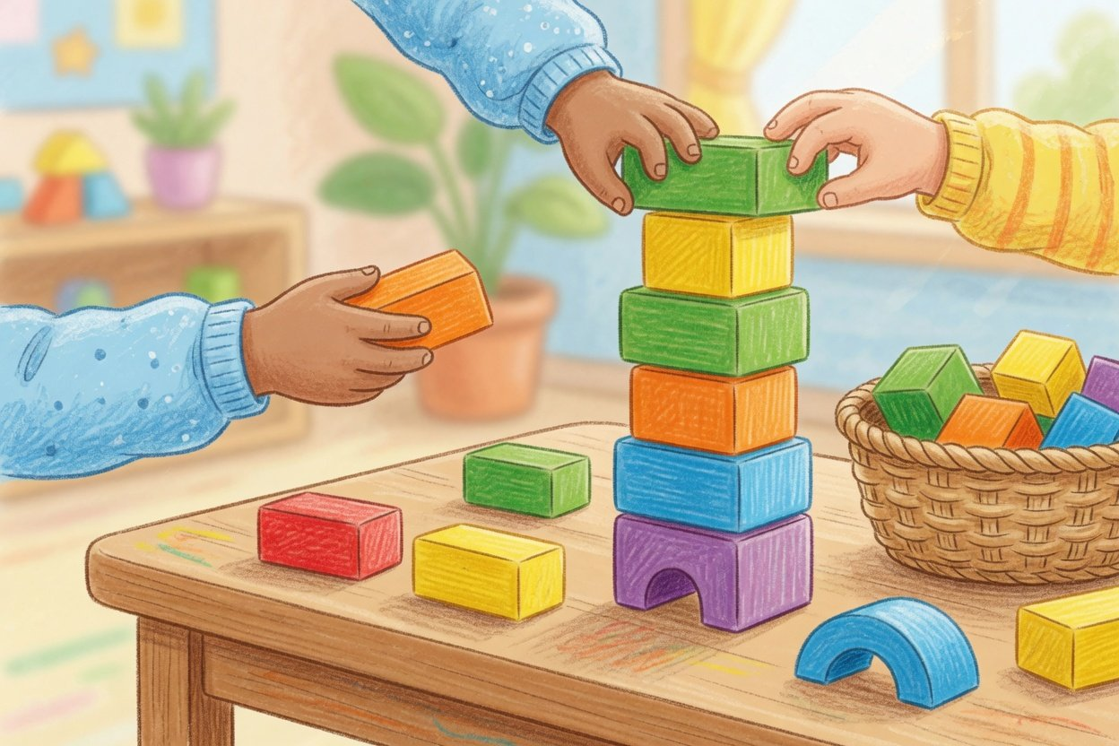
01
How children grow
Five areas in the ministry's guidelines for ages 3 to 6
Illustration: block play (AI-generated)
Notes:
Now to the children themselves: what they grow into between three and six. Our guide here is the Ministry of Education's Learning and Development Guidelines for Children Aged 3 to 6, published in 2012.

Slide 7
How children grow
Five areas grow together from age 3 to 6
Health
Language
Social
Science
Art
Youngest · ages 3 to 4
Youngest · ages 3 to 4
Youngest · ages 3 to 4
Youngest · ages 3 to 4
Youngest · ages 3 to 4
Dresses and puts on
Talks in front of
Curious about
Counts up to 5,
Loves to scribble,
shoes with help
people they know
kindergarten, likes
touching each one
cut and stick
going
Oldest · ages 5 to 6
Oldest · ages 5 to 6
Oldest · ages 5 to 6
Oldest · ages 5 to 6
Oldest · ages 5 to 6
Ties their own
Tells what
Settles quarrels with
Adds and takes
Shows ideas with
shoelaces
happened, clearly
friends on their own
away to 10 with
many tools
and in order
real things
and materials
Source: Ministry of Education, Guidelines for Children Aged 3 to 6 (2012). Rough expectations at the end of each age, not pass marks
7
New term parents' meeting · Autumn term 2026
Notes:
The guidelines describe development in five areas: health, language, social, science and art. For each, they say roughly what a child can do by the end of three to four, four to five, and five to six. We picked one example per area, the end of the youngest class on the left and the end of the oldest class on the right. In health, for example, a younger child dresses with help, and by the oldest class ties their own shoelaces. One word on science: adding and taking away within ten, the guidelines say, is done by handling real objects, not by reciting or drilling. These are rough expectations, not pass marks. A little earlier or a little later is normal.

Slide 8
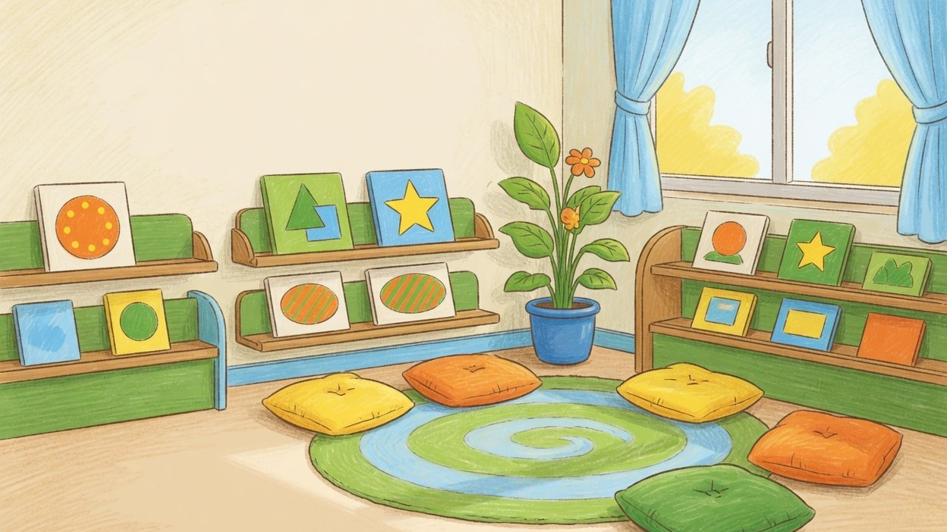
How children grow
No single ruler,
no head start on school
“Never measure every child with one ruler.” “No early lessons or drilling that pull
seedlings up to make them grow.”
Ministry of Education, Guidelines for Ages 3 to 6 (our translation). The law bans primary school lessons too (Article 59)
Background: AI-generated illustration
8
New term parents' meeting · Autumn term 2026
Notes:
These two lines come straight from the guidelines, and we would like every parent to remember them. Every child has their own pace. In one class some children talk first and some run first, and both are fine. Please also don't rush your child into primary school content. Article 59 of the Preschool Education Law says kindergartens may not teach primary school courses, and primary school teaching starts from zero. The guidelines add that teaching young children to read characters early through rote memory and drilling does not suit how they learn. Playing together and reading picture books at home will do more good than early pinyin or sums. The background is an AI-generated illustration of a picture-book corner.

Slide 9
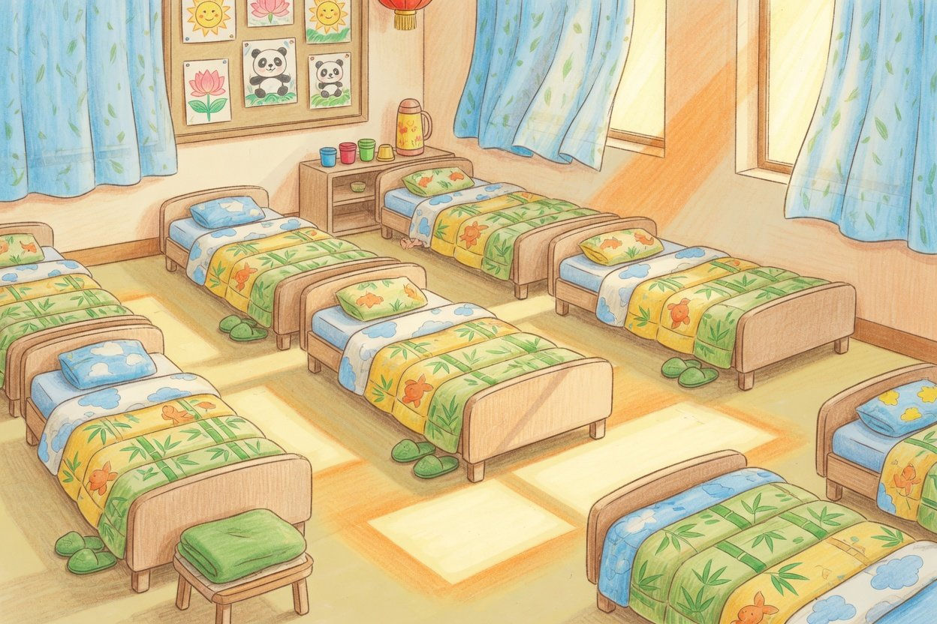
How children grow
A day at kindergarten: at least 2 hours outdoors
Outdoors
At least 2 hours a day, 1 hour of it exercise
Meals
Nap
3.5 to 4 hours between
Usually about 2 hours
main meals
Arrival
Home time
Brought by you or an
Illustrations: outdoors, blocks, nap room (AI-generated)
Handed to you or an
adult you name
adult you name
Source: Kindergarten Work Regulations (Order No. 39), Articles 13, 18 and 23: outdoor time is a rule. Nap length is advice from the Guidelines for Ages 3 to 6
9
New term parents' meeting · Autumn term 2026
Notes:
Some parts of a kindergarten day are set by regulation. Under the Kindergarten Work Regulations, children normally spend at least two hours a day outdoors, and at least one hour of that is physical exercise. The one hour is part of the two, not on top. Main meals are three and a half to four hours apart. Children are brought in and collected by a guardian or an adult the guardian names. A nap of about two hours is the guidelines' advice, adjusted for age, season and the child. Play is the basic activity, which is also what the Preschool Education Law asks. The weekly menu is posted for you to see. The three pictures are AI-generated illustrations, not photos of our kindergarten.

Slide 10
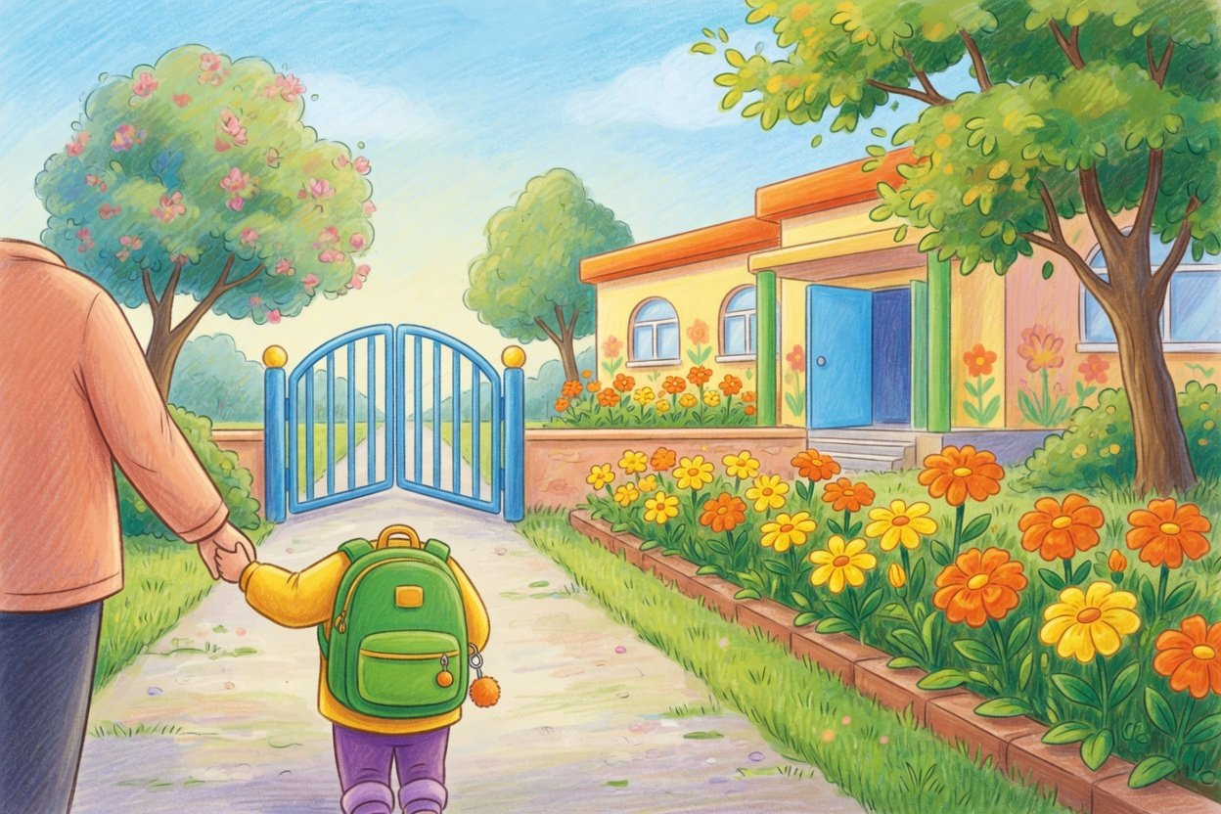
02
Home and school
What helps at home: sleep, screens, outdoors, meals,
eyes, settling in
Illustration: arriving at kindergarten (AI-generated)
Notes:
Now the heart of tonight: home and school working together. Children spend much of their day at home, and when sleep, screens, outdoor time, food and eyesight go well at home, we can build on it here.

Slide 11
Home and school
For the fridge: sleep, screens, outdoors
Sleep
Screens
Outside
Regular bedtime and
Under 1 hour a day in all, less
Run around outdoors every
wake-up. Naps count toward
is better. None at bedtime
day. 2 hours here, and
the day
at weekends
10 to 13 h (health office, nutrition
Health commission, nutrition society
Outdoors comes first for the eyes
society, WHO)
and WHO agree
11 to 12 h (ministry guidelines)
Source: Education ministry 2012, Patriotic Health office 2025, Nutrition Society 2022, WHO 2019, Health Commission 2021 (two papers), Work Regulations
11
New term parents' meeting · Autumn term 2026
Notes:
If you remember only three things tonight, make it these three, and stick them on the fridge. One, sleep enough: a regular bedtime and wake-up time, and naps count toward the day's sleep. Two, less screen time: the National Health Commission, the Chinese Nutrition Society and the World Health Organization all advise no more than an hour a day in total, and less is better. Three, get outside: children have two hours outdoors here every day, so keep it up at weekends and in the holidays. The exact hours differ a little between these bodies, and the next slide shows them side by side.

Slide 12
Home and school
Sleep, screens, outdoors: what each body advises
Who advises (ages)
Sleep
Screens
Outdoors and activity
Ministry guidelines, 3 to 6
11 to 12 h, nap about 2 h
15, 20 or 30 min at a stretch, by age
Usually 2 h or more outdoors
Health Commission, preschool
Not covered
20 min a time, or 15 at most
2 h or more a day
Patriotic Health office
10 to 13 h
Not covered
Not covered
Nutrition Society, 2 to 5
10 to 13 h, 1 to 2 h nap
1 h a day at most
120 min or more outdoors
WHO, 3 to 4
10 to 13 h
1 h at most, less is better
180 min or more of activity
Work Regulations, at school
Not covered
Not covered
2 h outdoors, 1 h of it exercise
Rule
Only the Work Regulations are a rule, the rest is advice. WHO covers ages 3 to 4 only, the Nutrition Society 2 to 5
Source: Education ministry 2012, Health Commission 2021 (two papers), Patriotic Health office 2025, Nutrition Society 2022, WHO 2019, Order No. 39
12
New term parents' meeting · Autumn term 2026
Notes:
This table puts the advice side by side. Sleep first. The Ministry of Education's guidelines suggest 11 to 12 hours a day for ages three to six, with a nap of about two hours. The National Patriotic Health Campaign Committee office, the Chinese Nutrition Society and the WHO say 10 to 13 hours. Both are fine, there is no need to merge them into one number. Screens: the guidelines say no more than 15, 20 or 30 minutes at a stretch for ages three to four, four to five and five to six. The National Health Commission published two papers in 2021. Its eye-care standard for ages four to six says avoid screens where possible, 20 minutes a time and no more than an hour a day in total. Its myopia prevention guide says no more than 15 minutes a time for anything other than learning. The nutrition society and the WHO both say no more than an hour a day in total. Outdoors: only the Kindergarten Work Regulations, Ministry of Education Order No. 39, are a binding rule, at least two hours outdoors a day at kindergarten including one hour of exercise. Everything else is advice. Mind the ages too: the WHO guideline covers three to four only, and the nutrition society's covers two to five.

Slide 13
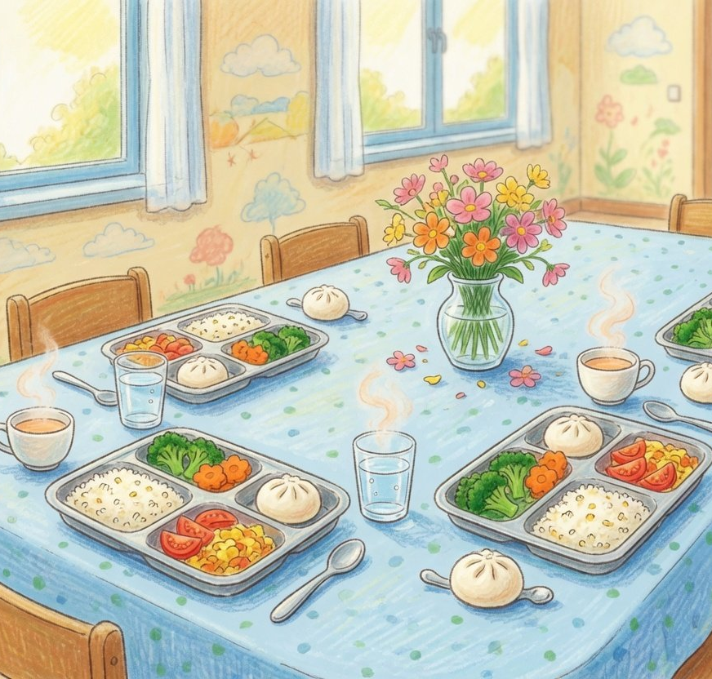
Home and school
Milk, water, little salt, no sugary drinks
350 to 500 g
600 to 800 ml
Milk a day
Plain water a day
The same for ages 2 to 5
Ages 4 to 5: 700 to 800
<2 / <3 g
12+ foods
Salt a day
Kinds of food a day
Ages 2 to 3, then 4 to 5
25 or more a week
Illustration: lunch (AI-generated)
Source: Chinese Nutrition Society, Dietary Guidelines for Preschool Children (2022), for ages 2 to 5
13
New term parents' meeting · Autumn term 2026
Notes:
For food we follow the Chinese Nutrition Society's 2022 dietary guidelines for preschool children, which cover ages two to five and are still the current edition. A few easy numbers. Milk: 350 to 500 grams a day. Plain water: 600 to 700 millilitres a day at two to three, 700 to 800 at four to five. Salt: under 2 grams a day at two to three, under 3 grams at four to five. Variety: 12 or more different foods a day and 25 or more a week. Three more: no sugary drinks. No whole beans or nuts for now, so they can't go down the wrong way. And no snacks in the 30 minutes before bed. The picture is an AI-generated illustration of lunch.

Slide 14
Home and school
12.7% of 6-year-olds short-sighted: go outside
14.5%
14.3%
2 hours outside
12.7%
The Health Commission advises ages 4
to 6 to spend 2 hours or more outdoors
a day, the main way to keep their
eyes' reserve
At a check-up:
Age 4: usually 0.6 or better
Age 5 and up: 0.8 or better
2018 (estimate)
Eyesight is checked every six months (Work
2020
2022
Regulations, Article 19)
Short-sighted 6-year-olds in China. 2018 is read back from “1.8 points lower than in 2018”
Source: Health Commission briefing (May 31, 2024), Education ministry Q&A (June 16, 2023), eye care standard (2021, No. 11)
14
New term parents' meeting · Autumn term 2026
Notes:
Now eyesight. In 2022, 12.7% of six-year-olds in China were short-sighted, 1.8 points lower than in 2018. The 2018 figure is worked out from those two numbers. In 2020 it was 14.3%. The National Health Commission's 2021 eye care standard advises children aged four to six to spend two hours or more outdoors every day, and that is the main advice for protecting their eyes. The kindergarten checks eyesight every six months, and here is how to read the result: at four, eyesight usually reaches 0.6 or better, and from five, 0.8 or better. There are several different measures of hyperopia reserve out there, so if you have questions, please ask an eye doctor.

Slide 15
Home and school
The first weeks are stressful: ease in slowly
What parents can do
70 children, 15 months
Stress hormones rose in the first 9 days.
Stay a while, then leave a little
More days easing in, more secure bonds
longer each day
Ahnert et al., Child Development 2004
Watch their eating, sleep and play
168 children, average 3.27
Over 10 weeks in new care, the rise in
Meet new people and
stress at school grew
places together
Bernard et al., Child Development 2015
Illustration: arriving (AI-generated)
No tears does not mean settled,
talk to us
The studies differ in who and what age. There is
no official number of days to settle in
Source: each study as named on its card. What parents can do: Ministry of Education, Guidelines for Ages 3 to 6
15
New term parents' meeting · Autumn term 2026
Notes:
Parents of the youngest children care most about settling in. To be clear first: there is no national standard for how many days it should take, and no official figure for how many children have separation anxiety. The percentages you see online have no source we could find, so we won't quote them. What we can share are two peer-reviewed studies. One followed 70 children aged 15 months. In the first nine days after their mothers left, the children's cortisol, a stress hormone, rose within an hour to 75 to 100 percent above home levels. The more days a mother spent easing the child in, the more likely the attachment stayed or became secure. The other, a US sample of 168 children with an average age of 3.27, found that over the first 10 weeks in a new childcare setting, the rise in cortisol at childcare grew. A high cortisol level is not a diagnosis of anxiety. So our advice: stay a while at first, then leave a little longer each day. Watch how your child eats, sleeps and plays, which is what the guidelines advise. No tears doesn't mean fully settled, so keep talking to us. And we won't promise no tears within a week, because every child is different. The picture is an AI-generated illustration.

Slide 16
Safety tips
Safety: pick-up, bus, meals, water, getting lost
Pick-up
School bus
Meals
Water
Getting lost
Only you or an adult you
A proper preschool bus, a
A leader eats every meal
Drowning is the top injury
Teach your address,
name. Tell us before
minder on board until
with the children, 125 g of
death for ages 1 to 14.
phone and your names,
someone new comes
every child is off
each dish kept 48 hours
Nothing replaces
and to ask the police
watching
Source: Kindergarten Work Regulations, School Bus Safety Regulations (Order No. 617), school food safety rules, China CDC, Guidelines for Ages 3 to 6
16
New term parents' meeting · Autumn term 2026
Notes:
Five safety tips. Pick-up: under the Kindergarten Work Regulations, children are collected by a guardian or an adult the guardian names. Please tell the teacher before someone new comes, because we will not hand your child to anyone we don't know. School bus: under the School Bus Safety Regulations, children ride a dedicated school bus with a minder on board the whole way, who leaves the bus only after making sure every child is off. Meals: under the 2019 rules on school food safety and nutrition, a kindergarten leader eats with the children at every meal, and at least 125 grams of each dish is kept chilled for 48 hours or more. Water: China CDC says drowning is the leading cause of injury death for children and teenagers aged 1 to 14 in China. Drowning is often fast and silent, a swim ring is not a proper flotation aid, and nothing replaces an adult actually watching. Getting lost: the guidelines suggest teaching children their home address, phone number and parents' names, and to ask the police for help. Never leave a child alone at home or in a car.

Slide 17
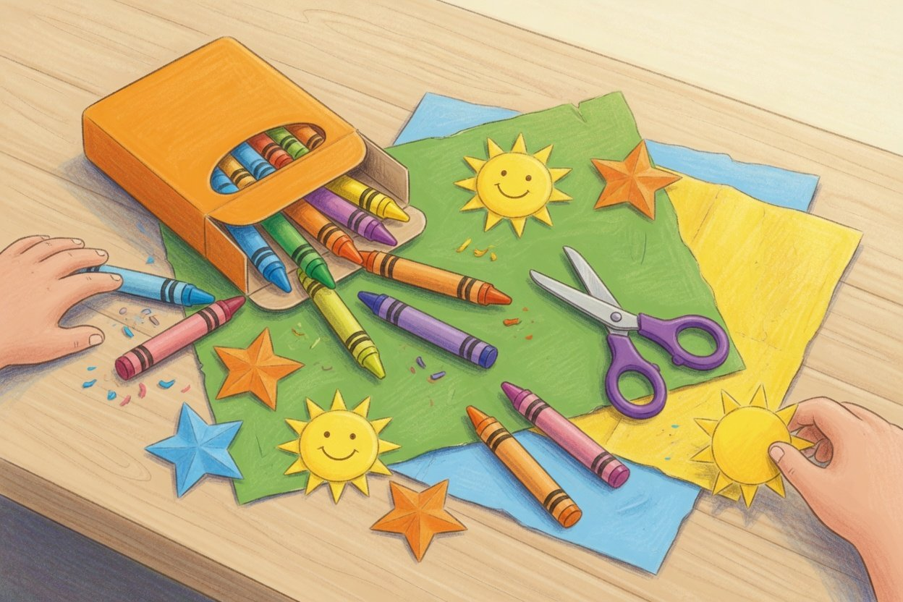
A few favours
Five small favours we ask of you
Tell us of allergies, conditions or illness
Preschool Education Law, Article 15
You or an adult you name picks up, tell us first
Work Regulations, Article 13
Medicine here needs your written consent
Work Regulations, Article 20
No early pinyin, characters or sums, just play
Ministry notice No. 57, 2018
Come to parents' meetings and open days
Work Regulations, Article 53
Illustration: crayons (AI-generated)
Not sure about something? Ask in the class group chat first
17
New term parents' meeting · Autumn term 2026
Notes:
Finally, five small favours, each backed by a rule. One, tell us about allergies, special conditions or illness, as Article 15 of the Preschool Education Law asks. Two, pick-up is by you or an adult you name, and please tell us of any change. Three, if your child needs medicine at kindergarten, please give us written consent first. Under the Kindergarten Work Regulations we cannot give medicine without a guardian's consent. Four, there is no need to drill pinyin, characters or sums early. A 2018 Ministry of Education notice bars kindergartens from teaching them in advance, and there is no need to race ahead at home either. Five, come to parents' meetings and open days. If you are unsure about anything, just ask in the class group chat.

Slide 18
See you soon
Next time: the open day
Open day
See a day in class, the date comes in the group chat
Class group chat
Weekly menus and every notice go here
Parents' committee
Sign up and help decide school matters
Ask a teacher any time
Background: AI-generated illustration
Notes:
Our next meeting is the open day. We will post the date in the class group chat well ahead, and you are welcome to come and see a day in class. Weekly menus and all notices go to the class group chat. And please do sign up for the parents' committee. Thank you all. Here is to a good term, growing up together. The background is an AI-generated illustration.

