Slide 1

Department of Pharmacy
·
For decision by the Pharmacy and
Therapeutics Committee
GLP-1 Weight-Loss
Drugs: Formulary Review
Drugs · prescribers · review rules
Agenda
Trials · labels · national documents · reimbursement list
Evidence
October 2026
Date
Illustration: an injection pen (AI-generated)
Notes:
This is the Department of Pharmacy's review for the Pharmacy and Therapeutics Committee on GLP-1 weight-loss drugs: whether to add them to the hospital formulary, which ones, and how to control their use. We start with the proposal, then why the decision cannot wait, then the evidence on efficacy, cardiovascular outcomes, safety and weight regain, the approvals and label thresholds in China, cost and insurance, and finally the drugs we recommend, the controls, the monitoring plan and the three items for the vote. Every figure comes from journal papers, drug labels, filings by China's NMPA and National Healthcare Security Administration, or press reports of prices, and each data page names its source. This is a formulary decision, not advice on treating any individual patient.

Slide 2
Proposal
GLP-1 formulary review · P&T committee
List tirzepatide and Wegovy, with three controls
Drugs: list tirzepatide and Wegovy, mazdutide per case
Proposal 1
Evidence: pages 5 to 13
Strongest Chinese and head-to-head data, and Wegovy alone has outcome data
Who prescribes: the weight clinic, endocrinology, nutrition
Proposal 2
Evidence: page 14
Only trained, authorized doctors, with a pharmacist reviewing every prescription first
Rules: check the label threshold, weight loss is self-pay
Proposal 3
Evidence: pages 15 to 17
Track efficacy, safety and adherence, with the first review six months after launch
2
Department of Pharmacy
/ 18
Notes:
Three proposals, which the last page asks the committee to vote on one by one. First, the drugs: list tirzepatide and semaglutide 2.4 mg, sold as Wegovy. Tirzepatide produced the largest weight loss in the only head-to-head trial and in its Chinese trial, and its price fell by about 80% this year. Wegovy is the only drug with cardiovascular outcome evidence and gained a cardiovascular indication in China in December 2025. Mazdutide, a domestic drug, has good Chinese data but no outcome data, and at retail prices costs about ¥2,020 per 4 weeks, more than the other two, so we propose buying it case by case rather than listing it. The rest stay off the formulary. Second, who prescribes: the weight management clinic, endocrinology and clinical nutrition, by doctors who have been trained and authorized, with a pharmacist reviewing each prescription before it is dispensed. Third, the rules: check each patient against the label threshold for that drug, bill all weight-loss prescriptions as self-pay, track three groups of measures, and review the program six months after launch.

Slide 3
Context
GLP-1 formulary review · P&T committee
Weight clinics are due, tirzepatide down 80%
Official
Press
Company
All
80%
None
Public tertiary general hospitals
Tirzepatide price cut from January
Domestic semaglutide
must run a weight clinic in 2026
1, 2026
injections approved
One of the National Health Commission's ten
10 mg, 4 weeks: ¥4,758 down to ¥936.70
Patent expired March 2026, as of Sept 8
pledges for 2026
Adult weight in China (2018)
Obese 16.4%
Overweight 34.3%
Other 49.3%
Obese and Overweight together 50.7%
Source: National Health Commission (Feb 2026), China News Service (Jan 2026), Zhifei filing (Sept 2026), national weight management guidance (2024)
3
Department of Pharmacy
/ 18
Notes:
Four reasons to decide at this meeting. The first is the mandate: at its February 12, 2026 briefing, the National Health Commission listed weight management clinics in every public tertiary general hospital as one of its ten public service pledges for the year. Its March 2025 notice already told these clinics to use drugs rationally and strictly by indication, so the formulary and prescribing rules have to be in place before the clinic opens. The second is price: since the 2025 national reimbursement list took effect on January 1, 2026, hospitals have charged the listed price for tirzepatide. The 10 mg strength fell from ¥4,758 to ¥936.70 per 4 weeks, about 80%, and hospitals say self-paying patients pay the new price too. These are prices reported in the press, as the reimbursement standard itself is not published. The third is need: China's 2024 weight management guideline cites an adult overweight rate of 34.3% and obesity rate of 16.4% in 2018. The fourth is that waiting for generics is not an option yet. The main semaglutide compound patent expired in March 2026, but a September 8 company filing says no domestic semaglutide injection has been approved, and Novo Nordisk says its data protection runs to April 2027.

Slide 4

Context
GLP-1 formulary review · P&T committee
Outside hospitals: fake drugs, insurance fraud
Goods
NMPA · Sept 2024
¥35m
Fake diet drugs containing
semaglutide, made and sold
Case value
Ministry of Public Security · Mar 2025
Over ¥22m
Shanghai diet-injection ring, 15
sites, 40 arrested
Fine
NHSA · Apr 2024
2 to 5 times
Billing weight loss to insurance may
be fraud
Warning
NMPA · Sept 2024
Strictly limited
Who may use weight-loss drugs
is limited
Illustration: a hospital outpatient pharmacy (AI-generated)
Source: NMPA (Sept 2024), Ministry of Public Security (Mar 2025), National Healthcare Security Administration (Apr 2024)
4
Department of Pharmacy
/ 18
Notes:
The risks outside hospitals are on the official record. In September 2024, China's drug regulator, the NMPA, published online drug sale cases including a ring that made and sold diet drugs containing semaglutide worth ¥35 million, and a beauty salon that sold unlabeled injections over WeChat for more than ¥10 million. In March 2025 the Ministry of Public Security reported a Shanghai case with 15 sites, 40 arrests and over ¥22 million involved. On insurance, the National Healthcare Security Administration said in April 2024 that weight loss is not covered, and that writing weight-loss prescriptions as if for diabetes may be treated as fraud on the insurance fund, with fines of two to five times the amount and suspension of insurance billing for 3 to 12 months. In the first two months of 2024, semaglutide was reimbursed more than 700,000 times. The NMPA's consumer warning says that some of these drugs are approved for obesity and overweight, but only for strictly defined patients. A proper hospital supply with prescription review is how we bring patients back from these channels. The picture is an AI-generated illustration.

Slide 5
Efficacy
GLP-1 formulary review · P&T committee
Chinese trials: 8 to 15 points more than placebo
More than placebo
Trial · drug · size and length
Weight change
Drug
Placebo
SURMOUNT-CN
15.2
−17.5%
Tirzepatide 15 mg
−2.3%
points
210 patients · 52 weeks
GLORY-1
14.3
−14.01%
Mazdutide 6 mg
+0.30%
points
610 patients · 48 weeks
STEP 12
9.9
−12.1%
Semaglutide 2.4 mg
−2.2%
points
242 patients · 44 weeks
STEP 7 China
8.3
−11.8%
Semaglutide 2.4 mg
−3.5%
points
300 patients · 44 weeks
Source: JAMA 2024, NEJM 2025, Lancet Diabetes Endocrinol 2026, Diabetes Obes Metab 2025. Not directly comparable
5
Department of Pharmacy
/ 18
Notes:
This page covers Chinese patients only. All four trials compare a drug with placebo, and the main measure is weight change from baseline. SURMOUNT-CN tested tirzepatide in 210 adults without diabetes at 29 sites in China for 52 weeks: weight fell 17.5% on 15 mg against 2.3% on placebo, and 85.8% against 29.3% lost at least 5%. GLORY-1 tested mazdutide in 610 Chinese adults for 48 weeks: weight fell 14.01% on 6 mg while the placebo group gained 0.30%. These are the journal and label figures, from multiple imputation. The company's announcement used another model and reported 14.8%. Semaglutide has two sets of Chinese data. The prespecified China subgroup of STEP 7, 300 patients over 44 weeks, lost 11.8% against 3.5%. It is a subgroup, not a separate confirmatory trial. STEP 12 enrolled 242 Chinese adults with lower BMI and lost 12.1% against 2.2% over 44 weeks. The gaps over placebo are our own calculation from these figures. The trials differ in patients, length and statistics, so the bars should not be ranked against each other. For a direct comparison, see the head-to-head trial on the next page.

Slide 6
Efficacy
GLP-1 formulary review · P&T committee
Tirzepatide −20.2% vs semaglutide −13.7%
RCT · NEJM 2025 · 751 patients · 72 weeks · open label
Share reaching target
Company figures
Tirzepatide
Semaglutide
Tirzepatide
−20.2%
81.6
64.6
60.5
48.4
Weight change · waist −18.4 cm
40.1
31.6
Semaglutide
27.3
−13.7%
16.1
≥10% loss
≥15% loss
≥20% loss
≥25% loss
Weight change · waist −13.0 cm
Nausea
Vomiting
Stopped (company)
43.6% vs 44.4%
15.0% vs 21.3%
6.1% vs 8.0%
Source: SURMOUNT-5 (NEJM 2025, Lilly-funded). Target shares and the stop rate are from Lilly, nausea and vomiting from ClinicalTrials.gov registry counts
6
Department of Pharmacy
/ 18
Notes:
SURMOUNT-5 is the only published head-to-head trial of tirzepatide against semaglutide. It enrolled 751 adults with obesity and without diabetes for 72 weeks. It was open label and funded by Eli Lilly, which the committee should keep in mind. Weight fell 20.2% on tirzepatide, with a 95% confidence interval of 21.4% to 19.1%, and 13.7% on semaglutide, interval 14.9% to 12.6%. Waist size fell 18.4 cm and 13.0 cm. The shares reaching each target come from Lilly's press release, using the treatment-regimen estimand: 81.6% against 60.5% lost at least 10%, and 31.6% against 16.1% lost at least 25%. The registry reports higher shares because it counts only patients with evaluable data, so the two sets should not be mixed. Side effects were similar: nausea 43.6% against 44.4% and vomiting 15.0% against 21.3%, calculated from ClinicalTrials.gov counts. Stopping for side effects, 6.1% against 8.0%, is the company's figure.

Slide 7
Heart
GLP-1 formulary review · P&T committee
Only semaglutide has CV outcome data: HR 0.80
RCT · NEJM 2023 · 17,604 patients · CV disease · no diabetes
Semaglutide
Placebo
HR (95% CI)
Endpoint
6.5%
8.0%
Major adverse CV events
0.80 (0.72-0.90)
0.85 (0.71-1.01)
2.5%
3.0%
Cardiovascular death
not significant
4.3%
5.2%
Death from any cause
0.81 (0.71-0.93)
3.4%
4.1%
Heart failure composite
0.82 (0.71-0.96)
0.6
0.8
1.0
1.2
← Favours Semaglutide
Favours Placebo →
Tirzepatide's outcome trial, SURMOUNT-MMO, is due in October 2027, with no results yet
Source: SELECT (NEJM 2023, mean follow-up 39.8 months, BMI ≥27), ACC summary, ClinicalTrials.gov NCT05556512
7
Department of Pharmacy
/ 18
Notes:
Only semaglutide has cardiovascular outcome evidence. SELECT enrolled 17,604 patients aged 45 or older with established cardiovascular disease, a BMI of 27 or more and no diabetes, followed for 39.8 months on average. The primary endpoint, cardiovascular death, non-fatal heart attack or non-fatal stroke, occurred in 569 patients, 6.5%, on semaglutide and 701, 8.0%, on placebo: a hazard ratio of 0.80, with a 95% confidence interval of 0.72 to 0.90. Cardiovascular death alone had a hazard ratio of 0.85 with an interval crossing 1, so it was not significant. Death from any cause had a hazard ratio of 0.81 and the heart failure composite 0.82. China approved the matching indication for Wegovy on December 16, 2025: to reduce major cardiovascular events in adults with established cardiovascular disease and a BMI of at least 27. Tirzepatide's equivalent trial, SURMOUNT-MMO, is still running, with primary completion expected in October 2027. SELECT also had a cost: 16.6% stopped for adverse events against 8.2%, and 10.0% against 2.0% for gastrointestinal events.

Slide 8
Safety
GLP-1 formulary review · P&T committee
Mostly GI effects, then thyroid and biliary risk
Incidence
Drug
Placebo
Thyroid C-cell tumors
Nausea
Vomiting
Stopped
On all three labels. Barred with MTC or MEN2 history
44%
24%
Placebo 16%
6.8%
Placebo 6%
Placebo 3.2%
Semaglutide 2.4 mg
US label
Gallbladder and bile duct
RR 2.29 in weight-loss trials, 76-trial meta-analysis
28%
13%
Placebo 8%
6.7%
Placebo 2%
Placebo 3.4%
Tirzepatide 15 mg
US label
Optic nerve (NAION)
Very rare with semaglutide, EMA, June 2025
50.5%
43.1%
Placebo 1.0%
1.0%
Mazdutide 6 mg
Chinese label
Aspiration under anesthesia
Placebo 5.9%
Placebo 2.9%
US label warning, check before surgery or endoscopy
Source: US Wegovy and Zepbound labels, Chinese mazdutide label, JAMA Intern Med 2022, EMA (June 2025). Not directly comparable
8
Department of Pharmacy
/ 18
Notes:
Most side effects are gastrointestinal. Each drug's figures come from its own label, from different trials, so they should not be ranked. Semaglutide 2.4 mg uses the pooled weight-loss trials on the US Wegovy label: nausea 44% against 16% on placebo, vomiting 24% against 6%, and 6.8% against 3.2% stopped for side effects. Tirzepatide 15 mg uses the US Zepbound label, pooling SURMOUNT-1 and 2: nausea 28% against 8%, and 6.7% against 3.4% stopped. Mazdutide 6 mg uses its Chinese label, from GLORY-1: nausea 50.5% and vomiting 43.1% against 5.9% and 2.9%, yet only 1.0% stopped in both groups. We could not obtain the Chinese labels for Wegovy and tirzepatide with their rates, so we use the US labels. There are four class risks. Thyroid C-cell tumors: all three labels carry a warning, and the drugs must not be used with a history of medullary thyroid cancer or MEN2. Gallbladder and bile duct disease: a meta-analysis of 76 randomized trials with over 100,000 patients found a relative risk of 2.29 in weight-loss trials. NAION, an optic nerve condition: the EMA concluded in June 2025 that it is a very rare side effect of semaglutide. China's adverse reaction monitoring center relayed this, but we found no Chinese label change. Aspiration under anesthesia or deep sedation is a warning on both US labels. Separately, the FDA asked in January 2026 for the suicidal ideation warning to be removed.

Slide 9
Safety
GLP-1 formulary review · P&T committee
Weight returns on stopping: +14.0% in a year
RCT · JAMA 2024 · 36 weeks on the drug, then drug or placebo
STEP 4 · semaglutide
0
Randomized
Kept −7.9%, switched +6.9%
48 weeks after randomization, JAMA 2021
Switched to placebo −9.9%
STEP 1 extension · semaglutide
−10%
Regained 11.6 points in a year
Net loss down to 5.6%
Up 14.0% from
week 36
BMJ 2026 meta-analysis
−20%
Regained 0.4 kg a month
−20.9%
37 studies, 9,341 people
Kept taking it −25.3%
US real world: about 2 in 3 stop within a year
Week 0
Week 36
Week 88
Source: SURMOUNT-4 (JAMA 2024), STEP 4 (JAMA 2021), STEP 1 extension (Diabetes Obes Metab 2022), BMJ 2026, China obesity guideline (2024)
9
Department of Pharmacy
/ 18
Notes:
Every study agrees that weight comes back after stopping. In STEP 4, patients took semaglutide for 20 weeks and lost 10.6%, then were randomized for 48 weeks: those who continued lost another 7.9%, those switched to placebo regained 6.9%. In SURMOUNT-4, patients took tirzepatide for 36 weeks and lost 20.9%. Over the next 52 weeks, those who continued lost another 5.5% and those switched to placebo regained 14.0%. 89.5% of those who continued kept at least 80% of the weight they had lost, against 16.6% of those who stopped. A 2026 BMJ meta-analysis of 37 studies and 9,341 people found an average regain of 0.4 kg a month after stopping, with cardiometabolic measures back at baseline in about 1.4 years. US real-world data cited in China's obesity guideline show about two in three patients stop within a year. For the hospital this means two things. Patients must hear before they start that this is long-term treatment and that the cost is long-term too. And the stopping rules and follow-up belong in the control plan, not just the prescribing.

Slide 10
Approvals
GLP-1 formulary review · P&T committee
Six approved in China, Wegovy adds CV and MASH
Weight-loss approvals (NMPA approval date)
2023-06-30
2024-06-18
Liraglutide
Wegovy
3.0 mg
Semaglutide 2.4 mg
2023-07-25
2024-07-16
2025-06-24
2026-03-03
Benaglutide
Tirzepatide
Mazdutide
Ecnoglutide
Weight loss
Weight loss
Weight loss
2023
2024
2025
2026
New indications, policy and patents
2025-12-16
2024-10-12
2026-09-08
Wegovy: heart
Obesity guideline
Wegovy: MASH
2026-03-20
Semaglutide patent ends
2026-01-01
New insurance list
2025-06-30
Tirzepatide: sleep apnea
Source: NMPA approval notices (July 2023 to Sept 2026). Dates are NMPA approval dates, not company announcements. Under review: mazdutide 9 mg, oral semaglutide 25 mg, domestic semaglutide
10
Department of Pharmacy
/ 18
Notes:
All approval dates here are the dates China's NMPA approved the drug, not the dates companies announced it. Six drugs are approved for weight loss: liraglutide 3.0 mg from Huadong on June 30, 2023, benaglutide on July 25, 2023, semaglutide 2.4 mg as Wegovy on June 18, 2024, tirzepatide on July 16, 2024 as a supplement to its May diabetes approval under the same approval numbers, mazdutide on June 24, 2025, and ecnoglutide on March 3, 2026. Wegovy has since added a cardiovascular indication, on December 16, 2025, and MASH with moderate to advanced liver fibrosis, on September 8, 2026. Tirzepatide also added obstructive sleep apnea on June 30, 2025. The June 25, July 19, June 27 and March 6 dates often seen in the press are when notices were published or companies announced. Still under review: mazdutide 9 mg, oral semaglutide 25 mg and several domestic semaglutide injections.

Slide 11
Approvals
GLP-1 formulary review · P&T committee
Label BMI bars: Wegovy 30/27. Others use 28/24
24
27
28
BMI
30
Review note
Wegovy, liraglutide 3.0 mg
obesity
comorbidity
Higher bar
Tirzepatide, mazdutide
obesity
comorbidity
Matches guidance
National weight guidance
<5% loss after 3 to 6 months
complication
Reference
Wegovy for heart disease
established CV disease
Check apart
Wegovy at BMI 24 to <28
off-label
Off-label
Overweight band, 1+ comorbidity
Obesity band
STEP 12 has Chinese data at BMI 24 to <28, the Wegovy label is unchanged
Source: Novo Nordisk, Lilly and Huadong announcements, mazdutide label, national weight management guidance (2024), STEP 12 (2026)
11
Department of Pharmacy
/ 18
Notes:
There are two sets of label thresholds, so prescriptions must be checked against the label of the drug prescribed. Wegovy and liraglutide 3.0 mg follow the international standard: a BMI of 30 or more, or 27 to 30 with at least one weight-related comorbidity. Tirzepatide and mazdutide follow the Chinese standard: 28 or more, or 24 or more with at least one comorbidity, the same cut-offs as China's 2024 weight management guidance. That guidance also says patients with obesity should first try 3 to 6 months of lifestyle change and move to drugs if they lose less than 5%. Wegovy's cardiovascular indication is separate: established cardiovascular disease and a BMI of at least 27. A note on STEP 12: it studied Chinese adults with a BMI of 24 to 28, who lost 12.1%, but we found no approval moving Wegovy's Chinese label to 28/24. Prescribing Wegovy at those levels is therefore off-label and needs informed consent and a filing. We could not find the official BMI threshold for ecnoglutide.

Slide 12
Cost
GLP-1 formulary review · P&T committee
Tirzepatide: under ¥1,000 per 4 weeks, self-pay
Change
4-week cost (¥)
Before
Early 2026
Insurance pays for type 2
−80%
937
Tirzepatide 10 mg
4,758
diabetes only
−80%
2025 list · tirzepatide limit
551
Tirzepatide 5 mg
2,758
“Glycemic control in adults with type
2 diabetes”
−48%
1,284
Wegovy 2.4 mg
2,463
Basic insurance drug rules, Article 8
Drugs for “weight loss, cosmetic” use
−48%
are excluded
987
Wegovy 1.7 mg
1,894
−31%
2,020
Mazdutide 6 mg (retail)
2,920
Weight loss is self-pay, mazdutide
is not listed
0
1,000
2,000
3,000
4,000
5,000
Source: hospital prices reported by China News Service and Time Weekly (Jan 2026), mazdutide from JD.com retail, rounded to ¥1. NHSA reimbursement list, 2025 edition
12
Department of Pharmacy
/ 18
Notes:
These are 4-week drug costs, all from press reports, since the insurance payment standard is not published. Since January 1, 2026 hospitals have charged tirzepatide at its reimbursement-list price: 10 mg fell from ¥4,758 to ¥936.70 per 4 weeks and 5 mg from ¥2,758 to ¥551.00, about 80%, and hospitals such as Nanjing Drum Tower say self-paying patients pay the new price too. Wegovy's prices were cut in late December 2025, starting in Sichuan and followed by Yunnan, Hebei and Liaoning, which Novo Nordisk described as its own decision: 2.4 mg fell from ¥2,463 to ¥1,284.36, about 48%, and 1.7 mg from ¥1,893.67 to ¥987.48. Mazdutide has no hospital price in our sources, so we use the JD.com retail price on January 12, 2026: ¥1,010 for a box of two 6 mg pens, about ¥2,020 for 4 weeks at one pen a week, against about ¥2,920 at launch. On insurance, the 2025 national list restricts semaglutide, tirzepatide and liraglutide to type 2 diabetes. Mazdutide and ecnoglutide are not on the list, and benaglutide was removed, with its transition ending on June 30, 2026. The rule behind this is that drugs mainly for weight loss are excluded from the list. In April 2024 the National Healthcare Security Administration said that writing weight-loss prescriptions to insurance may be fraud on the fund, with fines of two to five times the amount and 3 to 12 months' suspension of insurance billing.

Slide 13
Proposal
GLP-1 formulary review · P&T committee
List tirzepatide and Wegovy, mazdutide per case
Drug
Main evidence
4-week cost
Proposal
Head-to-head −20.2%, Chinese trial −17.5%, outcome
Tirzepatide
¥551 to ¥937
List
data due 2027
Semaglutide 2.4 mg
Only drug with outcome data, SELECT HR 0.80
¥987 to ¥1,284
List
Mazdutide
Chinese trial −14.01%, no outcome data, nausea 50.5%
About ¥2,020 (retail)
Per case
Ecnoglutide
Label BMI threshold and price not found
Not found
Defer
Liraglutide about ¥1,550
Liraglutide, benaglutide
Weaker: 5.4% over placebo, −6.0% at 16 weeks
Do not list
(30 days)
Source: trials and labels on earlier pages, China obesity guideline (2024), press-reported prices (Jan 2026). Cost ranges use common doses
13
Department of Pharmacy
/ 18
Notes:
Putting the evidence together, this is what we propose. List tirzepatide: in the only head-to-head trial it cut weight by 20.2% over 72 weeks, in its Chinese trial by 17.5% over 52 weeks, it now costs ¥551 to ¥937 per 4 weeks, and its label uses the Chinese 28/24 threshold. Its weakness is that outcome data arrive only in 2027. List semaglutide 2.4 mg, Wegovy: it is the only drug with cardiovascular outcome evidence, SELECT's hazard ratio of 0.80, and it is approved in China for that use, which suits patients with established heart disease. Mazdutide is a domestic drug that cut weight by 14.01% over 48 weeks in GLORY-1, but it has no outcome data, causes nausea in half of patients and costs about ¥2,020 per 4 weeks at retail, so we propose buying it case by case rather than listing it. Ecnoglutide was approved only in March 2026 and we could not find its label threshold or price, so we defer it. Liraglutide 3.0 mg adds only 5.4% over placebo at 56 weeks, is injected daily and costs about ¥1,550 for 30 days, and benaglutide has only 16 weeks of phase 3 data with a 6.0% loss and has left the reimbursement list. We propose listing neither.

Slide 14
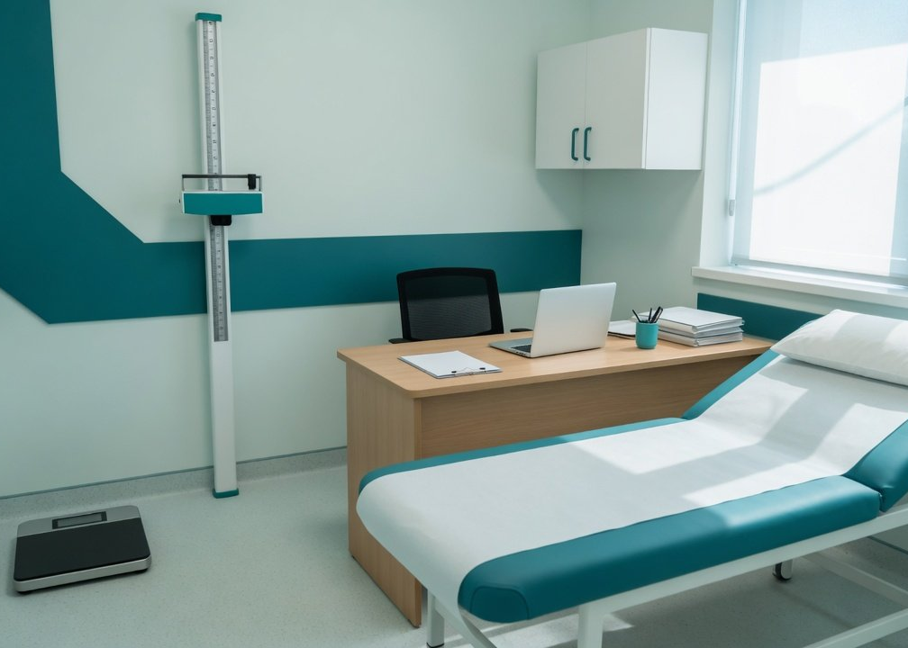
Management
GLP-1 formulary review · P&T committee
Three units prescribe, a pharmacist reviews
Where
Who
Weight clinic,
Hospital-authorized doctors
endocrinology, nutrition
only
Review
Follow-up
A trained pharmacist in
Endocrine, nutrition,
each clinic
surgery, pharmacy
Illustration: a weight clinic consulting room (AI-generated)
Source: National Health Commission notice (Mar 2025), Chinese Pharmaceutical Association draft (June 2026). The three units and one pharmacist per clinic are our proposal, not a national rule
14
Department of Pharmacy
/ 18
Notes:
We propose that only three units prescribe these drugs for weight loss: the weight management clinic, endocrinology and clinical nutrition. Other departments would not write weight-loss prescriptions, and diabetes prescribing stays under the current rules. To be clear, there is no national rule limiting which departments may prescribe. None of our three research passes found one, so this is a hospital rule. There is precedent abroad: Belgium's regulator requires that, for obesity, the first prescription come from an endocrinologist working in a multidisciplinary setting. Prescribing rights would go to doctors trained and authorized by the hospital. For pharmacists, the Chinese Pharmaceutical Association's draft standard asks for at least one specially trained pharmacist per institution, at intermediate title or above with three years' relevant experience. We propose at least one per clinic. Follow-up would be shared by endocrinology, clinical nutrition, bariatric surgery and pharmacy, following the National Health Commission's March 2025 notice and the draft standard. The picture is an AI-generated illustration.

Slide 15
Management
GLP-1 formulary review · P&T committee
Five checks before dispensing, failures stop it
Basis: Chinese Pharmaceutical Association draft (June 2026)
01
02
03
04
05
Threshold
Exclusions
Co-meds
Off-label
Billing
BMI, comorbidities and
MTC or MEN2 history,
Levothyroxine, warfarin,
Signed consent and a
Weight loss self-pay,
body build against
pregnancy, nursing
oral contraceptives
filed record
diabetes under
the label
insurance rules
Stop: a contraindication, a missed threshold, or
Tirzepatide for diabetes and for weight loss is one product, so
billing follows the diagnosis
appearance anxiety
Source: Chinese Pharmaceutical Association draft standard on weight-loss drugs in hospitals (June 2026), 2025 national reimbursement list
15
Department of Pharmacy
/ 18
Notes:
We propose five checks before a weight-loss prescription is dispensed. The first four come from the first checkpoint in the Chinese Pharmaceutical Association's draft standard. The fifth is ours, for insurance. One, threshold: check BMI and body composition against the label of the drug prescribed, since Wegovy's threshold differs from the other two. Two, contraindications: rule out a personal or family history of medullary thyroid cancer or MEN2, confirm that women of childbearing age are not pregnant, and do not use in pregnancy or breastfeeding. Three, interactions: focus on narrow-margin drugs such as levothyroxine, warfarin and oral contraceptives. Four, off-label use: the draft requires a signed off-label consent form and a filed record. Five, billing: weight-loss prescriptions are always self-pay and diabetes prescriptions follow the reimbursement list. Tirzepatide's two indications share one product and one set of approval numbers, so the system must bill by diagnosis. The draft says prescriptions for patients with contraindications or appearance anxiety should be stopped, and we add any patient below the label threshold.

Slide 16

Management
GLP-1 formulary review · P&T committee
Pharmacists also guard against misuse
First visit
Screen misuse risk with DAST-10
Monitoring
Flag doctor shopping and dose jumps
Surgery
Check aspiration risk before anesthesia or endoscopy
Special groups
Not in pregnancy or nursing, confirm no pregnancy
Illustration: a pharmacist at a review workstation (AI-generated)
Source: Chinese Pharmaceutical Association, draft standard on weight-loss drugs in hospitals (June 26, 2026)
16
Department of Pharmacy
/ 18
Notes:
Beyond reviewing prescriptions, pharmacists also guard against misuse. These steps come from the Chinese Pharmaceutical Association's draft standard posted in June 2026. It is still a draft for comment, and we propose following it until the final version appears. First, screen for drug misuse risk at the first visit with the DAST-10 questionnaire. Second, the draft asks hospitals to monitor GLP-1 prescriptions for unusual patterns, such as frequent visits to different institutions or doses rising abnormally fast, which needs IT support for alerts. Third, special groups: the drugs are not used in pregnancy or breastfeeding, and aspiration risk must be managed around surgery and sedated endoscopy, which the US Wegovy and Zepbound labels also list as a warning. The picture is an AI-generated illustration.

Slide 17
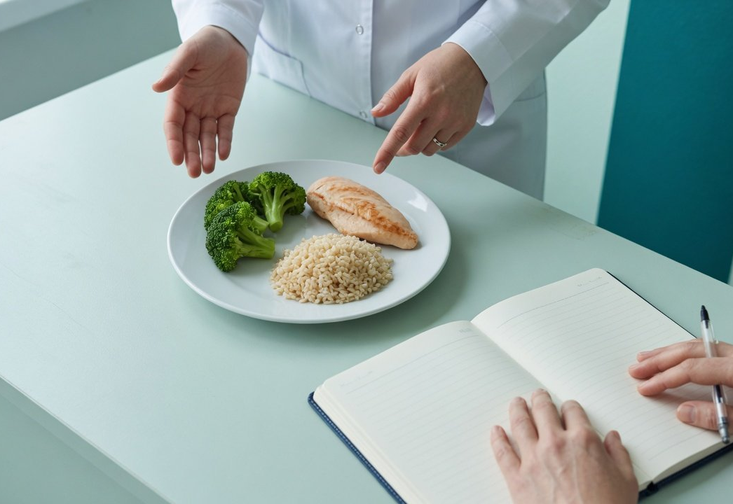
Monitoring
GLP-1 formulary review · P&T committee
Three metric groups, first review at six months
Efficacy
Safety
Adherence
Share losing ≥5% by 3 to
Serious events such
Still treated at six months
6 months
as pancreatitis
Under 5%,
Stops for side effects
Follow-up visits kept
consider stopping
Lean mass loss over 5%
Review dates
Launch
+6 months
2027-04
2027-10
2027-12
On the formulary
First review
Data protection ends
SURMOUNT-MMO due
Insurance deal ends
Source: Chinese Pharmaceutical Association draft (June 2026), China obesity guideline (2024), ClinicalTrials.gov. AI illustration
17
Department of Pharmacy
/ 18
Notes:
We would track three groups of measures, taken from the quality indicators in the Chinese Pharmaceutical Association's draft standard. Efficacy: the share of patients losing at least 5% after 3 to 6 months at the highest tolerated dose, and HbA1c control in patients with diabetes. China's obesity guideline says drug treatment that does not achieve at least 5% weight loss should be stopped. Safety: serious adverse events such as acute pancreatitis, severe allergy and cholecystitis, the share stopping for side effects, and the share losing more than 5% of baseline lean mass. Adherence: the share still treated at six months and the clinic follow-up rate. About two in three US patients stop within a year, so this one needs watching. We would review the program six months after launch. Three outside events could change today's judgment: Novo Nordisk says semaglutide's data protection runs to April 2027, after which domestic generics may be approved. Tirzepatide's outcome trial, SURMOUNT-MMO, is expected to finish in October 2027. And the reimbursement agreements for both drugs run to December 31, 2027. The picture is an AI-generated illustration.

Slide 18
Vote
Three items for the committee's vote
For
Against
Abstain
Drugs
1
Tirzepatide, Wegovy, mazdutide per case
Scope
2
Weight clinic, endocrinology, nutrition
Rules
3
Checks first, self-pay, six-month review
Committee chair's signature:
Submitted by: Department of Pharmacy
Date: October 2026
Notes:
We ask the committee to vote on three items. One, the drugs: list tirzepatide and semaglutide 2.4 mg, Wegovy. Mazdutide stays off the formulary and is bought case by case, ecnoglutide is deferred, and liraglutide 3.0 mg and benaglutide are not listed. Two, prescribers: only the weight management clinic, endocrinology and clinical nutrition, by doctors the hospital has trained and authorized. Three, the rules: pharmacists run the five pre-dispensing checks, all weight-loss prescriptions are self-pay, three groups of measures are tracked, with a first review at six months and further reviews at the three outside dates in 2027. If the committee approves, the Department of Pharmacy will draft the detailed rules with the medical affairs, IT and insurance offices.

