Slide 1
Q3 2026 business review
Home demand fell a fifth.
How do we play Q4?
China new-energy passenger cars: Q3 2026 review and Q4 actions
October 2026
Notes:
This review uses public data from the China Passenger Car Association (CPCA), the China Association of Automobile Manufacturers, customs figures and listed carmakers' filings to look back at China's new-energy passenger car market in Q3 2026 and propose our Q4 moves. CPCA's final September report is due in early October, so wherever September appears it is either the September 1–27 run rate or CPCA's September 17 forecast, and the page says which. The last page lists what management needs to decide.

Slide 2
Home sales fell a fifth. Reset the Q4 targets
Home market
01
Q3 home retail is down about a fifth, and NEV retail is falling too.
is shrinking
02
Growth moved abroad
NEV exports hit 1.058m in Jul–Aug, 2.5 times a year earlier.
Share is moving,
03
BYD lost about 4.5 points of share. Fewer price cuts, but deeper.
discounts went quiet
04
How we play Q4
Reset targets, spend in the subsidy window, clear every deal first.
Notes:
Four findings. The first three review Q3, the fourth is how we play Q4. The pages that follow take them in this order, and the last page is what management needs to confirm today.

Slide 3
Home retail fell over 20% three months running
2025
2026
Forecast
July retail, year on year
Million units
−20.9%
2.241
1.995
(forecast)
1.826
August retail, year on year
1.69
1.541
−23.6%
1.461
Sep 1–27 retail, year on year
−29%
Full-month forecast about 1.69m, −24.6%
July
August
September
Source: China Passenger Car Association (CPCA) reports (Jul–Sep 2025, Jul–Aug 2026), Sep 30 weekly data, Sep 17 forecast
Notes:
July retail was 1.461m units, down 20.9%. August was 1.541m, down 23.6%. The final September figure is not out yet. The 1.69m bar is CPCA's full-month forecast from September 17, about 24.6% below last year. The actual run rate to the 27th was worse, down 29%, and daily sales in the fourth week were down 42%, so the final number may come in below the forecast. Last September was the rush before the old subsidy stopped, which makes the base unusually high.

Slide 4
NEV share hit 65%, mostly as ICE sales collapsed
million units, axis from 2
NEV share of retail, Jul–Aug
65.2%
3.82
54.6% a year earlier
−0.13
−0.69
ICE share of the drop
3.00
84%
ICE cars −0.69m, NEVs −0.13m
Jul–Aug 2025
NEVs
ICE cars
Jul–Aug 2026
Source: CPCA monthly reports, Jul–Aug 2025 and 2026. Passenger car home retail, changes are the two years' published figures subtracted
Notes:
Home retail in July and August fell by 819k units. NEVs accounted for 132k of that and conventional fuel cars, hybrids without a plug included, for 687k. In August alone conventional cars sold 540k, down 40%, with pure petrol cars down 45%. So NEV share passed 65% because fuel cars collapsed faster, not because NEVs sold more. NEV retail itself was down 10.1% in August and 20% in September 1–27.

Slide 5
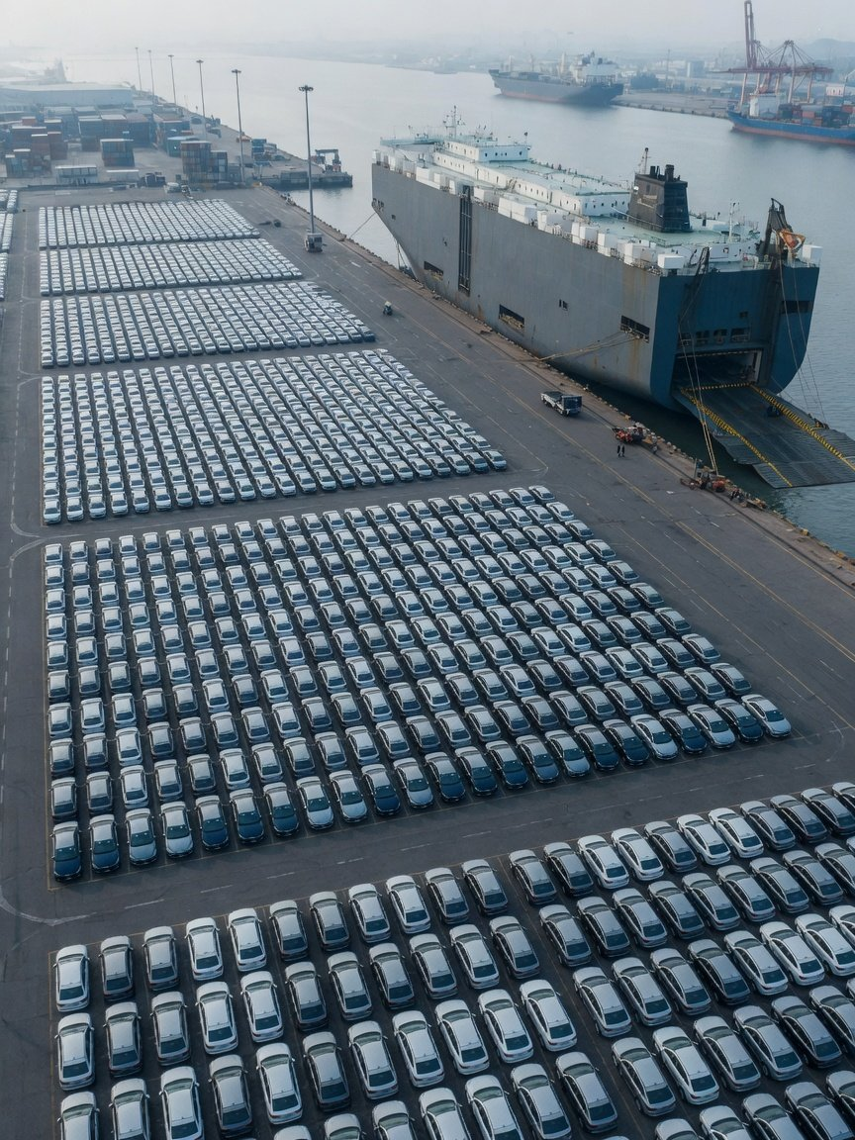
Growth went abroad:
NEV exports up 154%
1.058m
Jul–Aug NEV exports
from 0.417m
−1.6%
Wholesale incl. exports
−21.4%
Home retail
58.4%
NEV share of Aug exports
Brazil, 337k
Top market, Jan–Aug
Source: CPCA reports (Jul–Aug 2025, 2026), Cui Dongshu export analysis (Sep 24,
2026). Photo is illustrative
Notes:
Home retail is falling, yet carmakers' wholesale volume barely moved, and exports made up the gap. Passenger car exports in July and August were 1.806m, up 85%, of which NEVs were 1.058m, about 2.5 times a year earlier. Wholesale and retail measure different things, so they sit side by side here only to show how much exports made up, not to work out shares. The top five NEV export markets for January to August were Brazil, Belgium, the UK, Australia and the Philippines, from customs data compiled by CPCA secretary general Cui Dongshu. Brazil is first, but its import tariff on battery-electric cars rose to 35% in July, so Q4 needs a separate look.

Slide 6
BYD lost ~4.5 share points, start-ups gained 5.5
Share of home NEV retail, %
Aug 2025
Aug 2026
Start-ups' share in August
26.0%
27.8
BYD
23.3
−4.5 pts
Up 5.5 points year on year
12.1
Geely
11.0
Leapmotor in August NEV retail
No. 3
6.5
Changan
5.8
5.1
Tesla China
5.0
Source: CPCA (Aug 2026 report, Aug 2025 maker data via CnEVPost). Share of home NEV retail, approximate
Notes:
Share is each maker's home retail from the CPCA ranking divided by that month's NEV retail. The denominator is rounded, so the shares are approximate. BYD sold 233,943 at home in August, about 24.6% fewer than a year earlier, and its share fell from about 27.8% to 23.3%. Geely, Changan and Tesla China also gave up a little. The share went to the EV start-ups: 26.8% in July and 26.0% in August, each over 5 points higher than a year earlier, led by Leapmotor and NIO. The September maker ranking is not out, so a full Q3 share picture waits for CPCA's September report.

Slide 7
Q3 split: Leapmotor +78%, HIMA −29% in September
Q3 sales
YoY
Company
What stands out
110,034
about +108%
Zeekr
9X: 7,225 delivered in September
310,052
+78.3%
Leapmotor
Over 100k a month for three months
109,178
+25.4%
NIO Inc.
ES8: 10,542 delivered in September
1,323,065
+18.8%
BYD
Exports were 41.6% of sales
99,964
+7.2%
Li Auto
September down 15.6% on August
118,390
+2.1%
XPeng
MONA L03 over 10k in September
HIMA delivered 37,490 in September, down 29.2%, its fourth monthly decline in a row.
Source: company delivery releases via HKEX, SEC 6-K and CnEVPost (Aug 1 to Oct 1, 2026). Exports included
Notes:
Each company counts differently. BYD reports NEV sales including commercial vehicles and exports. NIO Inc. is the total of its three brands. The rest are deliveries. So the table is for each company's own direction, not for ranking them against each other. Zeekr's growth is worked back from its monthly year-on-year rates and is approximate. Leapmotor exported over 27,000 cars in September, so it is growing at home and abroad. HIMA is Huawei's car alliance. From September, Seres took over AITO's product planning, sales network and service, and the two signed a new five-year deal on September 30, which makes the channel switch HIMA's big Q4 question.

Slide 8
Fewer but deeper price cuts, then finance perks
Models cut in price in August
September's play: finance and insurance perks
10
Tesla: cash off
Up to RMB 10k off stock cars, then up to RMB 7k off from Sep 25
23 a year earlier
Xiaomi: 0% or insurance
SU7 and YU7: 3-year 0% finance or a RMB 6k insurance subsidy
Average cut per discounted NEV
RMB 45k
Zeekr 8X: both
RMB 10k insurance subsidy plus 5-year 0% finance
17.8% off, vs RMB 30k in H1
Leapmotor: perks
Purchase perks worth up to RMB 19,680
Source: CPCA price-cut tracking (Jul 6, Sep 8, 2026), Tesla China, China Daily, Yicai Global (Sep 2026)
Notes:
CPCA's own phrase is fewer cuts, deeper cuts. Fewer models were marked down, but discounted NEVs came down by RMB 45,000 on average, or 17.8%, against RMB 30,000 and 12% in the first half. In September carmakers stopped cutting list prices and switched to time-limited cash, 0% finance and insurance subsidies. CPCA secretary general Cui Dongshu sees this as a short push for the peak season rather than a new all-out price war. Our own deals should move the same way, but only if each one clears the pricing rules, which the rules page explains.

Slide 9
June's call needs Q4 retail about 65% above Q3
Actual
September forecast
Needed
Q4 over Q3, needed (approx.)
+65%
Million units
+65%
+11%
7.72
6.73
Only 11% a year ago
6.06
4.69
Q4 over last year, needed (approx.)
+15%
Q3 was about −22.6%
Q3 2025
Q4 2025
Q3 2026
Q4 2026
Source: CPCA reports and Sep forecast, Cui Dongshu's full-year call (Jun 9, 2026). Q4 worked back from an 11% decline
Notes:
In June, CPCA secretary general Cui Dongshu said full-year retail would fall only 11% and Q4 would return to growth. Worked backwards: 23.74m units for 2025 times 0.89, less 11.716m for January to August and the 1.69m September forecast, leaves about 7.72m for Q4, some 15% above Q4 2025's 6.728m. Every month of last year's Q4 sold over 2.22m, so the base is not low. Q3 2026's 4.69m uses the September forecast, so if the final number comes in lower, the gap gets bigger. The June call no longer holds, and our Q4 home target should not be worked back from it.

Slide 10
Subsidy funds lapse at year end: act in Oct–Nov
October
November
December
Window: subsidies still open
December 31
Local money is first come, first served: help buyers claim it
Unspent central funds go back
Purchase tax
Trade-in
Local subsidies
Halved, up to RMB 15k
12%, up to RMB 20k
First come, first served
Halved in 2026 and 2027, no cliff at
Scrappage subsidy, maxed out near a RMB
Such as 14,000 slots in Shanghai's Pudong
year end
167k price
Source: MOF/STA No. 10 of 2023, NDRC/MOF No. 1745 of 2025, Shanghai government, MOFCOM (Sep 2026)
Notes:
There is no purchase-tax cliff at year end, but there is a subsidy deadline: central trade-in money not spent by December 31 goes back to the central budget, and most local subsidies run on first come, first served. That may pull some sales into October and November, but no data puts a number on it, so we do not build it into the volume plan. We treat it as the window for promotions and store actions. Replacing an old car without scrapping it pays 8%, up to RMB 15,000. The third tranche of RMB 62.5bn in central funds went out before the end of June, and we have found no Q4 tranche as of October 3.

Slide 11
Q4 deals and export prices must clear new rules
July 7
August 27
September 1
Home
Price Law revision
One-year
Overseas conduct
conformity drive
rules
Clearer test for
below-cost
Self-checks due
Price on cost, no
dumping
by end-December
frequent big cuts
July
July 28
September 17
Abroad
Brazil: 35%
Turkey tariff
EU eyes PHEVs
ruled unlawful
BEV import tariff
Sales caps floated
WTO panel ruled,
but the tariff stays
For us: cost every Q4 deal and keep the paperwork, and no frequent big cuts to export prices.
Source: SAMR, MIIT, MOFCOM and WTO notices, Vrum and Financial Times reports (Mar–Sep 2026)
Notes:
For home promotions, the one that matters most is the Price Law revision and its rules on below-cost dumping: time-limited cash and finance offers have to be costed too, so they cannot become evidence of dumping. The production conformity campaign also covers how driver-assistance systems are tested, and carmakers must report their own checks by the end of December. On exports, the guideline from the commerce ministry and two other agencies asks for cost-based prices and no frequent big price swings, which carries the home pricing discipline overseas. Brazil's tariff on imported battery-electric cars rose to 35% in July, Mexico has charged 10% to 50% on cars from countries without a trade deal since January, and the EU's countervailing duties on Chinese battery-electric cars are still in place, with plug-in hybrids now under discussion.

Slide 12
Plan Q4 on the real trend, spend in the window
Chase June's call
Follow the real trend
Home target
Q4 65% above Q3
Reset to Q3's ~20% decline
Promotions
Match cash cuts
Finance and insurance perks, each cleared
Subsidy window
Buyers claim on their own
Stores help buyers claim in Oct–Nov
Exports
Ship to the old plan
Reprice Brazil and Mexico at new tariffs
Cost
Missed target, stock and discounts by Dec
Full-year target comes down
Notes:
On the left we keep chasing June's full-year call. On the right we follow what Q3 actually did. The right column costs us a lower full-year target, which needs a conversation with headquarters. The left costs more: Q4 would have to sell over 60% more than Q3, and whatever we miss turns into stock and year-end discounting, the very thing regulators are watching most closely this year.

Slide 13
For management to decide
Reset Q4 targets to Q3's real trend
01
02
03
Move promotion budget
Finance and insurance
Reprice exports to Brazil
into Oct–Nov
perks, each cleared
and Mexico
Notes:
What management needs to confirm today is the first point: Q4 home targets are reset to the actual Q3 trend and no longer worked back from June's full-year call. The three points below follow from that decision. Once CPCA publishes its September report in early October, we will replace the September forecast with the final figure and come back with updated targets.

