Slide 1
H1 2026 review of China's listed tea chains, with a plan for 2027
After the store boom,
what drives growth?
01
02
03
Store growth no longer pays
Subsidy-driven volume is fading
New categories are working first
Notes:
This review uses the 2026 interim results of five listed tea chains and third-party industry data to answer one question: after the store boom, where does 2027 growth come from? The answer comes first, the evidence follows, and the last page is the decision we need from management.

Slide 2
Grow sales per store,
not the store count
Mixue grew its store count 20.7% in the first half, yet revenue rose just
2.3%. Chain tea shops have shrunk for two years, and subsidy-inflated
volume is unwinding. Only coffee and breakfast are paying off so far.
Make same-store growth the first target for 2027.
Source: Mixue Group interim results (Aug 2026), China Insights Consultancy, 2026 New Tea Drinks White Paper (Mar 2026)
Notes:
This is the conclusion of the whole review. The three groups of evidence that follow answer three questions: can more stores still deliver growth, what held up 2025 volume, and which new growth paths are already showing results.

Slide 3
Closures have outpaced openings for two years
Net store loss, 2025
Opened
Closed
29,434
200k
173
157
103,135 opened, 132,569 closed
153
146
133
103
100k
Against 2024
2.5×
2024 net loss: 11,613
0k
2023
2024
2025
Source: China Insights Consultancy (Mar 2026), from Zhaimen Canyan data. Chain shops in prefecture-level cities and above
Notes:
Openings fell from 173,000 to 103,000 in three years, while closures stayed between 130,000 and 160,000. The chain segment still grew by 19,934 stores in 2023, then shrank by 11,613 in 2024 and 29,434 in 2025. Hongcan, which also counts independent shops, reports the opposite direction: 449,000 tea shops nationwide in December 2025, up 3.5%. The two sources measure different things.

Slide 4
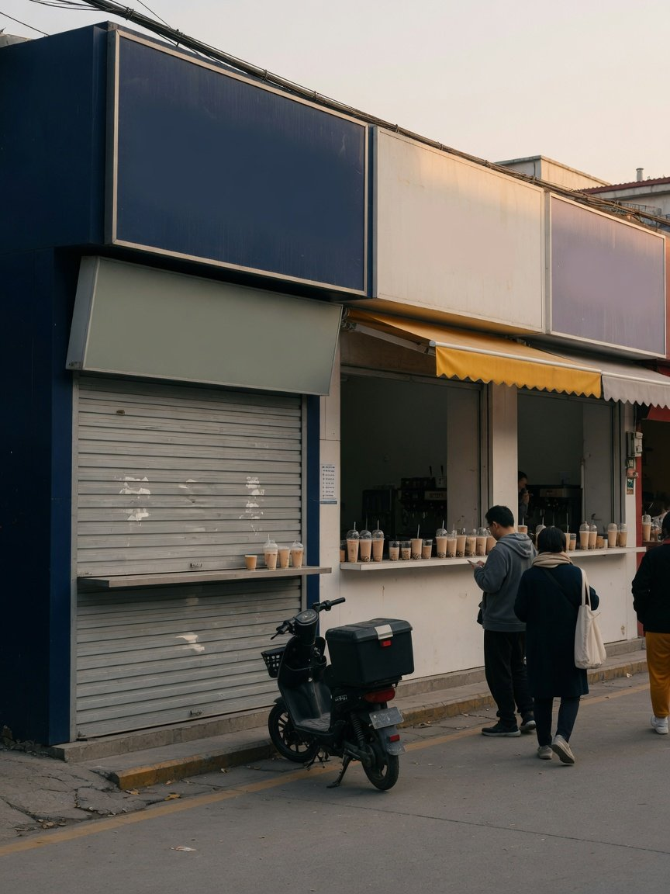
Guangzhou lost 2,326
tea shops in a year
14,355 → 12,029
Guangzhou
9,113 → 7,814
Shenzhen
All shrank
20 cities
Often 1.5 to 2 times openings
Closures
Source: Zhaimen Canyan data compiled by Kamen (Aug 2026). City
figures compare July 2025 with July 2026. The photo is illustrative.
Notes:
The change is easier to see on the street than in national totals. On Zhaimen Canyan's rolling count, China had about 373,000 milk tea shops in mid-July 2026, a net loss of about 54,500 in a year.

Slide 5
Mixue: stores up 20.7%, H1 revenue up only 2.3%
Store count, year on year
H1 revenue, year on year
H1 profit, year on year
+20.7%
+2.3%
−14.7%
63,987 stores at end-June
RMB 15.2bn
First fall since the IPO
“In the first half, sales per store fell by double digits at
both the group and the Mixue Bingcheng brand.”
Zhang Yuan, CEO, Mixue Group, interim results call, Aug 2026
Source: Mixue Group interim results and earnings call (Aug 2026). Revenue is mostly supplies and equipment sold to franchisees
Notes:
Store count is at group level, including Lucky Cup and Fulujia. Most revenue is what headquarters sells to franchisees, not what stores sell to customers, so revenue should track store count. The gap is now 18 percentage points. Mixue's shares fell 14.88% over the two trading days after the results.

Slide 6
CHAGEE's per-store GMV is down 37% in two years
Change in two years
750k
−37%
538
RMB 538k → RMB 338k
500k
404
338
Greater China same-store GMV
250k
−16.1%
Q2 2026, year on year
0k
Q2 2024
Q2 2025
Q2 2026
Source: CHAGEE Q2 2025 and Q2 2026 results (Aug 2025, Aug 2026)
Notes:
Quarter for quarter, CHAGEE's average monthly GMV per store in Greater China keeps falling. Q2 2026 was RMB 338,259, 37% below RMB 537,954 two years earlier. Greater China same-store GMV has fallen by double digits for five straight quarters, minus 16.1% in Q2 2026. Guidance for 2026 is revenue and profit roughly flat on 2025, with same-store recovery as the top KPI.

Slide 7
Guming's daily cups rose 18.8%, then stalled
H1 2026
Full year
First half
440 cups
600 cups
456
439 a year earlier
440
439
417
384
400 cups
Guming, 2026 interim results
200 cups
“Lower subsidies from
third-party delivery
platforms were a drag.”
0 cups
2023
2024
2025
H1 2025
H1 2026
Source: Guming annual and interim results (Mar 2025 to Aug 2026)
Notes:
Guming sold 384 cups per store per day in 2024. During the 2025 delivery subsidy war this rose to 456, up 18.8%, and the company named platform subsidies as one reason. In the first half of 2026 it was 440, level with 439 a year earlier. Mixue's management also said last year's delivery war pushed store sales to an abnormally high base.

Slide 8
Regulation is closing the subsidy route
13 May 2025
18 Jul 2025
Early Dec 2025
9 Jan 2026
17 Jun 2026
Platforms
Second summons
National standard
Antitrust review
Draft subsidy rules
summoned
JD, Meituan and Ele.me
Calls for rational
Platforms bear
Delivery competition
Merchants need not
competition
promotion costs
assessed
fund subsidies
Platforms are pulling back too. Alibaba said Q3 2025 was the peak of its instant-commerce
spending, and its loss per order from October was half the July and August level.
Source: SAMR, Xinhua and other reports (May 2025 to Jun 2026), Alibaba earnings call reported by Jiemian (Jan 2026)
Notes:
The May 2025 summons came from SAMR together with four other agencies. The January 2026 review was launched by the Office of the State Council Anti-Monopoly and Anti-Unfair Competition Commission, citing subsidy wars, price wars and traffic control. The June document is SAMR's draft ten rules on delivery platform subsidies. The 2027 volume plan should assume no platform subsidies.

Slide 9
Only new categories have held up per-store sales
New categories
Supply chain
Operating model
Overseas
Guming
Mixue Group
CHAGEE
CHAGEE
Who
Coffee machines in
About RMB 1.6bn
Direct-run stores up
Overseas stores up
Progress
about 94% of stores
this year
to 883
to 399
Cups flat as
Sales per store down
Same-store GMV in
Overseas same-store
Per-store trend
subsidies faded
double digits
Greater China −16.1%
GMV −15.1%
Can coffee reach 120
Will the spend lift
Can same-store sales
Can the store model
Watch next
cups a day?
store sales?
stop falling?
work abroad?
As subsidies faded, Guming kept cups per store steady, crediting coffee and breakfast.
Source: Guming, Mixue Group and CHAGEE interim and quarterly results and earnings calls (Aug 2026)
Notes:
All four paths are being tried by market leaders. Only new categories and dayparts show up in per-store numbers: in the half-year when subsidies faded, Guming's cups per store did not fall, and the company credits coffee and breakfast. Guming sold about 80 cups of coffee per store per day at the end of 2025 and targets about 120 in 2026. Mixue's supply chain spend and CHAGEE's model change have only just started, and store sales are still falling. Overseas store counts are rising, CHAGEE's overseas GMV grew 114.3% in Q2, but same-store sales abroad are still negative, and Mixue's overseas store count fell by 428 in 2025, its first annual decline.

Slide 10
Coffee is becoming tea shops' second engine
20%+
About 94%
Guming stores with coffee machines (June 2026)
120 cups
Coffee's share of Guming's revenue, H1 2026
Guming's daily coffee target per store for 2026
(about 80 at end-2025)
Source: Guming interim results and earnings call (Aug 2026)
Notes:
By June 2026 about 13,500 Guming stores had coffee machines, about 94% of the network. Mixue is following: its fresh-ground coffee machines reached more than 3,000 stores by end-June and more than 6,000 by 27 August, with about 14,000 planned by year end.

Slide 11
Plan 2027 around each store, not store count
Store count first
Same-store growth first
Net new stores
Same-store growth, cups a day
Lead target
2025 volume, with subsidies
2026 volume, after subsidies
Volume baseline
New store openings
Coffee, breakfast, sourcing
Where to invest
Set by opening targets
Scale up once the model works
Overseas pace
Existing stores get diluted
Slower store growth near term
Cost
In August, Mixue's management said store count is no longer its primary target.
Source: Mixue Group interim earnings call (Aug 2026)
Notes:
Planning by store count assumes a new store brings in roughly what an old one does. That no longer holds. Planning by same-store growth still allows openings, but each one must first show it will not eat into nearby stores. Guming's management has made the same point: a wave of weak stores dilutes the business of existing franchisees.

Slide 12
Make same-store growth
the first target for 2027
01
02
03
Rebuild the volume baseline
Give coffee and breakfast their
Test the store model before
without subsidies
own budgets
overseas targets
Notes:
The decision we need today is the first one: replace net new stores with same-store growth as the lead target for 2027. The three items listed are what the budget has to change once that is agreed.

