Slide 1
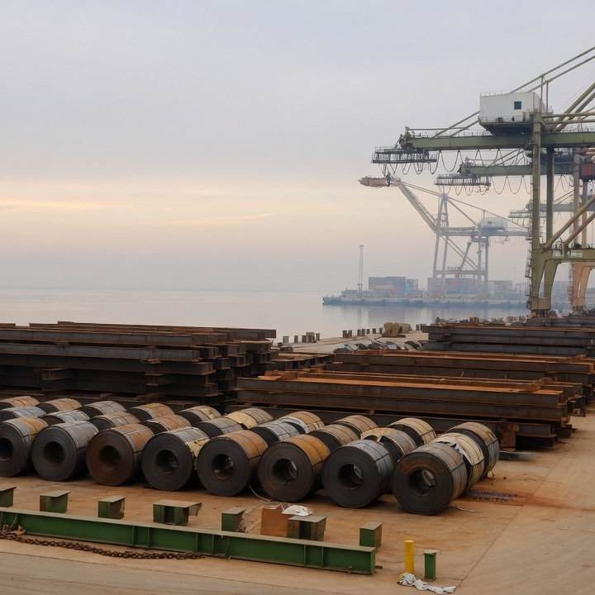
Sustainability Department · Briefing for the Board ESG Committee
CBAM is live: cut the
bill with verified data
2026
2034
97.5%
0%
Free allocation (the CBAM factor) falls from 97.5% to 0
October 2026
Notes:
This is the Sustainability Department's decision briefing for the Board ESG Committee. The EU Carbon Border Adjustment Mechanism (CBAM) entered its definitive period on 1 January 2026. The steel and aluminium goods we ship to the EU are already counting embedded emissions, and the certificates for all of 2026 are surrendered in one go by 30 September 2027. The deck uses only the legal texts, official EU and Chinese data, and industry figures whose basis is stated. None of our own export volumes, emissions or profits appear here. Costs are given per tonne and per 10,000 tonnes exported, and wherever our own data is needed the slide says it is still to come. Every amount from 2027 onward holds the certificate price at €75.36: it is a demonstration, not a carbon price forecast. The cover photo is an AI-generated illustration.

Slide 2
2026
2027
2034
Decision
Two asks: verified data and three budget lines
The bill is already running
For the committee
Priced on default values: about €164 per tonne of coil, due 30 Sept 2027
1
Approve actual values
Fastest cut: report actual emissions
Start accounting 2026 emissions and book an
accredited verifier
At the industry average, aluminium drops from about €144 to €14 per tonne,
once verified
2
Add three budget lines
Green power and new routes: no cut yet
Verification, green certificates, EAF and DRI studies
Green power answers Chinese quotas and buyers. Routes must be set
before 2034
2
Sustainability Department
/ 17
Notes:
The answer first. One, the money is already accruing. Everything imported since 1 January 2026 counts, and on the EU's default values for China a tonne of hot-rolled coil costs about €164, all settled on 30 September 2027. Two, the fastest and cheapest way to lower that is not green power but replacing default values with verified actual emissions. At the aluminium industry average, the cost per tonne would fall from about €144 to about €14. Three, green power and certificates do not reduce the CBAM bill today, but China already sets green power quotas for aluminium smelting and RE100 recognises Chinese certificates, and a new steel or aluminium route has to be chosen before free allocation ends in 2034. So we ask the committee for two decisions: switch to actual values and start verification now, and put verification, green power and route studies into the budget. Amounts follow once we have verifier quotes and a study scope.

Slide 3
2026
2027
2034
Timing
2026 imports are settled once, by 30 Sept 2027
2027-11-01
2026-01-01
2027-02-01
Unused 2026 void
Charging starts
Sales open
Resale only in 2027
Imports start counting
Then 50% held quarterly
2027-09-30
2026-04-07
First declaration
Q1 price €75.36
All of 2026 settled at once
Quarterly in 2026
2026: imports counted, no certificates held
2027: sales, surrender, cancellation
Q1 2026 price
Q2 2026 price
Q3 2026 price
Pending
Who pays
€75.36
€75.28
€82.32
Legally the EU's authorised CBAM
declarant, not our plant. Contracts decide
Published · 2026-04-07
Published · 2026-07-06
Recalculated by the legal method
who bears it.
§ Regulation (EU) 2025/2083, amended Art. 6, 20, 22 to 24
Source: Regulation (EU) 2025/2083, European Commission price page, EEX auctions
3
Sustainability Department
/ 17
Notes:
The date that matters is 30 September 2027. All 2026 imports are declared and settled that day in a single step. Certificates only go on sale on 1 February 2027, so nothing is bought during 2026, but emissions are already being counted. In 2026 the certificate price follows each quarter's EU ETS auction price: €75.36 for the first quarter and €75.28 for the second. The Commission was due to publish the third quarter on 5 October. Recalculating it from EEX auction data with the legal method gives €82.32, which is our recalculation, not an official figure. From 2027, declarants must hold certificates covering 50% of the year's embedded emissions at the end of each quarter, so cash is tied up from then on. Legally, the payer is the authorised CBAM declarant in the EU, meaning our importer or its agent, not our plant. Who carries the cost in the end depends on pricing and contract terms, which the roadmap deals with.

Slide 4
2026
2027
2028
2029
2030
2031
2032
2033
2034
The bill
Coil on defaults: €164/t in 2026, €312/t in 2034
Carbon steel bolts €625
€600
€163.5
Coil per tonne, 2026
€1.64m per 10,000 t exported
€400
Aluminium plate €404
Hot-rolled coil €312
Unwrought aluminium €294
€312
€200
Coil per tonne, 2034
€164
Free allocation gone
€0
2026
2027
2028
2029
2030
2031
2032
2033
2034
CBAM factor
97.5%
95%
90%
77.5%
51.5%
39%
26.5%
14%
0%
A demo at €75.36, not a forecast
Source: calculated from Regulations (EU) 2025/2621 and 2025/2620 and Directive 2023/959. From 2027 the amounts hold the price at €75.36 as a demonstration
4
Sustainability Department
/ 17
Notes:
This is what we pay per tonne. All four lines follow the default path, where we do nothing and the declarant files the EU's default values for China. Hot-rolled coil costs about €163.5 per tonne in 2026, or about €1.64 million per 10,000 tonnes exported. It rises every year for two reasons: free allocation falls by law from 97.5% to zero in 2034, and the default-value markup climbs from 10% to 30% from 2028. By 2034 coil costs about €312 per tonne, unwrought aluminium about €294, aluminium plate about €404 and carbon steel bolts about €625. To be clear, the certificate price is held at the first-quarter 2026 level of €75.36 throughout, so the chart shows what the rules alone do. It is not a carbon price forecast. On sensitivity, every €10 on the certificate price moves the 2026 coil cost by about €21.7 per tonne. Our recalculated third-quarter price is €82.32, which the Commission has not yet published.

Slide 5
2026
2034
The bill
€164: defaults plus 10%, less 97.5% of benchmark
€24.0
−€100.7
Formula
€240.2
n = D × (1 + m)
− factor × CSCF × BM
cost = n × P
€163.5
P = €75.36
default 3.187
D
markup 10%
m
97.5%
factor
100%
CSCF
EU benchmark 1.370
BM
China default
10% markup
Free allocation
Due
3.187 t
+0.319 t
0.975 × 1.370 = 1.336 t
2.170 t
§ Reg. 2025/2083 Art. 6(2)(c) · Reg. 2025/2620 formula 6
Source: Regs (EU) 2025/2621 (defaults) and 2025/2620 (benchmarks), Decision (EU) 2026/1862 (CSCF). Coil 7208, Q1 2026 price €75.36
5
Sustainability Department
/ 17
Notes:
Here is how €163.5 per tonne comes about. Step one: the EU default value for Chinese hot-rolled coil is 3.187 tonnes of CO2 equivalent per tonne, worth about €240 at €75.36. Step two: filing on default values adds a markup, 10% in 2026, taking emissions to 3.506 tonnes and adding about €24. Step three deducts the free allocation adjustment. Formula 6 of the implementing regulation sets it as the CBAM factor times the cross-sectoral correction factor times the EU benchmark, 0.975 × 1.00 × 1.370, or 1.336 tonnes, about €101. Step four would deduct carbon prices already paid in China, which we set at zero for the reasons on the China carbon price slide. What remains is 2.170 tonnes, about €163.5 per tonne. Step three is the key: the free part is set by the EU benchmark and has nothing to do with our own emissions. Every tonne above the benchmark is charged in full from the first year.

Slide 6
2026
2034
The bill
The 97.5%-of-emissions shortcut misses €150/t
Common shortcut
The legal formula
Free allocation
Free allocation
Emissions × 97.5%
0.975 × EU benchmark 1.370
Coil, per tonne in 2026
Coil, per tonne in 2026
About €3.6 to €6
About €163.5
Basis
Several media and consultancy sites
Basis
Implementing Regulation (EU) 2025/2620, formula 6
Why the gap: the deduction is EU benchmark × factor, not emissions × factor. China's default of 3.187 is far above the 1.370
benchmark, and everything above it is charged from year one. Price, budget and negotiate by the legal formula.
Source: Implementing Regulation (EU) 2025/2620 formula 6, Decision (EU) 2026/1862 (CSCF 100%), Directive 2023/959
6
Sustainability Department
/ 17
Notes:
The most widely shared shortcut multiplies emissions by 2.5%, treating free allocation as 97.5% of a company's own emissions. On that basis, hot-rolled coil would cost only €3.6 to €6 per tonne in 2026. It does not match the legal text. Formula 6 of Implementing Regulation 2025/2620 sets the free allocation adjustment as the CBAM factor times the cross-sectoral correction factor times the benchmark. It deducts 97.5% of the EU benchmark, not 97.5% of our emissions. The default value for Chinese coil, 3.187 tonnes, is 2.3 times the 1.370 benchmark, and everything above the benchmark is charged in full from the first year. The two methods differ by more than €150 per tonne. The point of this slide is one shared basis: sales quotes, finance budgets and contract talks all use the legal formula, or we badly understate the cost.

Slide 7
2026
2034
Exposure
China tops EU CBAM steel imports, 70% downstream
EU imports of CBAM steel from China, 2025, by value (€bn)
Ch. 73 articles €9.35bn, 69.5%
Ch. 72 steel
7326 articles
7308 structures
7318 bolts
Other Ch. 73
4.10
3.40
2.41
1.70
1.84
Ch. 72 steel €4.10bn, 30.5%
9.07 Mt
21.1%
€3.25bn
CBAM steel from China, 2025
Share of non-EU imports, first
Aluminium, 613,000 t, 10.7%
Worth €13.46bn
Turkey second at €7.18bn
42% is other articles, 7616
Source: Eurostat Comext DS-045409 (updated 15 Sept 2026), summed by Annex I codes. EU import values
7
Sustainability Department
/ 17
Notes:
This is exposure at industry level, not our own figures. In 2025 the EU imported about 9.07 million tonnes of CBAM-covered steel from China, worth €13.46 billion and 21.1% of the value of such imports from outside the EU. China ranks first, ahead of Turkey at €7.18 billion. The mix matters. Chapter 72 plate and coil account for only €4.1 billion. About 70% of the value is Chapter 73 goods: other steel articles at €3.4 billion, structures at €2.41 billion, bolts and screws at €1.7 billion. Aluminium follows the same pattern: of €3.25 billion, 42% is other aluminium articles under 7616 and unwrought aluminium is only €40 million. Downstream goods carry far higher default values, as the next slide shows. We built these figures from Eurostat raw data, adding and removing codes line by line against Annex I, and the values are EU import statistics. Our own export volumes and product mix are still to come from finance and sales, matched by CN code.

Slide 8
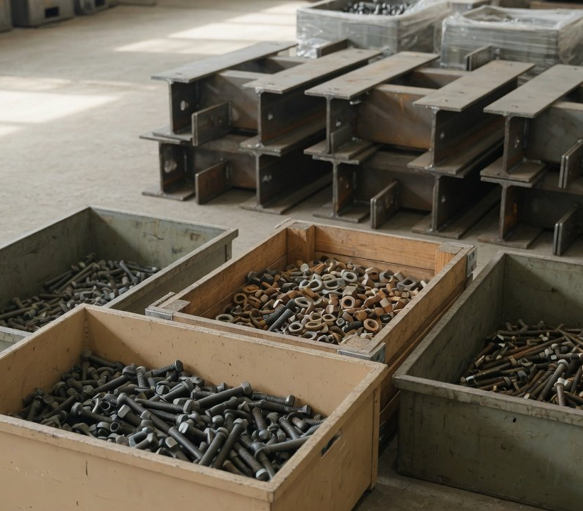
2026
2034
Exposure
Bolts carry twice coil's default: €428/t in 2026
China default, tCO₂e/t (before markup)
Hot-rolled 7208
3.187
Structures 7308
6.035
Steel bolts 7318 15
6.375
EU benchmark about 1.37
€428
€625
Bolts, per tonne in 2026
Bolts, per tonne in 2034
2.6 times hot-rolled coil
A demo at €75.36, not a forecast
Illustration: fastener warehouse (AI-generated)
Source: Regulations (EU) 2025/2621, 2026/1740, 2025/2620, at €75.36. The photo is an AI-generated illustration
8
Sustainability Department
/ 17
Notes:
Downstream goods cost more because their default values carry the emissions of the whole production chain, taken at the Chinese average and then marked up. The default for carbon steel bolts is 6.375 tonnes per tonne, exactly twice the 3.187 for hot-rolled coil. Steel structures carry 6.035, aluminium foil and other aluminium articles 5.559. On the default path, bolts cost about €428 per tonne in 2026, 2.6 times coil, or about €4.28 million per 10,000 tonnes exported. With the price held, they reach about €625 per tonne in 2034. The more downstream goods in our export mix, the more urgent the switch to actual values, because that is where defaults and real emissions tend to differ most. Our measured product emissions will be filled in after verification. The photo is an AI-generated illustration.

Slide 9
2026
2034
Exposure
Defaults put Chinese coil €63/t above Turkish
Hot-rolled flat 7208 default, tCO₂e/t (before markup)
India
About €63
4.28
China
More per tonne of Chinese coil than Turkish, 2026
3.187
€163.5 against €100.6
Ukraine
2.483
Turkey
2.3×
2.428
China's default against the 1.370 EU benchmark
Vietnam
South Korea 1.5×, Turkey 1.8×
2.35
South Korea
This compares everyone on defaults. Once rivals report actual
2.118
values, the gap changes.
EU benchmark 1.370
Source: Regulations (EU) 2025/2621, 2026/1740 (before markup), 2025/2620. Leading 2025 EU suppliers, ordered by default value
9
Sustainability Department
/ 17
Notes:
Default values are set at each exporting country's average emission intensity, then marked up. China's default for hot-rolled coil is 3.187 tonnes per tonne, 2.3 times the 1.370 EU benchmark. Among the main rival sources in the EU market, Turkey sits at 2.428, South Korea 2.118, Vietnam 2.350 and Ukraine 2.483, all below us. Only India, at 4.280, is higher. In money, on default values Chinese coil costs about €163.5 per tonne in 2026 against about €100.6 for Turkish coil, about €63 more, and South Korean coil costs even less, about €75. As long as we stay on defaults, our quotes start at a disadvantage to Turkish and Korean mills. That is the plainest commercial case for actual values.

Slide 10
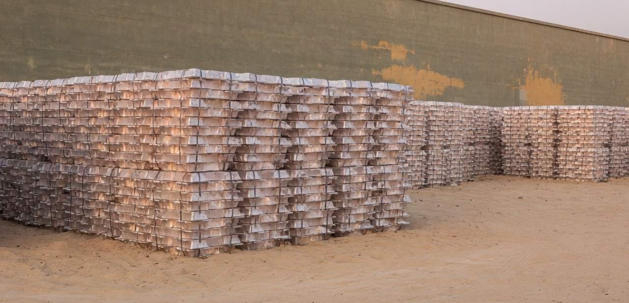
2026
2027
2028
2029
2030
2031
2032
2033
2034
Savings
Fastest lever: verified data, aluminium to €14/t
Unwrought aluminium, cost per tonne (€)
Default path
Actual at 1.57
294
239
197
169
144
118
Illustration: primary aluminium ingots (AI-generated)
63
1.57 is a reported industry average
22
Not our measured value. Actual values skip the 10% to 30%
16
14
markup, but must pass EU-accredited verification.
2026
2027
2028
2030
2034
Our own value: after verification
A demo at €75.36, not a forecast
Source: industry association figure (reported by Jiemian, 23 May 2026), Regs 2025/2621 and 2025/2620. The photo is an AI illustration
10
Sustainability Department
/ 17
Notes:
The fastest lever is replacing default values with verified actual emissions, for two reasons: actual values carry no 10% to 30% markup, and the benchmark follows our real production route. Take unwrought aluminium. Its default value is 3.000, counted as 3.3 tonnes after markup, which costs about €144 per tonne in 2026. The China Nonferrous Metals Industry Association has been reported as putting the sector's average direct emissions for primary aluminium at about 1.57 tonnes. Filed at that level and verified, the cost would be about €14 per tonne in 2026, €63 in 2030 and €118 in 2034, saving about €1.3 million per 10,000 tonnes exported in 2026. Three caveats. First, 1.57 is an industry average scenario, not our measurement, and our own figure will be filled in after verification. Second, a real filing builds the free allocation from process benchmarks step by step, while this uses the column B benchmark as an approximation, so the result will differ. Third, amounts from 2027 also hold the price at €75.36 and are not a forecast. Steel works the same way: every 0.1 tonne of actual emissions below the default saves about €7.5 per tonne. The photo is an AI-generated illustration.

Slide 11
2026
2027
2034
Verification
Verification first: an on-site visit in year one
01
02
03
04
Calculate
Hire a verifier
Site visit
Hand over
Reg. 2025/2547 sets the method.
Accredited by a member state
On site in the first verified year,
To the EU declarant, with the 2026
Steel and aluminium: direct
body. Non-EU firms may apply
then at least every second year
declaration by 30 Sept 2027
emissions only
Default values
Actual values
Verification
Not required
Required, by an accredited verifier
Markup
10% in 2026, 30% from 2028
None
China's carbon price
Annual default price only
Price actually paid
Source: Implementing Regs (EU) 2025/2546, 2025/2547, 2025/2621, Delegated Reg. 2025/2551, Reg. 2025/2083 Art. 9
11
Sustainability Department
/ 17
Notes:
Switching to actual values is not a matter of typing in a number. It takes four steps. First, calculate embedded emissions using the method in Implementing Regulation 2025/2547, counting only direct emissions for steel and aluminium. Second, engage an accredited verifier. Accreditation comes from a national accreditation body in an EU member state, firms registered outside the EU may apply, and verifiers already accredited for the EU ETS can extend their scope. The accreditation rules only came out in December 2025 and the system is still being built, so the sooner we book, the better. Third, the first verified year requires a physical site visit, after which remote verification is possible under conditions, with a site visit at least every second year. Fourth, hand the verified data to the EU declarant in time for the 2026 declaration due on 30 September 2027. The table shows the difference between the two routes. Defaults are easy and need no verification, but carry a markup, and China's carbon price can only be deducted at the Commission's annual default price. Note also that China's product carbon footprint certification, issued under 2025 rules from the national certification authority, is a separate system and does not count as CBAM verification.

Slide 12
2026
2034
Offsets
China's carbon price offsets little: ±3% at most
±3%
2025 carbon price, €/t CO₂
EU EUA
€73.43
China CEA
€7.68 · ¥62.36
2026 allowances for steel and aluminium
About 9.6×
A = E × (1 + α), −3% ≤ α ≤ +3%
EU against China price, 2025 averages at ECB rates
Allowances roughly match verified emissions, so a firm pays for at most about 3%
of them.
Article 9 rules: still a draft
§ MEE climate rule (2026) No. 1
On defaults, only the EU's annual default price can be deducted
Source: MEE climate rule (2026) No. 1 (1 Sept 2026), MEE 2025 national carbon market data (1 Jan 2026), EEX auctions, ECB rates, Reg. 2025/2083 Art. 9
12
Sustainability Department
/ 17
Notes:
CBAM lets declarants deduct a carbon price actually paid in the country of origin, but for us there is little to deduct, for three reasons. First, since China's national carbon market took in steel and aluminium smelting, allowances for 2024 equalled verified emissions, so they were essentially free. For 2026 the formula is allowances equal emissions times one plus α, with α between minus 3% and plus 3%, so a company pays real money for at most about 3% of its emissions. Second, the price gap is wide: in 2025 the EU auction average was €73.43 against 62.36 yuan, about €7.68, in China's market, roughly 9.6 times apart. Third, the implementing rules for the deduction under Article 9 were reportedly published only as a draft in May 2026, and we have found no vote since. Filing on default values allows only the Commission's annual default carbon price, and none has been published for China. As a rough upper bound, a 3% shortfall works out to about €0.37 of carbon price paid per tonne of CO2, so our estimates set the deduction at zero.

Slide 13
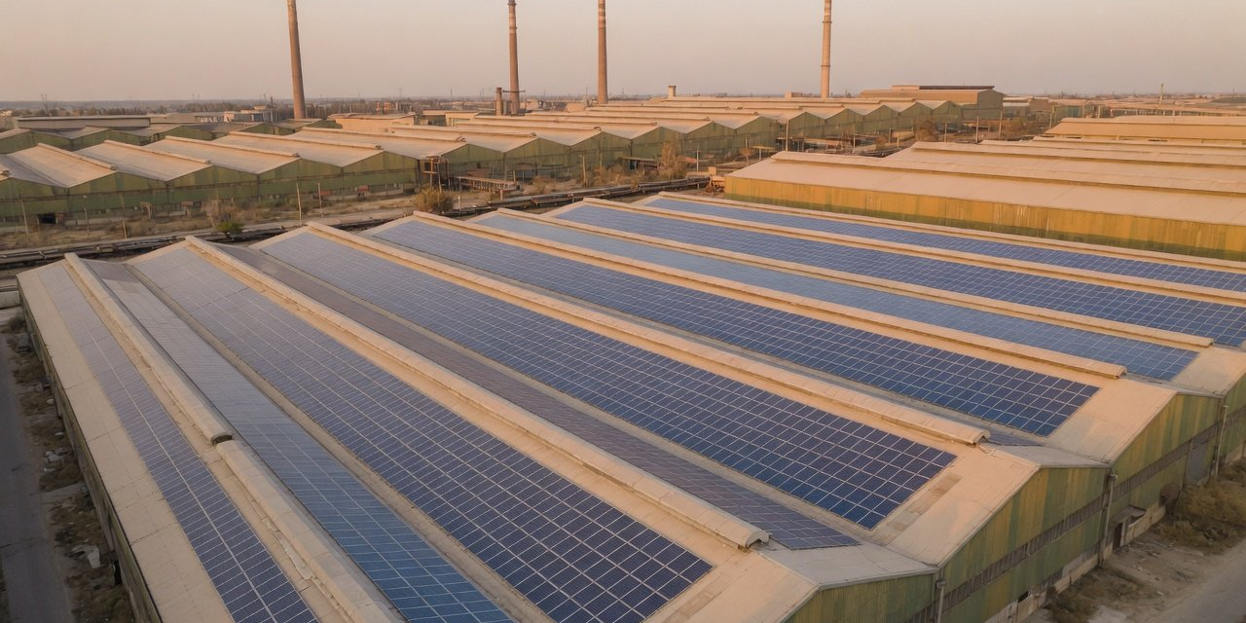
2026
2027
2034
Green power
Green power cuts no CBAM yet, but quotas need it
A tonne of aluminium's emissions, in two parts (tCO₂)
Direct
Indirect, power (Scope 2)
3
7, 70%
CBAM counts only this
Green power cuts this part, not on the bill today
Direct uses the EU default of 3.000; indirect = 13,202 kWh × 0.5306 kgCO₂/kWh. Guidance
No.3: green certificates may not set emission factors.
Illustration: rooftop solar on a steel plant (AI-generated)
0
25.2% to 70%
About ¥83
CBAM certificates saved today
Smelter green power quotas, 2025
Certificates per tonne of aluminium
Steel and aluminium count direct only
By province, via certificates
13.2 at ¥6.32, RE100 accepts
Source: Regulation (EU) 2023/956 Annex II, Guidance No.3 (14 Aug 2026), NDRC and NEA notice 669 (2025), NEA, MEE. The photo is an AI illustration
13
Sustainability Department
/ 17
Notes:
Green power needs two answers. On today's CBAM bill: steel and aluminium sit in Annex II, which counts only direct emissions, so indirect emissions from purchased power are excluded. The Commission's Guidance No.3 of 14 August 2026 says in so many words that using market-based instruments such as guarantees of origin or green certificates to set emission factors is not allowed. Buying green power or certificates therefore saves no CBAM certificates today. Green power cuts Scope 2. Why do it anyway: first, China already enforces it. The 2025 quotas from the NDRC and the National Energy Administration require aluminium smelters to source 25.2% to 70% green power depending on the province, checked against green certificates, while steel is monitored but not yet assessed. Second, since May 2025 RE100 fully recognises Chinese green certificates, which European buyers will ask about. Third, law firms report that the EU plans to assess in 2027 whether to bring indirect emissions from steel and aluminium into CBAM, with nothing decided. On cost, a tonne of primary aluminium uses about 13,202 kWh according to the China Nonferrous Metals Industry Association, or about 13.2 certificates, about ¥83 at the August average of ¥6.32 for 2026-vintage certificates. The photo is an AI-generated illustration.

Slide 14
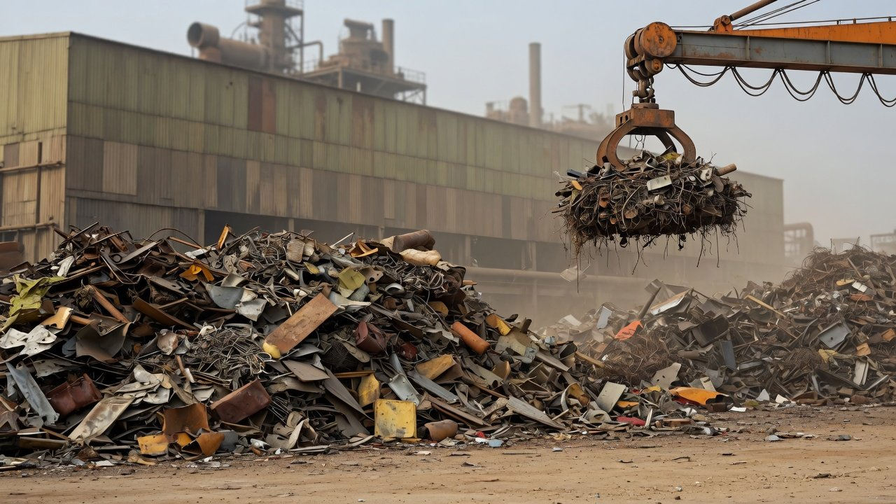
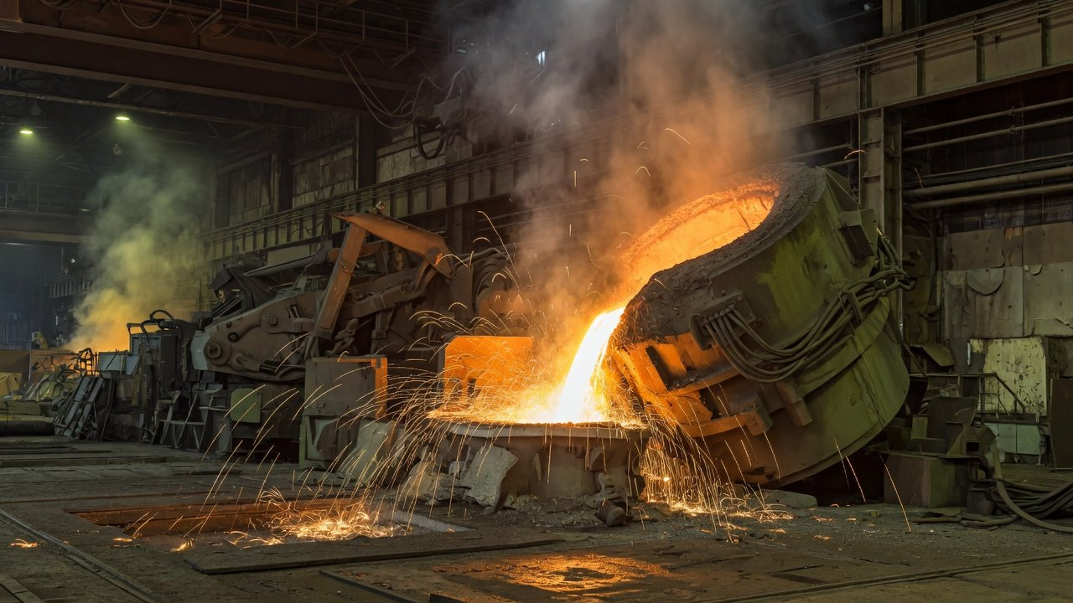
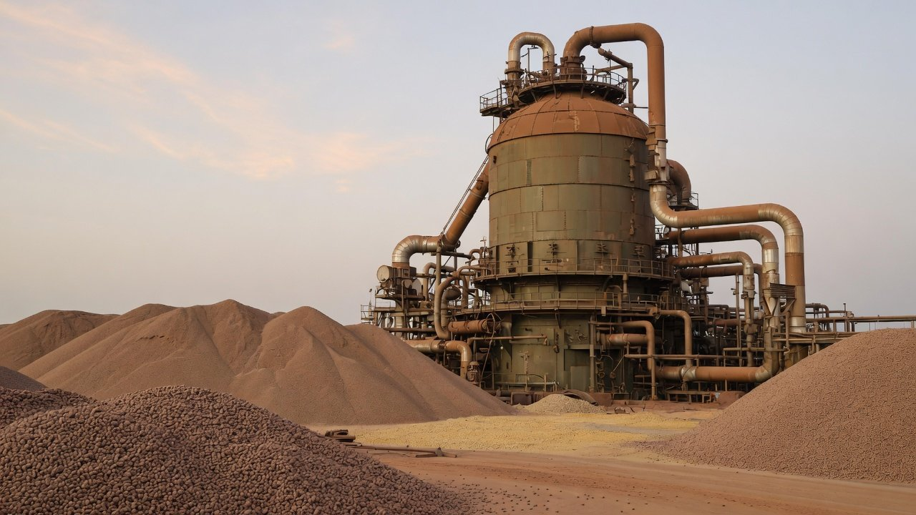
2026
2028
2029
2030
2031
2032
2033
2034
Routes
EAF, DRI and hydrogen: a decade, measured apart
Scrap
Electric arc furnace
Direct reduction shaft
tCO₂ per tonne of steel, worldsteel full scope (not CBAM's)
Hydrogen pilot: about 70% less CO₂
BF-BOF
2.34 · baseline
HBIS Zhangxuan's 1.2 Mt plant, against a long-process
plant of its size.
DRI-EAF
1.47 · 37% lower
Scrap EAF
Company figure, as reported
0.69 · 70% lower
Source: worldsteel Sustainability Indicators 2025, HBIS Zhangxuan pilot (company figure). The photos are AI illustrations
14
Sustainability Department
/ 17
Notes:
Changing the production route is the real way to cut direct emissions, but it takes a decade, and the figures must be read on their own basis. By worldsteel's 2024 data, the blast furnace route emits 2.34 tonnes of CO2 per tonne of crude steel, scrap-based electric arc furnaces 0.69, about 70% lower, and direct reduced iron fed to an electric arc furnace 1.47, about 37% lower. Those two figures are worldsteel's broad basis, covering Scope 1, Scope 2 and part of Scope 3, which is not the CBAM boundary of direct emissions only, so they cannot go straight into the certificate formula. On hydrogen, HBIS Zhangxuan says its 1.2 million tonne pilot emits 70% less than a blast furnace route of the same size, a company figure carried by the media. One CBAM detail: after a switch to an electric arc furnace the benchmark changes too, to 0.072 for scrap-based hot-rolled coil and 0.481 for the DRI route, so the lower emissions only show up through actual values. We found no reusable figure for the investment per tonne of such conversions in China, so the study scope and budget are still to be set. The photos are AI-generated illustrations.

Slide 15
2026
2027
2028
2034
Rules
Three rules still moving, from 2027 to 2038
Current law: free allocation ends in 2034
Proposal: to 2038
2026
2027
2028
2030
2034
2038
2027
2028
Set
2038
In talks
Proposal
Defaults reviewed
Downstream goods join
Free allocation ends later
Markup rises to 30% from 2028
More steel and aluminium goods
Coil about €297 in 2034 (proposal case)
Implementing Reg. (EU) 2025/2621
COM(2025) 989, in trilogue
COM(2026) 616 (2026-07-17)
Neither proposal is law yet, so our estimates follow current law. We review each quarter and return when they change.
Source: European Parliament Legislative Observatory 2025/0419(COD), COM(2026) 616 (17 July 2026), Reg. 2025/2621
15
Sustainability Department
/ 17
Notes:
Three rules are still moving. First, default values must be reviewed by 2027 at the latest, and the markup rises to 30% from 2028. That much is settled. Second, the downstream extension. In December 2025 the Commission proposed COM(2025) 989 to bring more downstream steel and aluminium goods into CBAM from 1 January 2028. Parliament adopted its amendments at first reading on 15 September, and trilogue talks come next. It is not law. Third, the EU ETS review proposal COM(2026) 616 would push the end of free allocation from 2034 to 2038. If adopted, coil in 2034 would cost about €297 per tonne instead of €312 and unwrought aluminium about €278 instead of €294, a limited change, and it has not been adopted. Our estimates all follow current law and treat proposals as scenarios only. The Sustainability Department will track them each quarter and come back to the committee when something material changes.

Slide 16
2026
2027
2028
2034
Roadmap
Roadmap: verified 2026 data by 30 September 2027
Q4 2026
H1 2027
30 Sept 2027
From 2028
Method and verifier
Site verification
First surrender
Route study
Data
Verify
Send
Study
2026 emissions by the
First-year site visit
Verified emissions to
Compare EAF and DRI routes
EU method
the declarant
Verify
Power
Settle
Book an accredited verifier
Certificates to the quota
2026 certificates surrendered
Deals
Report
Review buyers' CBAM clauses
Align Scope 1 and 2
with verification
Verification: TBD
Certificates: TBD
Budget
Budget
Study: TBD
Budget
Source: Regulation (EU) 2025/2083 Art. 6(1) and 22, Reg. 2025/2546, China MOF climate standard Art. 28
16
Sustainability Department
/ 17
Notes:
The roadmap works back from 30 September 2027. In the fourth quarter of 2026: calculate 2026 direct emissions with the EU method, book an accredited verifier, and review contracts with EU buyers to see how CBAM costs are shared. In the first half of 2027: complete the first-year site verification, buy green certificates to meet the domestic quota, and align the Scope 1 and Scope 2 figures in our sustainability report with the verified CBAM data. Article 28 of the Ministry of Finance climate disclosure standard asks for Scope 1, 2 and 3 to be disclosed separately. By 30 September 2027: hand verified emissions to the declarant so they replace the defaults. From 2028, when the markup rises to 30%: start the feasibility study comparing electric arc furnace and DRI routes. The budget lists items only. Verification awaits verifier quotes, certificate volumes await the confirmed quota, and the study awaits its scope. We will bring amounts back to the committee once they are known.

Slide 17
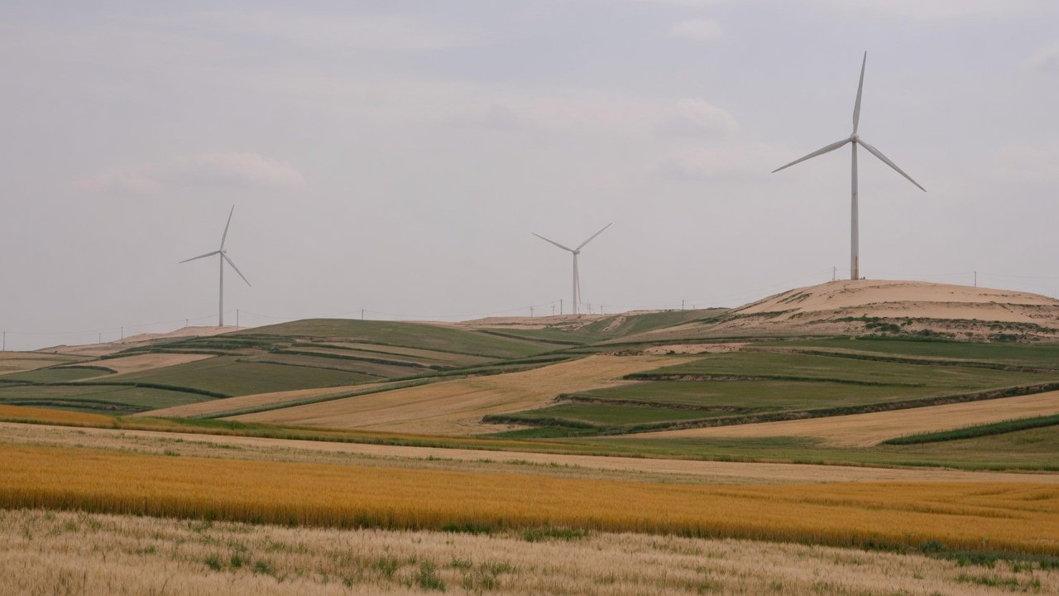
Decision
Three decisions for the
committee today
Actual values
count and verify 2026 emissions
Green power
budget certificates for the quota
Routes
fund EAF and DRI studies
Sustainability Department · October 2026
Notes:
To close, the three decisions we ask for today. The first is the most urgent: approve the switch to actual values, start calculating 2026 direct emissions and book an accredited verifier now, because the accreditation system is still being built and the first verified year needs a site visit. Second, budget green certificates to meet the domestic quota. They do not lower the CBAM bill today, but domestic rules and buyers already ask for them. Third, add electric arc furnace and DRI feasibility studies to the budget, so a route is set before free allocation ends in 2034. Amounts for all three follow once quotes and scope are settled. If the rules change materially, we will come back with an update. The background photo is an AI-generated illustration.

